Slide 1
Optimal Market Making for Cryptocurrency Options : Summer Project Weekly Update
Team Members: Robert Cao, Dhrubojeet Haldar, Shiqin Song, Surya Sridhar, Vedashree Teli, Peng Yang
Team Mentor: Mr Dendi Suhubdy
Advisors: Dr Tao Pang, Mr Patrick Roberts
June 8th, 2026

Slide 2
General Housekeeping Setup
Recurring collaborative working session set on Tuesday; meetings ad-hoc otherwise
Github setup for code collaboration
Drive setup for resources, data, presentation slides and meeting notes
Google Chat for communications/ email communications with mentor
JIRA board setup to keep track of weekly tasks

Slide 3
Last Week (1st June - 7th June)
Met on Tuesday, Thursday and Saturday (30 – 45 mins each)
Led discussion on project timelines and deliverables
Dhrubojeet looked up different data sources as alternatives to Coincall
Split work on Problem Set 1 as follows,
Q1. Surya
Q2. Vedashree
Q3. Peng
Q4. Shiqin
Q5. Robert
Went through syllabus for Week 2; discussed on resources to understand HJB

Slide 4
Blockers / Concerns
Confusion on optimal way to follow the syllabus / grading requirements / TA requirements
Coincall being inaccessible in the US, with VPN options not looking promising; L3 data mismatch seen as well
Question on resources for understanding the math-heavy sections of the project
Altering the project timeline to fit 9 weeks instead of 10

Slide 5
Next Week (1st June - 7th June)
Session on understanding HJB and Avellaneda -Stoikov Model and how to use them
Work on datasets once that has been clarified and retroactively use that for last week’s work
Identify a strategy to better combine code practices and math concepts such that the entire deliverable feels like one complete unit

Slide 6
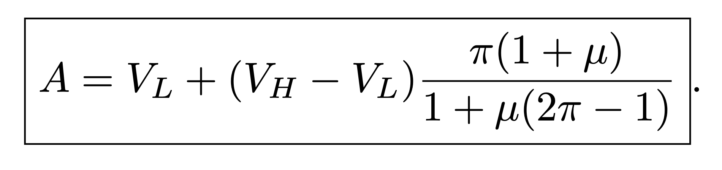
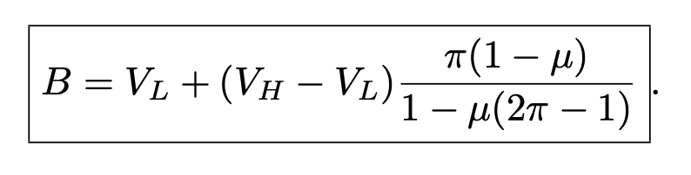
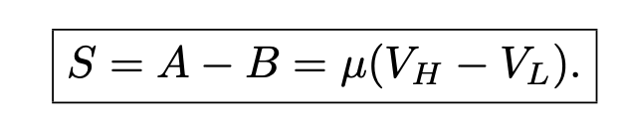
Findings of Week 1: Glosten-Milgrom
Ask Quote
Bid Quote
Equilibrium Bid-Ask Spread

Slide 7
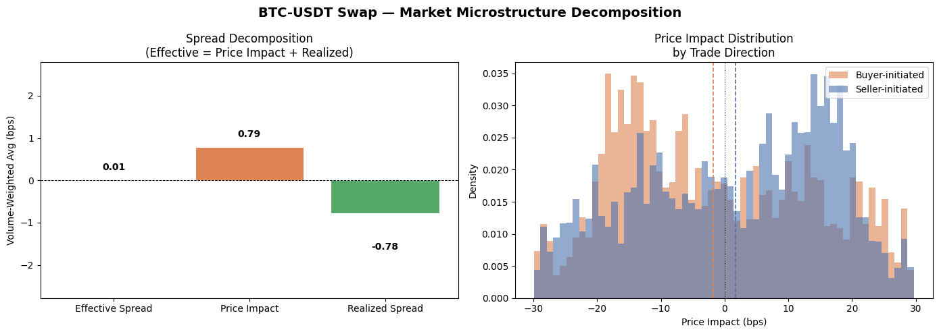
Findings of Week 1: Price Impact
Analysis on BTC-USDT perp data for 1 hour (June 2nd 2026)

Slide 8
Inference on Tentative Data
Near-zero effective spread (~0.009 bps) — market makers earn almost nothing upfront.
Price impact dominates — trades predict midpoint direction, flow is toxic.
Negative realized spread — adverse selection exceeds spread revenue; LPs lose money net.

