Slide 1
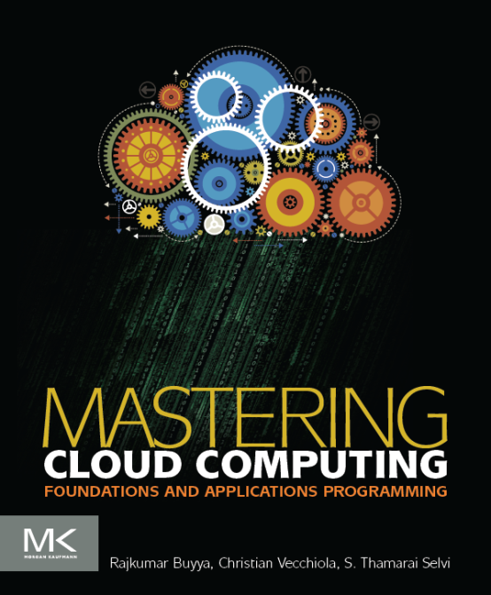
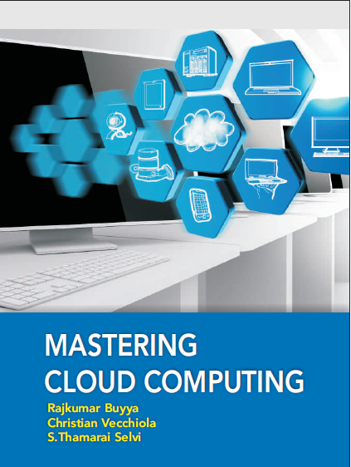
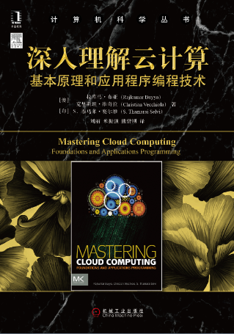
Virtualization
Morgan Kauffman, USA
McGraw Hill, India
China Machine Press, China

Slide 2
Chapter 3 - Virtualization : Objectives
After completing this unit you should be able to understand
Characteristics of Virtualized environments
Taxonomy of Virtualization Techniques
Execution Virtualization
Other Types of Virtualization
Virtualization and cloud computing
Pros and Cons of Virtualization

Slide 3
Introduction
Virtualization is a large umbrella of technologies and concepts that are meant to provide an abstract environment—whether this is virtual hardware or operating system—to run applications.
This term is often synonymous with hardware virtualization, which plays fundamental role in efficiently delivering Infrastructure-as-a-Service solutions for Cloud computing.
virtualization technologies have a long trail in the history of computer science and have come into many flavors by providing virtual environments at operating system level, programming language level, and application level.
Virtualization technologies not only provide a virtual environment for executing applications, but also for storage, memory, and networking.

Slide 4
Virtualization: reasons for renewed interest
Virtualization technologies have gained a renewed interested recently due to the confluence of different phenomena
Increased performance and computing capacity: Almost all modern PCs have resources enough to host a virtual machine manager and execute a virtual machine with a by far acceptable performance.
Underutilized hardware and software resources: Hardware and software underutilization is occurring due to (1) the increased performance and computing capacity, and (2) effect of limited or sporadic use of resources. Using these resources for other purposes after hours could improve the efficiency of the IT infrastructure. In order to transparently provide such a service, it would be necessary to deploy a completely separate environment, which can be achieved through virtualization.
Lack of space: The continuous need for additional capacity, whether this is storage or compute power, makes data centers grow quickly. This condition along with hardware underutilization led to the diffusion of a technique called server consolidation, for which virtualization technologies are fundamental.

Slide 5
Virtualization: reasons for renewed interest
Contd..
Greening initiatives: Recently, companies are increasingly looking for ways to reduce the amount of energy they consume and to reduce their carbon footprint. Hence, reducing the number of servers through server consolidation will definitely reduce the impact of cooling and power consumption of a data center. Virtualization technologies can provide an efficient way of consolidating servers.
Rise of administrative costs: Power consumption and cooling costs have now become higher than the cost of the IT equipment. Virtualization can help in reducing the number of required servers for a given workload, thus reducing the cost of the administrative personnel.

Slide 6
Virtualization reference model
Virtualization is a broad concept and it refers to the creation of a virtual version of something, whether this is hardware, software environment, storage, or network.
In a virtualized environment there are three major components: guest, host, and virtualization layer.
The guest represents the system component that interacts with the virtualization layer rather than with the host as it would normally happen.
The host represents the original environment where the guest is supposed to be managed.
The virtualization layer is responsible for recreating the same or a different environment where the guest will operate.

Slide 7








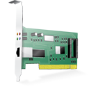





Virtualization reference model
Guest
Virtual Image
Applications
Applications
Virtualization Layer
Virtual Hardware
Virtual Storage
Virtual Networking
Software Emulation
Host
Physical Hardware
Physical Storage
Physical Networking

Slide 8
Characteristics of virtualized environments
Increased Security: The ability to control the execution of a guest in a completely transparent manner opens new possibilities for delivering a secure, controlled execution environment.
The virtual machine represents an emulated environment in which the guest is executed. All the operations of the guest are generally performed against the virtual machine, which then translates and applies them to the host.
This level of indirection allows the virtual machine manager to control and filter the activity of the guest, thus preventing some harmful operations from being performed.
Resources exposed by the host can then be hidden or simply protected from the guest. Moreover, sensitive information that is contained in the host can be naturally hidden without the need of installing complex security policies. Increased security is a requirement when dealing with untrusted code.

Slide 9
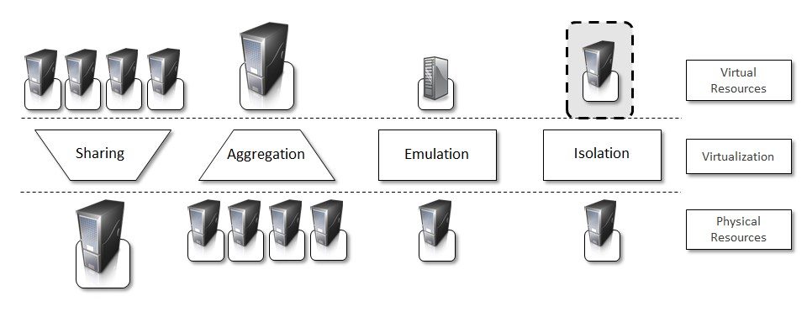
Characteristics of virtualized environments contd…
Managed Execution: Virtualization of the execution environment does not only allow the increased security but a wider range of features can be implemented. In particular, sharing, aggregation, emulation, and isolation are the most relevant.
Fig- Functions Enabled by Managed Execution

Slide 10
Characteristics of virtualized environments contd…
Sharing:
Virtualization allows the creation of a separate computing environment within the same host. In this way it is possible to fully exploit the capabilities of a powerful guest, which would be otherwise underutilized.
Sharing is a particularly important feature in virtualized data centers, where this basic feature is used to reduce the number of active servers and limit power consumption.
Aggregation.
It is not only possible to share the physical resource among several guests, but virtualization also allows the aggregation, which is the opposite process. A group of separate hosts can be tied together and represented to guests as a single virtual host. This function is naturally implemented in middleware for distributed computing and a classical example is represented by cluster management software, which harnesses the physical resources of a homogeneous group of machines and represents them as a single resource.

Slide 11
Characteristics of virtualized environments contd…
Emulation. Guests are executed within an environment that is controlled by the virtualization layer, which ultimately is a program. This allows for controlling and tuning the environment that is exposed to guests.
For instance, a complete different environment with respect to the host can be emulated, thus allowing the execution of guests requiring specific characteristics that are not present in the physical host.
hardware virtualization solutions are able to provide virtual hardware and emulate a particular kind of device such as SCSI (Small Computer System Interface) devices for file IO, without the hosting machine having such hardware installed.
Old and legacy software, which does not meet the requirements of current systems, can be run on emulated hardware without any need of changing their code. This is possible either emulating the required hardware architecture or within a specific operating system sandbox, such as the MS-DOS mode in Windows 95/98.

Slide 12
Characteristics of virtualized environments contd…
Isolation. Virtualization allows providing guests—whether they are operating systems, applications, or other entities—with a complete separate environment, in which they are executed. The guest performs its activity by interacting with an abstraction layer, which provides access to the underlying resources.
Isolation brings several benefits, for example it allows multiple guests to run on the same host without each of them interfering with the other.
Secondly, it provides a separation between the host and the guest. The virtual machine can filter the activity of the guest and prevent harmful operations against the host.

Slide 13
Characteristics of virtualized environments contd…
Performance tuning: This feature is a reality at present time, given the considerable advances in hardware and software supporting virtualization. It becomes easier to control the performance of the guest by finely tuning the properties of the resources exposed through the virtual environment. This provides means to effectively implement a Quality of Service infrastructure that more easily fulfill the service level agreement established for the guest.
For instance software implementing hardware virtualization solutions can expose to a guest operating system only a fraction of the memory of the host machine or to set the maximum frequency of the processor of the virtual machine.
Another advantage of managed execution is that sometimes it allows easily capturing the state of the guest, persisting it, and resuming its execution.
This, for example, allows virtual machine managers such as Xen Hypervisor to stop the execution of a guest operating system, to move its virtual image into another machine, and to resume its execution in a completely transparent manner. This technique is called virtual machine migration and constitutes an important feature in virtualized data centers for optimizing their efficiency in serving applications demand.

Slide 14
Characteristics of virtualized environments contd…
虚拟机的迁移
虚拟机迁移是将虚拟机实例从源宿主主机迁移到目标主机，并且在目标主机上能够将虚拟机运行状态恢复到其在迁移之前的相同状态，以便能够继续完成应用程序的任务。
为什么要进行虚拟机迁移？
云计算中心的物理服务器负载经常处于动态变化中，当一台物理服务器负载过大时，若此刻不可能提供额外的物理服务器，管理员可以将其上面的虚拟机迁移到其他服务器，达到负载平衡
云计算中心的物理服务器有时候需要定期进行升级维护，当升级维护服务器时，管理员可以将其上面的虚拟机迁移到其他服务器，等升级维护完成之后，再把虚拟机迁移回来

Slide 15
Characteristics of virtualized environments contd…
（1）动态迁移
实时迁移（Live Migration）就是保持虚拟机运行的同时，把它从一个计算机迁移到另一个计算机，并在目的计算机恢复运行的技术。
VM
VM
VM
VM
Hypervisor
Hypervisor
硬件
硬件
服务器 1
服务器 2

Slide 16
Characteristics of virtualized environments contd…
（2）迁移步骤
源宿主机A
目标宿主机B
1.预迁移
2.预定资源
3.预复制
VM
VM
4.停机复制
5.提交
6.启动

Slide 17
Characteristics of virtualized environments contd…
Portability: The concept of portability applies in different ways according to the specific type of virtualization considered.
In the case of a hardware virtualization solution the guest is packaged into a virtual image that, in most of the cases, can be safely moved and executed on top of different virtual machines.
In the case of programming level virtualization, as implemented by the JVM or the .NET runtime, the binary code representing application components (jars or assemblies), can be run without any recompilation on any implementation of the corresponding virtual machine.
This makes the application development cycle more flexible and application deployment very straightforward: one version of the application, in most of the cases, is able to run on different platforms with no changes.

Slide 18
Taxonomy of Virtualization Techniques
Virtualization covers a wide range of emulation techniques that are applied to different areas of computing. A classification of these techniques helps to better understand their characteristics and use.
Virtualization is mainly used to emulate execution environments, storage, and networks.
Among these categories execution virtualization constitutes the oldest, most popular, and most developed area.
We can divide these execution virtualization techniques into two major categories by considering the type of host they require.
Process level techniques are implemented on top of an existing operating system, which has full control of the hardware.
System level techniques are implemented directly on hardware and do not require―or require a minimum support from―an existing operating system.

Slide 19


How it is done?
Technique
Virtualization Model
Emulation
Application
Execution Environment
Process Level
High-Level VM
Programming Language
Storage
Multiprogramming
Operating System
Virtualization
Network
Hardware-assisted
Virtualization
Full Virtualization
System Level
Hardware
….
Paravirtualization
Partial Virtualization

Slide 20
Execution Virtualization
Execution virtualization includes all those techniques whose aim is to emulate an execution environment that is separate from the one hosting the virtualization layer.
All these techniques concentrate their interest on providing support for the execution of programs, whether these are the operating system, a binary specification of a program compiled against an abstract machine model, or an application.
Therefore, execution virtualization can be implemented directly on top of the hardware, by the operating system, an application, or libraries dynamically or statically linked against an application image.

Slide 21
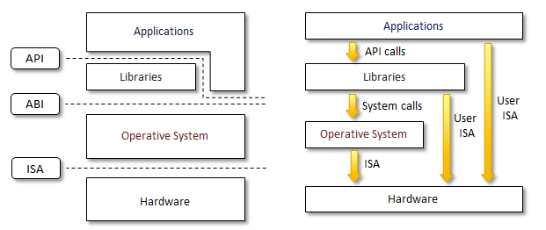
Machine Reference Model
Virtualizing an execution environment at different levels of the computing stack requires a reference model that defines the interfaces between the levels of abstractions, which hide implementation details.
From this perspective, virtualization techniques actually replace one of the layers and intercept the calls that are directed towards it.
Therefore, a clear separation between layers simplifies their implementation, which only requires the emulation of the interfaces and a proper interaction with the underlying layer.
Modern computing systems can be expressed in terms of the reference model described in the figure.
Fig: Machine reference Model

Slide 22
Machine Reference Model contd…
At the bottom layer, the model for the hardware is expressed in terms of the Instruction Set Architecture (ISA), which defines the instruction set for the processor, registers, memory, and interrupts management.
ISA is the interface between hardware and software and it is important for the OS developer (System ISA), and developers of applications that directly manage the underlying hardware (User ISA).
The Application Binary Interface (ABI) separates the operating system layer from the applications and libraries, which are managed by the OS.
ABI covers details such as low-level data types, alignment, and call conventions and defines a format for executable programs. System calls are defined at this level. This interface allows portability of applications and libraries across operating systems that implement the same ABI.
The highest level of abstraction is represented by the Application Programming Interface (API), which interfaces applications to libraries and/or the underlying operating system.
The machine level resources such as processor registers and main memory capacities are used to perform the operation in the hardware level of CPU.
Such layered approach simplifies the development and implementation of computing systems and also simplifies the implementation of multi-tasking and the co-existence of multiple executing environments.

Slide 23
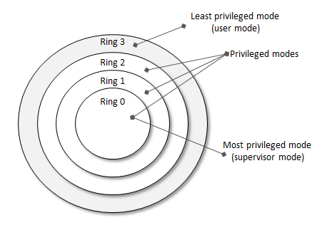
Security Rings and Privileged Modes
Machine reference model also provides ways for implementing a minimal security model for managing and accessing shared resources.
For this purpose, the instruction set exposed by the hardware has been divided into different security classes, which define who can operate with them.
The first distinction can be made between privileged and non-privileged instructions.
Non-privileged instructions are those instructions that can be used without interfering with other tasks because they do not access shared resources. This category contains, for example, all the floating, fixed point, and arithmetic instructions.
Privileged instructions are those that are executed under specific restrictions and are mostly used for sensitive operations, which expose (behavior sensitive) or modify (control sensitive) the privileged state.
a possible implementation features a hierarchy of privileges (see Figure ) in the form of ring based security: Ring 0, Ring 1, Ring 2, and Ring 3; Ring 0 is in the most privileged level and the Ring 3 in the least privileged level. Ring 0 is used by the kernel of the OS and rings 1 and 2 are used by the OS level services and Ring 3 is used by the user. Recent systems support only two levels with Ring 0 for the supervisor mode and Ring 3 for user mode.

Slide 24
Security Rings and Privileged Modes
特权指令：系统的一些操作和管理关键系统资源的指令，只有在最高特权级上能够正确运行。如果在非最高特权级上运行，特权指令会引发一个异常，处理器会陷入到最高特权级，交由系统软件处理了。在不同的运行级别上，指令的执行效果不同，并不是每个特权指令都会引发异常，它有可能被直接忽略。
敏感指令：操作特权资源的指令，包括修改虚拟机的运行模式或者下面物理机的状态；读写时钟、中断等寄存器；访问存储保护系统、地址重定位系统及所有的I/O指令。
虚拟化场景下，要求将GuestOS内核的特权解除，从原来的0降低到1或者3。这部分特权指令在GuestOS中发生的时候，就会产生Trap，被VMM捕获，从而由VMM完成。
对于一般 RISC 处理器，如 MIPS，PowerPC 以及 SPARC，敏感指令一定是特权指令，但是x86 例外，绝大多数的敏感指令是特权指令，但是由部分敏感指令不是特权指令，执行这些指令的时候不会自动trap被VMM捕获。

Slide 25
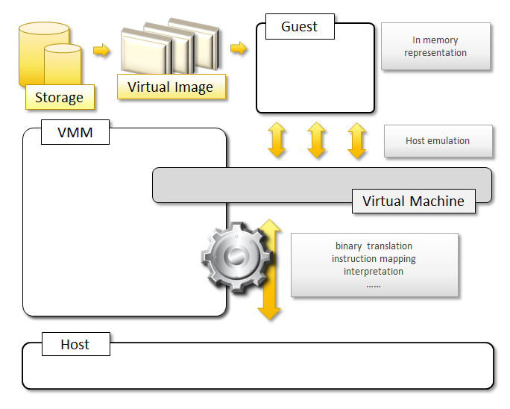
Hardware Level Virtualization
Hardware level virtualization is a virtualization technique that provides an abstract execution environment in terms of computer hardware on top of which a guest operating system can be run.
In this model, the guest is represented by the operating system, the host by the physical computer hardware, the virtual machine by its emulation, and virtual machine manager by the hypervisor.
The hypervisor is generally a program, or a combination of software and hardware, that allows the abstraction of the underlying physical hardware.
Hardware level virtualization is also called system virtualization, since it provides ISA to virtual machines, which is the representation of the hardware interface of a system. This is to differentiate from process virtual machines, which expose ABI to virtual machines.

Slide 26
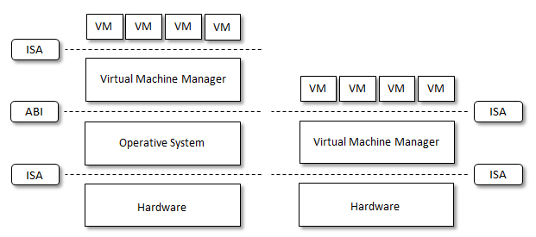
Hypervisors
A fundamental element of hardware virtualization is the hypervisor, or virtual machine manager (VMM). It recreates a hardware environment, where guest operating systems are installed. There are two major types of hypervisors: Type I and Type II.
Type I hypervisors run directly on top of the hardware. Therefore, they take the place of the operating systems and interact directly with the ISA interface exposed by the underlying hardware, and emulate this interface in order to allow the management of guest operating systems. This type of hypervisors is also called native virtual machine, since it run natively on hardware.
Type II hypervisors require the support of an operating system to provide virtualization services. This means that they are programs managed by the operating system, which interact with it through the ABI and emulate the ISA of virtual hardware for guest operating systems. This type of hypervisors is also called hosted virtual machine, since it is hosted within an operating system.
Fig-Hosted (left) and Native (right) Virtual Machine

Slide 27
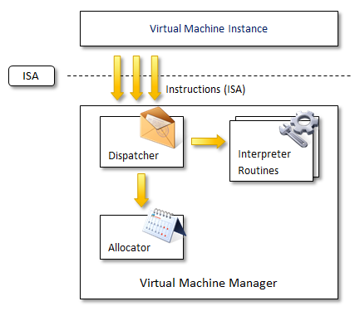
Hypervisor Reference Architecture
Conceptually, a virtual machine manager is internally organized as described in the Figure.
Three main modules coordinate their activity in order to emulate the underlying hardware: dispatcher, allocator, and interpreter.
The dispatcher constitutes the entry point of the monitor and reroutes the instructions issued by the virtual machine instance to one of the two other modules.
The allocator is responsible for deciding the system resources to be provided to the VM: whenever a virtual machine tries to execute an instruction that results in changing the machine resources associated with that VM, the allocator is invoked by the dispatcher.
The interpreter module consists of interpreter routines. These are executed whenever a virtual machine executes a privileged instruction: a trap is triggered and the corresponding routine is executed.
Fig- hypervisor reference architecture

Slide 28
Hypervisor Reference Architecture contd…
The design and architecture of a virtual machine manager, together with the underlying hardware design of the host machine, determine the full realization of hardware virtualization, where a guest operating system can be transparently executed on top of a VMM as if it was run on the underlying hardware.
The criteria that need to be met by a virtual machine manager to efficiently support virtualization were established by Goldberg and Popek in 1974 [23]. Three properties have to be satisfied:
Equivalence: a guest running under the control of a virtual machine manager should exhibit the same behavior that when it is executed directly on the physical host.
Resource control: the virtual machine manager should be in complete control of virtualized resources.
Efficiency: a statistically dominant fraction of the machine instructions should be executed without intervention from the virtual machine manager.
The major factor that determines whether these properties are satisfied is represented by the layout of the ISA of the host running a virtual machine manager. Popek and Goldberg provided a classification of the instruction set and proposed three theorems that define the properties that hardware instructions need to satisfy in order to efficiently support virtualization.

Slide 29
Popek and Goldberg theorems
Theorem-1: For any conventional third-generation computer, a VMM may be constructed if the set of sensitive instructions for that computer is a subset of the set of privileged instructions.
Theorem 2: A conventional third-generation computer is recursively virtualizable if
It is virtualizable and.
A VMM without any timing dependencies can be constructed for it.
Theorem 3: A hybrid VMM may be constructed for any conventional third generation machine, in which the set of user sensitive instructions are a subset of the set of privileged instructions.

Slide 30
Hardware Virtualization Techniques
Hardware-assisted virtualization:
This term refers to a scenario in which the hardware provides architectural support for building a virtual machine manager able to run a guest operating system in complete isolation.
This technique was originally introduced in the IBM System/370. At present, examples of hardware-assisted virtualization are the extensions to the x86-64 bit architecture introduced with Intel VT
Full virtualization
Full virtualization refers to the ability of running a program, most likely an operating system, on top of a virtual machine directly and without any modification, as if it were run on the raw hardware.
In order to make this possible, virtual machine managers are required to provide a complete emulation of the entire underlying hardware.
The principal advantage of full virtualization is complete isolation, which leads to enhanced security, ease of emulation of different architectures, and coexistence of different systems on the same platform. Whereas it is a desired goal for many virtualization solutions, it poses important concerns on performance and technical implementation.

Slide 31
Hardware Virtualization Techniques
Paravirtualization
This is a not transparent virtualization solution that allows implementing thin virtual machine managers.
Paravirtualization techniques expose a software interface to the virtual machine that is slightly modified from the host and, as a consequence, guests need to be modified.
The aim of paravirtualization is to provide the capability to demand the execution of performance critical operation directly on the host.
solutions using paravirtualization include: VMWare, Parallels, and some solutions for embedded and real time environment such as TRANGO, Wind River, and XtratuM.
Partial virtualization
Partial virtualization provides a partial emulation of the underlying hardware, thus not allowing the complete execution of the guest operating system in complete isolation.
Partial virtualization allows many applications to run transparently but not all the features of the operating system can be supported as happens with full virtualization.
An example of partial virtualization is address space virtualization used in time sharing systems.
Partial virtualization was implemented on the experimental IBM M44/44X. Address space virtualization is a common feature of contemporary operating systems.

Slide 32
Hardware Virtualization Techniques
CPU虚拟化
CPU虚拟化技术把物理CPU抽象成虚拟CPU，任一时刻，一个物理CPU只能运行一条虚拟CPU指令。
每个客户端操作系统可以使用一个或多个虚拟CPU，在各个操作系统之间，虚拟CPU的运行是相互隔离，互不影响。
CPU虚拟化需要解决正确运行和调度两个关键问题：
1
虚拟CPU的正确运行是要保证虚拟机指令正确运行。现有的实现技术包括模拟执行和监控执行
2
调度问题是指VMM决定当前哪个虚拟CPU在物理CPU上运行，要保证隔离性、公平性和性能。

Slide 33
Hardware Virtualization Techniques
内存虚拟化
内存虚拟化技术把物理内存统一管理，包装成多个虚拟的物理内存提供给若干虚拟机使用，每个虚拟机拥有各自独立的内存空间。虚拟机管理器完成并维护物理内存和虚拟机所使用的内存的映射关系。
虚拟内存的管理包括3种地址
机器地址
物理地址
虚拟地址
虚拟地址（VA）：Guest OS 提供给其应用程序使用的线性地址空间。
物理地址（GPA）：经 VMM 抽象的、虚拟机看到的伪物理地址。
机器地址（MA）:真实的机器地址，即地址总线上出现的地址信号。

Slide 34
Hardware Virtualization Techniques
内存隔离
MMU（Memory Management Unit）内存管理单元：
1）它是CPU中用来管理虚拟存储器、物理存储器的控制线路。
2）同时负责将虚拟地址映射为物理地址，以及提供硬件机制的内存访问授权
Xen为了让内存可以被不同的虚拟机共享，在虚拟地址与机器地址之间增加了一层中间层（伪物理层），Guest OS只能看到中间层，认为自己的物理地址是从0开始，“连续”的地址。
虚拟地址
伪物理地址
机器地址
Xen将这层中间地址真正地映射到机器地址上却可以是不连续的，这样保证了所有的物理内存可被任意分配给不同的Guest OS

Slide 35
Hardware Virtualization Techniques
虚拟机监控器使用分段和分页机制对自身的物理内存进行保护。x86体系结构提供了支持分段机制的虚拟内存，这能够提供另一种形式的特权级分离。
每一个段包括基址、段限和一些属性位。
（1）基址和虚拟地址相加形成线性地址
（2）段限决定了这个段中所能访问的线性空间的长度
（3）属性位则标记了该段是否可读写，可执行，是代码段还是数据段等
代码段一般标记为可读和可执行，数据段标记为可读和可写。
段在装载经由段描述符完成，装载内容会被缓存，直到下一段的装载。

Slide 36
Operating System Level Virtualization
Operating System level virtualization offers the opportunity to create different and separated execution environment for applications that are managed concurrently.
Differently from hardware virtualization, there is no virtual machine manager or hypervisor and the virtualization is done within a single operating system, where the OS kernel allows for multiple isolated user space instances.
The kernel is also responsible for sharing the system resources among instances and for limiting the impact of instances on each other.
A user space instance in general contains a proper view of the file system which is completely isolated, separate IP addresses, software configurations, and access to devices.
Examples of operating system level virtualizations are: FreeBSD Jails, IBM Logical Partition (LPAR), SolarisZones and Containers, Parallels Virtuozzo Containers, OpenVZ, iCore Virtual Accounts, Free Virtual Private Server (FreeVPS) and others.
The services offered by each of these technologies differ and most of them are available on Unix based systems.

Slide 37
Programming Language Level Virtualization
Programming language level virtualization is mostly used for achieving ease of deployment of applications, managed execution, and portability across different platforms and operating systems.
It consists of a virtual machine executing the byte code of a program, which is the result of the compilation process.
Compilers implemented used this technology produce a binary format representing the machine code for an abstract architecture.
The main advantage of programming-level virtual machines, also called process virtual machines, is the ability of providing a uniform execution environment across different platforms.
Programs compiled into byte code can be executed on any operating system and platform for which a virtual machine able to execute that code has been provided.
As an example, both Java and .NET provide an infrastructure for pluggable security policies and code access security frameworks.

Slide 38
Application Level Virtualization
Application level virtualization is a technique allowing applications to be run on run-time environments which do not natively support all the features required by such applications.
In this scenario, applications are not installed in the expected run time environment, but run as if they were.
In general, these techniques are mostly concerned with partial file systems, libraries, and operating system component emulation.
Such emulation is performed by a thin layer—a program or an operating system component—that is in charge of executing the application.

Slide 39
Application Level Virtualization
Emulation can also be used to execute program binaries compiled for different hardware architectures. In this case, one of the following strategies can be implemented:
Interpretation. In this technique every source instruction is interpreted by emulator for executing native ISA instructions leading to poor performance. Interpretation has a minimal startup cost but a huge overhead since each instruction is emulated.
Binary Translation. In this technique every source instruction is converted to native instructions with equivalent functions. After a block of instructions is translated it is cached and reused. Binary translation has a large initial overhead cost but over time it is subject to a better performance, since previously translated instruction blocks are directly executed.
Application virtualization is a good solution in the case of missing libraries in the host operating system: in this case a replacement library can be linked with the application or library calls can be remapped to existing functions available in the host system.
Another advantage is that in this case the virtual machine manager is much lighter since it provides a partial emulation of the run time environment if compared to hardware virtualization.
One of the most popular solution implementing application virtualization is Wine, which is a software application allowing Unix-like operating systems to execute programs written for the Microsoft Windows platform.

Slide 40
Storage Virtualization
Storage virtualization is a system administration practice that allows decoupling the physical organization of the hardware from its logical representation.
By using this technique users do not have to be worried about the specific location of their data, which can be identified by using a logical path.
Storage virtualization allows harnessing a wide range of storage facilities and representing them under a single logical file system.
There are different techniques for storage virtualization one of the most popular includes network based virtualization by means of Storage Area Networks (SANs).
Storage Area Networks use a network accessible device through a large bandwidth connection to provide storage facilities.

Slide 41
Storage Virtualization
存储技术分类
RAID (Redundant Array of Independent Disk)技术
磁盘阵列
NAS (Network Attached Storage)网络连接存储技术
专用文件服务器
通过标准网络协议加入
SAN (Storage Area Network)存储区域网络技术
专门为存储建立的独立于TCP/IP网络之外的专用网络
磁盘阵列连接高速通信网络
FC-SAN为通过光纤通道协议转发SCSI协议，IP-SAN通过TCP协议转发SCSI协议

Slide 42
Storage Virtualization
SAN与NAS差异
本质不同
NAS专用文件服务器，是一个存储设备；SAN是为存储专门开辟的高速的数据网络
采用的网络不同
NAS采用的是拟态网结构，遵守TCP/IP协议；而SAN采用的是专用的数据存储网络，采用的是光纤网络协议

Slide 43
Storage Virtualization
SAN与NAS差异
处理应用系统数据请求的方式
NAS是文件服务器，提供文件访问服务；SAN是块设备，提供数据块的数据访问服务
数据共享能力不同
NAS实现异构计算机和操作系统之间的数据共享，只要遵守TCP-IP标准的通信协议；SAN遵守厂商自己专用的通信协议，如果需要共享存储，则需要专用的共享软件

Slide 44
Storage Virtualization
SAN与NAS差异
文件系统存在的位置不同
NAS的文件系统存储在设备上；SAN的文件系统在服务器主机上

Slide 45
Storage Virtualization
目前，实现存储虚拟化的方式主要有三种：
基于主机的
存储虚拟化
基于存储设备
的存储虚拟化
基于网络的
存储虚拟化

Slide 46
Storage Virtualization
基于主机的存储虚拟化
基于主机的存储虚拟化，也称基于服务器的存储虚拟化或者基于系统卷管理器的存储虚拟化，其一般是通过逻辑卷管理来实现的。
应用场景
数据
存储共享
存储
资源管理
数据复制
及迁移
集群系统
远程备份
灾难恢复

Slide 47
Storage Virtualization
优点
不需要硬件支持，不修改现有系统架构
虚拟化层作为扩展的驱动模块，以软件形式嵌入操作系统
代表产品：
Symantec Veritas Volume Manager
缺点
占用主机资源，降低应用性能
存在操作系统和应用的兼容性问题
主机升级、维护、扩展、迁移复杂

Slide 48
Storage Virtualization
基于存储设备的存储虚拟化
该技术通过在存储设备上添加虚拟化功能实现，可以将一个阵列上的存储容量 划分为多个存储空间(LUN)，供不同的主机系统访问
应用场景
当有多个主机服务器需要访问同一个磁盘阵列时，可以使用基于存储设备的存储虚拟化技术

Slide 49
Storage Virtualization
优点
与主机无关，不占用主机资源
数据管理功能丰富
代表产品：
HP EVA
H3C IX系列
HDS TagmaStor
SUN 6920系列
缺点
一般只能实现对设备内磁盘的虚拟化
不同厂商间的数据管理功能不能互操作 ，扩展性差

Slide 50
Storage Virtualization
基于网络的存储虚拟化
在网络设备上实现存储虚拟化，如通过在SAN中添加虚拟化引擎实现
根据实现位置不同
基于交换机的虚拟化
基于路由器的虚拟化
基于元数据服务器的虚拟化，例如SAN网络中，接入一台专用的元数据服务器来实现虚拟化的功能
应用场景
当多个主机服务器需要访问多个异构存储设备时,可以使用基于网络的存储虚拟化技术

Slide 51
Storage Virtualization
优点
与主机无关，不占用主机资源
支持异构存储设备
统一不同存储设备的数据管理功能，可扩展性好。
代表产品：
EMC VPLEX、NetApp GFiller
IBM SVC
H3C IV系列
缺点
部分厂商数据管理功能弱，成熟度低，仍然存在和不同存储、主机兼容的问题

Slide 52
Network Virtualization
Network virtualization combines hardware appliances and specific software for the creation and management of a virtual network.
Network virtualization can aggregate different physical networks into a single logical network (external network virtualization) or provide network like functionality to an operating system partition (internal network virtualization).
The result of external network virtualization is generally a Virtual LAN (VLAN). A VLAN is an aggregation of hosts that communicate with each other as if they were located under the same broadcasting domain.
Internal network virtualization is generally applied together with hardware and operating system level virtualization in which the guests obtain a virtual network interface to communicate with.
There are several options for implementing internal network virtualization: the guest can share the same network interface of the host and use NAT to access the network; the virtual machine manager can emulate, and install on the host, an additional network device together with the driver; or the guest can have a private network only with the guest.

Slide 53
Network Virtualization
核心层网络虚拟化
核心层网络虚拟化，主要指的是数据中心核心网络设备的虚拟化。
核心层网络具备超大规模的数据交换能力，以及万兆接入能力
提供虚拟机箱技术，简化设备管理，提高资源利用率，提高交换系统的灵活性和扩展性，为资源的灵活调度和动态伸缩提供支撑
要求
VPC技术实现跨交换机的端口绑定，在下级交换机上连属于不同机箱的虚拟交换机时，可以把分别连向不同机箱的万兆链路用于和IEEE802.3ad兼容的技术实现以太网链路捆绑，提高冗余能力和链路互连带宽，简化网络维护

Slide 54
Network Virtualization
接入层网络虚拟化
接入层虚拟化，可以实现数据中心接入层的分级设计。根据数据中心的走线要求，接入层交换机要求能够支持各种灵活的部署方式和新的以太网技术。
数据中心以太网DCE和融合增强以太网CEE包括：
拥塞通知
（IEEE 802.1Qau）
增强传输选择ETS
（IEEE 802.1Qaz）
优先级流量控制PFC
（IEEE 802.1Qbb）
链路发现协议LLDP
（IEEE 802.1AB）

Slide 55
Network Virtualization
虚拟机网络虚拟化
虚拟机网络交互包括：物理网卡虚拟化和虚拟网络交换机，在服务器内部虚拟出交换机和网卡功能。
虚拟机网络交互需要实现以下功能：
（1）虚拟机的双向访问控制和流量监控，包括深度包检测、端口镜像、端口远程镜像、流量统计。
（2）虚拟机的网络属性应包括VLAN、QoS、ACL、带宽等。
（3）虚拟机的网络属性可以跟随虚拟机的迁移而动态迁移，不需要人工干预或静态配置，从而在虚拟机扩展和迁移过程中，保障业务的持续性。
（4）虚拟机迁移时，与虚拟机相关的资源配置，如存储、网络配置也随之迁移。同时保证迁移过程中业务不中断。

Slide 56
Network Virtualization
虚拟机网络虚拟化
扩展虚拟数据中心中交换机和虚拟网卡的功能标准：
802.1Qbg EVB （Edge Virtual Bridging）和802.1Qbh BPE（Bridge Port Extension）
外部网络能够支持虚拟交换功能，对于虚拟交换网络范围内VM动态迁移、调度信息，均通过LLDP扩展协议得到同步以简化运维
802.1Qbg
将远程交换机部署为虚拟环境中的策略控制交换机，而不是部署成邻近服务器机架的交换机，通过多个虚拟通道，让边缘虚拟桥复制帧到一组远程端口
802.1Qbh

Slide 57
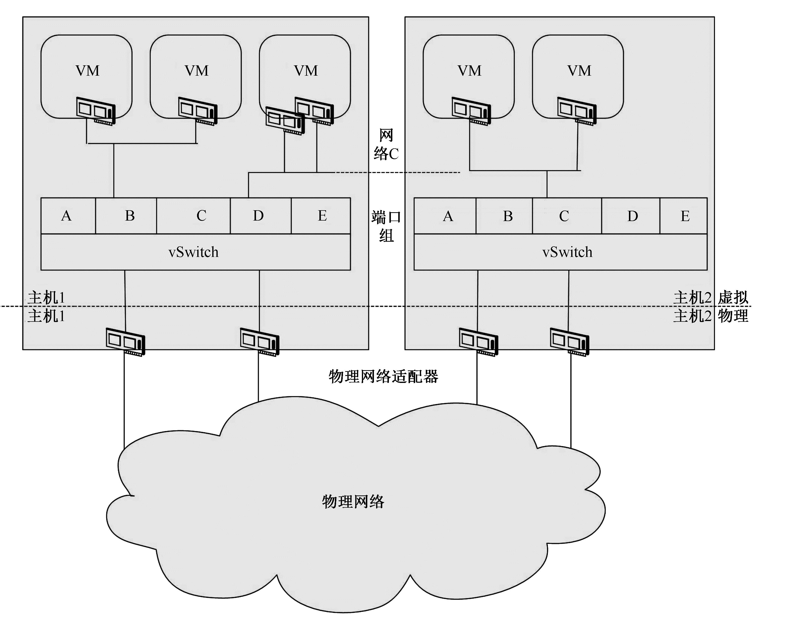
Network Virtualization
VMware的网络虚拟化技术主要是通过VMware vSphere中的vNetwork网络元素实现的，其虚拟网络架构如图所示。
包括：viNIC、vSwitch和dvSwitch

Slide 58
Network Virtualization
虚拟交换机vSwitch
虚拟交换机用来满足不同的虚拟机和管理界面进行互连。每台服务器都有自己的虚拟交换机。
虚拟交换机的一端是与虚拟机相连的端口组，另一端是与虚拟机所在服务器上的物理以太网适配器相连的上行链路。虚拟机通过与虚拟交换机上行链路相连的物理以太网适配器与外部环境连接。
虚拟交换机可将其上行链路连接到多个物理以太网适配器以启用网卡绑定。通过网卡绑定，两个或多个物理适配器可用于分摊流量负载，或在出现物理适配器硬件故障或网络故障时提供被动故障切换。

Slide 59
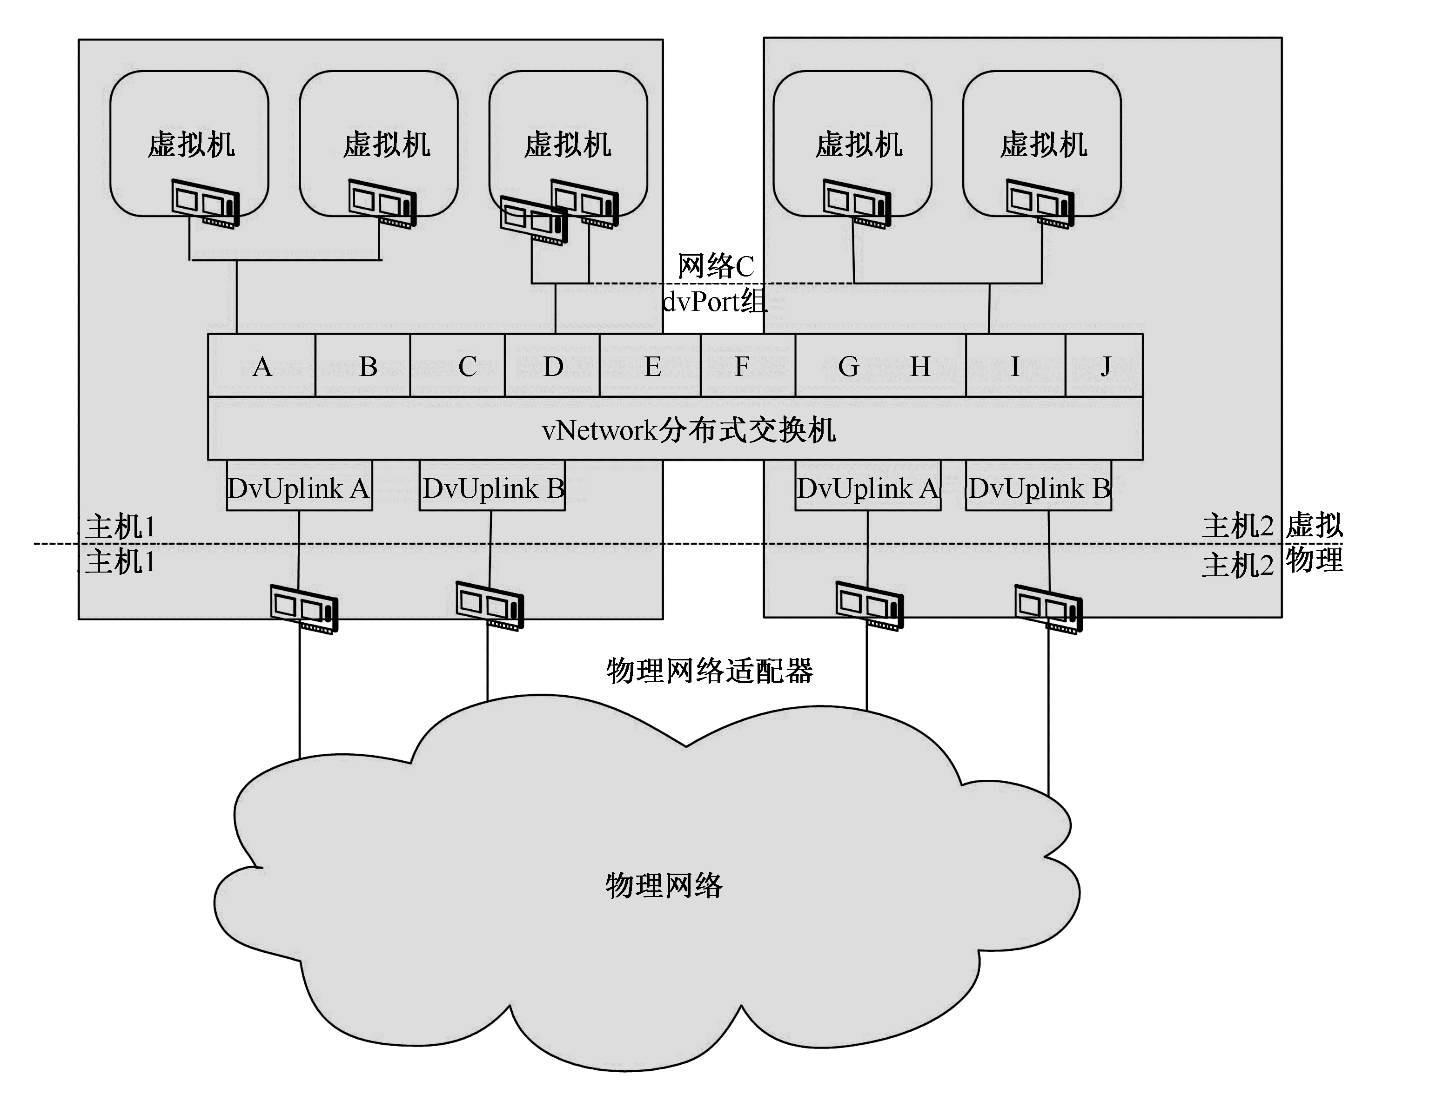
Network Virtualization
分布式交换机
vNetwork分布式交换机（dvSwitch）是vSphere的新功能。将所有关联的主机上的交换机进行集成，作为单个虚拟交换机使用。每个dvSwitch都是一种可供虚拟机使用的网络集线器。
在虚拟机之间进行内部流量路由，或者连接物理以太网适配器链接外部网络，可以为每个vSwitch分配一个或多个dvPort组（聚合）。

Slide 60
Network Virtualization
端口组 是虚拟环境特有的概念
端口组是一种策略设置机制，这些策略用于管理与端口组相连的网络。同一端口组相连的所有虚拟机属于虚拟环境中的同一网络。
将端口组配置为执行策略，以提供增强的网络安全、网络分段、更佳的性能、高可用性及流量管理。

Slide 61
Network Virtualization
VLAN
VLAN支持将虚拟网络与物理网络VLAN集成。
为保证VLAN ID在较大型的网络中不会出现重复，可以在专用网络中使用专用的VLAN ID。
流量调整定义平均带宽、峰值带宽和流量突发大小的QOS策略，设置策略以改进流量管理。
网卡绑定为个别端口组或网络设置网卡绑定策略，以分摊流量负载或在出现硬件故障时提供故障切换。

Slide 62
Desktop Virtualization
Desktop virtualization abstracts the desktop environment available on a personal computer in order to provide access to it by using a client server approach.
Desktop virtualization provides the same outcome of hardware virtualization but serves a different purpose.
Similarly to hardware virtualization it makes accessible a different system as if it was natively installed on the host, but this system is remotely stored on a different host and accessed through a network connection.
Moreover, desktop virtualization addresses the problem of making the same desktop environment accessible from everywhere.
While the term desktop virtualization strictly refers to the ability to remotely access a desktop environment, generally, the desktop environment is stored in a remote server or a data center which provides a high availability infrastructure and ensures the accessibility and the persistence of the data.
The basic services for remotely accessing a desktop environment are implemented in software components such as: Windows Remote Services, VNC, and X Server.
Infrastructures for desktop virtualization based on Cloud computing solutions are: Sun Virtual Desktop Infrastructure (VDI), Parallels Virtual Desktop Infrastructure (VDI), Citrix XenDesktop and others.

Slide 63
Desktop Virtualization
VMware View是桌面虚拟化产品，主要部件如下：
View Connection Server（ View连接服务器）
接收到的远程桌面用户请求重定向到相应的虚拟桌面、物理桌面或终端服务器。
View Manager Security Server（View安全连接服务器）
可选组件
View Administrator Interface（ View管理接口程序）
用于配置View Connection Server、部署和管理虚拟桌面、控制用户身份验证。
View代理
安装在虚拟桌面依托的虚拟机(或物理机、终端服务器)上，安装后提供服务，可由View Manager Server管理。

Slide 64
Desktop Virtualization
View Client（View客户端程序）
安装在需要使用“虚拟桌面”的计算机上，通过它可以与View Connection Server通信，从而允许用户连接到虚拟桌面。
View Client with Offline Desktop（View 客户端程序）
支持View脱机桌面，可以让用户“下载”vSphere Server中的虚拟机到“本地”运行。
View Composer
安装在vCenter Server上的软件服务，可以通过View Manager使用“克隆链接”的虚拟机

Slide 65
Application Server Virtualization
Application server virtualization abstracts a collection of application servers that provide the same services as a single virtual application server by using load balancing strategies and providing a high availability infrastructure for the services hosted in the application server.
This is a particular form of virtualization and serves the same purpose of storage virtualization: providing a better quality of service rather than emulating a different environment.

Slide 66
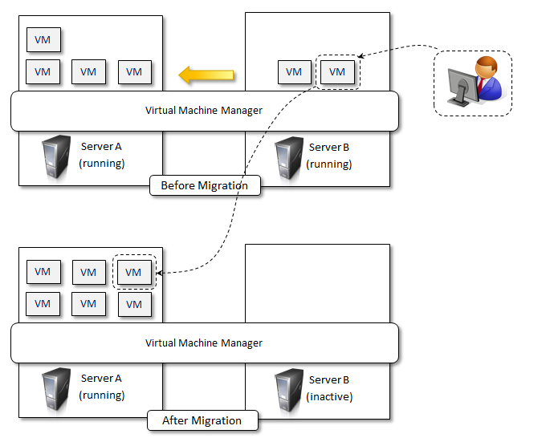
Virtualization and Cloud Computing
Virtualization plays an important role in Cloud computing, since it allows for the appropriate degree of customization, security, isolation.
Virtualization technologies are primarily used to offer configurable computing environments and storage.
Particularly important is the role of virtual computing environment and execution virtualization techniques. Among these, hardware and programming language virtualization are the techniques adopted in Cloud computing systems.
virtualization also gives the opportunity of designing more efficient computing systems by means of consolidation
Server consolidation and virtual machine migration are principally used in case of hardware virtualization even though technically possible also in case of programming language virtualization.
Storage virtualization constitutes an interesting opportunity given by virtualization technologies, often complimentary to the execution virtualization.
Finally, Cloud computing revamps the concept of desktop virtualization, initially introduced in the mainframe era.
Fig- . Live Migration and Server Consolidation

Slide 67
Pros and Cons of Virtualization
Advantages of Virtualization
Managed execution and isolation are perhaps the most important advantages of virtualization.
these two characteristics allow building secure and controllable computing environments. A virtual execution environment can be configured as a sandbox, thus preventing any harmful operation to cross the borders of the virtual host.
Moreover, allocation of resources and their partitioning among different guests is simplified, being the virtual host controlled by a program.
Portability is another advantage of virtualization, especially for execution virtualization techniques.
Portability and self-containment also contribute to reduce the costs for maintenance, since the number of hosts is expected to be lower than the number of virtual machine instances.
Finally, by means of virtualization it is possible to achieve a more efficient use of resources. Multiple systems can securely coexist and share the resources of the underlying host, without interfering with each other.

Slide 68
Pros and Cons of Virtualization
Disadvantages of Virtualization
Performance Degradation
Performance is definitely one of the major concerns when using virtualization technology. Since virtualization interposes an abstraction layer between the guest and the host, increased latencies and delays can be experienced by the guest.
Also, when hardware virtualization is realized through a program that is installed or executed on top of the host operating systems, a major source of performance degradation is represented by the fact that the virtual machine manager is executed and scheduled together with other applications, thus sharing with them the resources of the host.
Inefficiency and Degraded User Experience
Virtualization can sometime led to an inefficient use of the host. In particular, some of the specific features of the host cannot be exposed by the abstraction layer and then become not accessible.
Security Holes and New Threats
Virtualization opens the door to a new and unexpected form of phishing. The capability of emulating a host in a complete transparent manner, has led the way to malicious programs which are designed to extract from the guest sensitive information.

Slide 69
Review questions
What is virtualization and what are its benefits?
What are characteristics of virtualized environments?
Discuss classification or taxonomy of virtualization at different levels.
Discuss machine reference model of execution virtualization.
What are hardware virtualization techniques?
List and discuss different types of virtualization.
What are benefits of virtualization in the context of Cloud computing?
What are disadvantages or cons of virtualization?

Slide 70
Conclusions
Discussed Characteristics of Virtualized environments
Taxonomy of Virtualization Techniques
Execution Virtualization
Other Types of Virtualization
Virtualization and cloud computing
Pros and Cons of Virtualization

Slide 71
References
Rajkumar Buyya, Christian Vecchiola, and Thamarai Selvi, Mastering Cloud Computing, McGraw Hill, ISBN-13: 978-1-25-902995-0, New Delhi, India, 2013.
Chapter 3- Virtualization
Section 3.1 to 3.5
This chapter slides text is compiled by:
Dr. Sounak Paul, BIT Mesra, Deoghar, India

