Slide 1
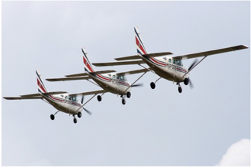
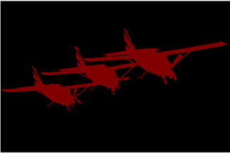
A everyday image (left) and the pixel-wise class maps (right) from the PASCAL VOC-2012 dataset

