Slide 1


Slide 2

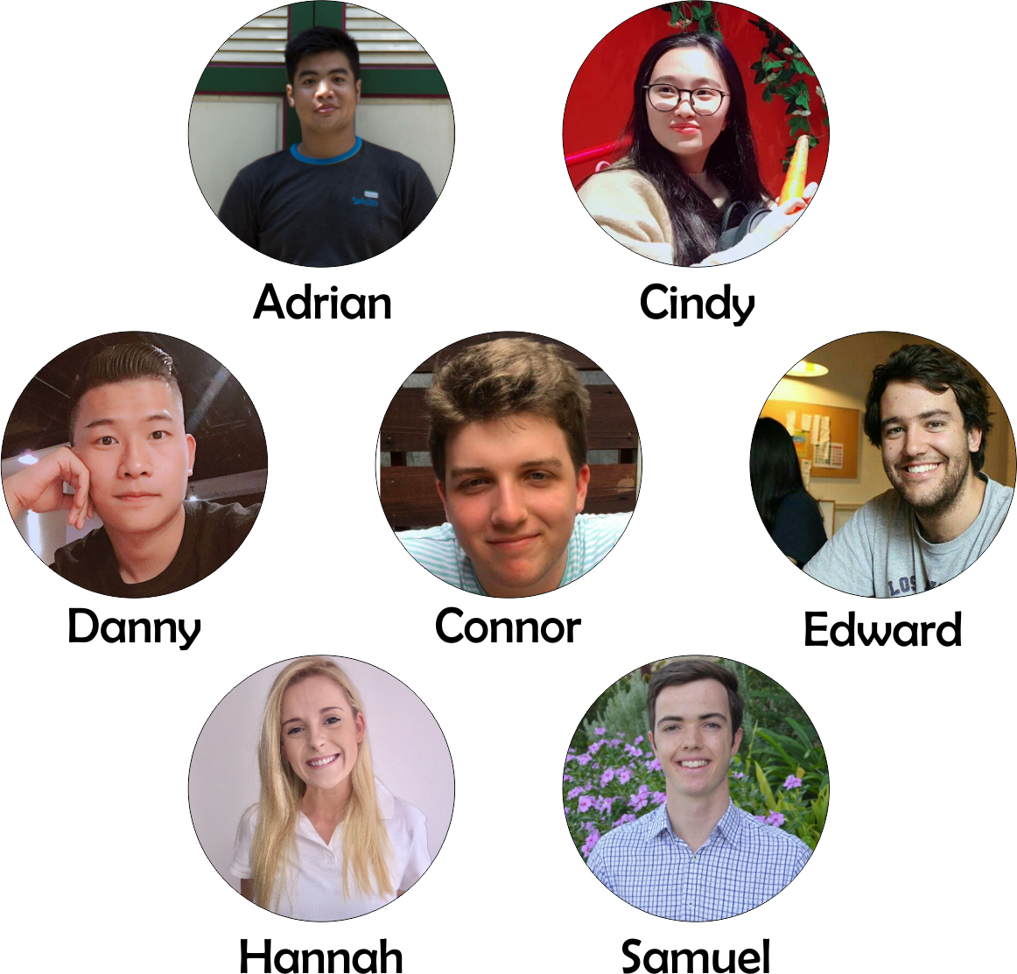
MEMBERS

Slide 3




ANDROID STUDIO
COREL DRAW
TOOLS
REACT NATIVE
FIREBASE

Slide 4





5
APPS
PAGES
PLAN
DISCOVER
ABOUT ME
MY DIARY
CHAT

Slide 5

See what stories have been published by your friends
DISCOVER

Slide 6

Easy access
to info
Example :
accommodation,
transport and
location
PLAN

Slide 7

MY DIARY
Create private daily diaries
from text and camera roll images (multiple trips)

Slide 8
Send and receive
messages to
friends
CHAT

Slide 9
Store your basic
info for
future use
ABOUT ME

Slide 10

DEMO

Slide 11
GOOD
React Native !
Independent working through Git based on Trello
Firebase
Morning scrum
REFLECTIONS
LESS GOOD
Combination of Android Studio and React Native
Setting up emulator etc
Created multiple style sheets (should have written first!)

Slide 12

THANK YOU
STAY HUNGRY!!!
AROOOOOO

