Slide 1
RevYou Reviews for You
By Team RatBit

Slide 2
Agenda
Team
Project
Progress
Approach
Demo
Project Vision
Reflection
Roadmap
Questions

Slide 3
Team
James Burns | Christopher Thorpe | Mikeala Summerville
Team Leader System Architect | Project Manager | Technical Documentation
ZhangYang | Tony Li | LIANGZHENYU
Vice Leader Quality Control Officer | Lead Designer | Product Manager

Slide 4
Project
RevYou is an aggregated review site.
Like Metacritic, Rotten Tomatoes, TestFreaks
RevYou however, takes all the categories and combines them in to one place.

Slide 5
Project
RevYou allows you to see the reviews of many products in one place.
RevYou focuses on letting you know who is writing your review.
RevYou allows the user to ranks reviews on how relevant they to them.
RevYou is easily extendable, allowing categories to be added with minimal effort.
RevYou gives the user choices to view only what they want to see.

Slide 6
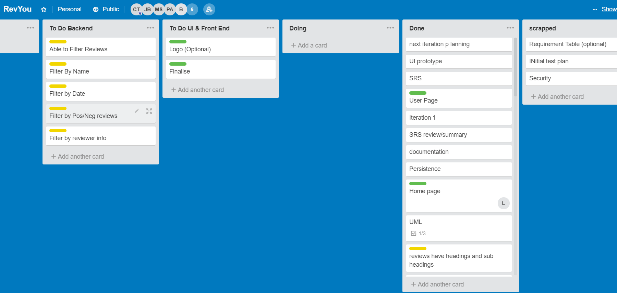
Progress
Current Image of the trello board

Slide 7
Progress
Goal | Achievement
Fill our website with products and ratings | Complete
Able to make user account and sign in | Complete
User is able to search for products | Complete
User is able to write reviews | Complete
User is able to search for reviews | Complete
User is able to follow reviewers | Incomplete
User is able to set preferences for what they want to look at | Incomplete

Slide 8
Approach – Frontend
Node.js and express.js framework
Required for dynamic routing
PUG – HTML – Allows backend results to be rendered
LESS – CSS – More organized styles
CoffeeScript – JavaScript – Quick production of short scripts
Frontend is served and rendered by express.js routing.

Slide 9
Approach – Backend
All data for the site was collected using scrapers in Python
Data was scraped from Steam, Goodreads and IMDb
Data is currently stored in JSON files
Passwords are salted and hashed with SHA-512
The inner workings of the site are written in 12 TypeScript classes and 2 interfaces which interacts with the frontend

Slide 10
Demo
TONY TAKE THE WHEEL

Slide 11
Project Vision – Short Term
Move to a database rather than Json files
Expand the range of products our site holds
Log in with Social Media (FB, WeChat)
Polish pages and improve usability
Improve review editing process

Slide 12
Project Vision – Long Term
Implement more sophisticated user controls
Develop an API for accessing review data/metadata
Develop a suggestions system based on user info/activity
Create an API for developers or corporates to add their own categories.

Slide 13
Reflection
Achieved most of the goals we wanted to achieve
We were not able to implement one of the most important features
Getting the data we wanted took longer than we thought it would
It helped to have a member of the group with experience making websites
The boot section needs polishing

Slide 14
Questions?

