Slide 2
Problem Definition
Travel can often be stressful
Planning activities
Navigating around in destination
Language barriers
Most travel organisations don’t take ALL demographics into account, especially:
Elderly
Disabled

Slide 3
Solution Overview (Scope)
Travolla makes global travel more accessible, for more people. With unique features to help you personalise and streamline your getaway, Travolla allows you to truly experience a place in a natural, authentic way.
Incorporates three main services:
Optimised Journey Planner
Activity Heat Map
Local Tour Guide Matching System

Slide 4
Solution Overview (Scope)
Platform:
Website – Accessible on all personal computers and mobile devices
App – Accessible on Android mobile devices

Slide 5
Solution Overview (Miscellaneous Scope)
For Iteration 1:
Focusing on two cities: Dalian, China and Brisbane, Australia
User account system
Security of user information
Other information pages (company information, FAQs)

Slide 6
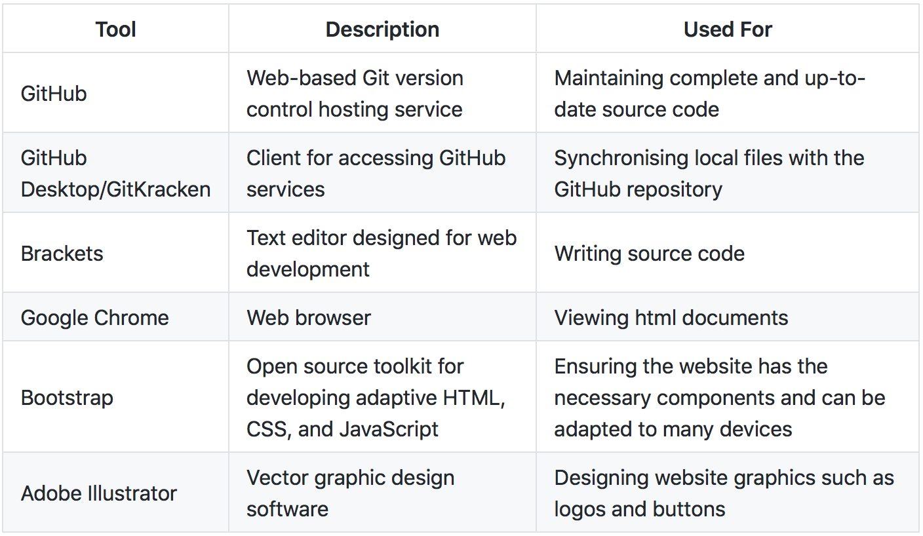
Environmental Requirements

Slide 7
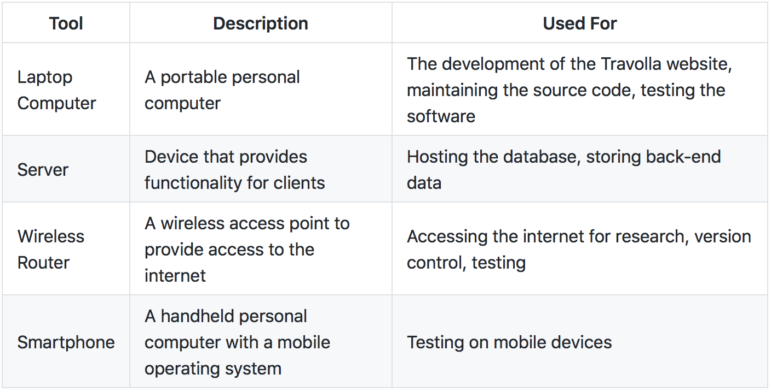
Environmental Requirements

Slide 8
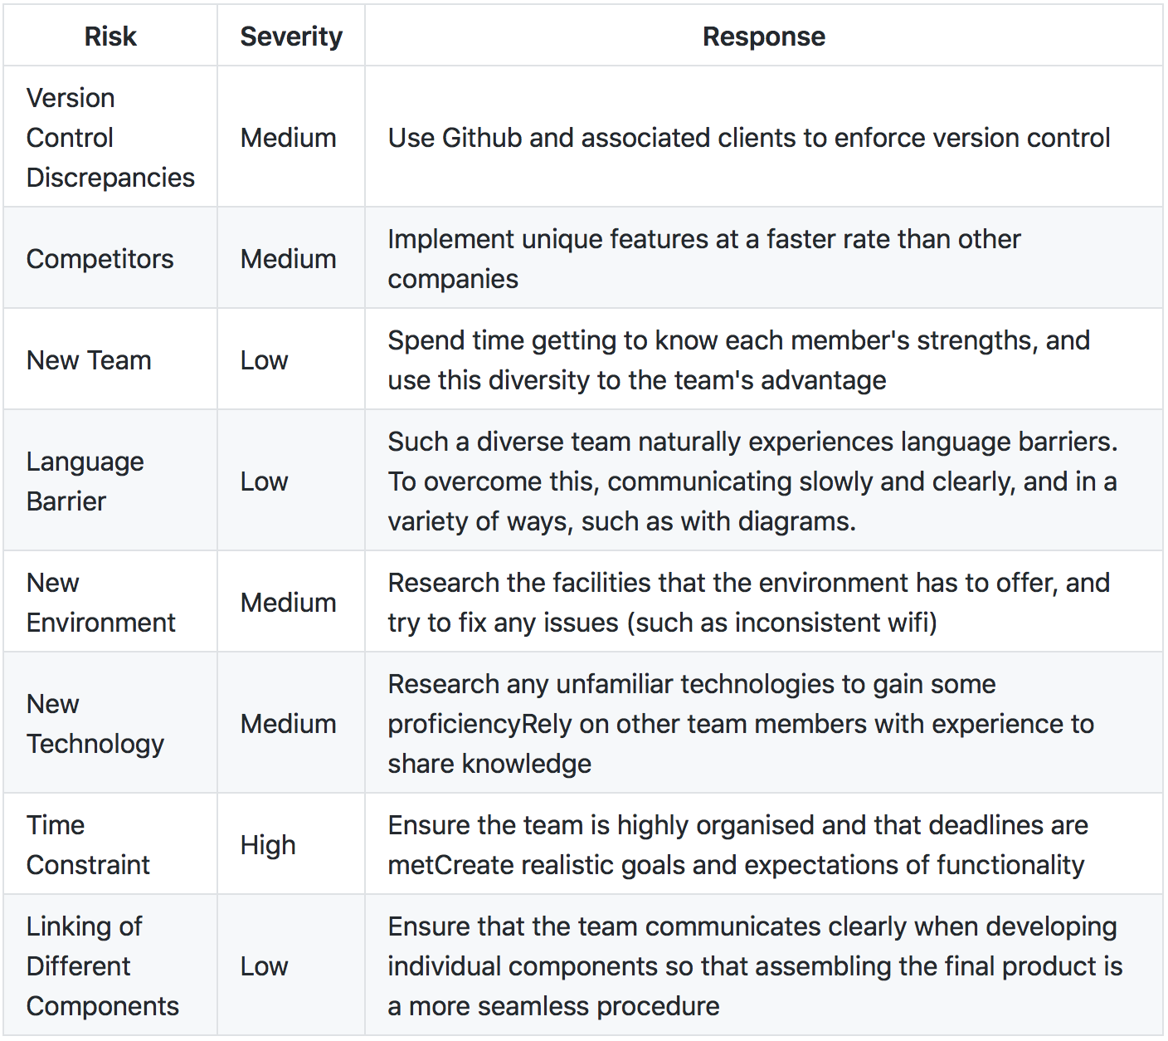
Risk Analysis

Slide 9
Team

Slide 10
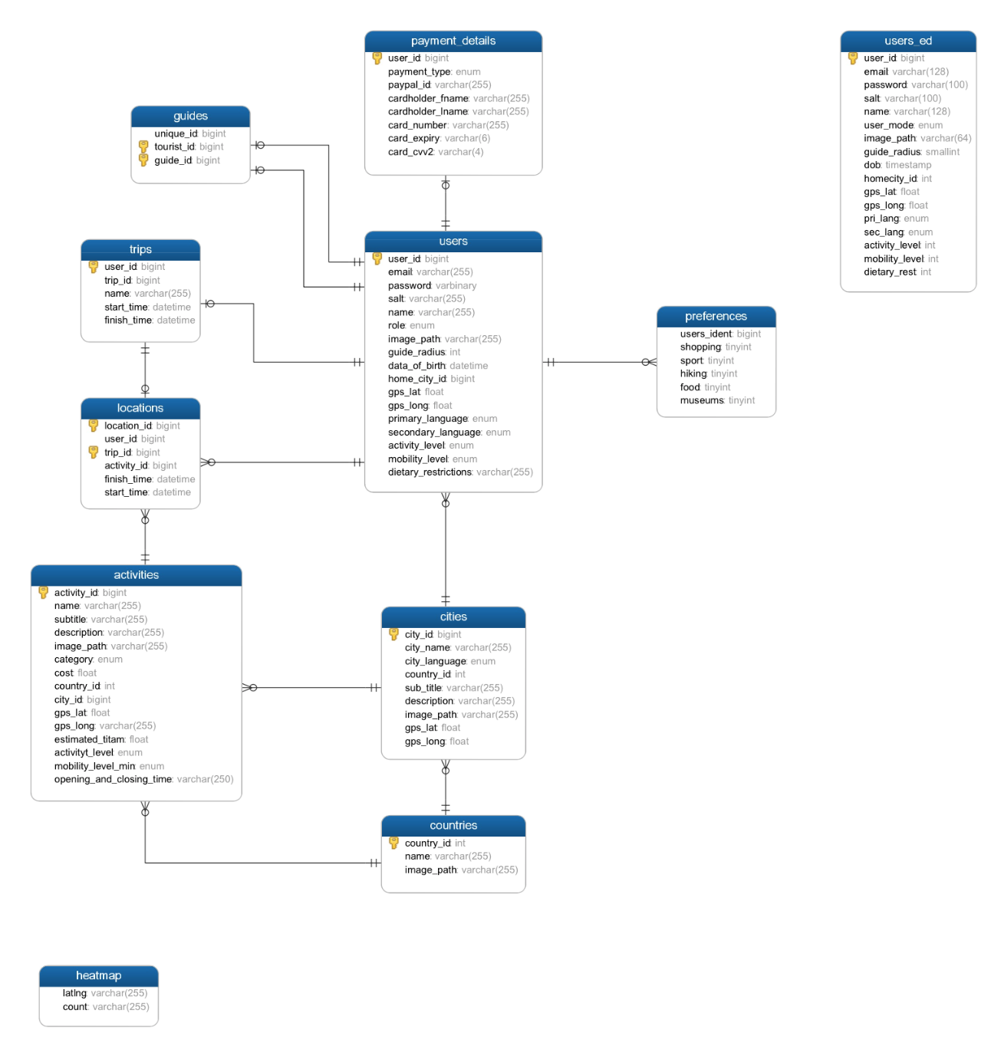
Database ER Diagram

Slide 11
Optimised Journey Planner
Produces an optimised timetable of activities in destination based on:
Personal interests
Popularity of attractions
Best times to visit
Accessibility requirements
Level of activity

Slide 12
Activities Heatmap
Takes statistics on activity popularity and displays them in an interactive, visual way
Can be used to make decisions about activities for optimised timetables
Make instantaneous decisions based on live information

Slide 13
Local Tour Guide Matching System
Matches travellers with local people at each destination
Incorporates aspects such as:
Location
Timing
Languages Spoken
Personal Preferences
Activity Level
Accessibilty

Slide 14
Retrospective
Problem | Solution
Linking Journey Planner to Database – Choosing between NodeJS and AJAX for SQL integration | Chose AJAX as it integrated more smoothly with the pre-existing PHP
Pressing buttons too quickly produced unexpected results due to slow internet | No feasible solution to slow internet yet
JavaScript is a new language for many of us – Problems with multiple functions executing simultaneously rather than sequentially like in other languages | Limiting number of functions used to force sequential flow

Slide 15
Retrospective
Keep Clearly assigned roles Setting manageable goals with time limits | Try Breaking down roles further Using subgoals to more specifically assign work Clear communication is key. Found that messaging a group chat when working on a document (so that only one person is working on a document at any time) was efficient for a small group Creating new servers Working as a team to teach each other and share skills
Problem GitHub merge conflicts GFW blocking/slowing development servers Not everyone was familiar with the languages and technologies being used

Slide 16
Timeline
Iteration | Iteration 1 |  |  |  | Iteration 2
Features | Functional Journey Planner | Functional Heat Map |  | Functional Guide Matching | Improvements of three key features |  | Add more cities and destinations
Platforms | Website |  | Android App |  | Website | Android App |  | iOS App

