Slide 2
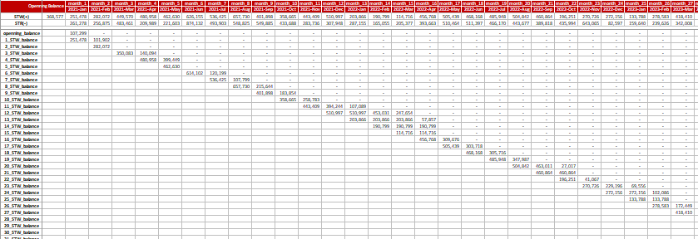
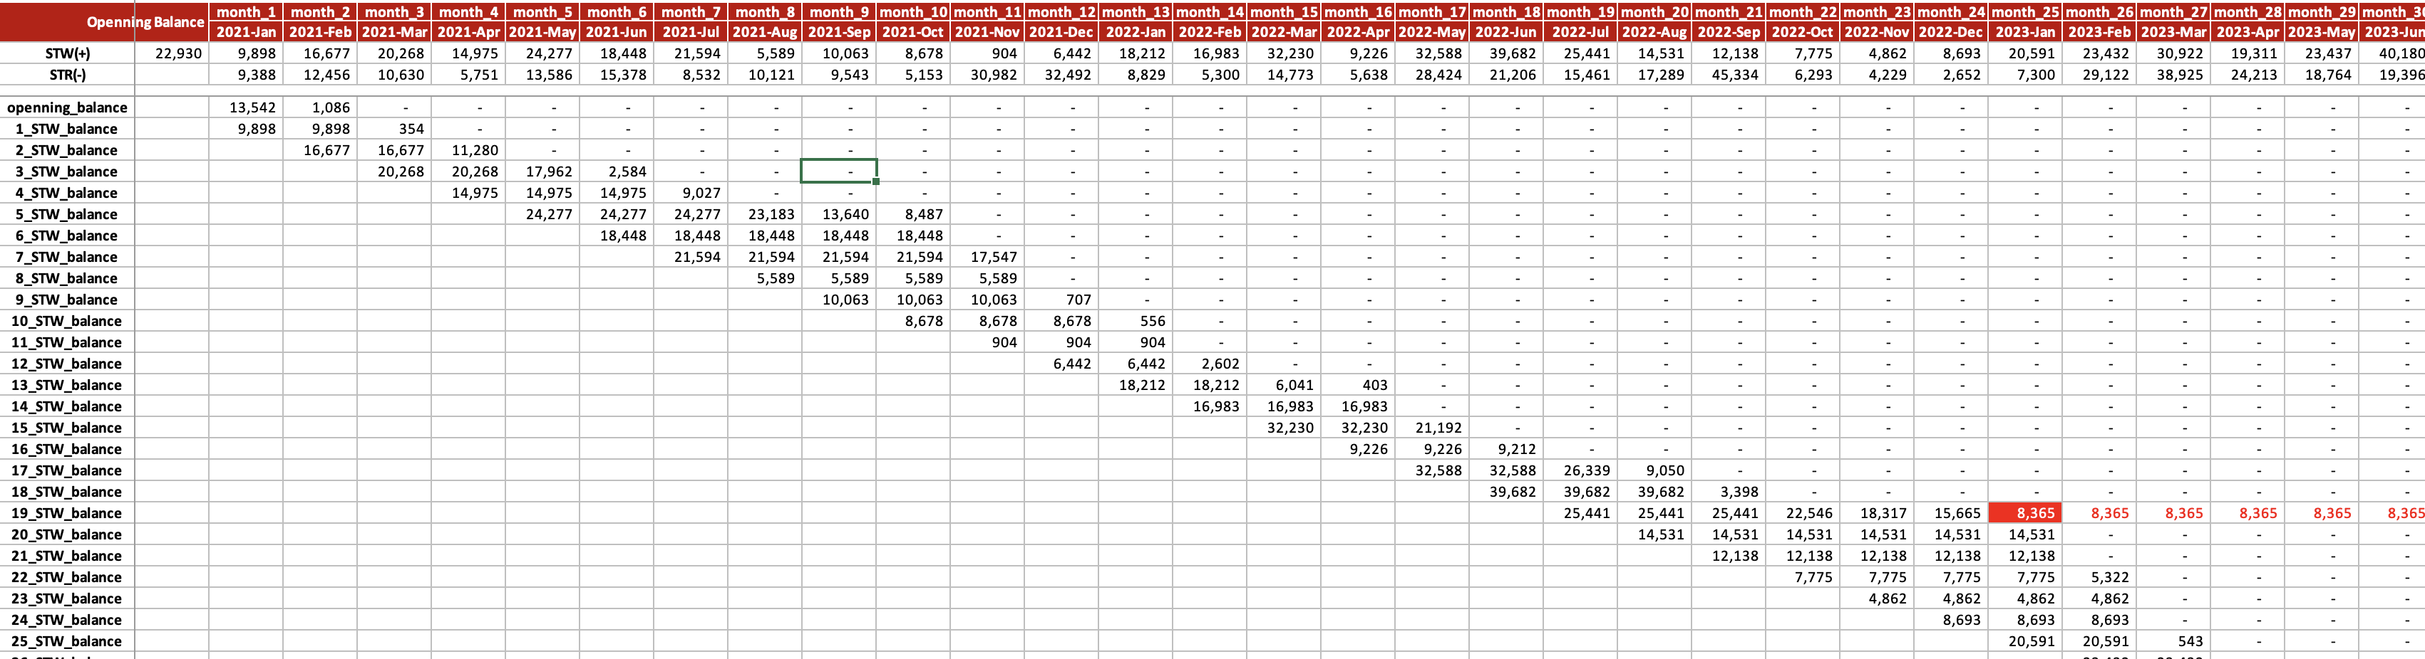
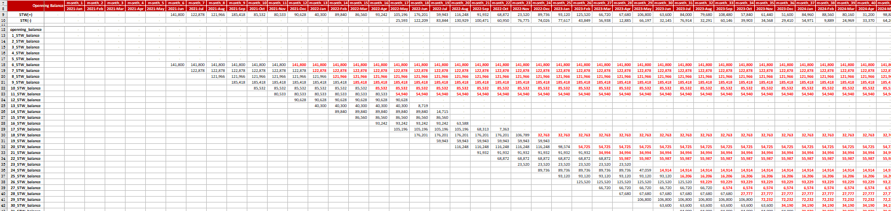
Pre-2024 Data simulation of WS
FIFO method is leveraged to simulate inventory balance based on confirmed data scope and logic，and overview of results will be provided for reference.
Data & Logic
Overview of results
Data Source: STW & STR in WCCS from 2021 to 202410
SKU Scope: brand family belongs to “BUD, HBI, HBO, HKOW, and ISP”
Calculation Logic: FIFO
Freeze Cycle: 9 months or or based on brand-respective expiration cycle
Unit of Measure: box→HL
1
2
3
Total balance of WS - HL
Total balance
Opening balance + STW
# of batches to be written-off
ETA
Batch I: 3WS adjustment
Batch II: national WS – t+10 of frozen cycle confirmation
3
No batch
3
A few batches
3
Majority of batches

Slide 3





A wholesaler who directly gets beer from ABI, can be further divided into 2 types:
T1 WS: only purchase beer from ABI
T1.5 WS: purchase beer from ABI as well as from other T1 WS
Business Scenario
Calculation Logic
Case from ABI: 77%
For a T1 WS, STW =
Case to T1.5: 13%
1
2
5
For a T1 WS, STR Calculated =
1
2
3
Case from T1: 23%
T1.5 WS
4
T2.5 WS
T1 send to POC
T1 send to T2
T1.5 send to POCs
Case to T1: 87%
1
3
POC
T1 WS
For a T1.5 WS, STW =
Note:
For T1.5, only consider the volume directly coming from ABI
2
POC
2
For a T1.5 WS, STR Calculated =
4
5
T2 WS
T1.5 send to POCs
T1.5 send to T2.5
1
POC
For a T1 wholesaler:
Could only get beer from ABI
Could send beer to a T1.5 wholesaler, to a T2 wholesaler, or directly to POCs
Note:
Wholesaler identity could change in the past
SKU mapping relationship could change in the past, e.g., one SKU could come from ABI or T1 WS(s) during different periods
If send different batches to POC/T2/T1.5 in the same month, new batches are given priority to T1.5

Slide 4
Thank you !

Slide 5


If this wholesaler is a T1.5 wholesaler, the STR we need is…
STR Calculated only includes the volume directly coming from ABI
= STR send to wholesalers + STR (coming from ABI) send to POCs
POC
For a T1.5 wholesaler:
Beer getting from T1 could only send to POCs
Beer from ABI could send to a T2.5 wholesaler or POCs
T1 WS
T1.5 WS
T2.5 WS
POC
STW
STR
POC

Slide 6
方式一
POC
T1 WS
T1.5 WS
As a T1
POC
T2 WS
POC
STW
STR
POC
As a T1.5
T1 WS
T1.5 WS
T2.5 WS
POC
STW
STR
POC

Slide 7
方式二
POC
T1 WS
T1.5 WS
As a T1
POC
T2 WS
POC
STW
STR
POC
As a T1.5
T1 WS
T1.5 WS
T2.5 WS
POC
STW
STR
POC

Slide 8
If this wholesaler is a T1 wholesaler , the STR we need is…
T1 WS: only purchase beer from ABI
T1.5 WS: purchase beer from ABI as well as from other T1 WS
 | Number | Case from ABI
T1 | 74% | 87.0%
T1.5 | 26% | 13.0%
For T1.5
Case from ABI | 77%
Case from T1 | 23%
Data / Account
Calculation Logic
STW
STR
For a T1 WS, STR Calculated:
= T1.5 send to POCs + T1 send to T2 + T1 send to POC
POC
T1 WS
T1.5 WS
Separate T1.5 from T2:
Get historical STR data, if affiliated T1 WS sometimes equals to the current WS → T1.5 WS
Affiliated T1 WS always not equal → T2 WS
POC
T2 WS
POC
Get STR Qty:
T1.5 send to POCs: have affiliated T1, with “True” STR label
T1 send to T2: have affiliated T1, with “False” STR label
T1 send to POC: affiliated T1 equals to current WS ID, with “True” STR label
For a T1 wholesaler:
Could only get beer from ABI
Could send beer to a T1.5 wholesaler, to a T2 wholesaler, or directly to POCs
Note:
Wholesaler identity could change in the past
Only have POC ID (no WS ID) in the STR data, POC mapping relation often changes

