Slide 1
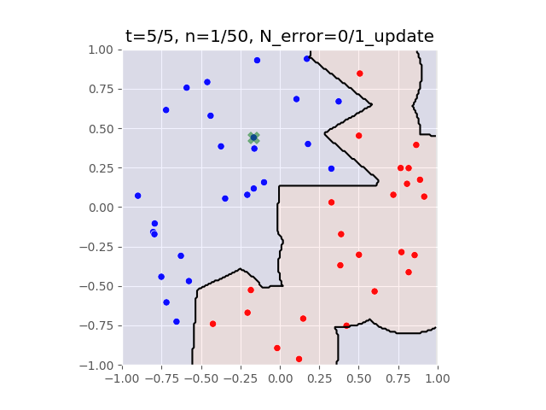
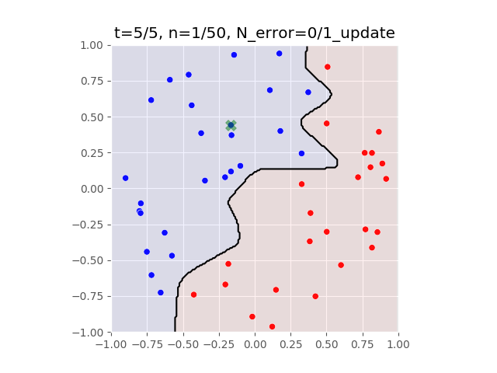
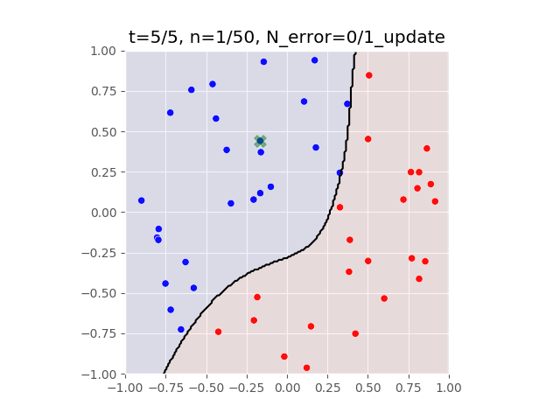
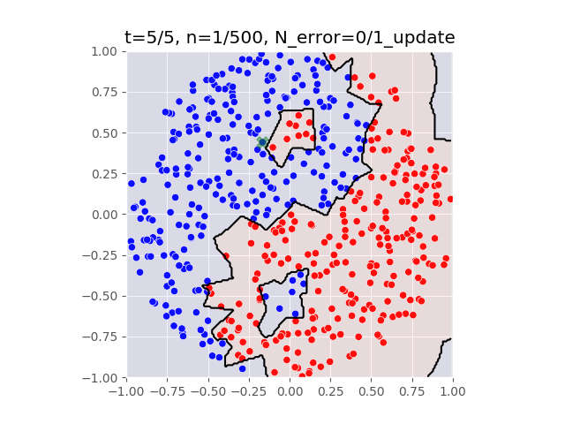
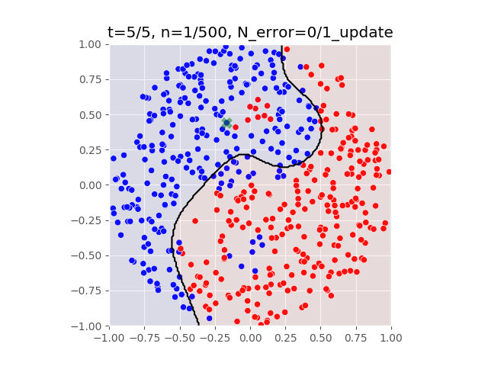
Bias-Variance Trade-off of RBF-kernel perceptron
Sigma=0.01
Sigma=0.1
Sigma=0.4
Low-bias, high variance
High-bias, low variance
More flexible
Less prone to overfit

