Slide 1

BLOCKCHAIN TECHNOLOGY
Summiya Saif (2212143)

Slide 2
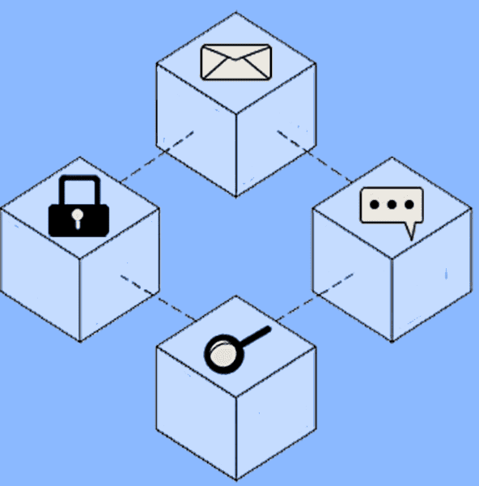
Introduction to blockchain
Blockchain was first proposed in 2008 and implemented in 2009
Blockchain could be regarded as a public ledger, in which all committed transactions are stored in a chain of blocks.
Blockchain can work in a decentralised environment, which is enabled by integrating several core technologies such as cryptographic hash, digital signature (based on asymmetric cryptography) and distributed consensus mechanism
Bitcoin is the most famous application of blockchain, blockchain can be applied into diverse applications far beyond cryptocurrencies

Slide 3

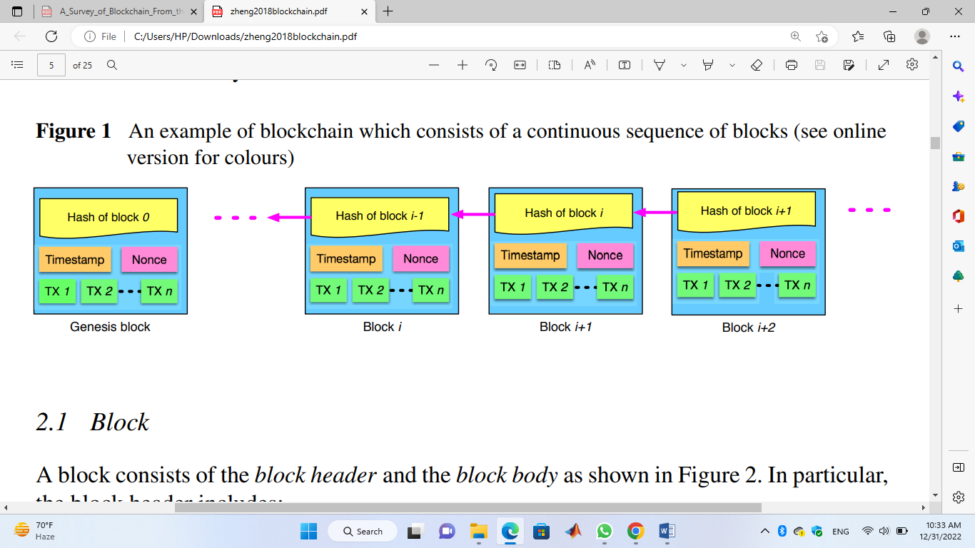
Blockchain Technology
The blockchain is a sequence of blocks, which holds a complete list of transaction records like conventional public ledger.
Each block points to the immediately previous block via a reference that is essentially a hash value of the previous block called parent block.

Slide 4
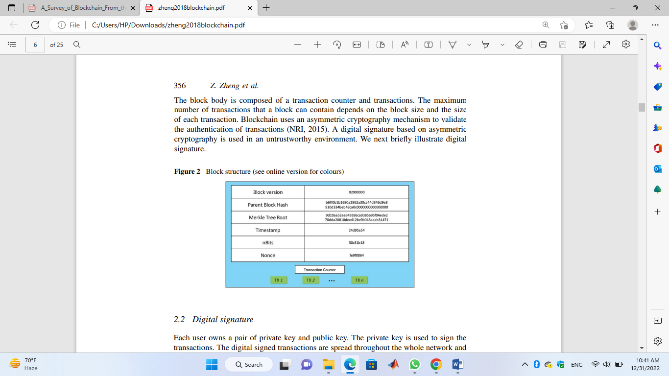
Block
A block consists of the block header and the block body. In particular, the block header includes:

Slide 5
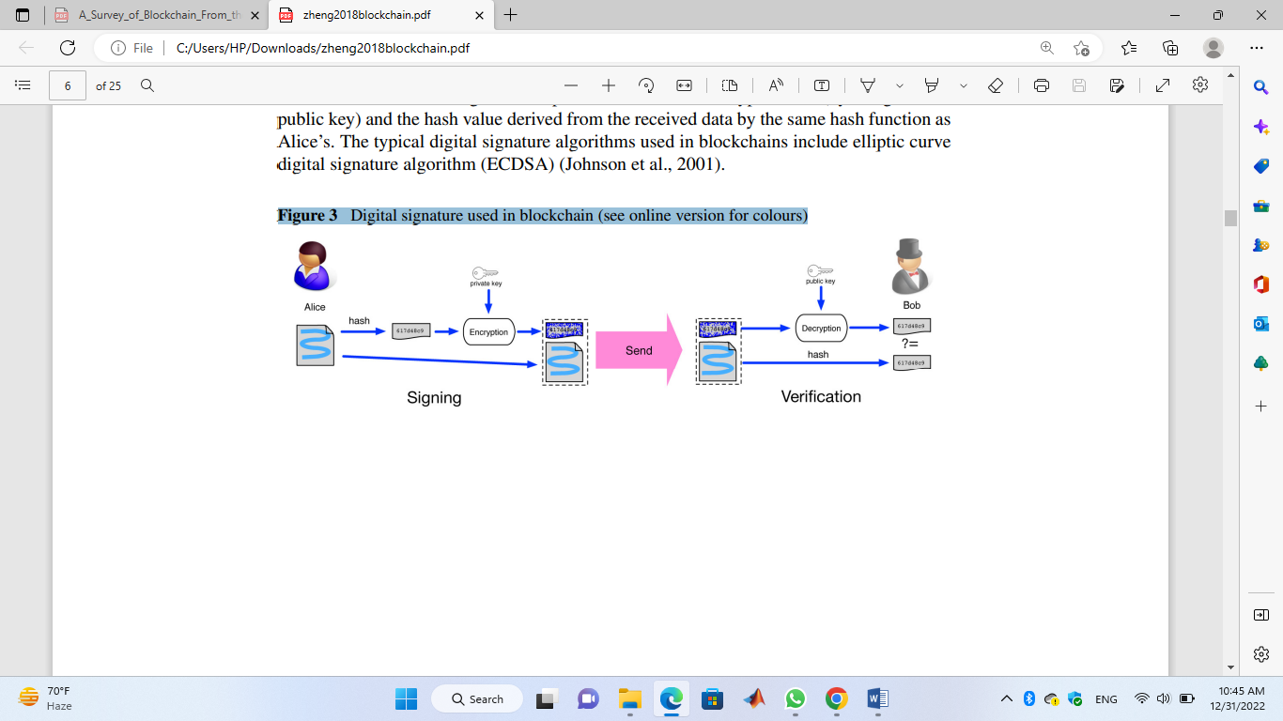
Digital signature
Each user owns a pair of private key and public key. The private key is used to sign the transactions. The digital signed transactions are spread throughout the whole network and then are accessed by public keys, which are visible to everyone in the network.

Slide 6
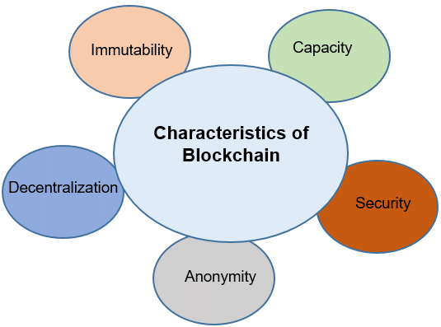
Key characteristics of blockchain

Slide 7
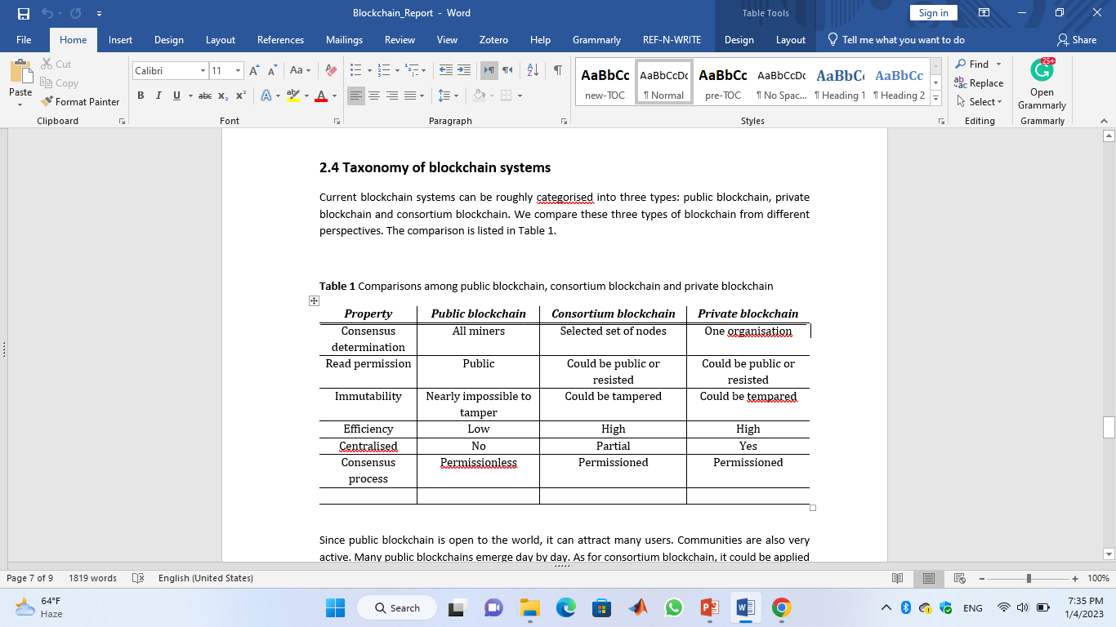
Taxonomy of blockchain systems
Current blockchain systems can be roughly categorised into three types: public blockchain, private blockchain and consortium blockchain.
Property | Public blockchain | Consortium blockchain | Private blockchain
Consensus determination | All miners | Selected set of nodes | One organisation
Read permission | Public | Could be public or resisted | Could be public or resisted
Immutability | Nearly impossible to tamper | Could be tampered | Could be tempared
Efficiency | Low | High | High
Centralised | No | Partial | Yes
Consensus process | Permissionless | Permissioned | Permissioned

Slide 8
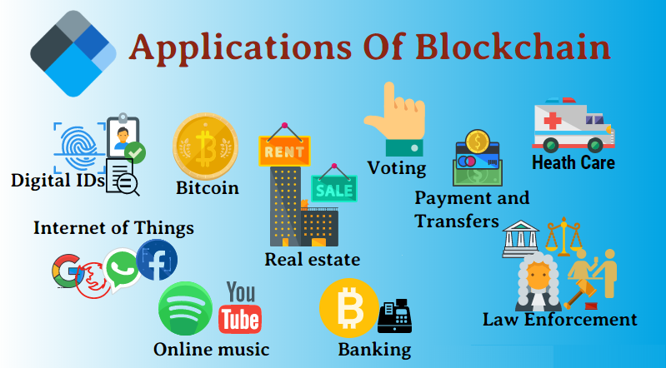

Slide 9


Slide 10
Conclusion
Blockchain could be applied to a variety of fields far beyond Bitcoin
Blockchain has shown its potential for transforming the traditional industry with its key characteristics: decentralisation, persistency, anonymity and auditability
The blockchain technology is acquiring immense attention from public and private sectors, more smart contract-based applications would be put into use.

