Slide 1
Summoner desktop app design & user experience
Draft by Remy Tuyeras
04/2025

Slide 2


SuperJo30459
First register on website (username and password will be stored in SQL database). Desktop GUI is available to anyone, but login can only be done if proper payment/registration has been processed
************
login

Slide 3
Import an agent
Management
Performance
Build an agent
Hosting
Newsfeed
Launch an agent
Adding a feature should be equivalent to adding a folder in the code (modular logic). Window and button layout should dynamically readjust (e.g. screen size, varying number of buttons)

Slide 4

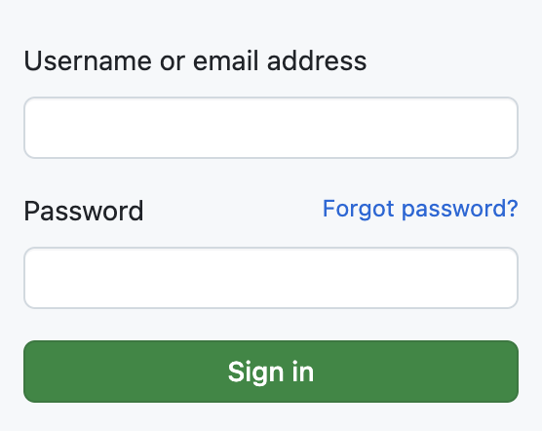
Import an agent
From google drive
From device

Slide 5

Import an agent
File valid for our SDK (parsed correctly) and compatible with our app
From device
app.py
tooling.py
Feature.py
Agent name
app.py
Register agent under an ID on our platform (agent is not added until the upload to the registry is confirmed and completed). This operation can also be done on our website.
CAST key
283rm7xf3ygf74d7mhezdh23eh
+ Add

Slide 6
Import an agent
Management
Performance
Build an agent
Hosting
Launch an agent

Slide 7
User interactions may have revealed gaps in an agent’s ability to effectively respond to requests from other agents. This functionality is available through our premium API services.
Build an agent
Duplicate, mutate, and recombine agents using existing ones. This functionality is available through our premium API services.
From reports
From saved agents
From templates
Build agents from a set of generic features (learned from data collected across the platform).

Slide 8
From saved agents
[Content to be added]

Slide 9
From templates
[Content to be added]

Slide 10
From reports
[Content to be added]

Slide 11
Import an agent
Management
Performance
Build an agent
Hosting
Launch an agent

Slide 12

Launch an agent
Agent_129484
Agent_23040
Agent_1bob3
Launch
Clients are run locally (for now) and will connect to specific servers or roam our server registry according to coded rules and policies.

Slide 13
Import an agent
Management
Performance
Build an agent
Hosting
Launch an agent

Slide 14
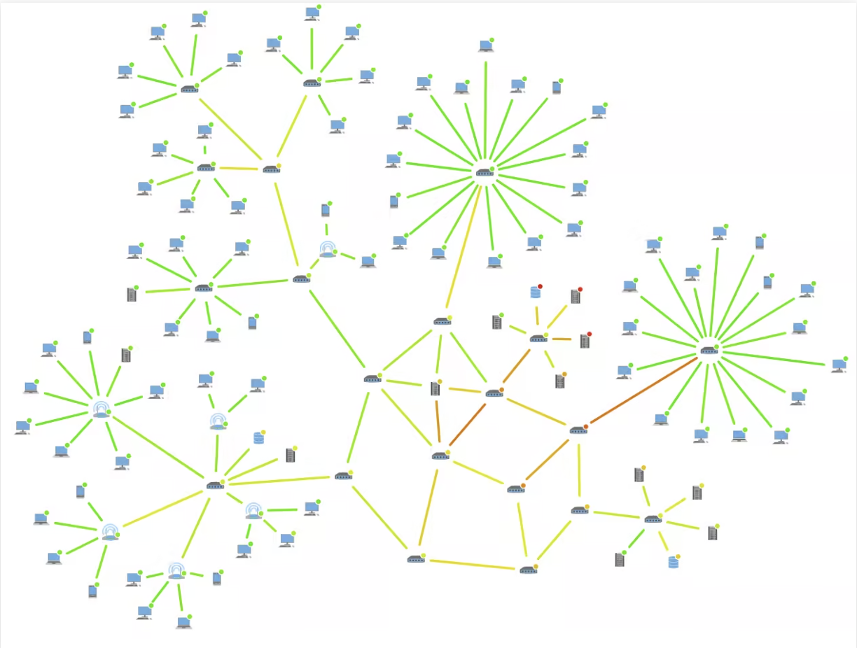
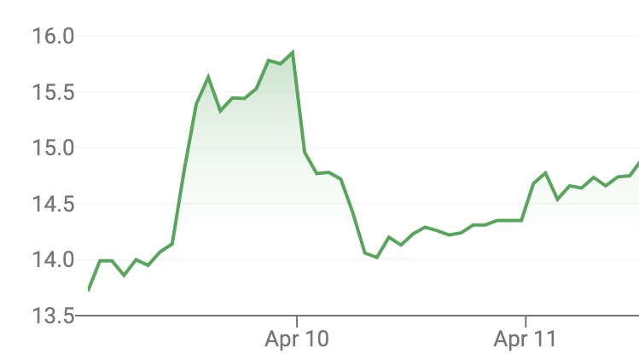

Interactive window with hovering features giving information on any server nodes visited by any agent (launched at least once)
Management
Sum of all the user's wallets
Friends
Friend Requests
Sensitive decisions requiring user's authorization (if configured by user as such)
Foes
Requests for action
https://github.com/yWorks/yfiles-for-html-demos
https://www.yworks.com/pages/network-monitoring-visualization-in-the-browser#how-to-create-a-network-monitoring-visualization

Slide 15
Friends
[Content to be added]

Slide 16
Foes
[Content to be added]

Slide 17
Friend Requests
[Content to be added]

Slide 18
Requests for action
[Content to be added]
Sensitive decisions requiring user's authorization (if configured by user as such)

Slide 19
Import an agent
Management
Performance
Build an agent
Hosting
Launch an agent

Slide 20
Hosting
Hoster servers
Launch locally
Launch remotely

Slide 21

Launch locally
Protocol options
Restrictions
Host agents
Allow /quit
Friends
Agent_129484
Allow JSON
Foes
Agent_23040
Async.
Encrypted
Agent_1bob3
Create server

Slide 22
Import an agent
Management
Performance
Build an agent
Hosting
Launch an agent

Slide 23
Performance
Data & storage
Statistics
Log reports

Slide 24
Data & storage
[Content to be added]

Slide 25
Statistics
[Content to be added]

Slide 26
Log reports
[Content to be added]

