Slide 1

APTECH VISION 2021
EXPLORING IDEAS FOR TOMORROW

Slide 2

GROUP MEMEBERS:
SYEDA FAZILA WALI :
Syeda Fazila Wali is completing her bachelor’s degree in software engineering from Virtual University-Karachi and also is enrolled in Aptech’s 3 year Software Program.
SUMNA IMRAN:
Sumna Imran is completing her bachelor’s degree in computer science from UBIT-Karachi University and also is enrolled in Aptech’s 3 year Software Program.

Slide 3
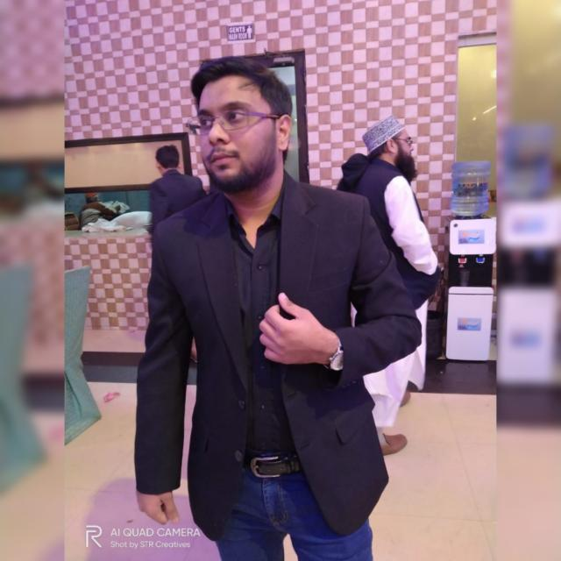

INSTRUCTOR:
MOHAMMAD FAIZAN:
Graduated from Karachi University, 3 years Diploma from Aptech, MCS from Microsoft.

Slide 4

TECHNOLOGY USED:
WORDPRESS:
WordPress is a free and open-source content management system written in PHP and paired with a MySQL or MariaDB database. Features include a plugin architecture and a template system, referred to within WordPress as Themes
XAMPP:
XAMPP is a free and open-source cross-platform web server solution stack package developed by Apache Friends, consisting mainly of the Apache HTTP Server, MariaDB database, and interpreters for scripts written in the PHP and Perl programming languages.

Slide 5
OUR MOTIVE:
Our motive behind this project as a WordPress developers was to make use sure that the website is user friendly , responsive and user has the best experience using it.
Our aim also was to include different plugins in our website and provide more than one functionality to user so that user can do what he wants to do like donate, add products to cart, become a volunteer etc.

Slide 6

OUR PROJECT FOR APTECH VISION 2021: “FS ORGANIZATION”

Slide 7
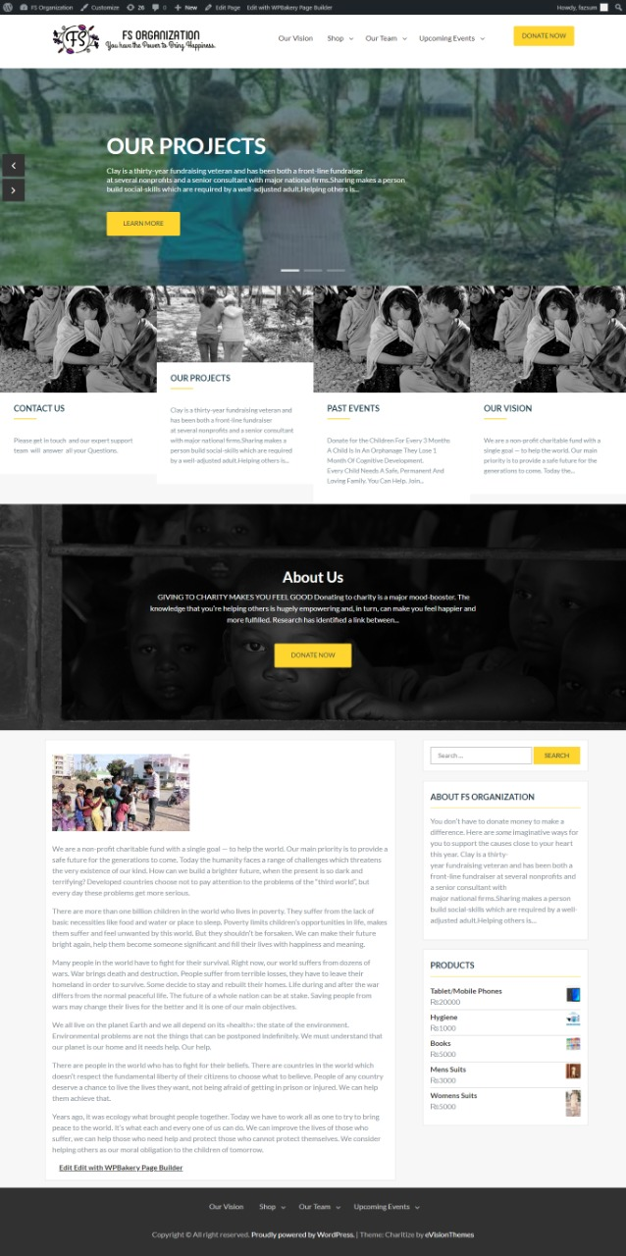
HOME PAGE

Slide 8
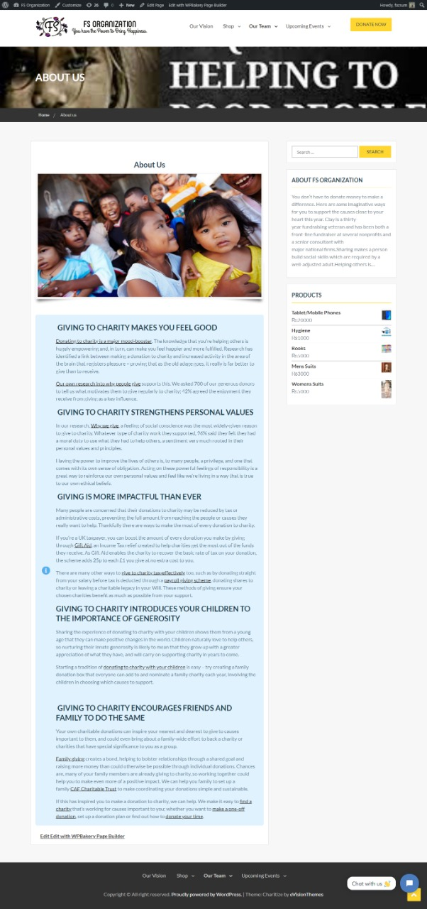
ABOUT US PAGE

Slide 9

CONTACT US PAGE

Slide 10
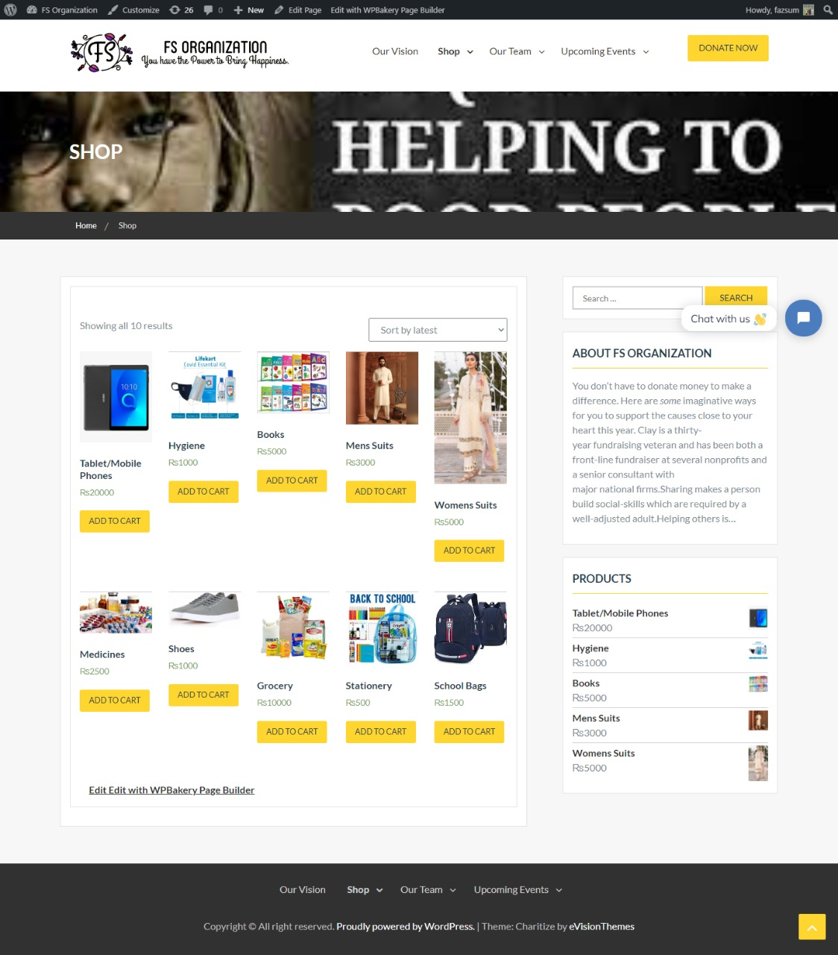
OUR SHOP PAGE

Slide 11
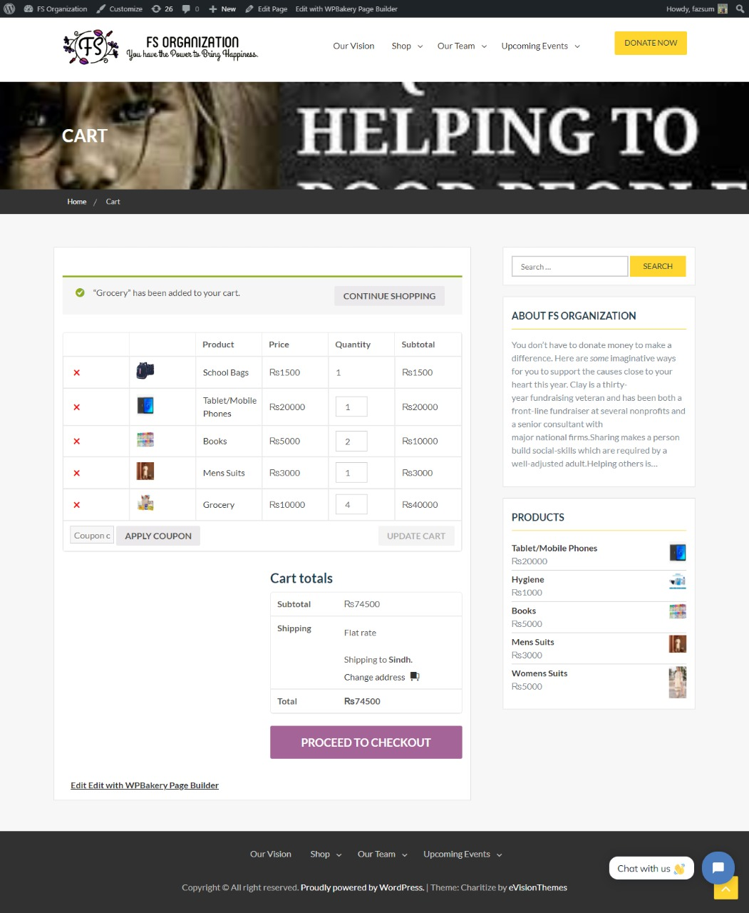
CART

Slide 12
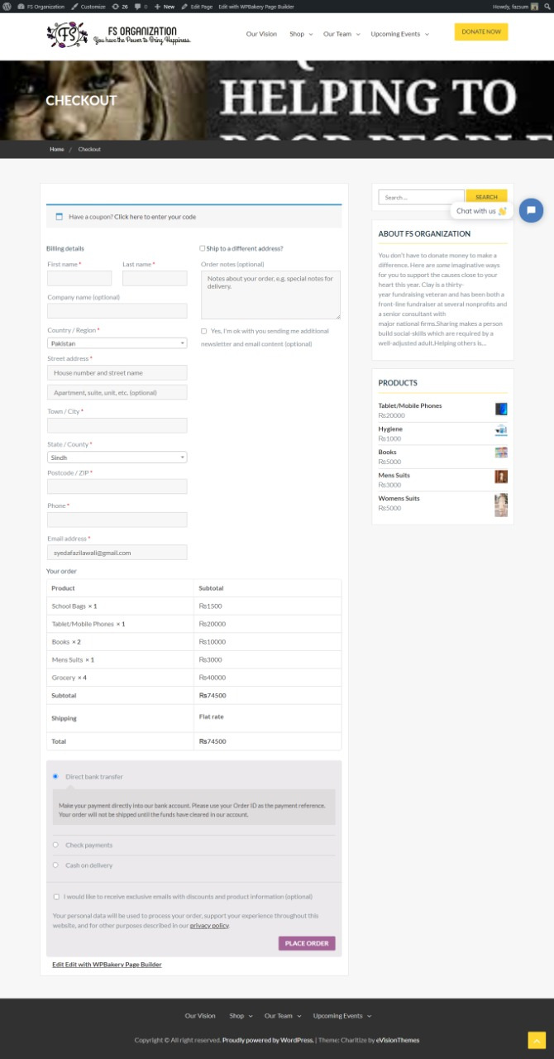
CHECK OUT

Slide 13
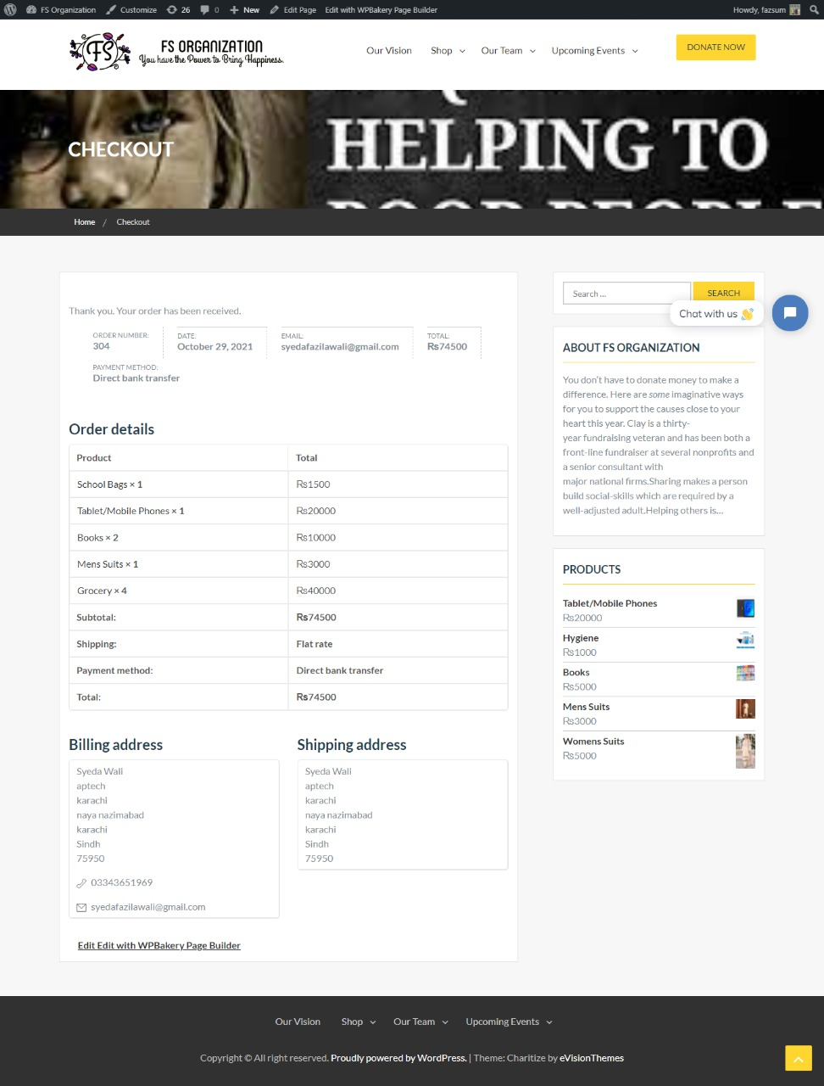
ORDER RECEIVE RECEIPT

Slide 14
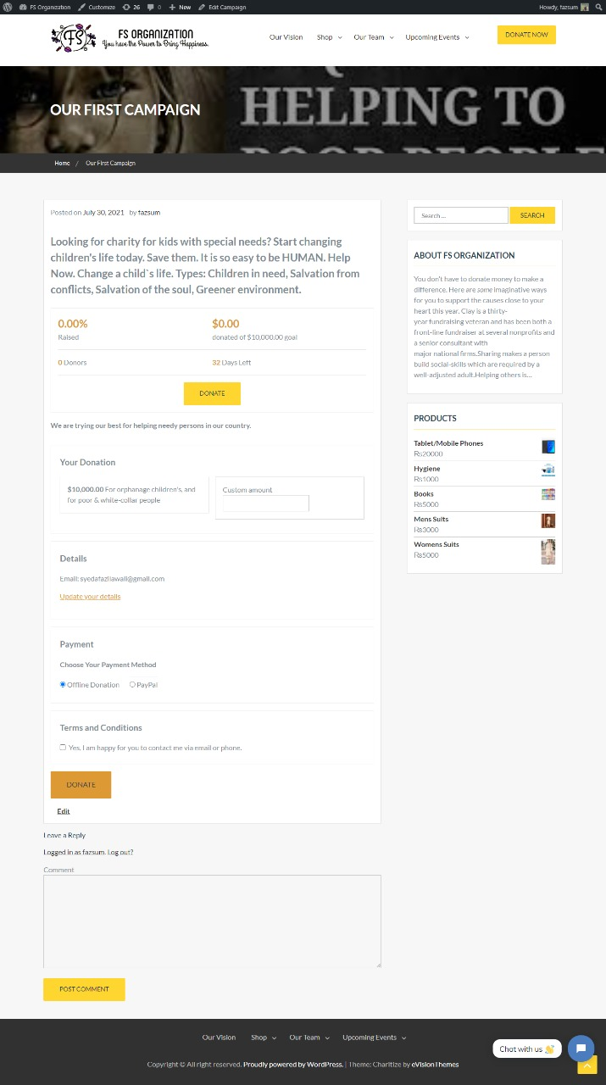
OUR FIRST CAMPAIGN DONATION

Slide 15
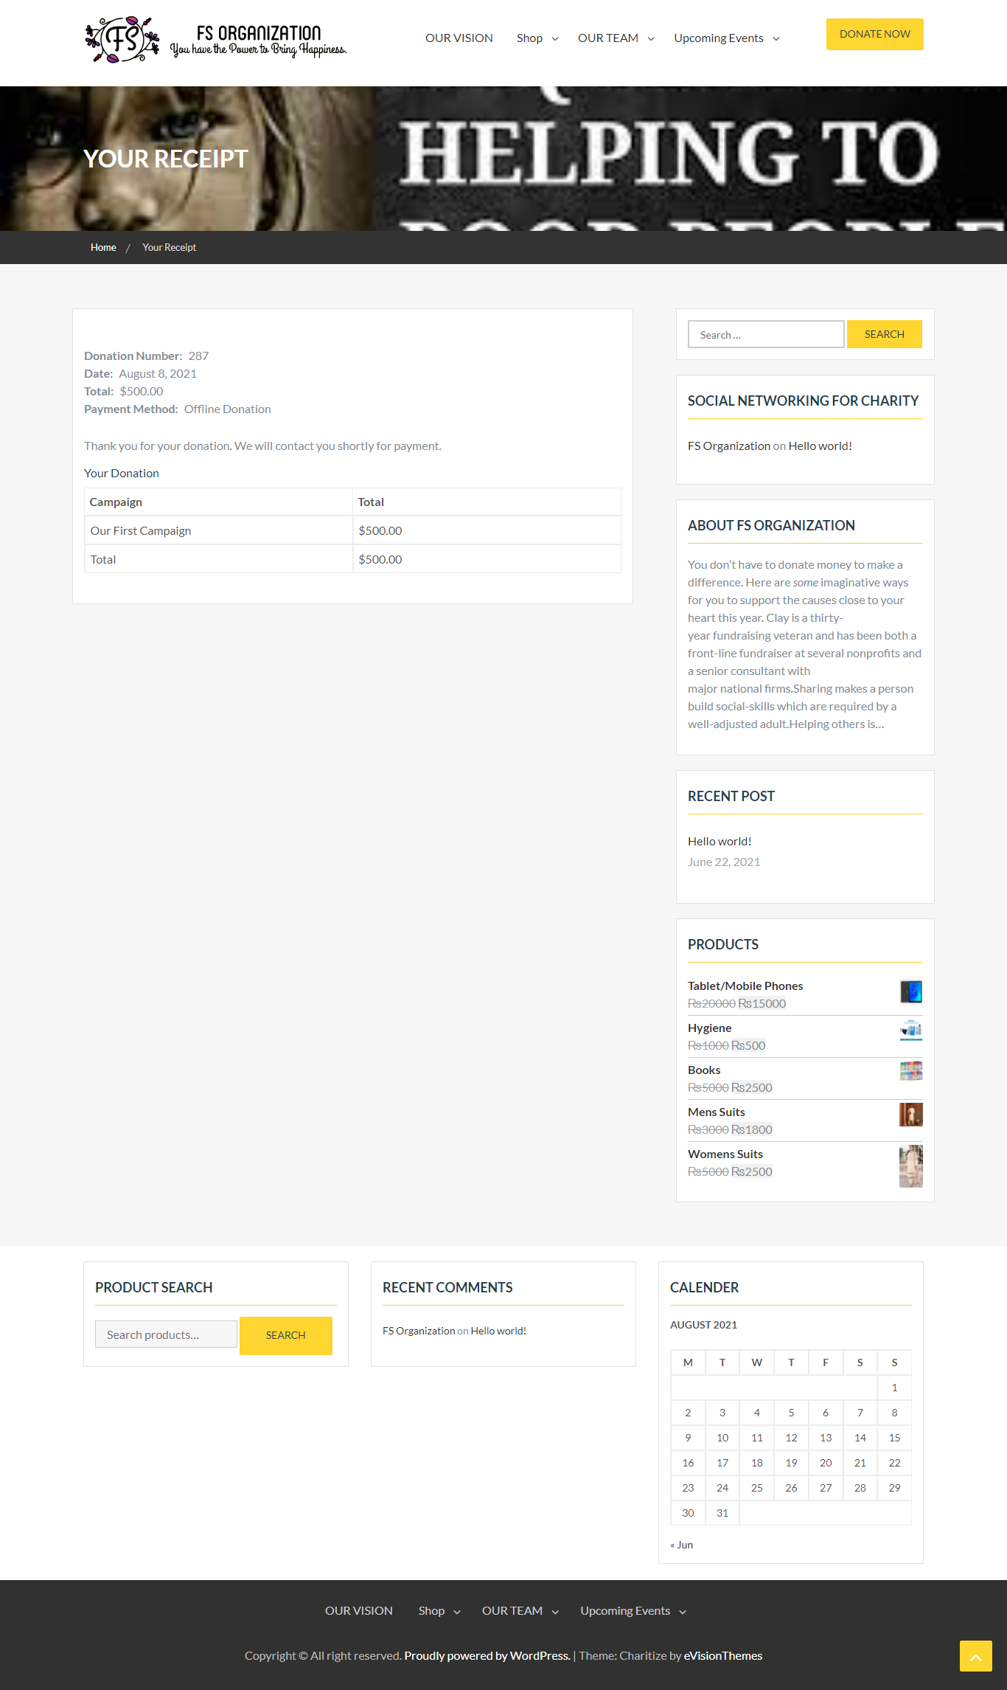
DONATION RECEIPT

Slide 16
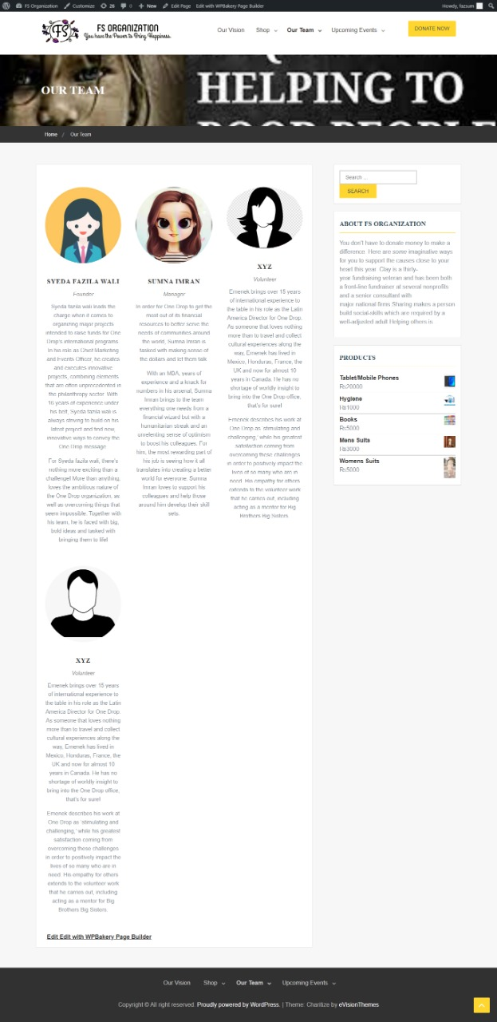
OUR TEAM

Slide 17
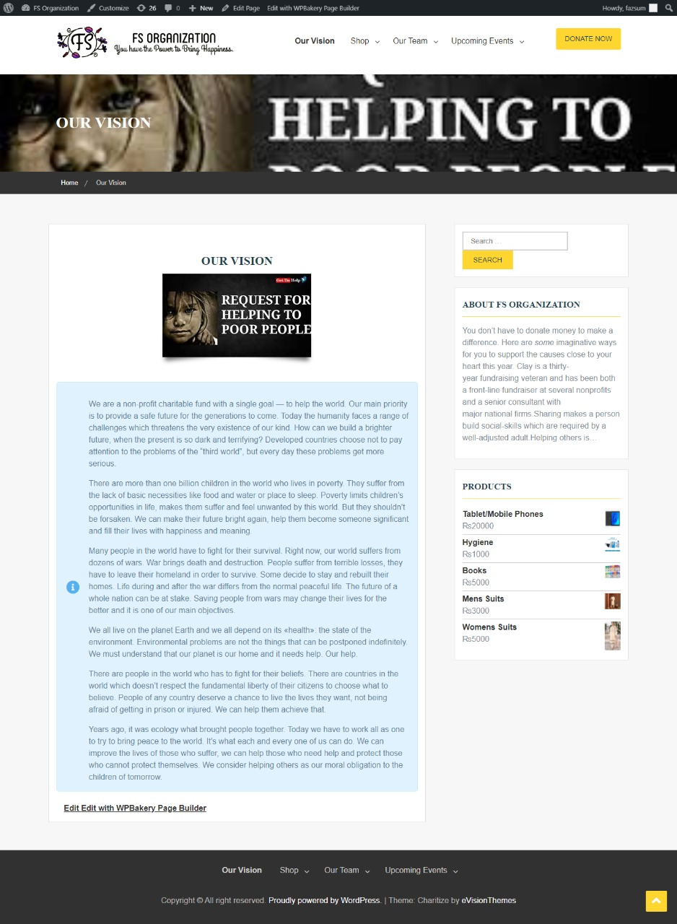
OUR VISION

Slide 18
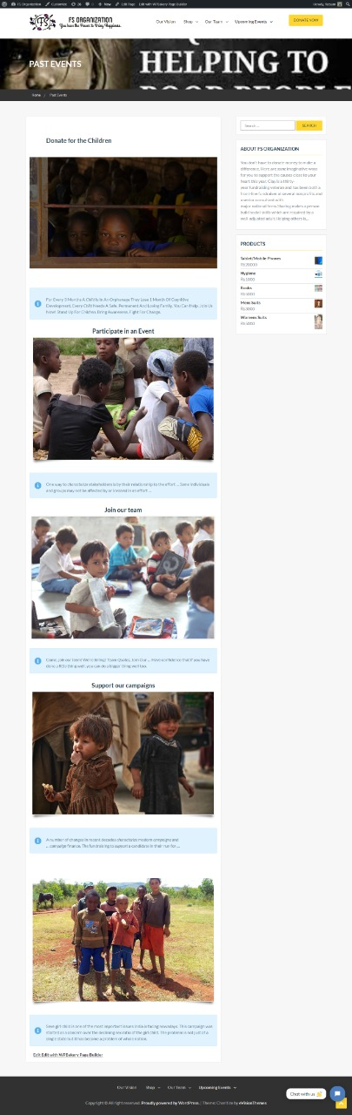
PAST EVENTS

Slide 19
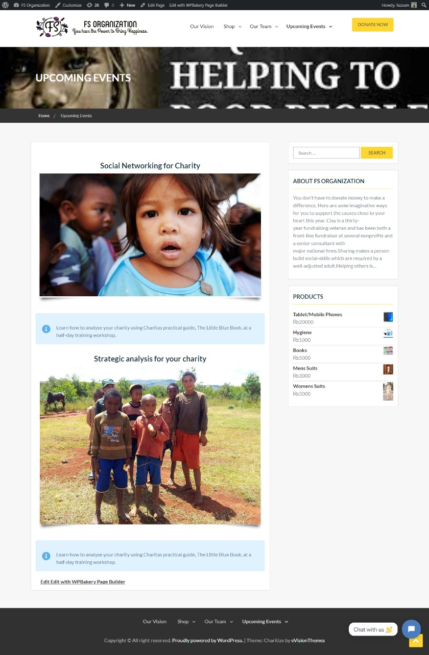
UP COMING EVENTS

Slide 20
EDUCATION

Slide 21

HUMAN SERVICES

Slide 22
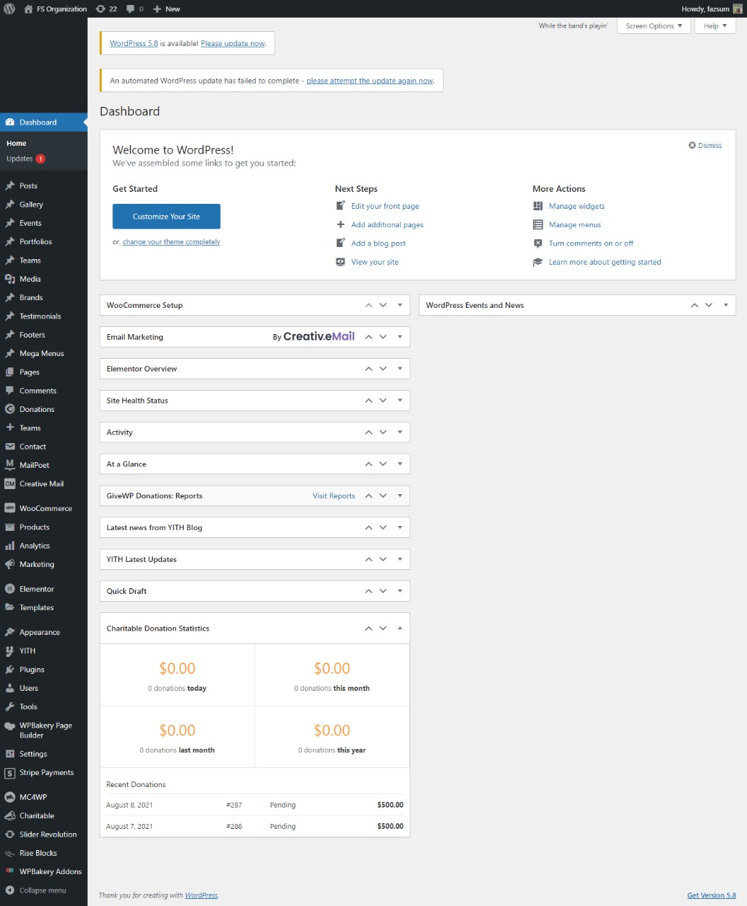
ADMIN PANEL

Slide 23
THE END
THANK YOU FOR YOUR ATTENTION!

