Slide 1









AWS Cloud
AWS Organizations
Current and new AWS accounts
Security Tooling account
Lambda functions: integration
Amazon GuardDuty
CloudWatch
Collector and sources
Org Management account
Log Archive account
Apps
AWS CloudTrail
Amazon S3
Amazon SNS

Slide 2



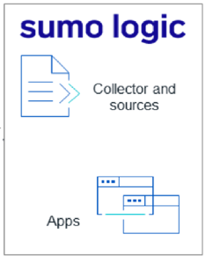






Diagram draft 2
AWS Cloud
AWS Organization
Region-1
Current new accounts
Region-1
Region-n
Security Tooling Account
Region-n
Integration
Amazon GuardDuty
Amazon
CloudWatch
Lambda function
User
Management Account
Log Archival Account
Organizational
CloudTrail
Amazon S3 Buckets
Amazon SNS

Slide 3




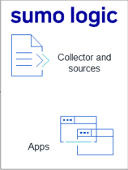





Diagram draft 1
AWS Cloud
Integration
Amazon Guard Duty
Amazon
CloudWatch
AWS Lambda function
Amazon S3 Buckets
AWS CloudFormation template
Amazon
CloudTrail
Amazon S3 Delivery Bucket
Amazon SNS

Slide 4
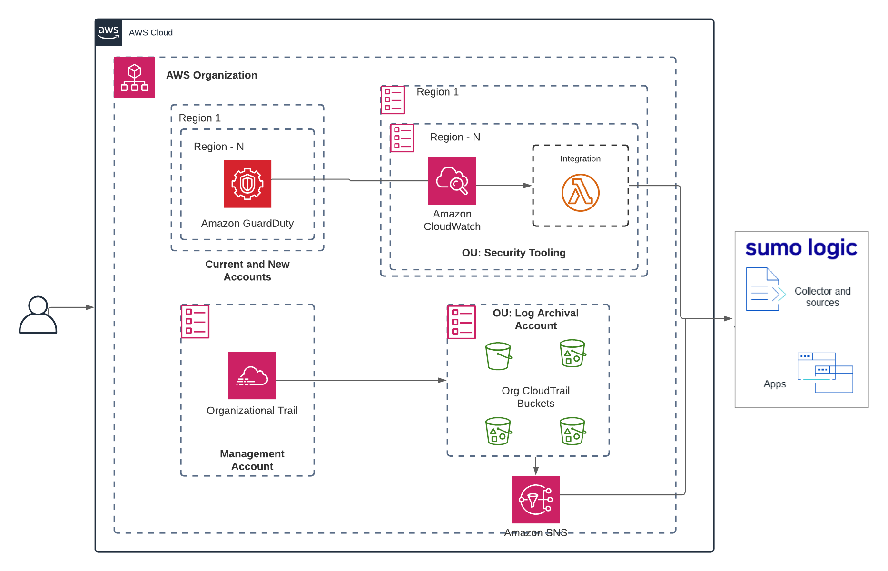
architecture_bckup.png from the SIEM repo 11/16/2021

