Slide 1
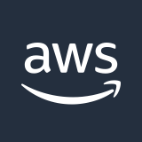







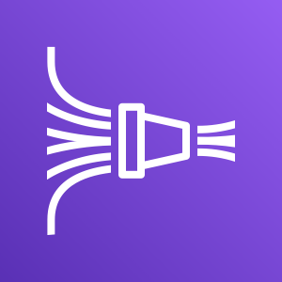


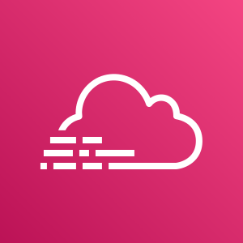
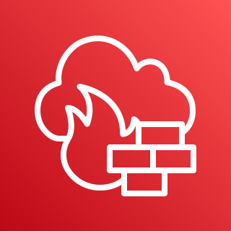

AWS Cloud
Amazon GuardDuty
Amazon VPC flow logs
Amazon CloudWatch
Lambda functions: integration
AWS Security Hub
Amazon CloudWatch
Collector and sources
AWS WAF
Amazon Kinesis
Data Firehose
Apps
AWS Config
Amazon S3
AWS CloudTrail
AWS Network Firewall
Amazon SNS

