Slide 1





Meta Ad Performance Dashboard
Power BI Dashboard Analysis
By – Sumon Kundu

Slide 2
Presentation Flow
01
Introduction
02
Objective
03
Dataset Summary
Meta ads & purpose of the dashboard
Business problem the report solves
Tables, key fields & data model
04
KPI Overview
05
Dashboard Insights
06
Recommendations & Conclusion
12 KPIs & funnel snapshot
Audience, geography, time, ad types, platforms
Business actions & final wrap-up
Meta Ad Performance Dashboard | Sumon Kundu

Slide 3
Objective of the Project
A performance tracking report for paid ad campaigns on Facebook and Instagram, giving visibility into reach, engagement, conversions and budget utilization.
01
02
03
04
05
Find the best platform
Track ROI & budget
Know the audience
Analyze the funnel
Visualize KPIs
Facebook vs Instagram
Optimize budget allocation
Engagement by gender, age, country
Impressions → Clicks → Purchases
For faster business decisions
In Scope
Out of Scope
Paid ad campaigns on Facebook and Instagram only
Other platforms (Messenger, Audience Network)
Organic engagement – only paid ads
Meta Ad Performance Dashboard | Sumon Kundu

Slide 4
Dataset Overview & Data Model
Meta Ads performance data covering campaigns, ads, user demographics and ad interaction events, modelled on how Facebook/Instagram capture data – organized as a star schema.
campaigns
Dimension
ads
Dimension
ad_events
FACT TABLE
users
Dimension
campaign_id
name
start_date, end_date
duration_days
total_budget
ad_id, campaign_id
ad_platform
ad_type
target_gender
target_age_group
target_interests
event_id, ad_id, user_id
timestamp
day_of_week
time_of_day
event_type: Impression, Click, Share, Comment, Purchase
user_id
user_gender, user_age
age_group
country, location
interests
campaigns → ads → ad_events ← users | Fact table: ad_events | Dimensions: ads, campaigns, users
Meta Ad Performance Dashboard | Sumon Kundu

Slide 5
Key KPIs Analyzed
KPI | Formula | Used For
Impressions | Count of event_type = Impression | Measure reach
Clicks | Count of event_type = Click | Engagement intent
Shares | Count of event_type = Share | Viral engagement
Comments | Count of event_type = Comment | Sentiment & feedback
Purchases | Count of event_type = Purchase | Conversions
Engagements | Clicks + Shares + Comments | Engagement volume
CTR | (Clicks ÷ Impressions) × 100 | Ad effectiveness
Engagement Rate | (Engagements ÷ Impressions) × 100 | Overall ad appeal
Conversion Rate | (Purchases ÷ Clicks) × 100 | Funnel efficiency
Purchase Rate | (Purchases ÷ Impressions) × 100 | Conversion from reach
Total Budget | Sum of campaigns.total_budget | Cost analysis
Avg Budget / Campaign | Total Budget ÷ Campaign Count | Budget distribution
Meta Ad Performance Dashboard | Sumon Kundu

Slide 6
KPI Performance Snapshot
Source: Facebook page of the dashboard
Impressions
Clicks
Shares
Comments
Purchases
Engagements
216.0K
25.4K
1.3K
2.6K
1.3K
29K
CTR
Engagement Rate
Conversion Rate
Purchase Rate
Total Budget
Avg Budget/Camp.
11.76%
13.56%
5.21%
0.61%
2.5M
50.7K
Strong top of funnel
Weak purchases
Budget
CTR 11.76%, engagement rate 13.56%
Well above the ~1–2% industry CTR
Purchase rate only 0.61%
Just 1.3K purchases from 216K impressions
2.5M total budget
50.7K average per campaign – multiple campaigns
Meta Ad Performance Dashboard | Sumon Kundu

Slide 7
Conversion Funnel
Source: Facebook page of the dashboard
Insight
Impressions 216K
Strong awareness & interest, but weak purchase action
Sharp drop-off in the lower funnel
▼ CTR 11.76%
Clicks 25.4K
Interpretation
The funnel leaks: likely landing page, audience mismatch or weak offers
▼ Conversion rate 5.21% of clicks
Purchases 1.3K
Business Impact
Purchase rate: 0.61% of impressions
Optimize landing pages, offers and retargeting
Meta Ad Performance Dashboard | Sumon Kundu

Slide 8
Audience by Gender
Source: Facebook page of the dashboard
Insight
Female-targeted ads: 13K (43%) – highest
Male-targeted ads: 6K (22%)
All-gender ads: 10K (35%)
Interpretation
Ads targeted at women drive the most engagement – core audience skews young and female
Business Impact
Tailor creatives and campaigns toward female audiences
Meta Ad Performance Dashboard | Sumon Kundu

Slide 9
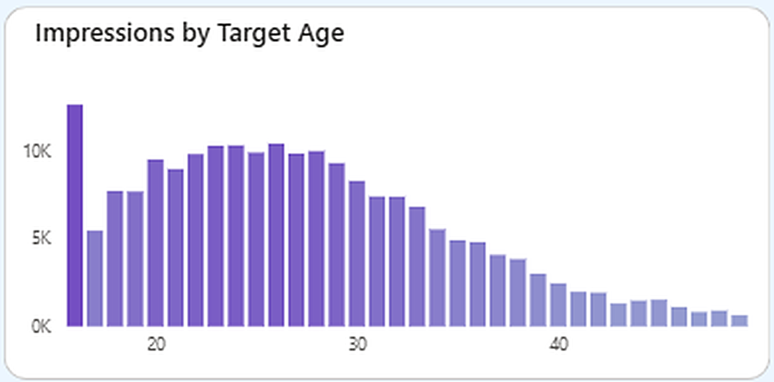
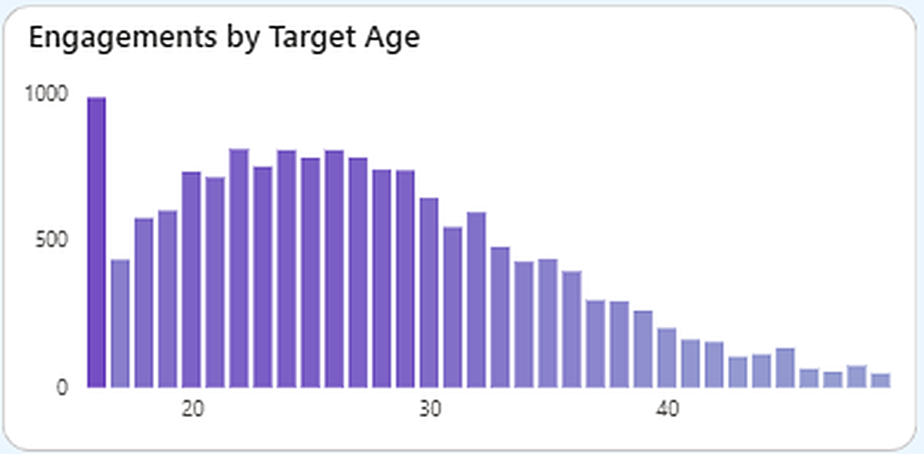
Audience by Target Age
Facebook page | Impressions measure
Insight
Activity concentrated in ages ~18–30
Drops significantly after 35+
Interpretation
Primary audience = young adults
The youngest age group has the tallest bar; impressions stay high through the 20s and taper steadily after ~30.
Business Impact
Target ads at females aged 18–30 for better ROI
Meta Ad Performance Dashboard | Sumon Kundu

Slide 10
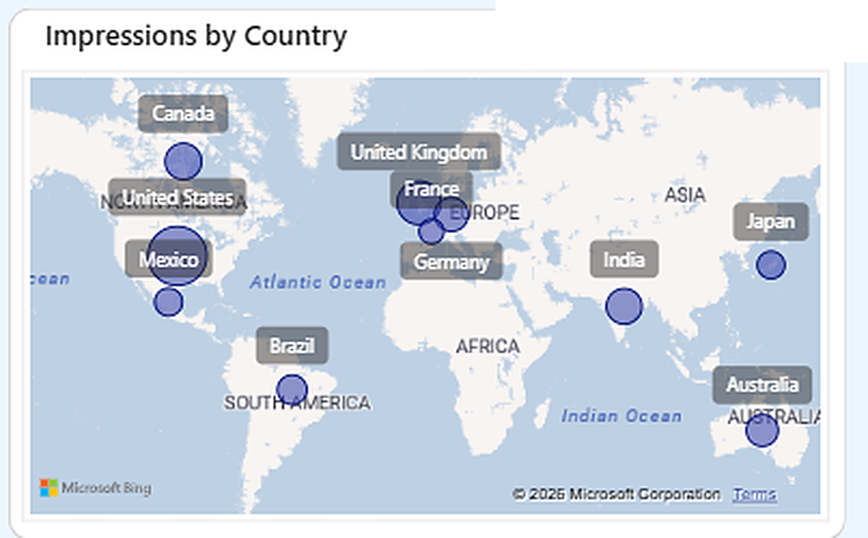
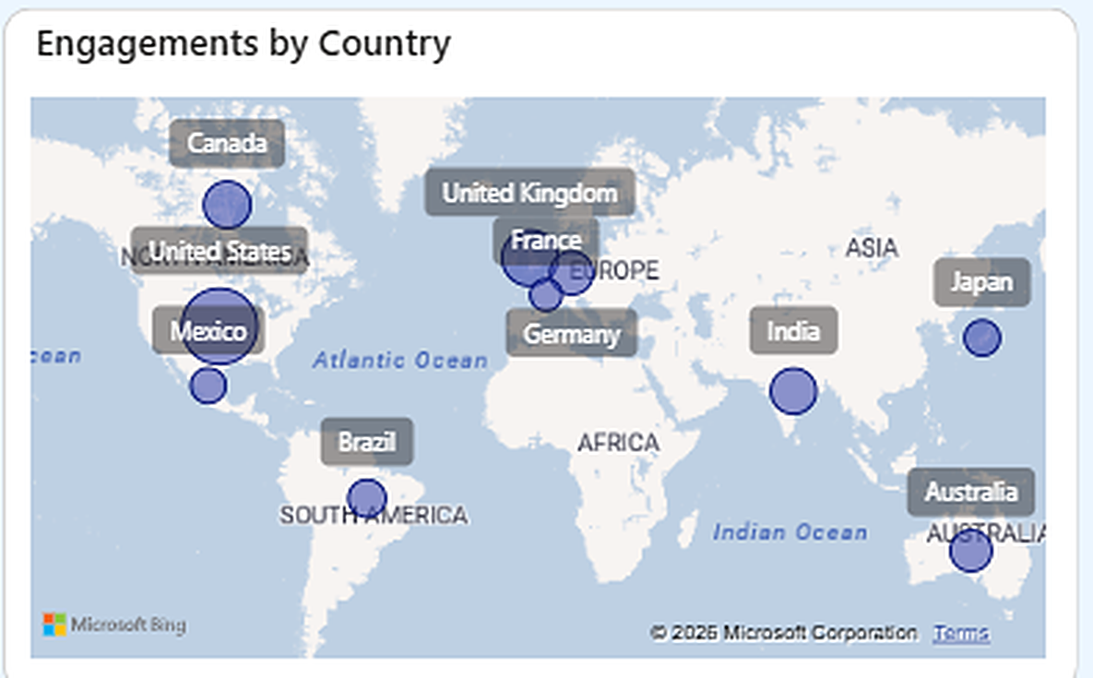
Geographic Distribution
Facebook page | Impressions measure
Insight
Reach spans 10 countries in 5 regions
Largest bubbles: North America (US/Mexico) and Europe; India leads in Asia
Interpretation
Impressions concentrate in North America & Europe; Germany/UK likely offer higher purchasing power
Business Impact
Bubble size shows the selected measure (Impressions).
Volume campaigns in India & US; premium campaigns in Germany/UK
Meta Ad Performance Dashboard | Sumon Kundu

Slide 11
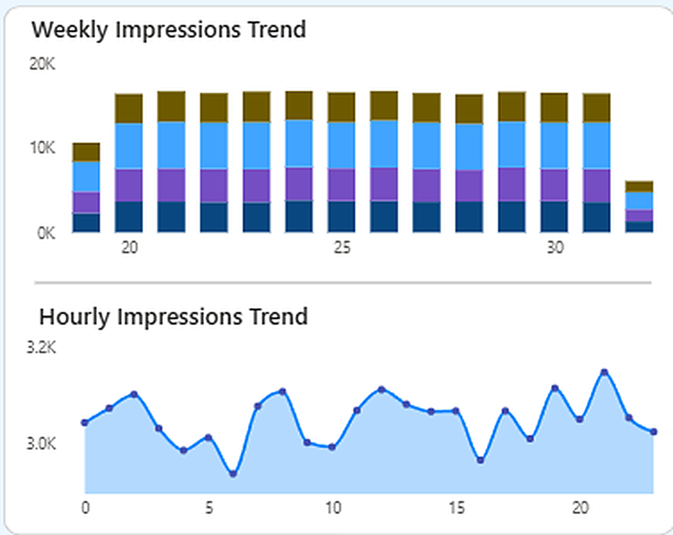
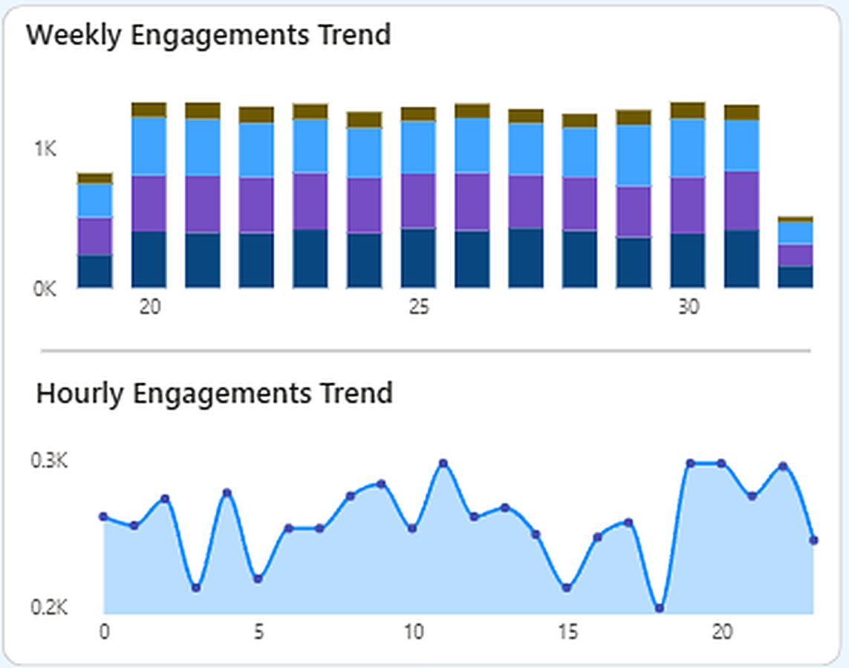
Weekly & Hourly Trends
Facebook page | Impressions measure
Insight
Weekly: steady at ~16K, no sharp drop (first and last bars are partial weeks)
Hourly: highest peak at ~21 h; dips at ~6 h and ~16 h; swings stay small
Interpretation
Steady weekly volume shows consistent delivery; hourly swings are small
Business Impact
Weight delivery toward the evening peak (~19–21 h) and midday (~12 h)
Meta Ad Performance Dashboard | Sumon Kundu

Slide 12
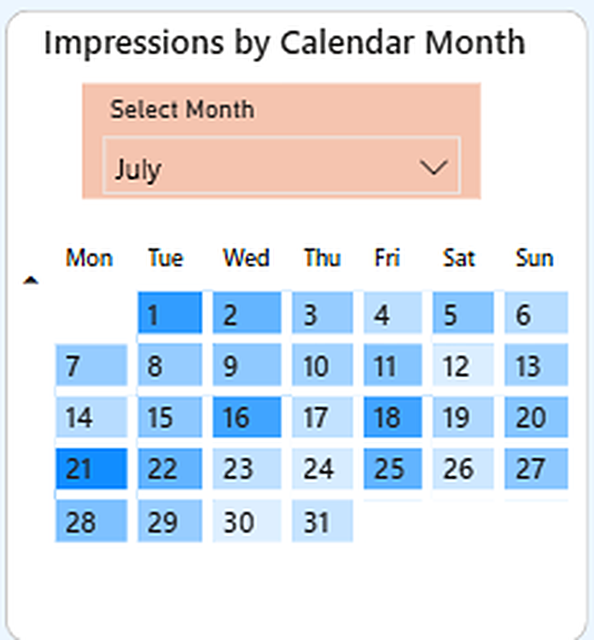
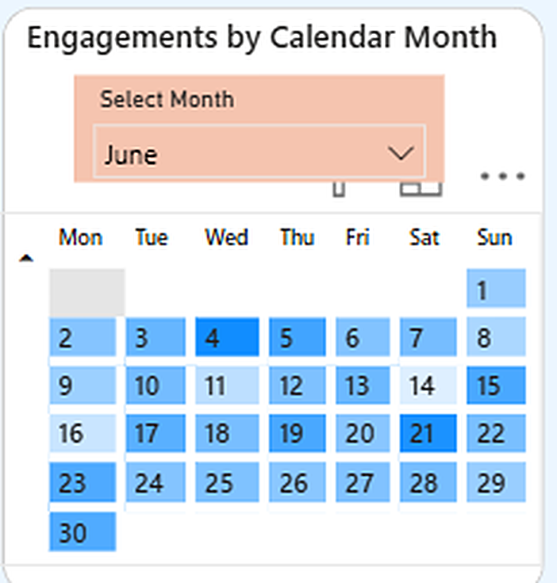
Calendar View – Seasonality
Facebook page | Impressions measure | July
Insight
Darker days = higher activity
Darkest day: 21st; also strong on 1st, 16th, 18th, 22nd, 25th
Interpretation
Activity peaks on specific days – possibly launches or promotions
Business Impact
Plan event-based campaigns and promotions around peak days
Meta Ad Performance Dashboard | Sumon Kundu

Slide 13
Ad Type Performance – Facebook
Ad Type | Impr. | Clicks | CTR | Purch. Rate | Conv. Rate | Eng. Rate
Carousel | 48K | 6K | 11.7% | 0.59% | 5.1% | 13.4%
Image | 51K | 6K | 11.7% | 0.57% | 4.9% | 13.5%
Stories | 72K | 8K | 11.8% | 0.65% | 5.5% | 13.6%
Video | 46K | 5K | 11.9% | 0.62% | 5.2% | 13.7%
Insight
Video: top CTR (11.9%) & engagement rate (13.7%)
Stories: most impressions (72K), best purchase rate (0.65%) & conversion (5.5%)
Interpretation
All formats sit in a narrow band (CTR 11.7–11.9%); Image & Carousel convert slightly lower
Business Impact
Focus budget on Video & Stories for better ROI
Meta Ad Performance Dashboard | Sumon Kundu

Slide 14
Ad Type Performance – Instagram
Ad Type | Impr. | Clicks | CTR | Purch. Rate | Conv. Rate | Eng. Rate
Carousel | 39K | 5K | 11.7% | 0.61% | 5.2% | 13.5%
Image | 37K | 5K | 12.2% | 0.53% | 4.3% | 13.9%
Stories | 37K | 4K | 11.7% | 0.59% | 5.0% | 13.4%
Video | 10K | 1K | 12.0% | 0.53% | 4.4% | 13.7%
Insight
Image: best CTR 12.2%, ER 13.9%
Carousel: best purchase rate 0.61%, conversion 5.2%
Video: only 10K impressions
Interpretation
Format ranking differs by page; Video rates rest on a small base (1K clicks)
Business Impact
Check format spend per platform before shifting budget
Meta Ad Performance Dashboard | Sumon Kundu

Slide 15
Instagram View vs Facebook
Insight
Instagram: 123.8K impressions vs 216.0K on Facebook; 708 purchases vs 1.3K
CTR 11.86% and ER 13.60% slightly above Facebook
Interpretation
Instagram attracts attention well but converts less: 4.82% vs 5.21%
Business Impact
Improve Instagram landing pages & offers to turn engagement into purchases
Meta Ad Performance Dashboard | Sumon Kundu

Slide 16
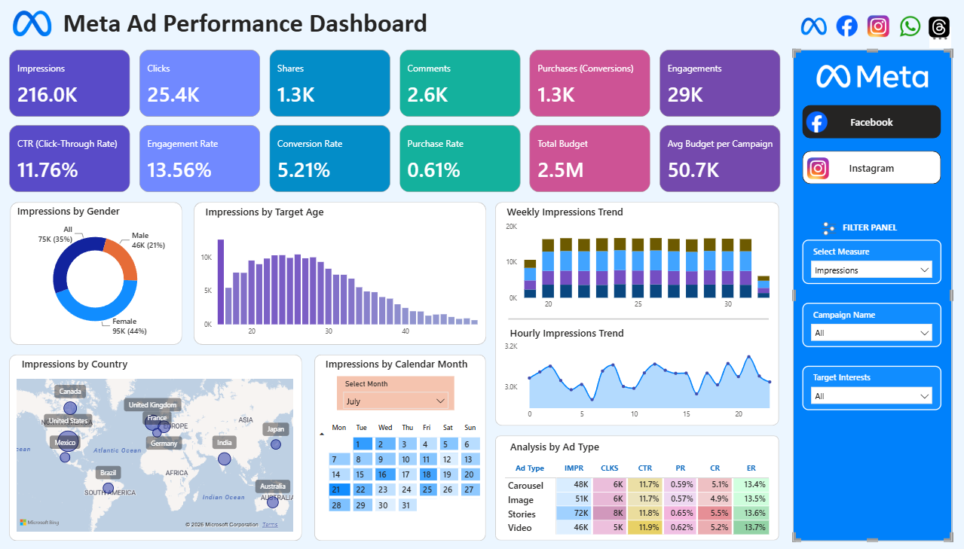
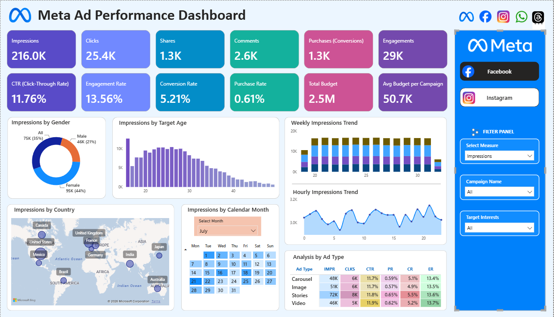
Final Dashboard – Facebook Page
Page Features
12 KPI cards at the top
7 visuals: gender donut, age bars, country map, calendar heat map, weekly columns, hourly area, ad-type matrix
Filter panel: Select Measure, Campaign, Interests
Measure shown: Impressions; calendar: July
Meta Ad Performance Dashboard | Sumon Kundu

Slide 17
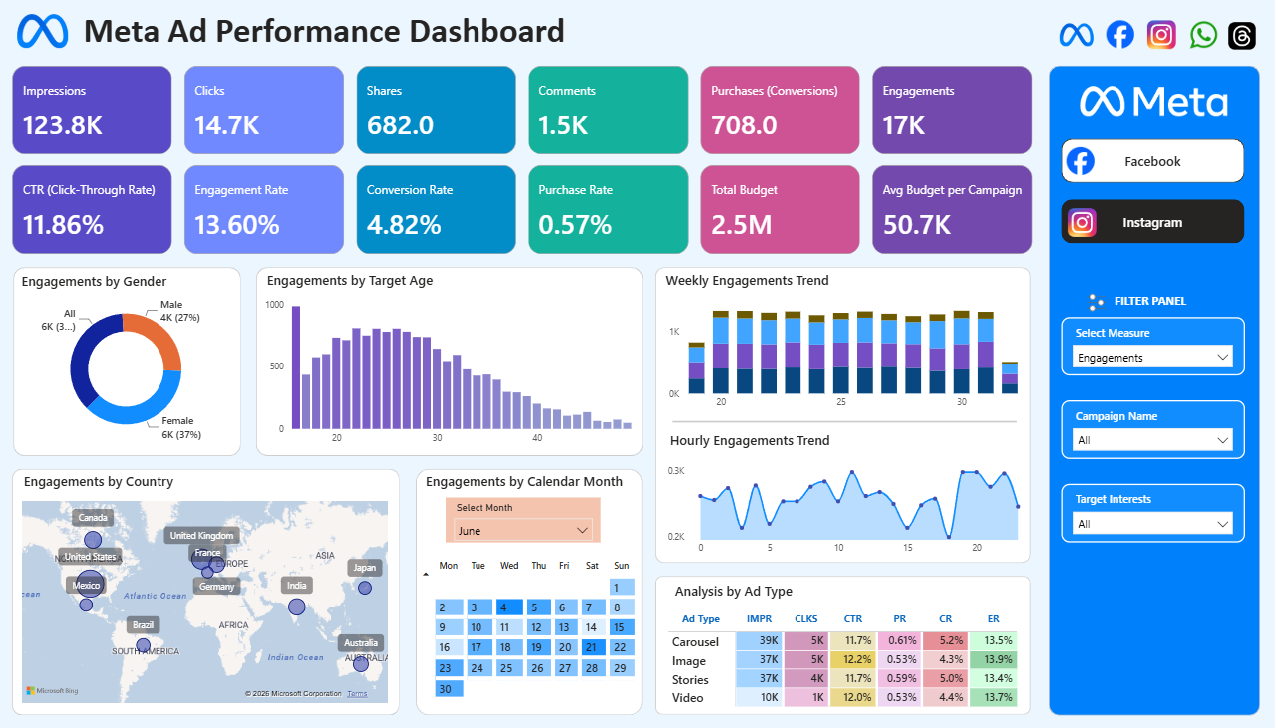
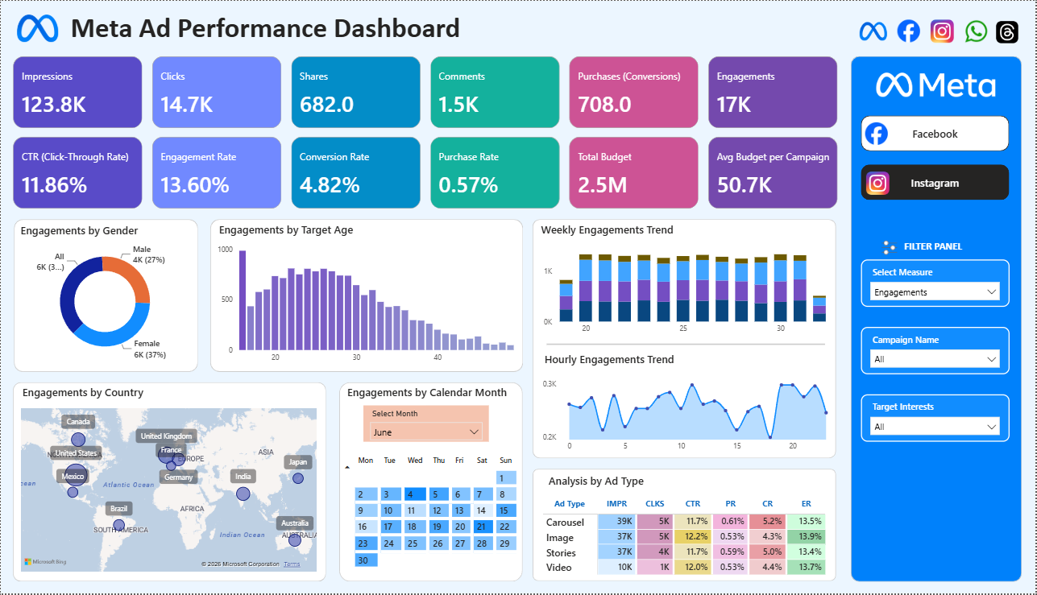
Final Dashboard – Instagram Page
Page Highlights
Same layout, filtered to Instagram
Select Measure = Engagements
123.8K impressions, 14.7K clicks, 17K engagements
Calendar shows June
Meta Ad Performance Dashboard | Sumon Kundu

Slide 18
Key Insights
Awareness & engagement
Purchase funnel leaks
Audience
CTR 11.76% and engagement rate 13.56% – creatives and targeting work at the top of the funnel.
Purchase rate only 0.61%; 1.3K purchases from 216K impressions.
Female-targeted ads drive the most engagement (43%); activity is concentrated in ages ~18–30.
Geography
Timing
Ad formats
Largest reach in North America & Europe; India leads in Asia; Germany/UK suit premium campaigns.
Hourly peak at ~21 h; some days (e.g., 21st) stand out on the calendar.
Video leads CTR (11.9%) and ER (13.7%); Stories lead conversion (5.5%).
Meta Ad Performance Dashboard | Sumon Kundu

Slide 19
Business Recommendations
Fix the purchase funnel
Improve landing pages, offers & retargeting to lift purchase rate.
Refine the audience
Target females aged 18–30, especially in India & the US.
1
2
Shift budget to top formats
Increase spend on Video and Stories ads.
Schedule smartly
Run ads in midday & evening slots (peak ~21 h).
3
4
Segment by geography
Volume in India & US; premium in Germany/UK.
Use event-based campaigns
Plan promotions around peak days.
5
6
Conclusion: strong awareness & engagement – next win is conversion optimization and retargeting.
Meta Ad Performance Dashboard | Sumon Kundu

Slide 20
Thank You
Meta Ad Performance Dashboard | Sumon Kundu

