Slide 1
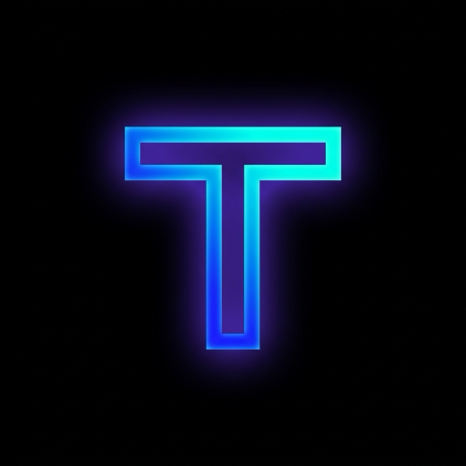
THREAD
The Autonomous Ambient Meeting Intelligence Engine
Silent Cloud VM · Multimodal Gemini Vision · Dynamic Island · 1-Tap Staged Action Execution
ENTERPRISE READY
SOC2 & 2-Party Consent Compliant
CROSS-PLATFORM
iOS Native + Web Companion + VM
GEMINI 2.0 VISION
Real-Time QR & Slide OCR

Slide 2
MARKET OPPORTUNITY & USER PAIN
Why 95% of AI Meeting Tools Fail Knowledge Workers
Meetings have become high-friction black holes where critical context, links, and action items vanish.
31.2 HOURS PER MONTH ARE WASTED IN BACK-TO-BACK MEETINGS.
73% of commitments, deadlines, and follow-up emails are delayed or forgotten within 24 hours of call completion.
1. INTRUSIVE BOT FRICTION
2. PASSIVE TEXT WALLS
3. ACTION ITEM AMNESIA
Traditional bots ('Otter.ai Bot has entered the room') are socially awkward, intrusive, and frequently blocked by enterprise IT firewalls.
• Distracts attendees & requires explicit manual inviting
• Fails in enterprise security domains
• Awkward for high-stakes recruiting & leadership calls
Legacy tools spit out 20-page unstructured transcripts nobody ever reads. They miss all visual cues and presentation slides.
• Blind to screen shares, slide QR codes, and forms
• No distinction between fluff and decisive moments
• Forces users to re-read hours of text after working
Notes are useless without execution. Knowledge workers still have to manually draft emails, add calendar events, and submit application forms.
• Zero automation for scheduling spoken deadlines
• No instant drafting of follow-up emails
• Commuters & mobile workers miss live meeting polls

Slide 3
THE BREAKTHROUGH SOLUTION
Thread: Ambient, Autonomous, Actionable
A fundamentally new paradigm: An autonomous cloud agent that attends, extracts multimodal intelligence, and executes actions.
1. SILENT CLOUD VIRTUAL MACHINE (VM)
2. MULTIMODAL GEMINI 2.0 VISION
Thread runs on a dedicated headless Cloud VM authenticated via your Google Workspace and Zoom credentials.
✓ Zero external bot joining your call
✓ Automatically joins on your behalf from your calendar
✓ Full control over meeting audio, chat, and slides
While other tools only listen to audio, Thread watches presentation screen shares with sub-second computer vision.
✓ Real-time slide OCR & bullet point summarization
✓ Instant QR code detection and link resolution
✓ Auto-detects application forms, portals, and deadlines
3. GLANCEABLE DYNAMIC ISLAND & LIVE ACTIVITIES
4. HUMAN-IN-THE-LOOP ACTION STAGING
The entire meeting condensed into 3-word glanceable updates streamed directly to Apple's Dynamic Island and Lock Screen.
✓ Know who is speaking and what is decided without looking
✓ Live audio waveform indicator
✓ Instant notification when actions require approval
AI autonomy with total human safety. Thread drafts the action, you approve with 1 tap or hands-free voice command.
✓ Drafted follow-up emails to exact speakers
✓ Spoken deadlines scheduled to Google Calendar
✓ 1-Tap / Voice 'Just Send It' approval

Slide 4
ENGINEERING & SYSTEMS
End-to-End System Architecture
A high-performance pipeline spanning headless cloud browser automation, multimodal inference, and real-time Apple clients.
LAYER 1: AMBIENT INGESTION
Cloud VM Chromium Worker (Headless Meet / Zoom) · In-Room Mic (Consent Guarded) · Chrome Extension
LAYER 2: MULTIMODAL INTELLIGENCE
Gemini 2.0 Flash Vision (QR / Slide OCR) · Whisper Diarization (Speaker ID) · Semantic Classifier (5 Moment Types)
LAYER 3: AGENTIC ACTION DISPATCH
Google Calendar API (Stage Deadlines) · Gmail API (Send Follow-Ups) · Form Auto-Fill Engine · Poll Auto-Voter
LAYER 4: CROSS-SURFACE COCKPITS
Native iOS Swift Cockpit · Apple Dynamic Island / Live Activity · Narrow Zoom Side-Panel · Driving Mode Voice HUD

Slide 5
CORE INNOVATION
The Silent Cloud Virtual Machine (VM)
No awkward third-party bots. Thread joins meetings natively as you, running in a headless secure cloud container.
✦ Autonomous Calendar Monitoring
Thread polls Google Calendar in the background. When an upcoming meeting is detected 5–10 minutes prior, it sends an actionable push notification: 'Join with Thread'.
✦ Headless Chromium Execution
A dedicated cloud worker spawns a lightweight headless Chromium container. It logs in with authorized session cookies, enters the waiting room, and joins silently.
✦ Dual Attendance Flexibility
The user can join on their phone or laptop as usual — Thread works quietly alongside as an invisible AI co-pilot. Or the user can skip the call entirely and let Thread represent them.
✦ VM Remote Meeting Control
Thread provides native iOS control buttons (Mute, Raise Hand, Reaction, Chat, Leave) that send lightweight WebSocket commands directly to the VM.
ENTERPRISE SECURITY & PRIVACY
🔒 Zero Credential Leaks
Tokens stored in encrypted enclave; VM destroys session state on meeting end.
⚡ Sub-100ms Command Latency
Mute and Raise Hand commands reach Zoom/Meet via fast WebSocket RPC.
🛡 Two-Party Consent Enforced
Microphone transcription strictly adheres to state and federal wiretapping consent rules.

Slide 6
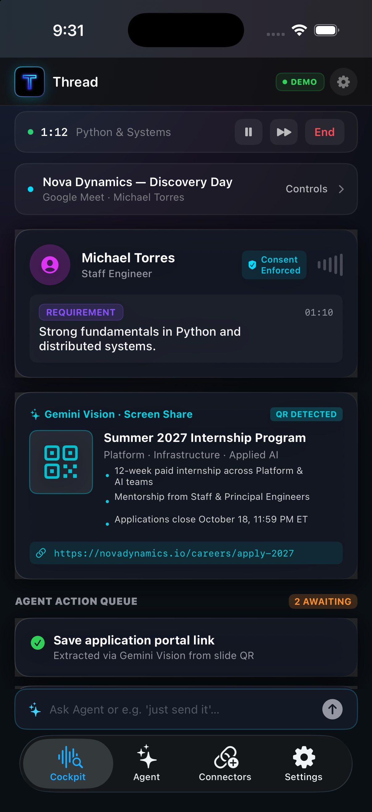
MULTIMODAL AI IN ACTION
Gemini 2.0 Vision: Real-Time Slide & QR Extraction
Audio is only half the meeting. Thread's vision pipeline decodes presentation slides, URLs, and QR codes live.
REAL-TIME VISION PIPELINE
1. Screen Share Frame Sampling
The VM captures keyframe diffs whenever a presenter advances slides, avoiding redundant token spend.
2. Sub-Second QR Code Decoding
Built-in computer vision decodes slide QR codes instantly, resolving application portals, feedback forms, and slide decks.
3. Autonomous Form Auto-Fill
From slide QR code to completed job application or survey in 1 tap, automatically mapping your pre-stored resume and profile.

Slide 7
ACTION EXECUTION
Human-in-the-Loop: Staged, Not Spammed
Autonomous AI with zero hallucination risk. Thread stages high-value actions for simple 1-tap user confirmation.
✉️ SMART EMAILS
📅 CALENDAR SYNC
📊 LIVE POLLS
📝 FORM AUTO-FILL
Context-Rich Drafts
• Detects requests: 'Sarah, can you send over the deck?'
• Pre-addresses email to sarah.chen@novadynamics.io
• Drafts polite executive summary
• Dispatches via Gmail OAuth on 1 tap
Spoken Deadlines
• Identifies exact dates: 'Applications close October 18'
• Calculates start and end timestamps automatically
• Populates Google Calendar with meeting notes and links
• Prevents missed recruiting and project milestones
Automated Voting
• Detects in-meeting Zoom / Meet pop-up polls
• Understands user sentiment & previous preferences
• Stages optimal option selection
• Casts vote autonomously or prompts user
1-Tap Applications
• Extracts application form link from slide QR code
• Parses candidate form fields (Name, Email, Resume)
• Pre-populates fields with zero typos
• Submits form directly on user confirmation

Slide 8
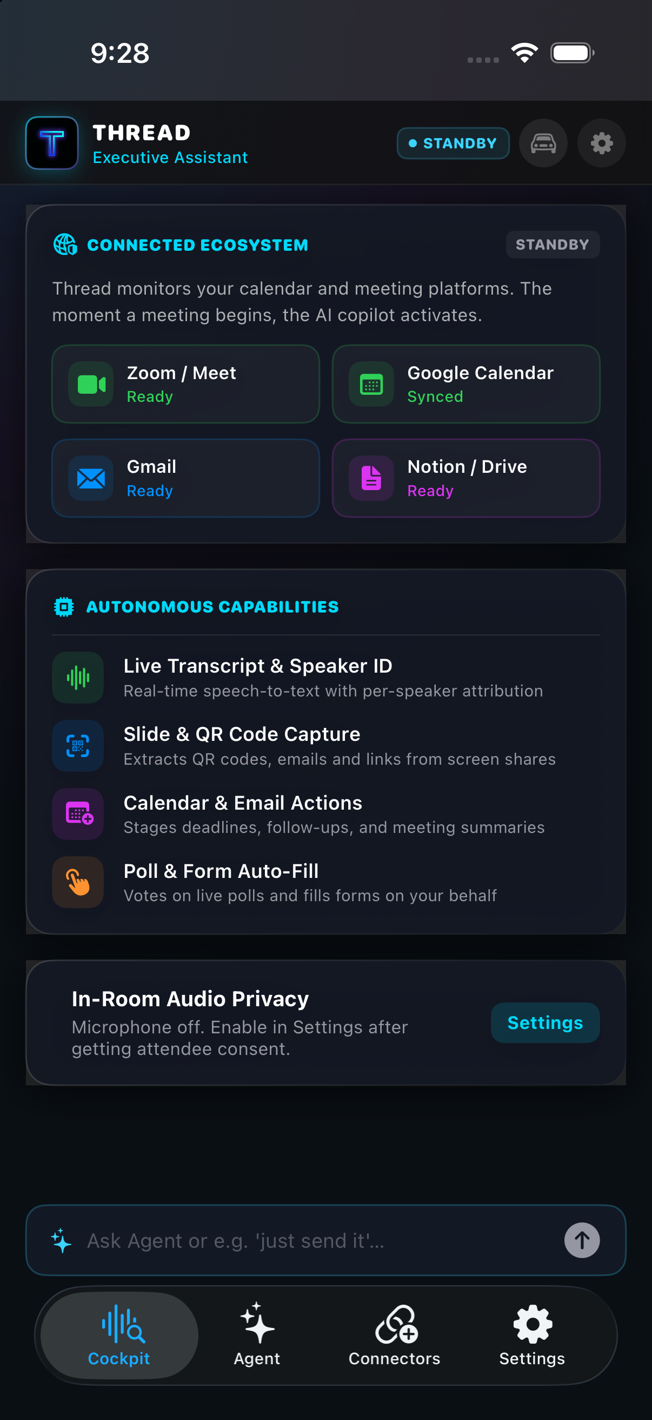
MOBILE FIRST CRAFTSMANSHIP
Native iOS Cockpit: Minimalist & Production-Grade
Engineered in Swift with SwiftUI and ActivityKit for fluid 120Hz responsiveness.
HOMESCREEN ARCHITECTURE
✦ Executive Standby Dashboard
Balanced 2x2 Connected Ecosystem showing Zoom, Meet, Google Calendar, and Gmail sync status at a single glance.
✦ Customizable Home Density
Users toggle between 'Minimal' (single quiet connector line) and 'Standard' (full autonomous capabilities overview) in Settings.
✦ Integrated VM Meeting Controls
Mute, Raise Hand, Send Reactions, and chat directly in the active Zoom/Meet session via native iOS buttons.
✦ Agent Command Pill
Natural language input with instant speech recognition. Command: 'Just send it' immediately approves and dispatches all pending staged drafts.

Slide 9
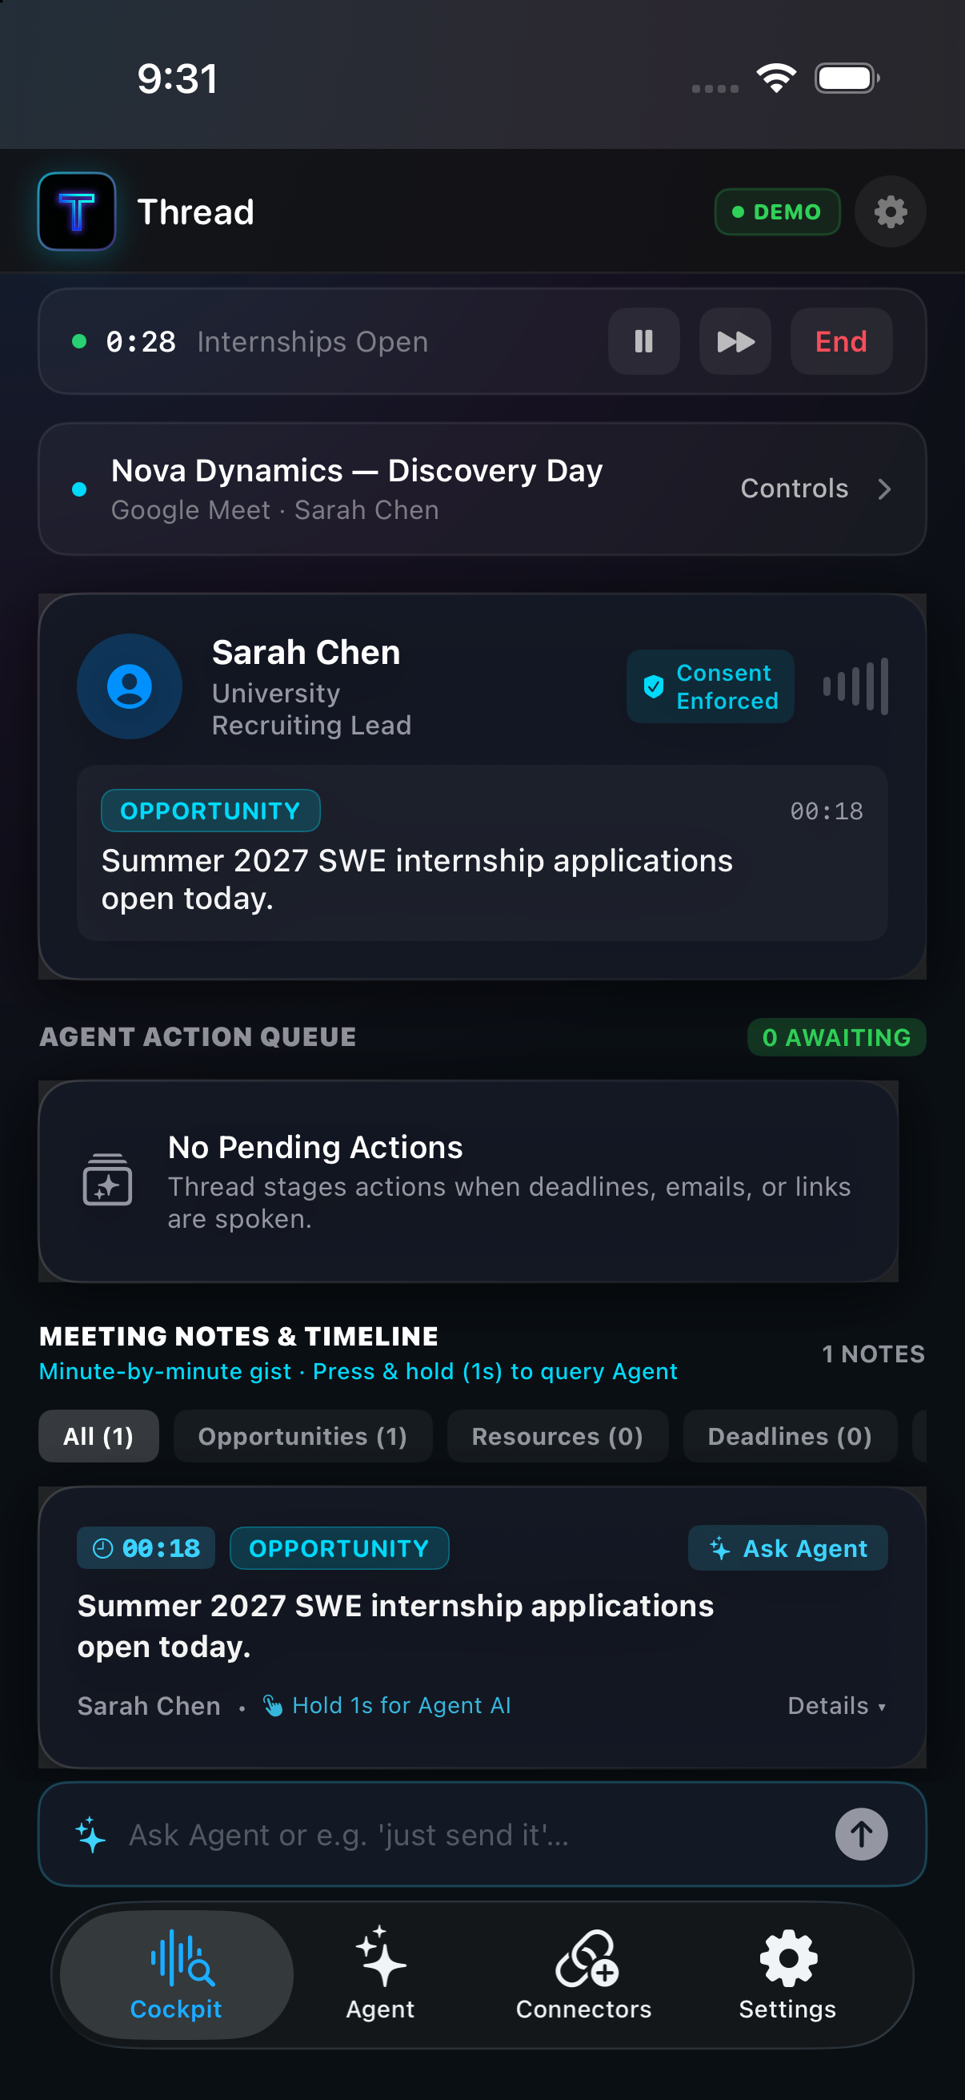
APPLE PLATFORM EXCELLENCE
Glanceable Intelligence: Dynamic Island & Live Activities
Meeting intelligence without unlocking your phone. Live Activity attributes stream real-time updates directly to iOS hardware.
DYNAMIC ISLAND CAPABILITIES
✦ 3-Word Live Gist
Dynamic Island pill renders ultra-compact takeaways (e.g. 'Internships Open', 'Python & Systems') updated every time speaker context shifts.
✦ Active Speaker & Diarization
See who is talking right now and their role with live audio equalizer bars.
✦ 1-Tap Deep Link Approvals
When an action is staged, the Dynamic Island expands to show an 'Approve' action that routes directly through URL schemes without app switching.
✦ Lock Screen Persistent Widget
Displays full meeting title, speaker initials, elapsed meeting clock, and real-time take-aways.

Slide 10
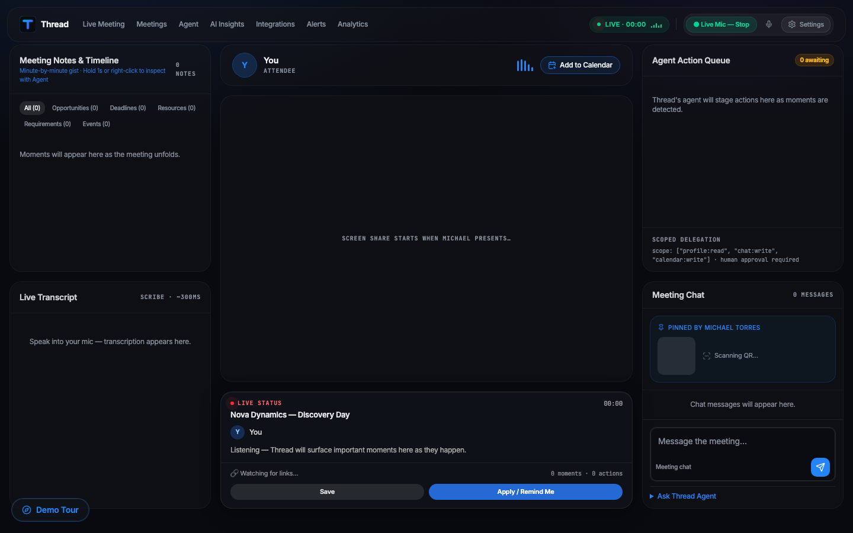
DESKTOP EXPERIENCE
Web Companion & Meeting Side-Panel
Designed to sit beside Zoom or Google Meet without obstructing your video call interface.
DUAL-MODE DESKTOP ARCHITECTURE
• Snappable /panel Route: Fits in a narrow 380px side-panel docked right alongside Zoom or Google Meet.
• Full Executive Cockpit: Interactive meeting graph, sentiment timeline, attendee mapping, and batch minute distribution.
• Live Synchronization: Changes approved on mobile reflect instantly on desktop via shared state.

Slide 11
INCLUSIVE & SAFE
Hands-Free Driving Copilot & Privacy Ethics
Making remote work accessible and legal on the go, with strict participant consent enforcement.
🚗 HANDS-FREE DRIVING COPILOT
🛡 PRIVACY & TWO-PARTY CONSENT GUARD
✦ Voice Announced Milestones
Reads upcoming polls, deadlines, and action items aloud over car speakers via AVSpeechSynthesis so drivers never look down at their screen.
✦ Speech-Activated Approvals
Driver simply speaks: 'Just send it' to dispatch an email, or 'Add to calendar' to schedule a deadline.
✦ High-Contrast Big Touch HUD
High-visibility controls designed specifically for automotive safe glanceability.
✦ Strict Opt-In Audio
Microphone listening is disabled by default. Explicit toggle requires acknowledgment of wiretapping regulations.
✦ Local Device Anonymization
PII filtering strips sensitive identifiers before sending semantic payloads to inference endpoints.
✦ Zero Cloud Retention
Raw meeting audio is processed ephemerally and discarded immediately after semantic moment extraction.

Slide 12
MARKET POSITIONING
Competitive Advantage: Why Thread Wins
Comparing Thread against traditional transcription tools and single-platform AI companions.
Feature Capability | Thread | Otter.ai | Zoom AI | MSFT Copilot
Silent Cloud VM Joining (No intrusive bot) | YES (Native) | No (Visible Bot) | No (Host only) | No (Teams only)
Multimodal Slide OCR & QR Code Extraction | YES (Sub-sec) | No (Audio only) | No (Audio only) | Partial
Autonomous Poll & Form Auto-Fill | YES (1-Tap) | No | No | No
Apple Dynamic Island & Live Activities | YES (Native) | No | No | No
Hands-Free Driving Copilot (Voice HUD) | YES (Voice) | No | No | No

Slide 13
PRESENTATION WALKTHROUGH
Live Demo Script: 125-Second Discovery Day
The exact sequence to demonstrate to judges to showcase Thread's complete autonomous capabilities.
0:00
Standby & Calendar Anticipation
Show clean Standby homescreen. Calendar notification triggers: 'Join with Thread'.
0:18
Diarized Speech & Moment Extraction
Sarah Chen speaks about Summer 2027 SWE Internships. Instantly flagged as 'Opportunity'.
0:45
Live Poll Auto-Voting
Zoom poll pops up on screen. Thread detects poll choices and stages 1-tap auto-vote.
1:10
Gemini Vision Slide & QR Scan
Michael Torres presents slide. Thread scans QR code and extracts career portal link live.
1:45
1-Tap 'Just Send It' Execution
User speaks voice command 'Just send it'. Email sent to Sarah Chen & deadline scheduled.

Slide 14
THE FUTURE OF WORK
Meetings Shouldn't Rely on Human Memory
Thread is redefining enterprise presence: From passive note taking to active autonomous execution.
STRATEGIC VISION & ROADMAP
EXECUTIVE SUMMARY
✦ Q4 2026: Multi-VM Orchestration
Parallel cloud workers attending concurrent break-out sessions and synchronizing cross-meeting dependencies.
✦ Q1 2027: Enterprise CRM Connectors
Deep write-backs into Salesforce, HubSpot, and Jira directly from verbal customer discussions.
✦ Q2 2027: Personalized Voice Clone Delegation
With user authorization, VM can verbally speak pre-approved updates in your voice during standups.
THREAD IS BUILT, VERIFIED, AND DEPLOYABLE.
✓ Zero-install silent cloud attendee
✓ Real-time multimodal slide & QR vision
✓ Dynamic Island & Apple Watch glanceability
✓ Safe human-in-the-loop 1-tap dispatch
✓ Production-grade iOS app and Web side-panel
Experience the Live Discovery Day Demo.

