Slide 1

Alternatives to PHP arrays
Alexander Guz, Software Engineer @ FlixBus
https://guzalexander.com
June, 2019

Slide 2
PHP array can be anything
array
set
array
list
map
queue
stack
domain model
...
https://secure.php.net/manual/en/language.types.array.php
Notes:
Versatile DS: an ordered map internally.
+/-: You can use it everywhere
Allows you to do something like this:

Slide 3
Example of misusing arrays
array_map( function($k, $v, $oDb) { return "$k = $v"; }, array_keys($aOriginalData), array_values($aOriginalData), array_fill(0, count($aOriginalData), $this->oDb) );
https://www.govnokod.ru/php
Notes:
All wrote it.
Cannot understand what it‘s doing.
But it does the job!

Slide 4
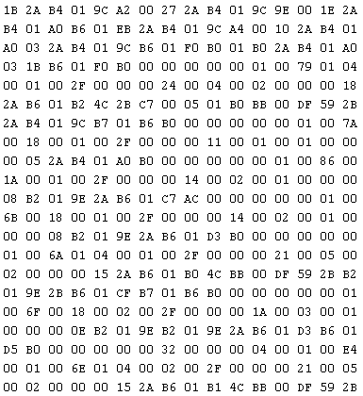
This is also valid code
Notes:
What we must remember is…

Slide 5
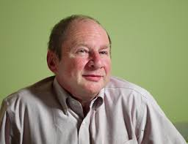
“Programs must be written for people to read, and only incidentally for machines to execute.”
Harold Abelson
https://www.goodreads.com/quotes/9168-programs-must-be-written-for-people-to-read-and-only
Notes:
Computers don’t care.
Developers do.
Reading/updating code
SCRUM ceremonies
Let's look at more examples.

Slide 6
Set intention is hidden
$ids = []; foreach ($collection as $item) { $ids[$item->getId()] = true; } $ids = array_keys($ids);
Notes:
What does "true" mean here?
Right. Nothing.

Slide 7
Stack intension is clear, but…
$stack = []; array_push($stack, 42); while (!empty($stack)) { $top = array_pop($stack); // do something here }
public function traverse(array $stack): void {}
Notes:
Intention is clear
In argument: why it’s a Stack?
A convention

Slide 8
Array is not just a data holder
public function getOrder(array $reservation): array { $orderId = 42; // use $reservation here return [ 'id' => $orderId, 'total' => $reservation['total'], 'items' => [/* items from $reservation */], 'createdAt' => new \DateTimeImmutable(), ]; }
Notes:
Bad at everything:
reservation is an array: what’s inside?
Order is array
Items are arrays
Refactoring: str_replace
Bugs of typos

Slide 9


Arrays are low-level elements
Do not express semantics or intention of the data structure
No strict schema
Bugs
Hard to deal with/refactor
Notes:
Becomes a mess.
Leads to...
Solution for the first two examples: set and stack is easy.

Slide 10
“Data Structures” extension fixes these issues
pecl install ds
composer require php-ds/php-ds // polyfill
Provides:
\Ds\Map
\Ds\Set
\Ds\Stack
\Ds\Queue
\Ds\Deque
\Ds\Vector
Also:
\Ds\Collection interface
\Ds\Hashable (objects as keys)
\Ds\PriorityQueue
\Ds\Pair
https://github.com/php-ds/ext-ds
Notes:
First two problems are easy: use Ds
Polyfill
Let’s look at previous examples

Slide 11
Clear usage of set
$ids = new \Ds\Set(); foreach ($collection as $item) { $ids->add($item->getId()); }
Notes:
No other interpretation

Slide 12
Clear usage of stack
$stack = new \Ds\Stack(); $stack->push(42); while (!$stack->isEmpty()) { $top = $stack->pop(); // do something here }
public function traverse(\Ds\Stack $stack): void {}
Notes:
Just by using DS, you will already make a huge difference in your day-to-day work.

Slide 13
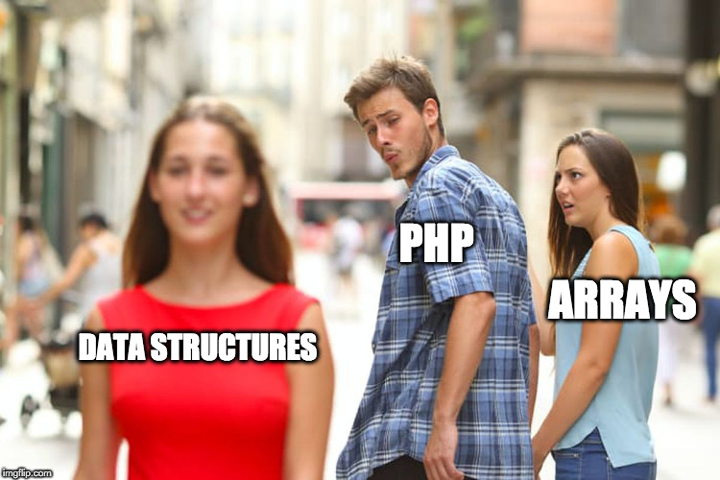
Notes:
But sometimes DS is not enough.

Slide 14
Array is not just a data holder
public function getOrder(array $reservation): array { $orderId = 42; // use $reservation here return [ 'id' => $orderId, 'total' => $reservation['total'], 'items' => [/* items from $reservation */], 'createdAt' => new \DateTimeImmutable(), ]; }
Notes:
Here DS won’t help: No Map
We have to go a level higher: create a domain model.

Slide 15
Create domain models
class Order { private $id; private $total; /** @var OrderItem[] */ private $items; public static function from(Reservation $reservation): Order { $order = new Order(); $order->setTotal($reservation->getTotal()); foreach ($reservation->getItems() as $item) { // Do something here } return $order; } // Other code: getters, addition business logic }
Notes:
Positive aspects:
1. Clear naming, which helps with readability.
2. Validation. For example, max size: not possible Stack, let along array.
3. Additional behavior inside model
4. Save developers' time: faster feature delivery with less bugs, easier refactoring; business language

Slide 16
Key takeaways
Use arrays when you need a simple data holder
Use DS to show clear intention in you code
Use Domain Models to implement high-level business requirements

Slide 17
Thank you!
Questions?

