Slide 1
Presentation on Open Courseware Management System
Prepared by
Muhammad Sumon Molla Selim
ID: 11203020
Program: BCSE
Supervised by
Abhijit Saha
Faculty
Department of Computer Science and Engineering

Slide 2
Contents of The Presentation
Organizational Overview
Project Overview
Requirements Engineering
System Planning
Analysis & Design
Software Demo

Slide 3
Organizational Overview

Slide 4

Organization Overview
Kodeeo is a Bangladesh based software solutions venture which assists companies, organizations and start-ups to materialize their ideas into great project. They are expert at web development, mobile app development, graphic design, digital marketing and all kinds of technology solutions.

Slide 5
Mission & Vision
Assist companies, organizations and start-ups to materialize their ideas into great project and virtualize their presence online
Bring innovative ideas into reality to solve great problems of the country
Not only serve the clients but also take the industry a step further

Slide 6
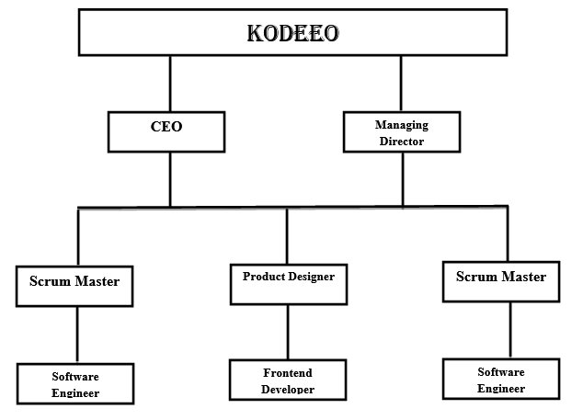
Organizational Structure

Slide 7
Project Overview

Slide 8
Broad Objective
Use my institutional educational experience in the real life working environment by developing an Open Courseware Management System for Kodeeo

Slide 9
Specific Objectives
Content management
Learner engagement
Communication and collaboration
Easy content distribution

Slide 10
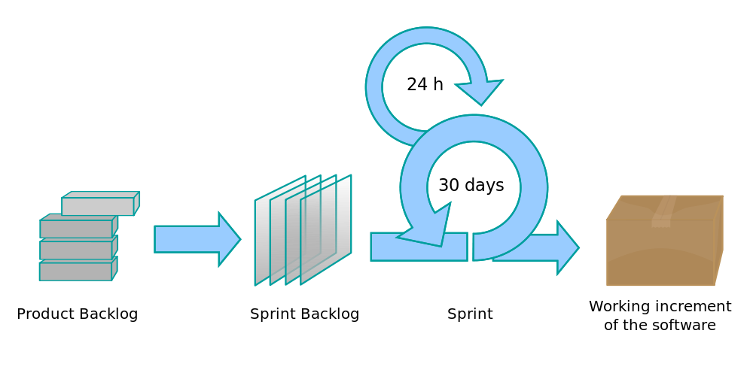
Software Development Process Model
The Scrum process

Slide 11
Why Scrum?
Adaptive planning
Evolutionary development
Early delivery
Continuous improvement
Rapid and flexible response to change

Slide 12
Feasibility Study
Technical Feasibility
Economic Feasibility
Operational Feasibility

Slide 13
Requirements Engineering

Slide 14
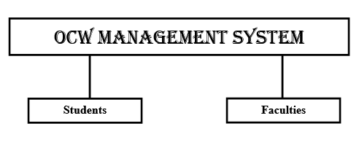
System Hierarchy

Slide 15
Functional Requirements for Faculty
1. Faculty shall be able to create account
2. Faculty shall be able to create courses
3. Faculty shall be able to upload lectures and assignments for courses
4. Faculty shall be able to view submissions
5. Faculty shall be able to give grade to student
Faculty

Slide 16
Functional Requirements for Student
1. Student shall be able to create account
2. Student shall be able to enroll in courses
3. Student shall be able to view the course materials
4. Student shall be able to submit assignment solutions
Student

Slide 17
Non-functional Requirements
Student and faculty should create an account and login to get access to the system
The system should be efficient so that many students and faculty can use the system at a time
Course materials should be protected and stored safely
Assignments should be accessible only to faculty
Students should have their privacy

Slide 18
System Benefits
Easy to access from anywhere
Saves valuable time, money and other resources
Online registration and enrollment for students
Online course materials distribution
Easy to provide and manage educational resources
Secured but open system for both students and faculties

Slide 19
System Planning

Slide 20
Functions of Proposed System (Continued)
Faculty Registration
Student Registration
Login
Add Course
Add Lectures
Add Assignments
Evaluation

Slide 21
Functions of Proposed System
Enroll to Course
View Lectures
View Assignments
Assignment Submission
Progress Report

Slide 22
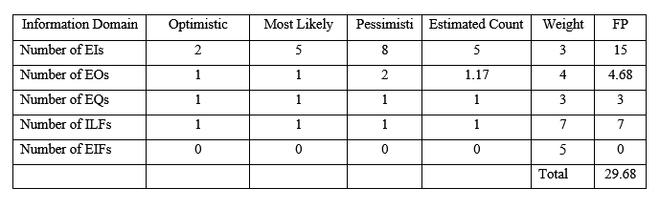
FP Count for Faculty Registration

Slide 23
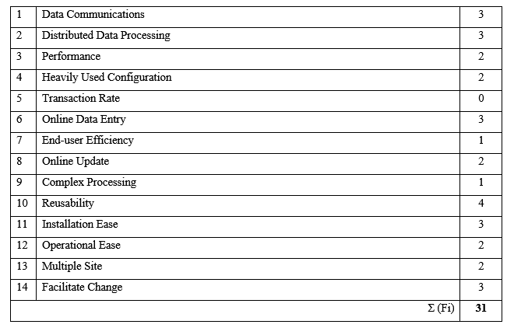
Complexity Adjustment Value

Slide 24
FP Based Estimation
FP = Count Total * [0.65 + 0.01 * Σ (Fi)]
= 29.68 * [0.65 + 0.01 * 31]
= 28.49
Final Estimation
Effort = FP / total no. of functions
= 332.31 / 12
= 27.69
= 28 man month (Approximate)

Slide 25
Final Estimation
FP Based estimation = 28 man month (approx.)
Process Based estimation = 42 man month (approx.)
Estimated time = 35 man month
Software development team = 9 members
Estimated time for the project
= 35/9 months
= 3.88 months
= 4 months (approx.)

Slide 26
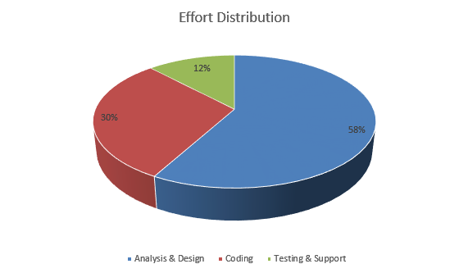
Effort Distribution

Slide 27
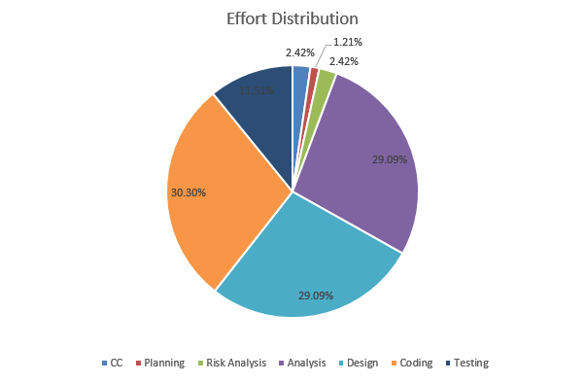
Detailed Effort Distribution

Slide 28
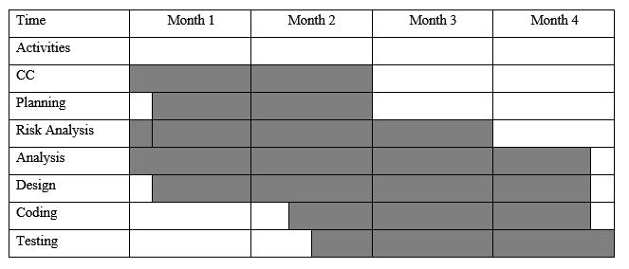
Project Scheduling Chart

Slide 29
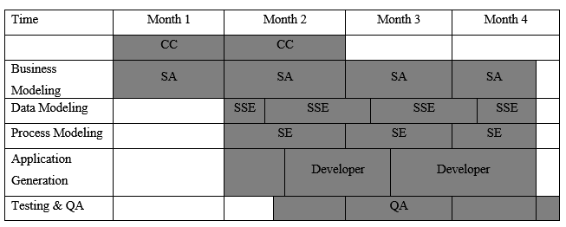
Personnel Requirement Chart

Slide 30
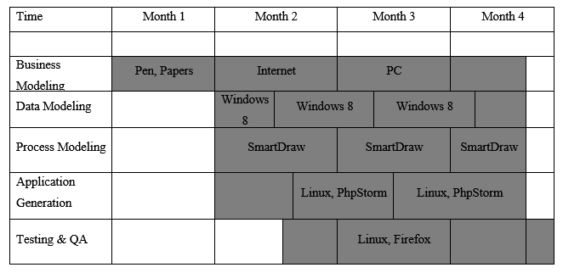
Resource Requirement Chart

Slide 31
Cost Estimation
Name | Amount | Total
Windows 8.1 | 18,500 | 38,000
MS Office 2013 | 8,000
PhpStorm | 6,500
Smart Draw | 5,000
Linux | FREE
Name | Amount | Total
3 Computers | 29,160 | 31,160
Computer Maintenance | 2,000
Name | Monthly Bill Rate | Bill Calculated for 4 months | Total
Electricity Bill | 2,000 | 8,000 | 98,000
Internet Bill | 2,500 | 10,000
House Rent | 20,000 | 80,000
Final Estimated Cost = 38,000/= + 31,160/= + 98,000/= BDT
= 1, 67,160/= BDT

Slide 32
Analysis & Design

Slide 33
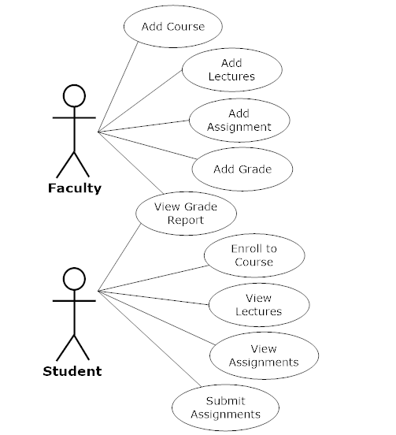
Use Case Diagram

Slide 34
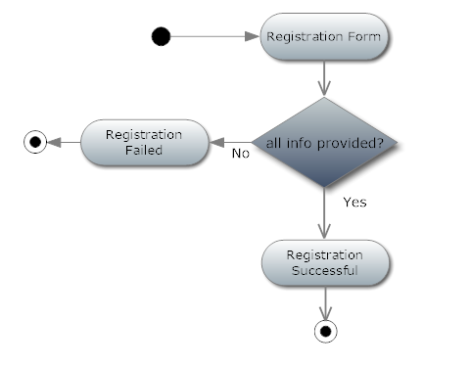
Activity Diagram for Registration

Slide 35
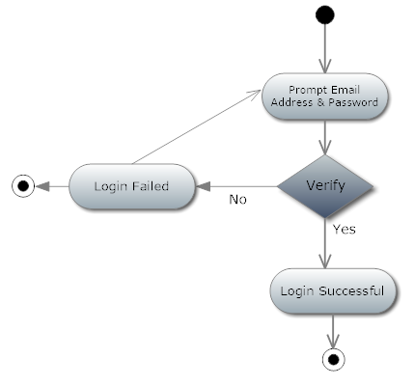
Activity Diagram for Login

Slide 36
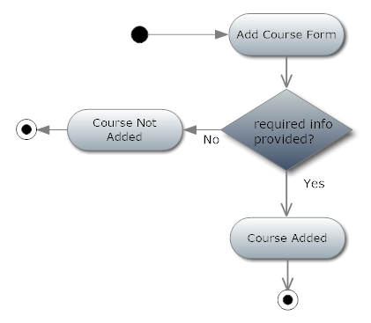
Activity Diagram for Add Course

Slide 37
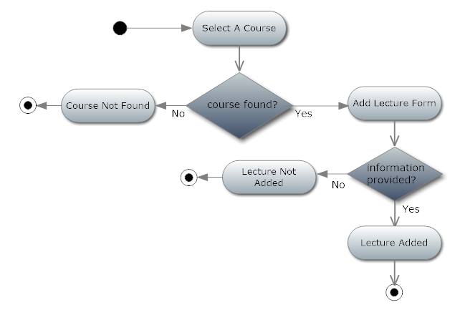
Activity Diagram for Add Lectures

Slide 38
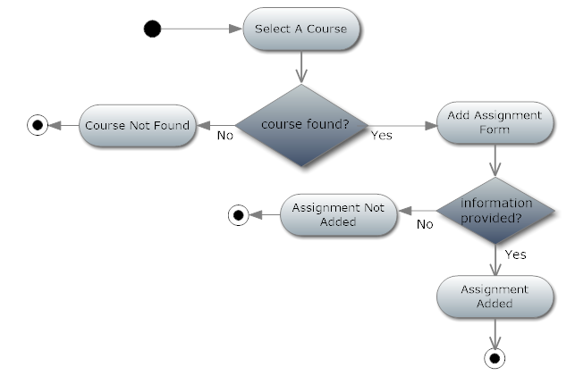
Activity Diagram for Add Assignment

Slide 39
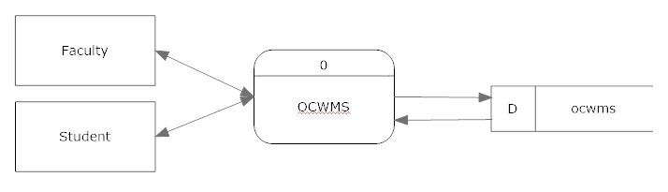
Context-level DFD

Slide 40
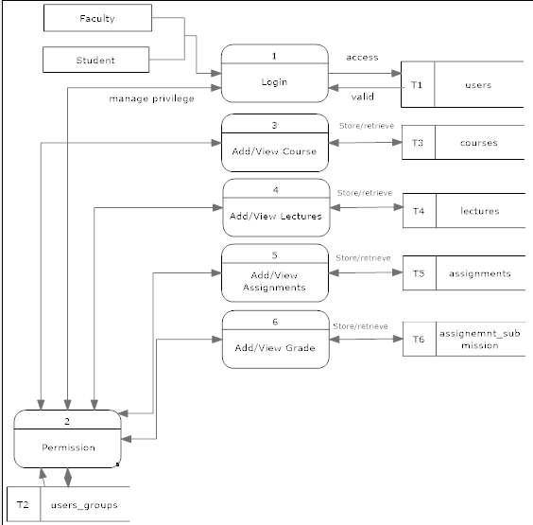
First Level DFD

Slide 41
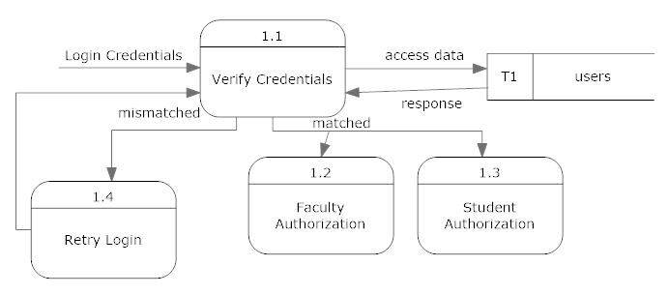
Level 2 DFD Process 1

Slide 42
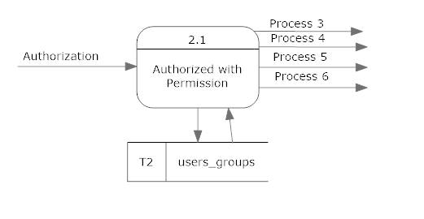
Level 2 DFD Process 2

Slide 43
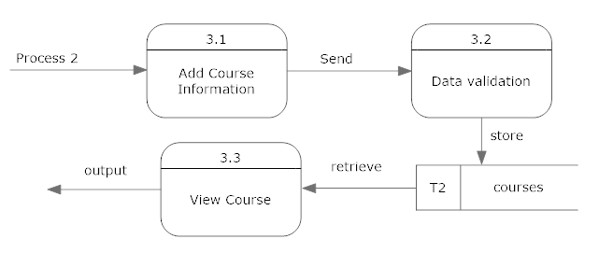
Level 2 DFD Process 3

Slide 44
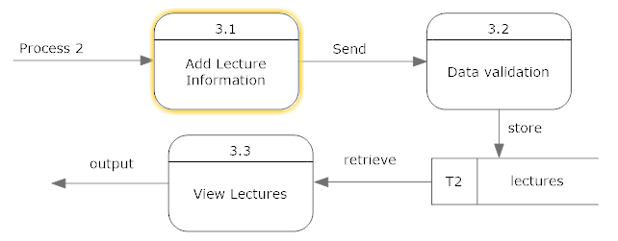
Level 2 DFD Process 4

Slide 45
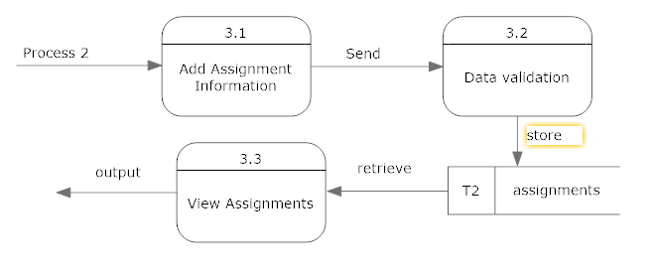
Level 2 DFD Process 5

Slide 46
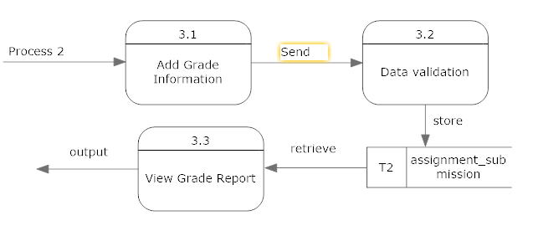
Level 2 DFD Process 6

Slide 47
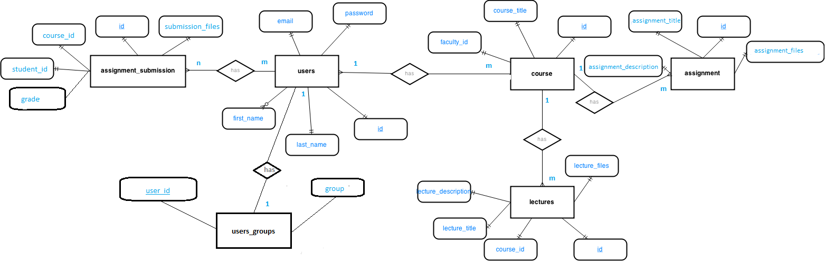
ER Diagram

Slide 48
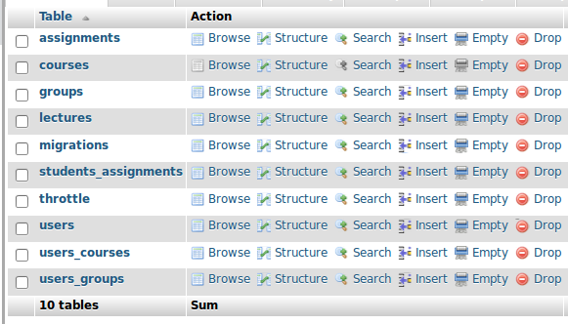
Database Design

Slide 49
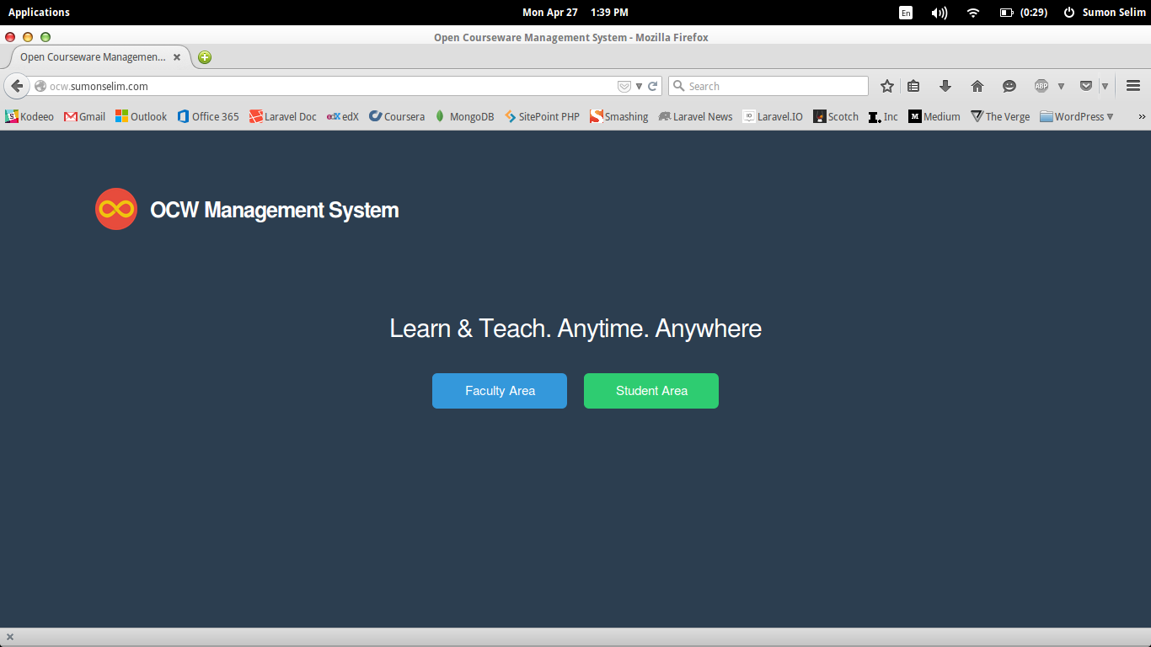
Interface Design

Slide 50
Development Tools
Backend Development: PHP, MySQL (Laravel Framework)
Frontend Development: HTML, CSS, JavaScript
IDE: PhpStorm
Text Editor: Sublime Text 3
Browser: Firefox, Chrome
Server: Apache 2.4, Linux

Slide 51
Future Improvements
Edit/Update/Delete Content Materials
Search Feature
AJAX CRUD Feature
User Profile
More features per feedback

Slide 52
Software Demo

Slide 53


Slide 54


