Slide 1

SQL CHALLENGE – 6
MARKETING ANALYSIS
Presented By: Sumanth Kumar

Slide 2
Introduction
I was appointed as a Marketing Analyst at ‘Sustainable Clothing Co.’
‘Sustainable Clothing Co.’ have been running several marketing campaigns and have asked me to provide insights whether they are successful or not.
This case study by Steel Data has 3 Tables:
Sustainable_clothing
Transactions
Marketing Campaigns

Slide 3
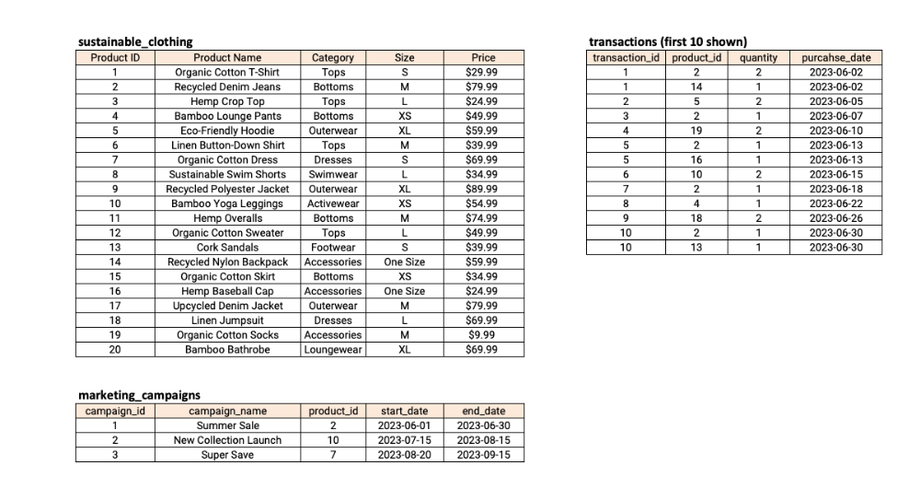
This is how the data in the tables looks like:

Slide 4
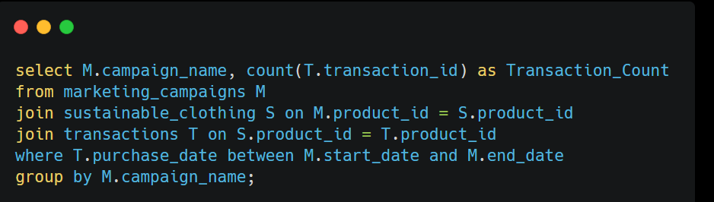
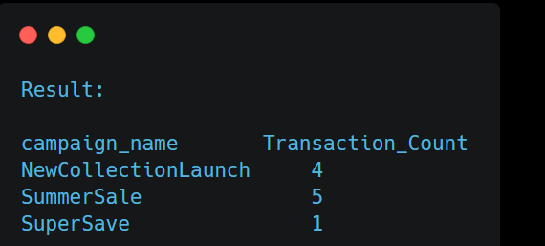
--1. How many transactions were completed during each marketing campaign?

Slide 5
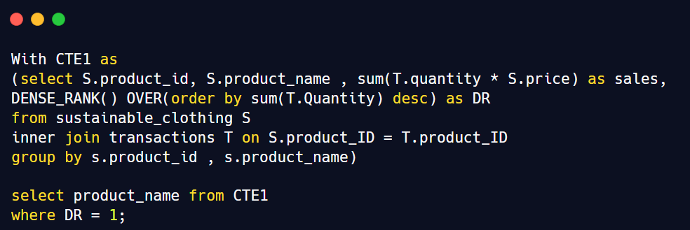
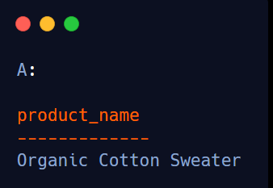
--2. Which product had the highest sales quantity?

Slide 6
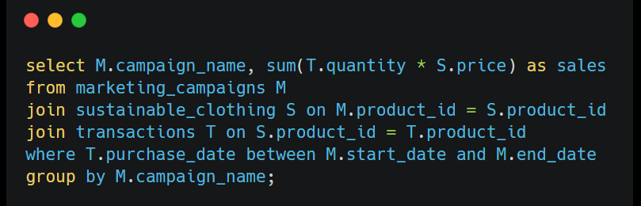
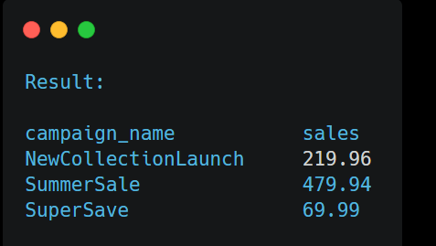
--3. What is the total revenue generated from each marketing campaign?

Slide 7
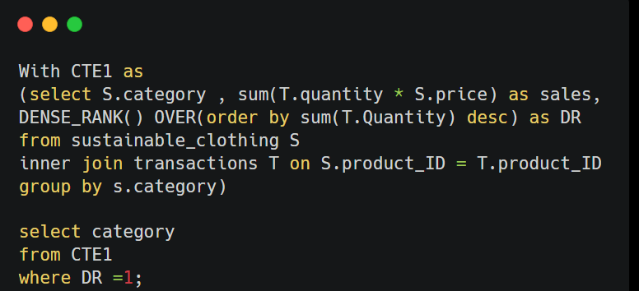
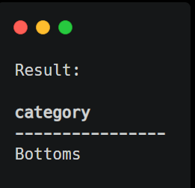
--4. What is the top-selling product category based on the total revenue generated?

Slide 8
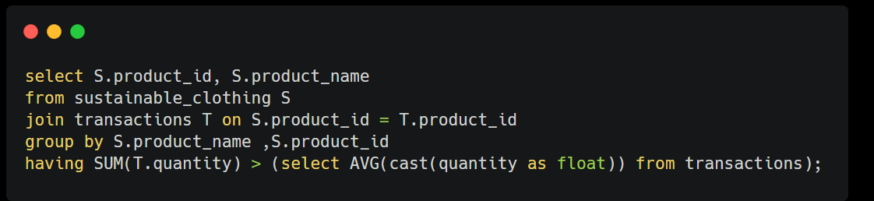
--5. Which products had a higher quantity sold compared to the overall average quantity sold?

Slide 9
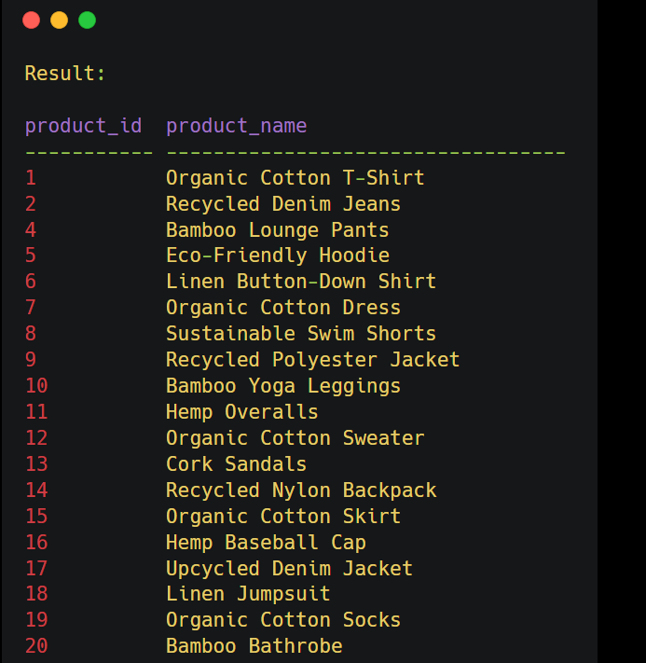

Slide 10
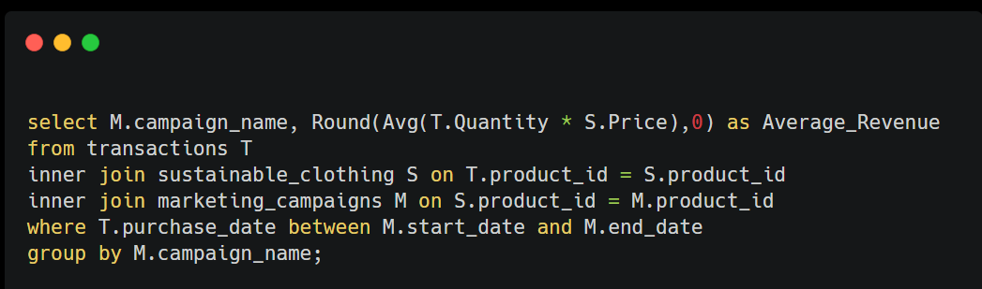
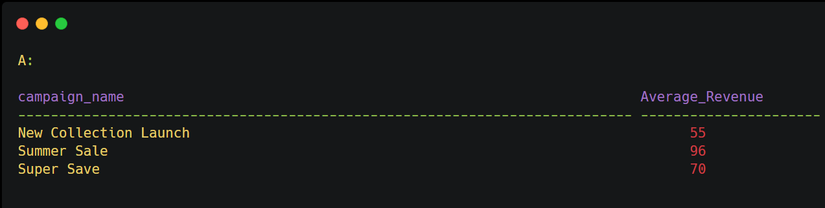
--6. What is the average revenue generated per day during the marketing campaigns?

Slide 11
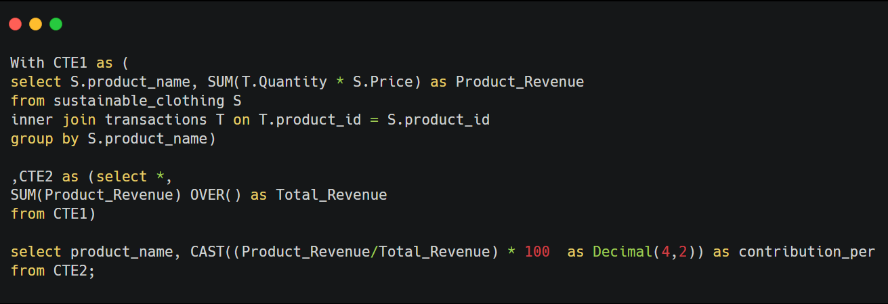
-- 7.What is the percentage contribution of each product to the total revenue?

Slide 12
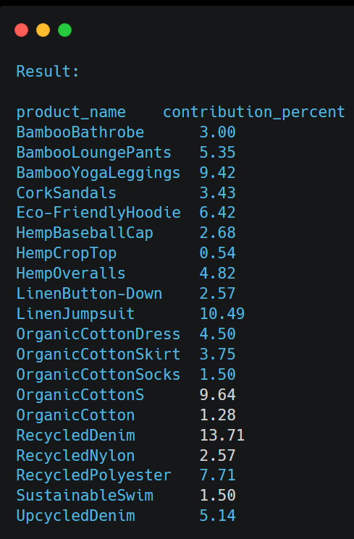

Slide 13
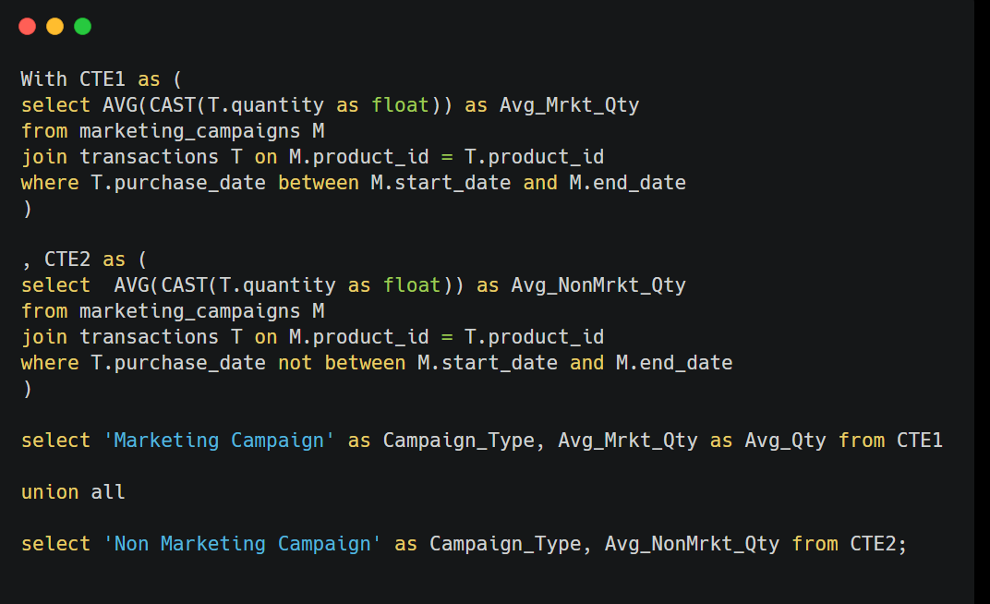
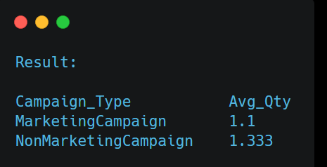
--8.Compare the average quantity sold during marketing campaigns to outside the marketing campaigns

Slide 14
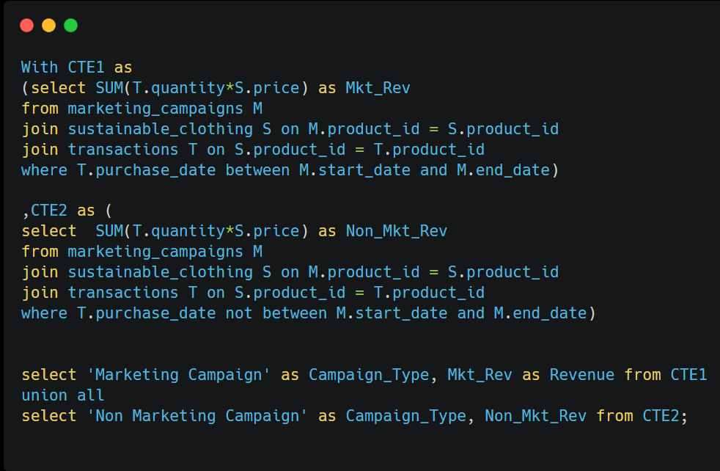
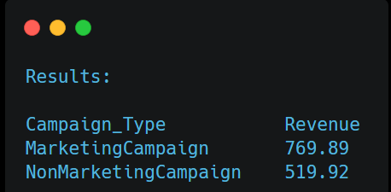
--9.Compare the revenue generated by products inside the marketing campaigns to outside the campaigns.

Slide 15
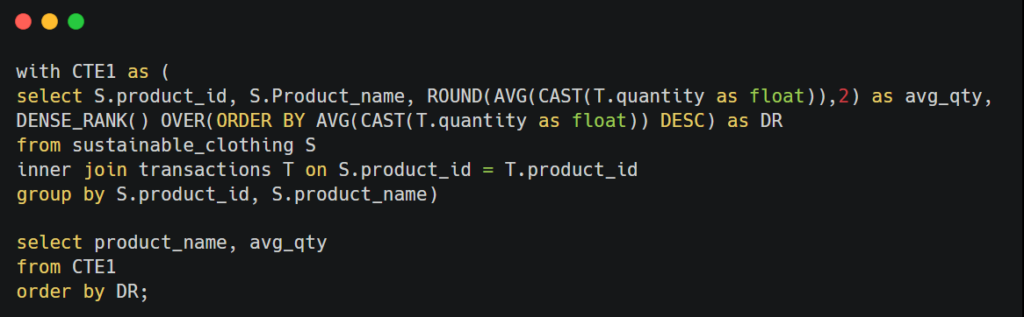
--10.Rank the products by their average daily quantity sold

Slide 16
