Slide 1


Slide 2



CODE VERSE HACKATHON 2025
Problem Statement Title- Design and develop an intelligent real-time smoke and fire detection system from surveillance cameras and/or any other suitable integrated sensors and provide real-time notifications to security staff.
Team Name- Sleepless
Team Members- Sumukh Goutam & Tanishq Maral

Slide 3
IDEA TITLE
Detailed Explanation: An AI-powered software system that analyzes existing CCTV camera feeds in real time to detect smoke and fire using deep learning models. The system applies multi-frame temporal analysis, filters false alarms, and sends immediate alerts with snapshots/video to security staff.
How It Addresses the Problem: Provides early fire detection without new hardware investment, reduces dependence on manual monitoring, minimizes false positives, and enables faster response to protect lives and assets.
Innovation & Uniqueness:
Software-only solution leveraging existing CCTV infrastructure.
Combines AI vision + temporal analysis for high accuracy.
Integrates with real-time notifications (SMS, WhatsApp, Push Alerts) for rapid response.
Scalable and adaptable across industries (smart cities, factories, hospitals).

Slide 4
TECHNICAL APPROACH
•Technologies to be used:
Capture: RTSP/ONVIF + FFmpeg/GStreamer
Inference: PyTorch/TensorFlow + TensorRT/ONNX Runtime
Edge Runtime: Docker + MQTT/Kafka
Backend: FastAPI/Node.js + Kafka broker
Databases: PostgreSQL, InfluxDB, S3/MinIO
Notifications: Twilio, Firebase, Slack/Teams
Frontend: React/Next.js + Grafana
Auth & Security: OAuth2/Keycloak + TLS
DevOps: Kubernetes (cloud), k3s (edge), Prometheus/Grafana

Slide 5
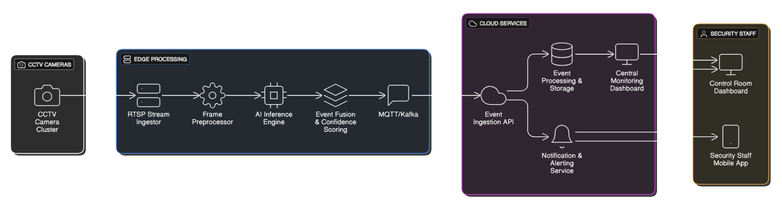
TECHNICAL APPROACH
•Methodology and process for implementation.

Slide 6
FEASIBILITY AND VIABILITY
Feasibility: Highly feasible since it leverages existing CCTV infrastructure; modern AI models (YOLO, CNNs) can detect smoke/fire in real time with edge/cloud processing. Minimal additional hardware required → cost-effective and scalable.
Challenges & Risks: False positives (fog, steam, glare mistaken as smoke), network latency in video transmission, limited camera coverage (blind spots), and privacy/security of video data.
Overcoming Shortcomings: Use multi-frame temporal analysis + AI model fine-tuning to reduce false alerts, deploy lightweight inference at the edge to cut latency, integrate optional environmental sensors for confirmation, and apply strong encryption + role-based access to ensure data security.

Slide 7
IMPACT AND BENEFITS
•Potential impact of the solution
Enhanced Public Safety
Faster detection of smoke/fire incidents than human monitoring → early response saves lives and prevents major accidents.
Property & Asset Protection
Detects fires at the incipient stage → reduces losses in factories, warehouses, offices, and residential complexes.
Scalability Across Sectors
Works in smart cities, industries, schools, hospitals, transport hubs — anywhere CCTV is already installed.
Reduced False Negatives
Continuous AI monitoring never “blinks” or gets distracted → critical in environments where human operators may miss early signs.
Operational Cost Savings
No need for new hardware (reuses existing CCTV cameras).
Reduces insurance claims and downtime caused by fire damage.
Data-Driven Safety Insights
Historical logs of incidents → useful for fire audits, compliance reporting, and improving safety protocols.
Global Applicability
Can be deployed in both developed & developing countries → flexible, software-only solution with cloud or local deployment.

Slide 8
IMPACT AND BENEFITS
•Benefits of the solution
1. For Organizations
Low CapEx: Uses existing CCTV infrastructure (no new expensive thermal/smoke hardware required initially).
Faster ROI: Immediate improvement in safety monitoring without major installations.
Regulatory Compliance: Meets safety standards & can support insurance certifications.
Integration Ready: Connects with alarm systems, sprinklers, or emergency protocols.
2. For Security Staff
Real-Time Alerts: Push notifications with camera snapshots & short clips → reduces reliance on constant manual monitoring.
Reduced Workload: AI filters out noise → staff focus only on high-confidence alerts.
Actionable Information: Alerts include camera location, severity, and supporting data.
3. For Society & Community
Life Safety: Faster emergency response → fewer casualties.
Environmental Impact: Prevents uncontrolled fires that cause toxic emissions.
Trust & Reliability: Safer public spaces increase confidence in infrastructure and governance.

