Slide 1

NORP Structured Project: Impact of Healthcare Policies on California Counties
By: Sumukh Paspuleti

Slide 2

Introduction
The Nonprofit Organization Research Panel is a project designed to collect and visualize nonprofit datasets, promoting nonprofit research
Healthcare is a significant concern for Americans, and thus, research into exploring the effects of various healthcare policies is essential
California has passed several sweeping laws to change the healthcare industry from insurance to California's Medicaid program

Slide 3
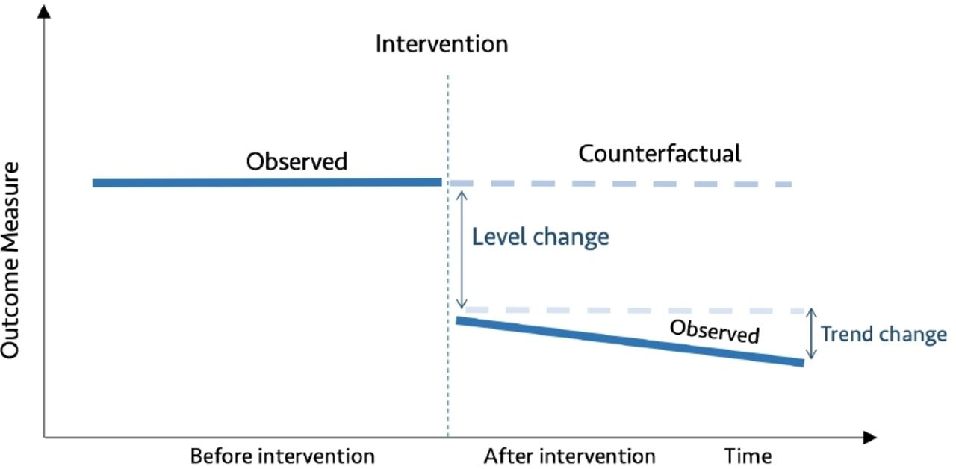
Motivation
Innovations in artificial intelligence introduce new possibilities into policy analysis
Models like an Autoregressive integrated moving average model can be used to perform an interrupted time series analysis to determine said impact
Related research papers have explored the use of AI models to determine the effect of certain events

Slide 4
Overview of Procedure
Gather datasets
Clean datasets
Run ARIMA and Gaussian Processes models
Run data visualization notebooks
Convert csv files into a merged JSON file
Create frontend web app
Create unit and end-to-end tests

Slide 5
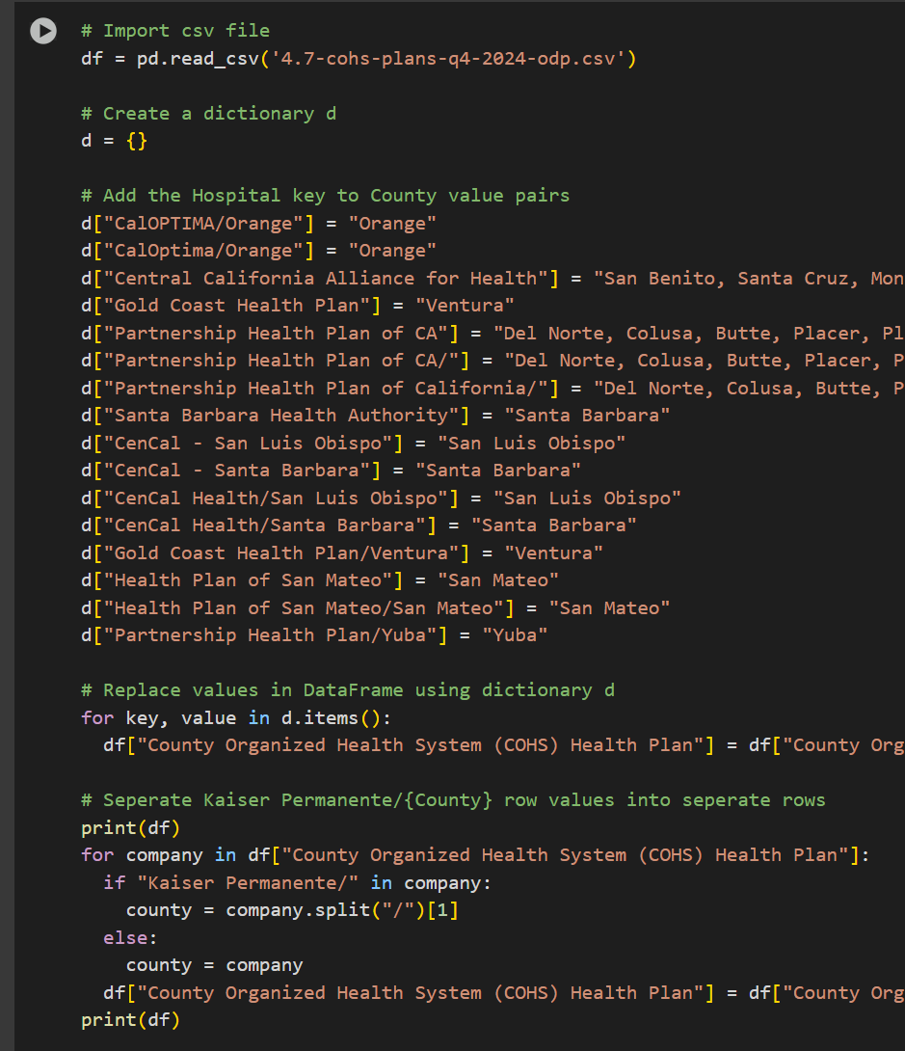
Data cleaning
Use the Pandas library to replace hospital values with county values to create a relationship between the county and statistics
Split the values with multiple counties in the same data frame value to create new rows
Then group all relevant identifying information to sum all statistics

Slide 6
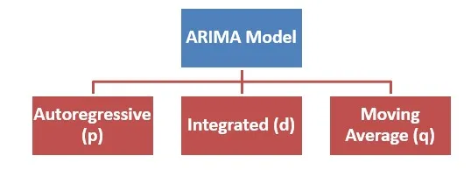
Implementation
Use the ARIMA model from the statsmodels library to predict the impact of policies and create a line chart to display the model's predicted values
Then use the Gaussian Process model to estimate the future ten years using the sklearn package

Slide 7
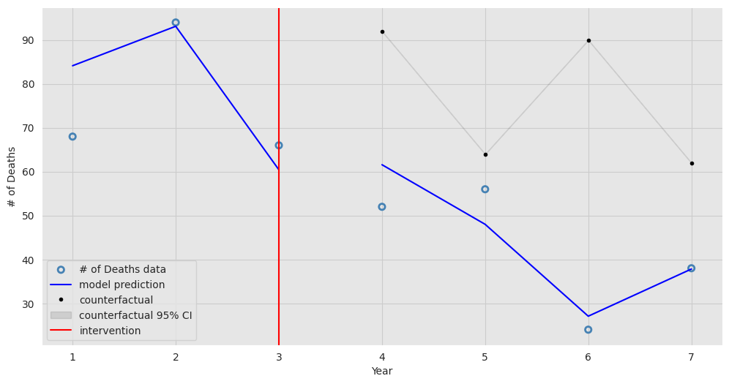
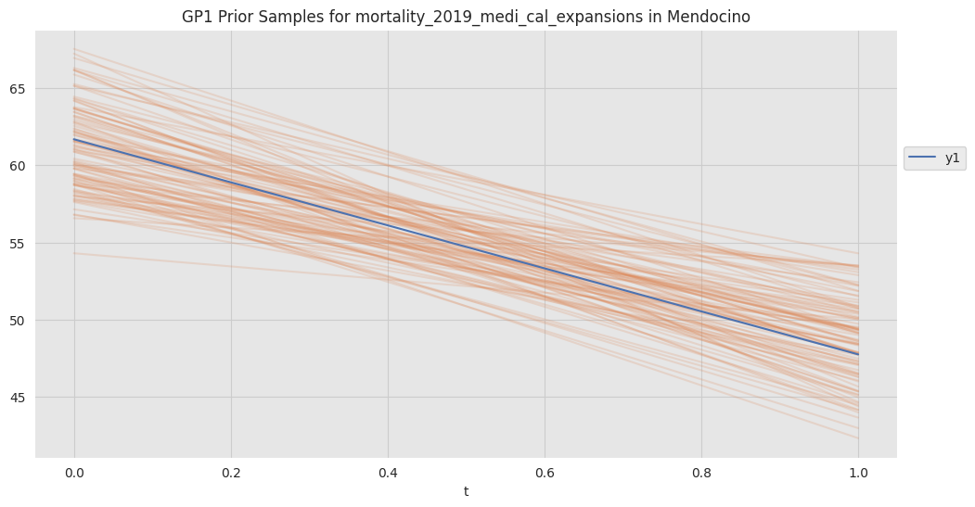
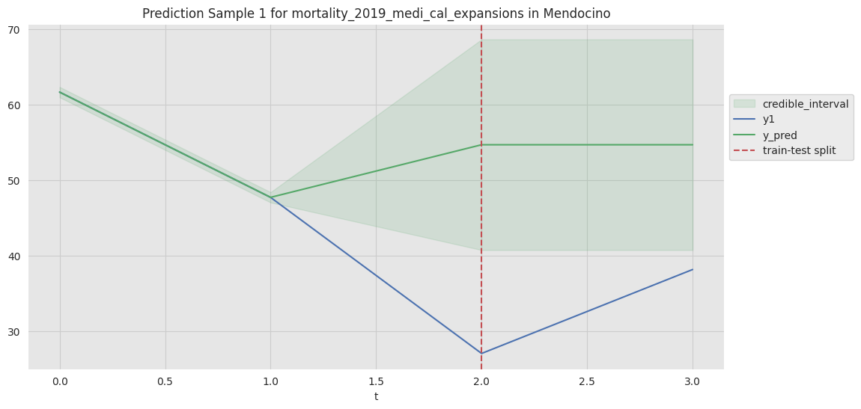
Data Results/Conclusion
The ARIMA and Gaussian Process models created a 96.44% decrease in the number of deaths from 2018 to 2019
The models helped show how the training and testing of the various datasets helped create accurate datasets
It was essential to create 100 predictions for the prior samples with the Gaussian Process and create 10 predictions using the Gaussian Process model

Slide 8
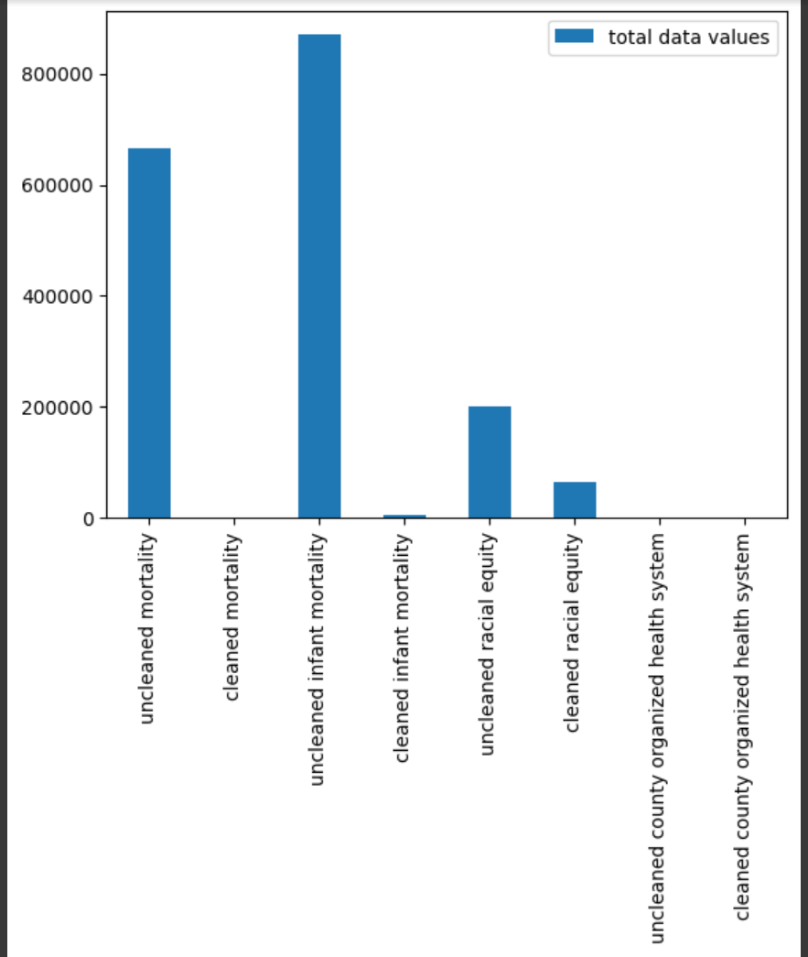
Data visualization
Use the Pandas library to remove all missing values to be able to get useful tables and charts
Get the total file size and the total number of data values of each dataset to compare between the unclean and clean datasets to show the effects of data cleaning
The resulting difference is displayed in several bar charts to help make the comparison easier to see

Slide 9
Demo

Slide 10
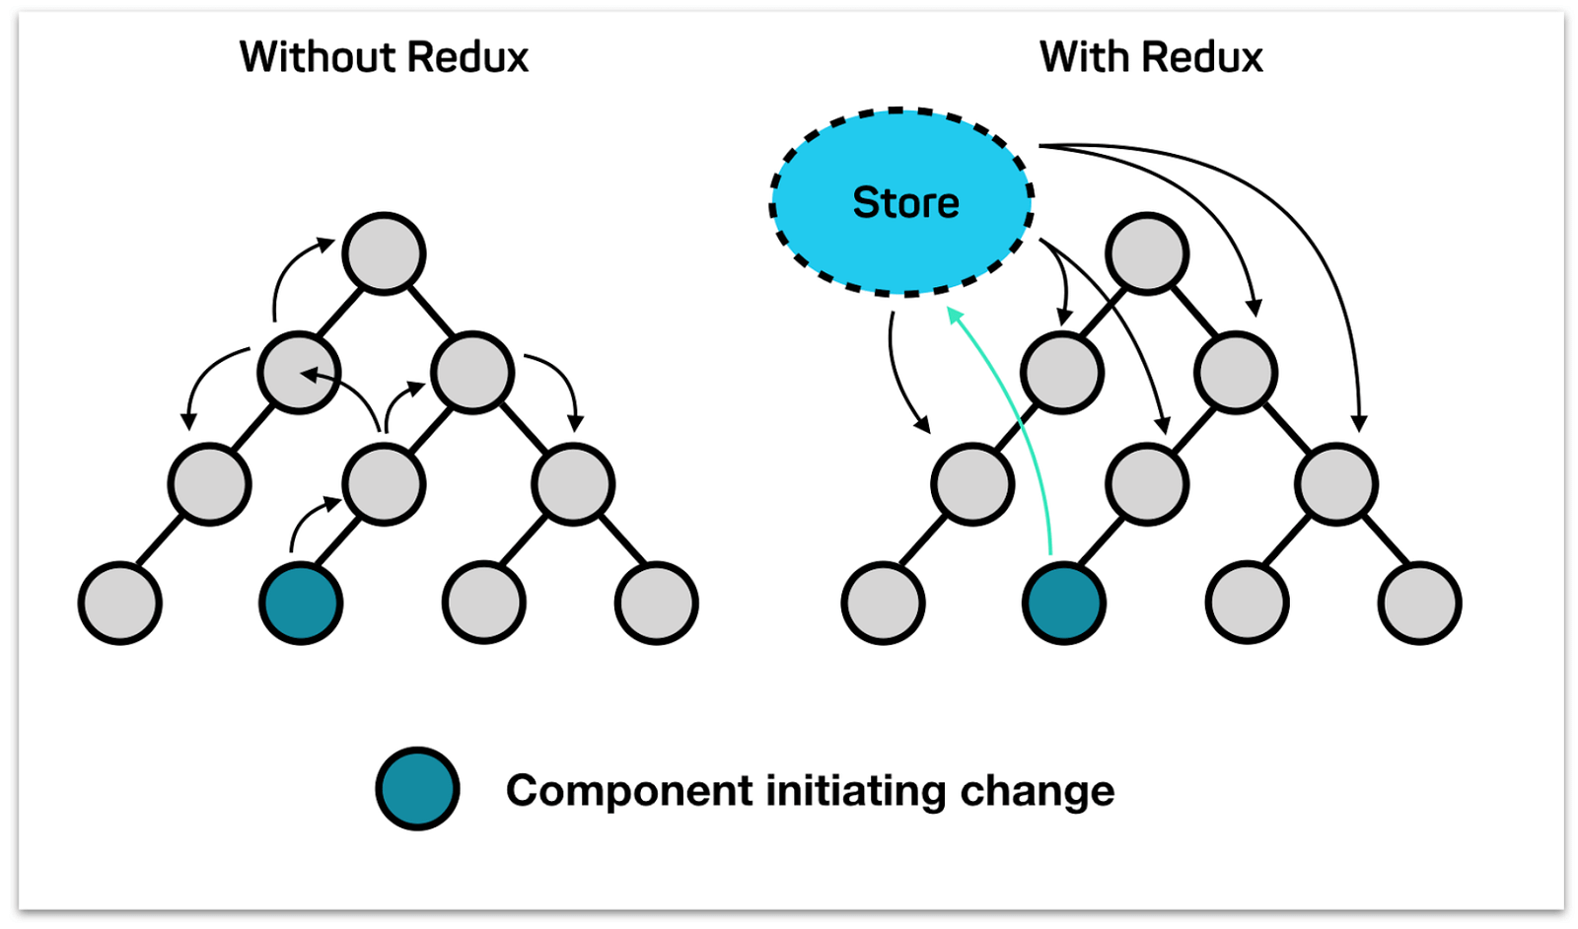
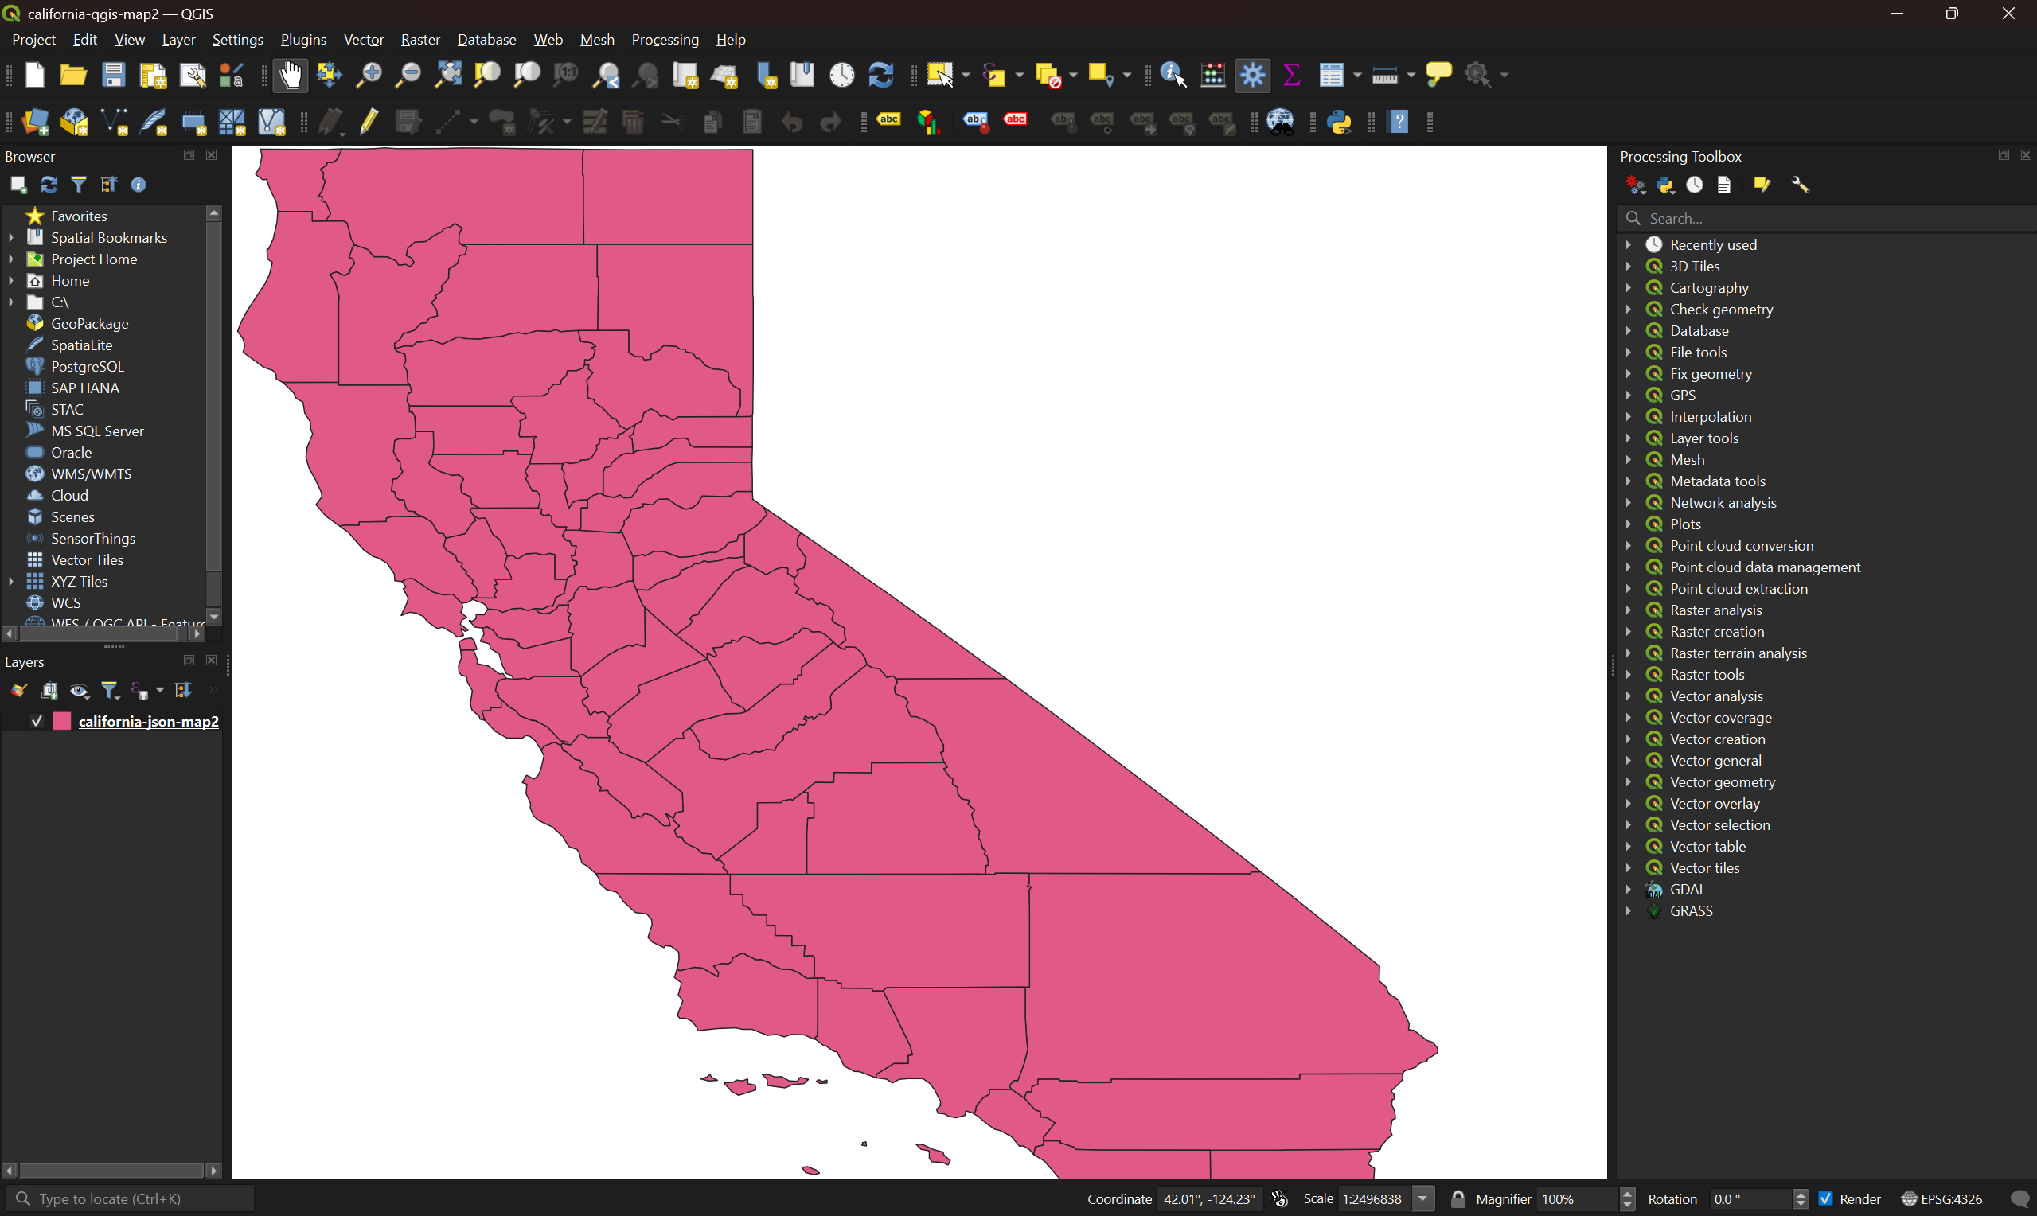
Skills Learned
Learned the QGIS software to edit GeoJSON files for integration in the Next.js web app
Learned the Redux JavaScript library to create a global store for the Next.js web app
Learned the Jest and Playwright testing frameworks to test the web app

Slide 11
Skills Learned
Learned about the Flexibility of Ideas, where the switching between multiple AI models shows the importance of improving existing ideas
Learned about Application Pull by researching the increasing use of artificial intelligence to make strategic decisions, as the leaders wanted more accurate models to become better at decision-making
Learned about the Technology Push as the introduction of generative artificial intelligence in the healthcare industry was led by developers pushing for the advancement of the technology and encouraging hospitals to adopt it.

Slide 12
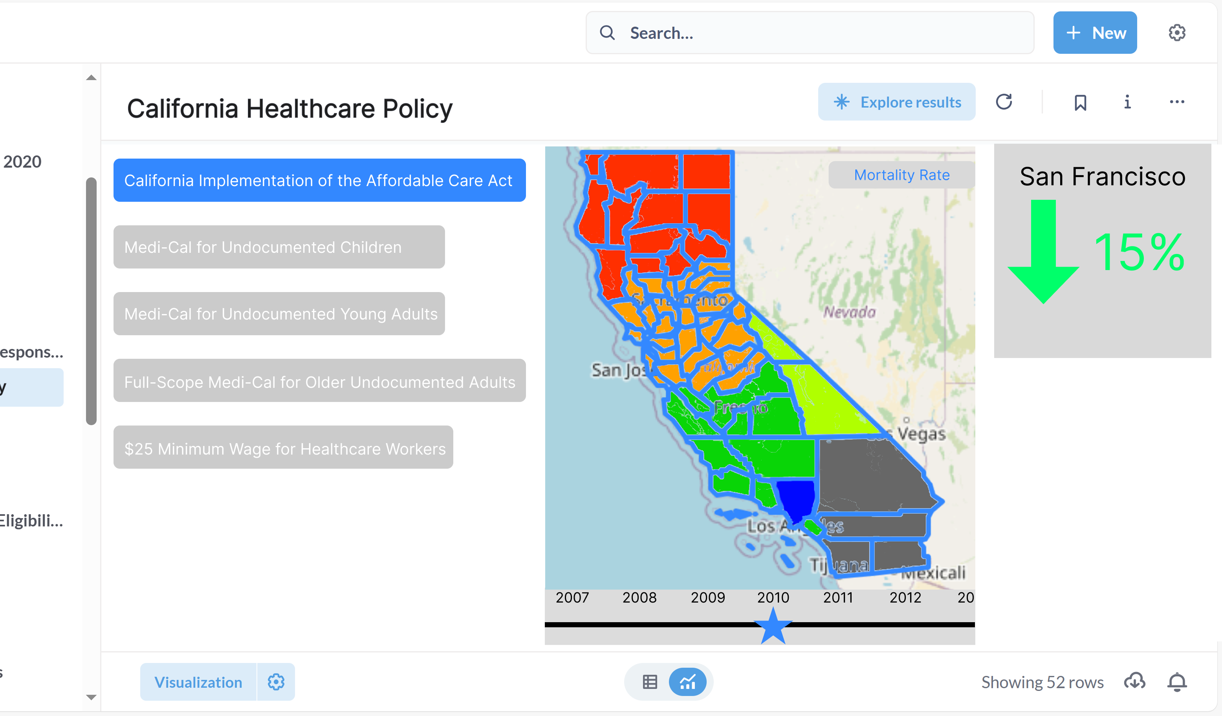
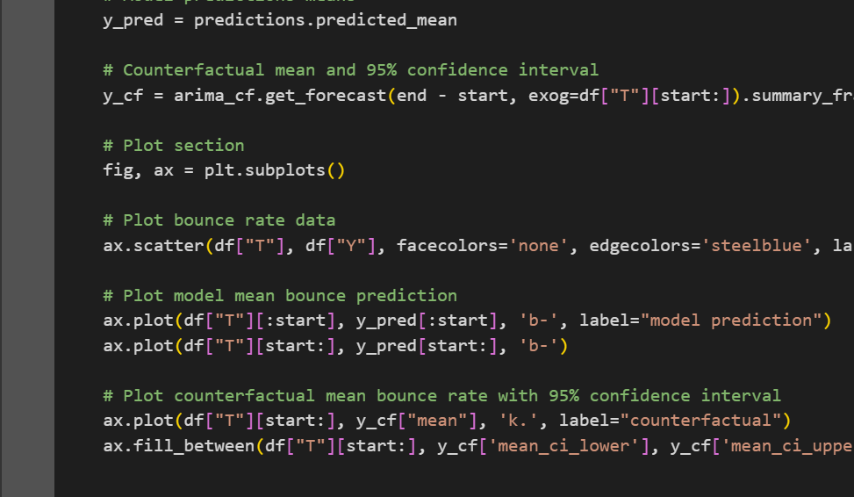
Deliverables
Gather datasets and learn about AI models
Clean datasets for use in AI models and create Figma designs for website layout
Create an AI Model implementation
Finish AI Model implementation and add instructions for its use to the README file

Slide 13
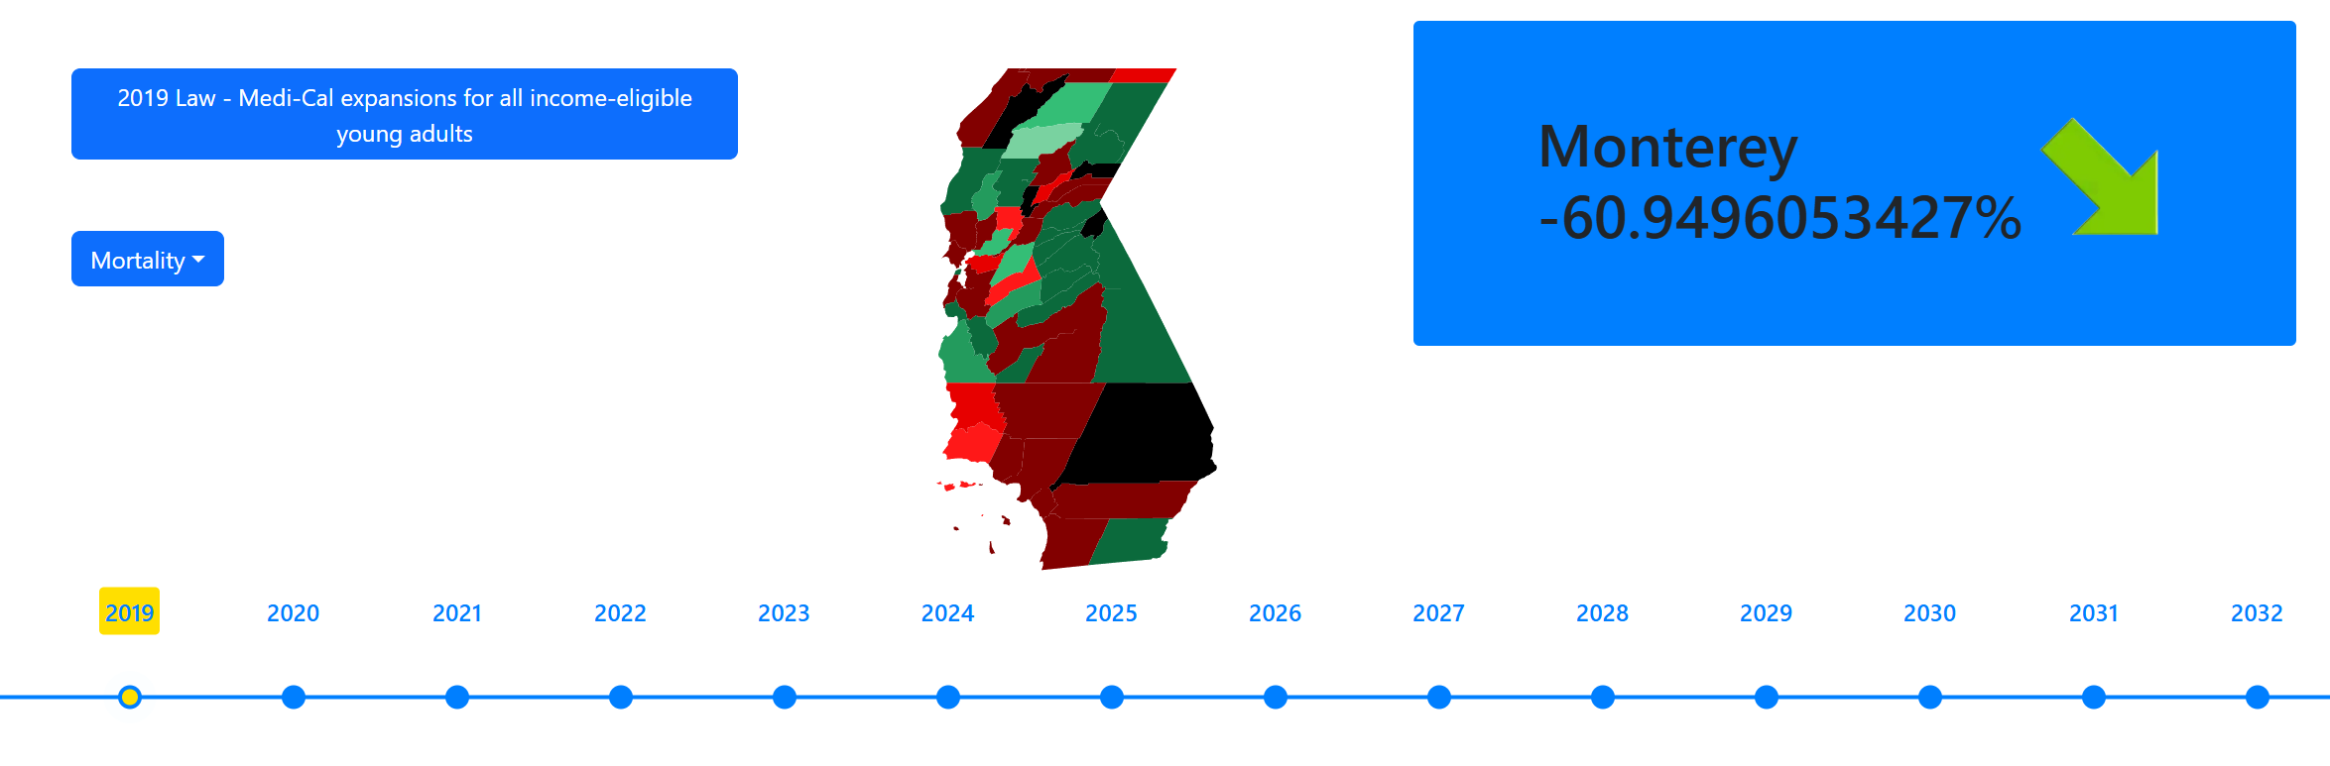
Deliverables
Code frontend Next.js website interactive diagram
Integrate the AI model with the website diagram

Slide 14
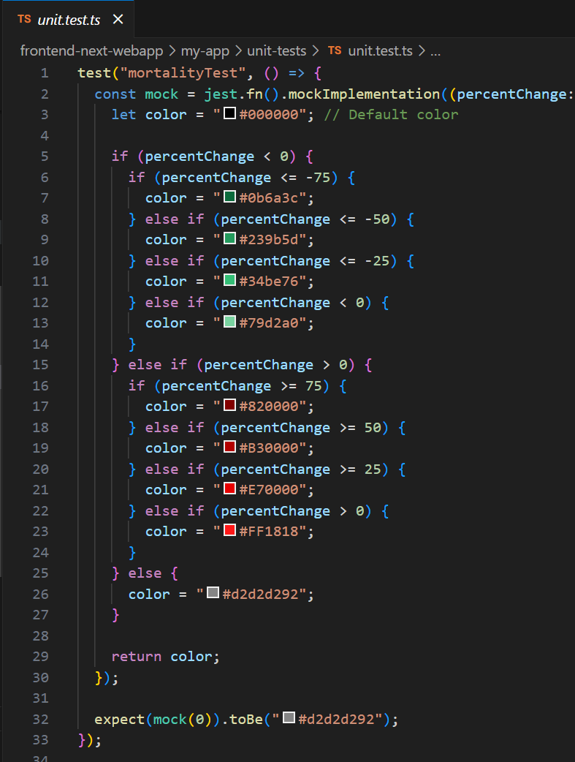
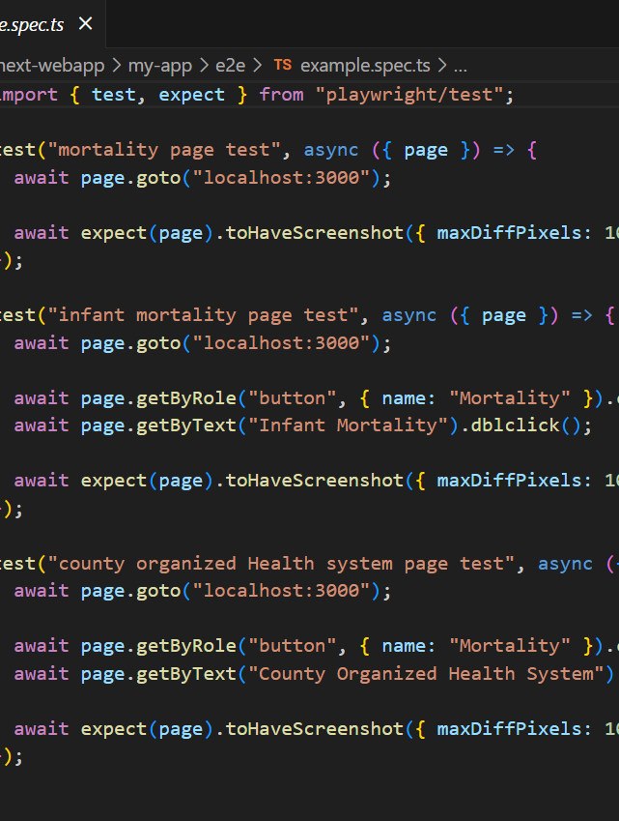
Deliverables
Create unit tests to test the model and end-to-end integration tests
Create a video presentation of the project and complete final end-to-end integration testing

Slide 15
References
Nong, Paige, et al. “Current use and evaluation of artificial intelligence and predictive models in US hospitals.” Health Affairs, vol. 44, no. 1, 1 Jan. 2025, pp. 90–98, https://doi.org/10.1377/hlthaff.2024.00842.
Arruda, Flavio Regis de. “Interrupted Time Series (ITS) in Python.” Xboard.Dev, 1 Jan. 2022, www.xboard.dev/posts/2020_01_01_interrupted-time-series-python-part-I/index.html.
“Pydata Berlin 2019: Gaussian Processes for Time Series Forecasting (Scikit-Learn).” Dr. Juan Camilo Orduz, 10 Oct. 2019, juanitorduz.github.io/gaussian_process_time_series/.
Santamato, Vito, et al. “Exploring the impact of artificial intelligence on Healthcare Management: A combined systematic review and machine-learning approach.” Applied Sciences, vol. 14, no. 22, 6 Nov. 2024, p. 10144, https://doi.org/10.3390/app142210144.
Chen, Yan, and Pouyan Esmaeilzadeh. Generative AI in Medical Practice: In-Depth Exploration of Privacy and Security Challenges (Preprint), 22 Sept. 2023, https://doi.org/10.2196/preprints.53008.

Slide 16
The end

