Slide 1
Employment Analysis
IAS Challenge 3.0
Team 40
Manisha Mehra
Sumukh Umesha
Eeshpaul Saggu
Yung-kuei Chen
Tableau Public Link

Slide 2
Contents
Executive Summary.................................................................................................................................................................3
2012 Overview.........................................................................................................................................................................4
Gender Analysis.......................................................................................................................................................................6
Education EDA.........................................................................................................................................................................7
Age Analysis.............................................................................................................................................................................9
Recession Analysis.................................................................................................................................................................11
Variable Importance..............................................................................................................................................................12
Artificial Neural Network.......................................................................................................................................................13
Random Forest.......................................................................................................................................................................15
Ensemble Model....................................................................................................................................................................17
Model Comparison(ANN Vs Random Forest Vs Ensemble)..................................................................................................18

Slide 3
Executive Summary
2012 overview: Sleeping, Socializing and Watching Television takes up most of people’s time. 61% of the dataset consist of employed people and 55% consists of women
People with higher wages work much harder
Men vs Women: The Percentage of employed women has gone down from 62% in 2005 to 56% in 2012
Education: the most common level of education achieved is the high school diploma
Child Care: Women spend 1.75 the amount of time caring for children than men
Recession: For men, the recession is a tipping point which marks a great increase in weekly earnings with a corresponding decrease in hours worked
Education level, Weekly hours worked, Weekly Earnings, Job searching and Age are the most important variables in our predictive models
Three predictive models were made with the following accuracies:
Artificial Neural Network: 93.53%
Random Forest: 94.42%
Ensemble model (SVM, XGBoost & Random Forest Classifiers): 91.65%

Slide 4
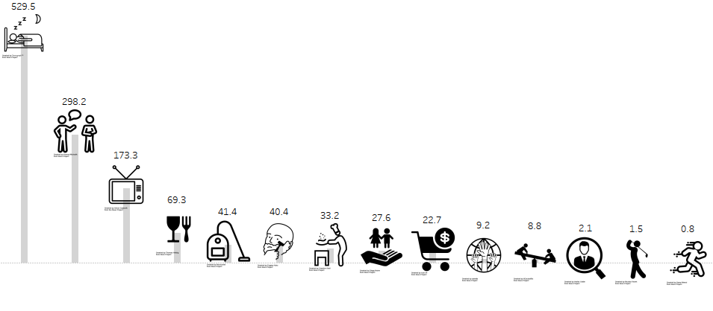
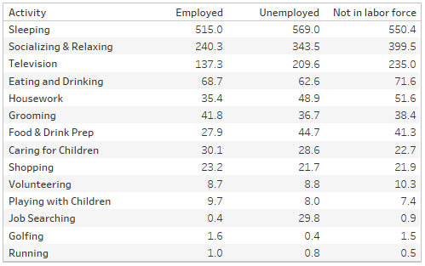
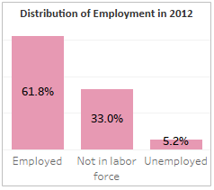
2012 Overview: Sleeping, Socializing and Watching Television takes up most of people’s time; Employed people count for 61.8% of the dataset in 2012 Down from 67.4% in 2005
Note: Numbers on this slide is total time spent in minutes per day in 2012

Slide 5
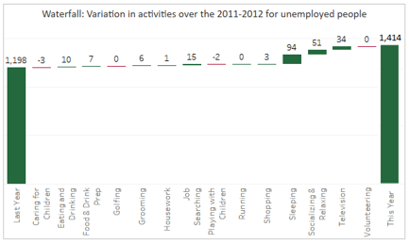
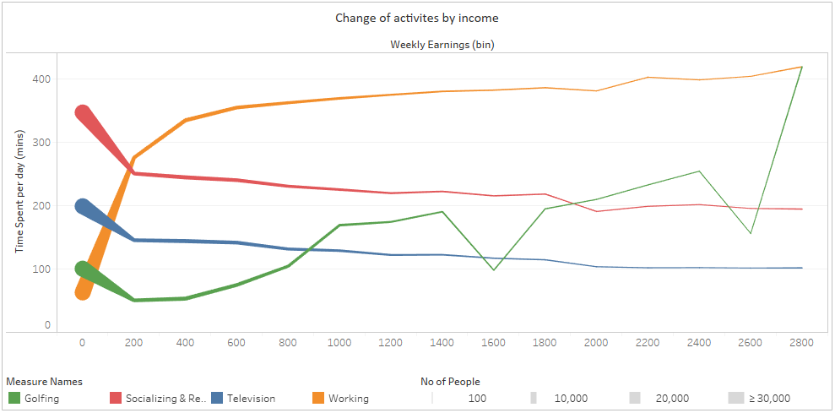
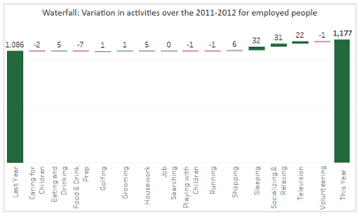
Unemployed people have increased their time spent on doing unproductive activities (Sleeping, Socializing and Television) by 1.5 hours while a productive activity like job searching has gone up by only 15 mins
Daily in 2012 Unemployed people spend:
18 hours Sleeping, Socializing & watching Television
30 mins finding jobs
Time spent working and time spent doing unproductive activities is inversely related weekly earnings
People with higher wages work much harder

Slide 6
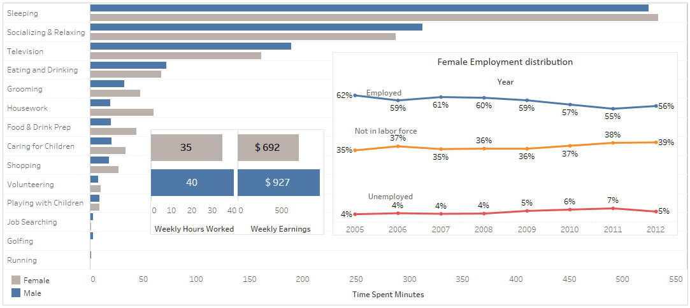
Men Vs Women: 1) Women show much higher time spent on chore like activities; 2) Despite working .9 times as much as men women get only .75 times the wage as men; 3) The Percentage of employed women has gone down from 62% in 2005 to 56% in 2012

Slide 7
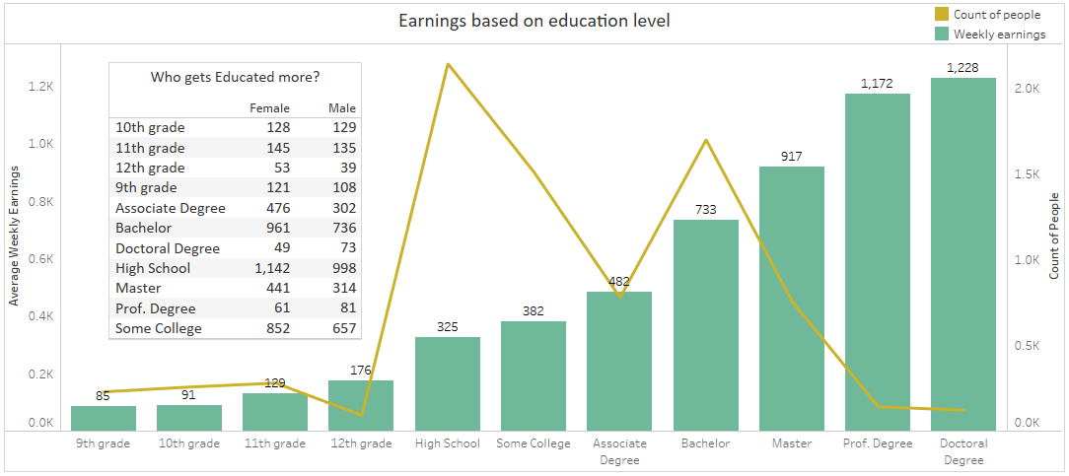
Education EDA: 1) The highest wages are earned by the most educated people ( >$1000 per week) while most common level of education achieved is a high school diploma. 2) Women account for 55% of the data in 2012, however they make up only 42% of people with a Prof. or a doctoral degree
Note: Data in this slide is for 2012

Slide 8
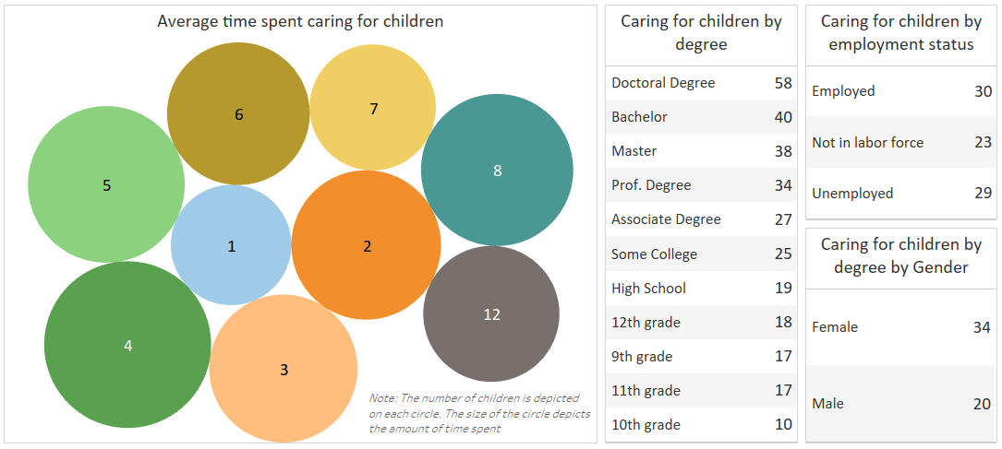
Child Analysis: 1) Women spend 1.75 the amount of time caring for children than men 2) Lesser the education, lesser is the amount of time spent caring for children. 3) Time spent caring for children gradually increases till 5 children after which it remains constant

Slide 9
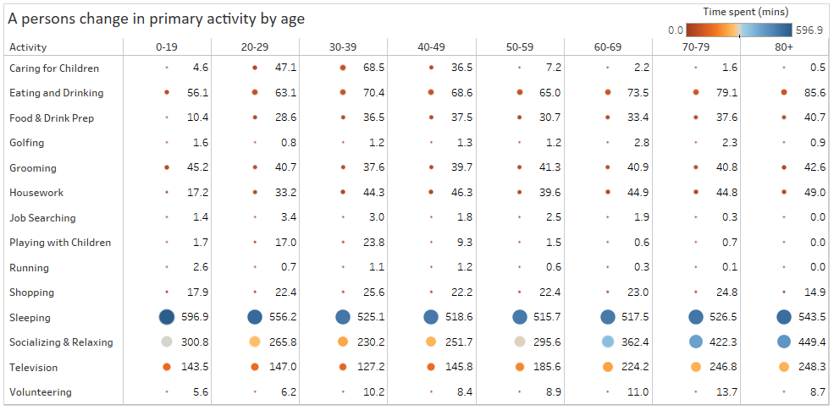
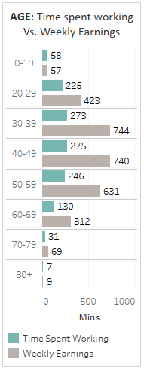
Age Analysis: 1) Teenagers spend 220% more time on running over any other age group 2) People in the 30-39 age bracket spend the most amount of time caring for children (69 mins/day) and playing with children (24 mins/day)
Note: Data in this slide is for 2012

Slide 10
Age Analysis: 3) There is a 40% in socializing and 30% increase in Television watching time for senior citizens.
Note: Data in this slide is for 2012. Weekly Earnings is in $

Slide 11
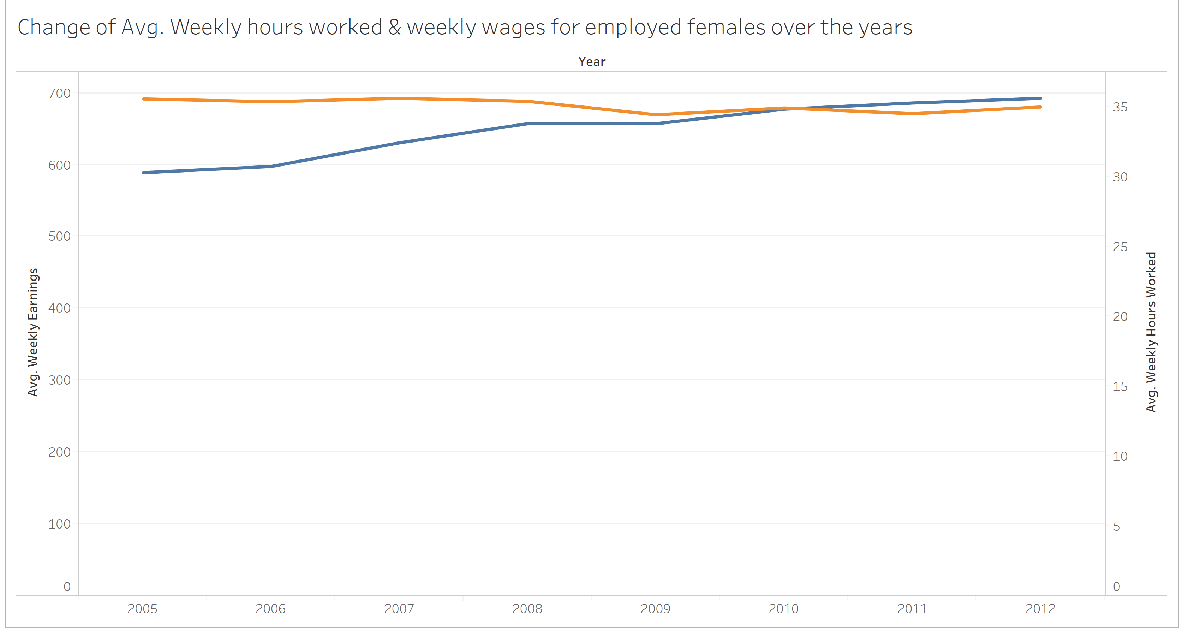
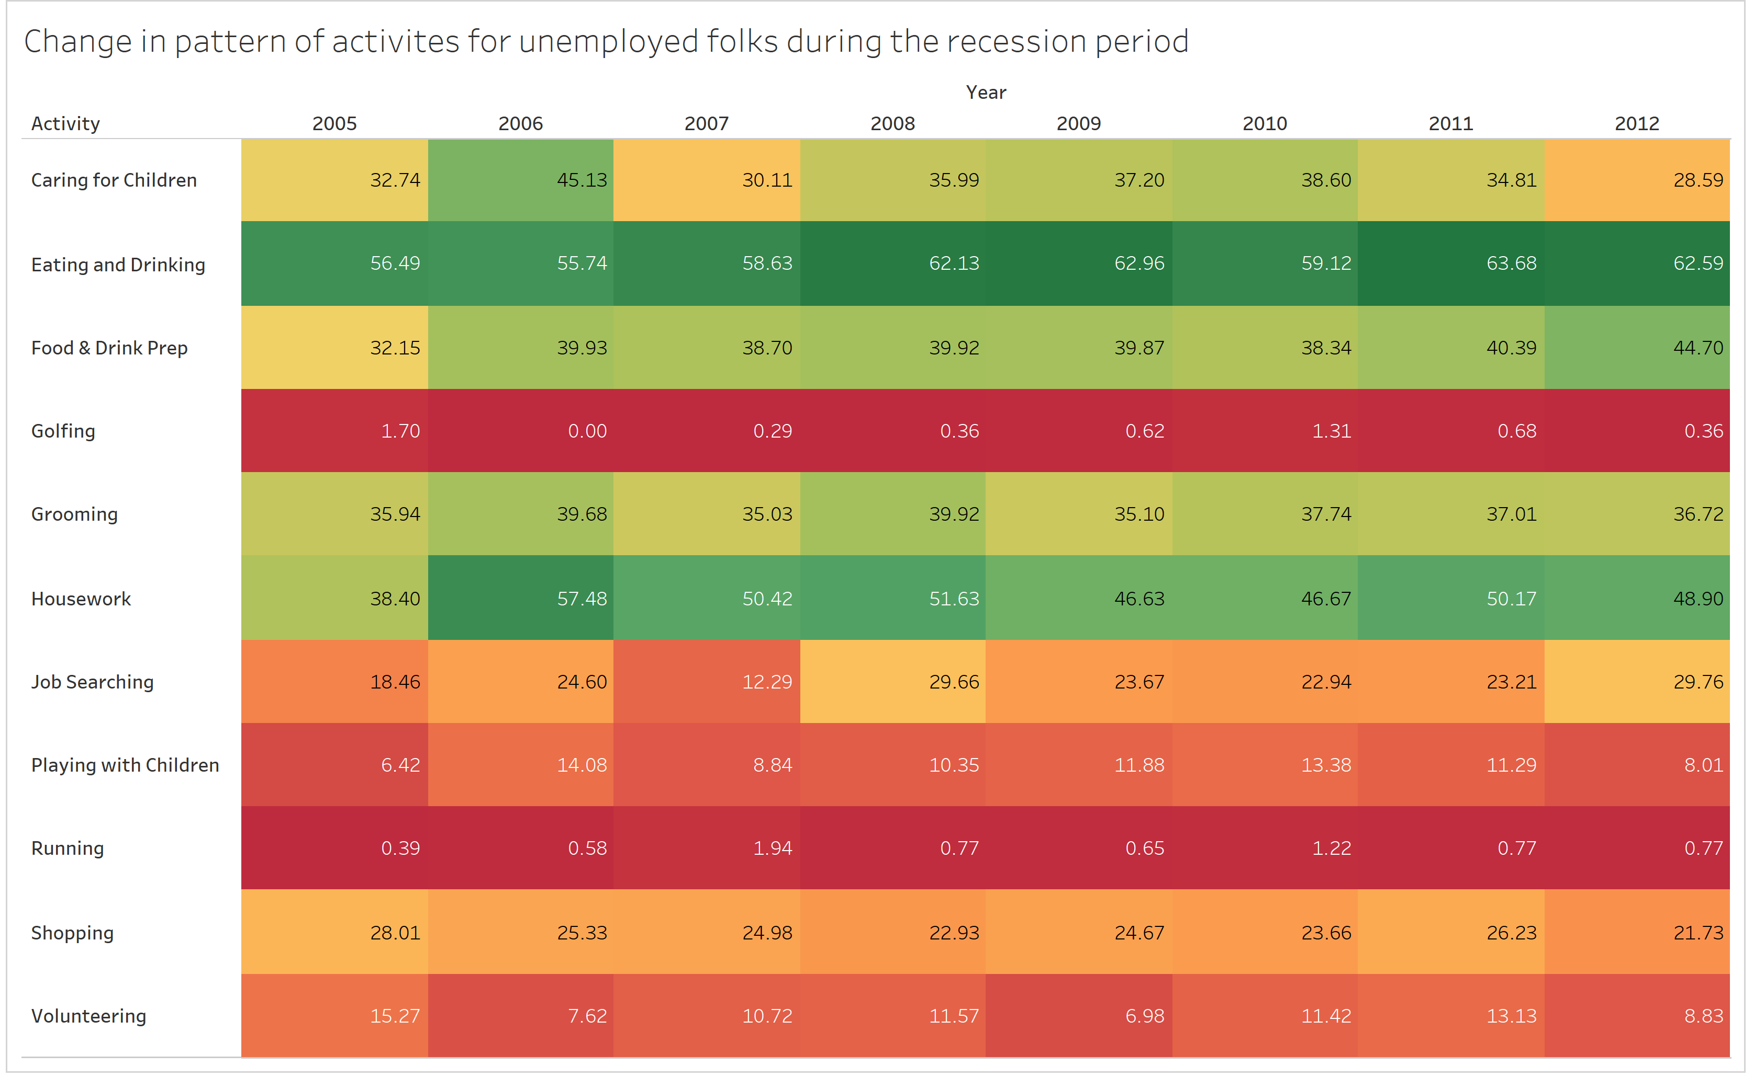
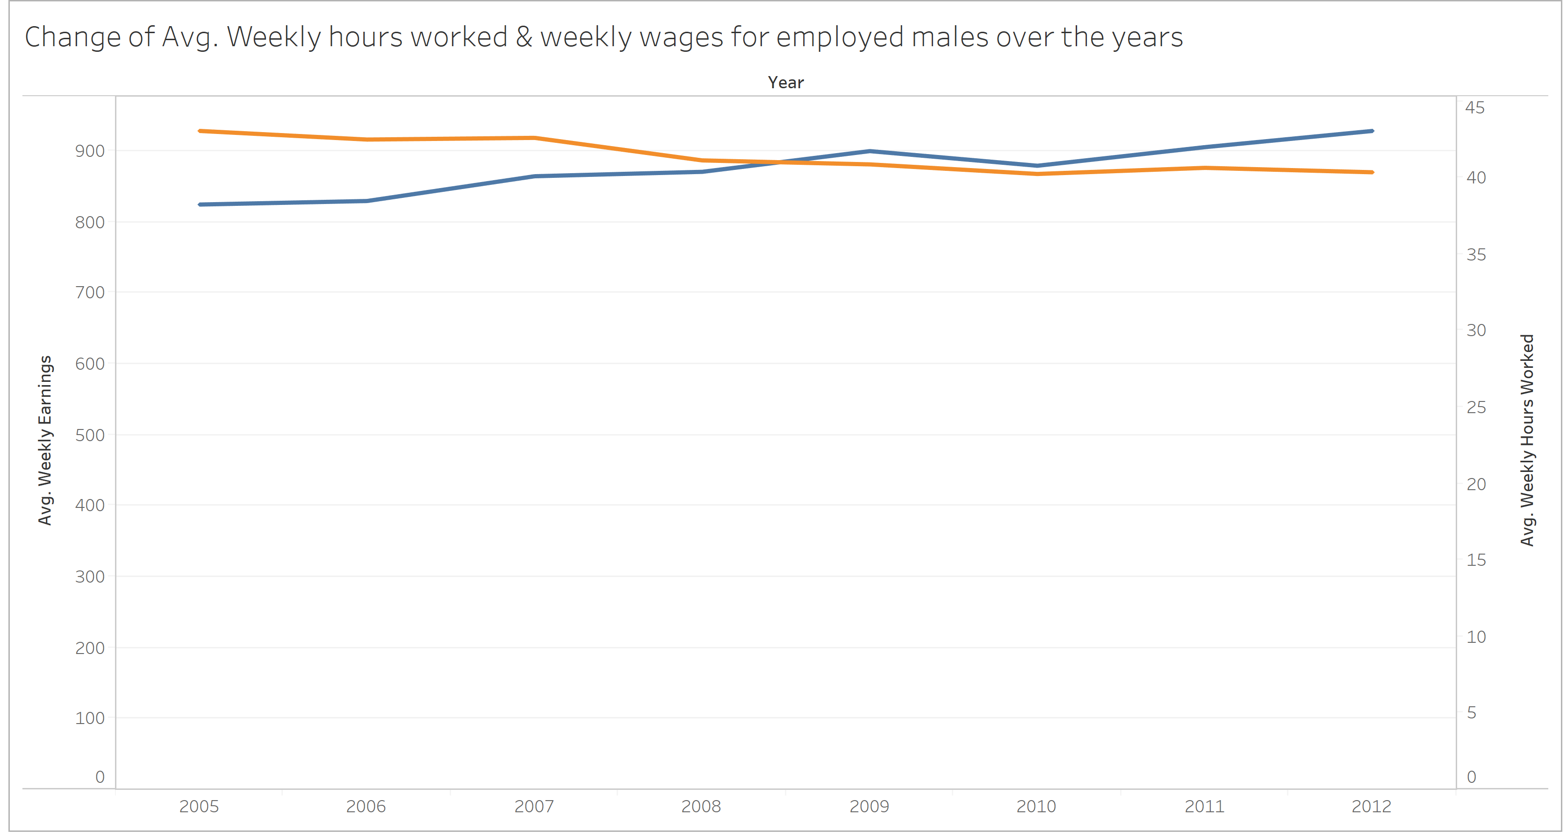
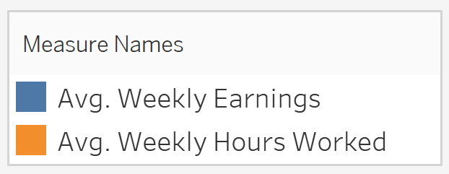
Recession Analysis: For men, the recession is a tipping point which mark a great increase in weekly earnings with a corresponding decrease in hours worked.
The average time spent on job searching has increases by over 2 times during 2008 when compared to 2007
The average time spent for sleeping has decreased by 25 minutes on a daily basis during recession

Slide 12
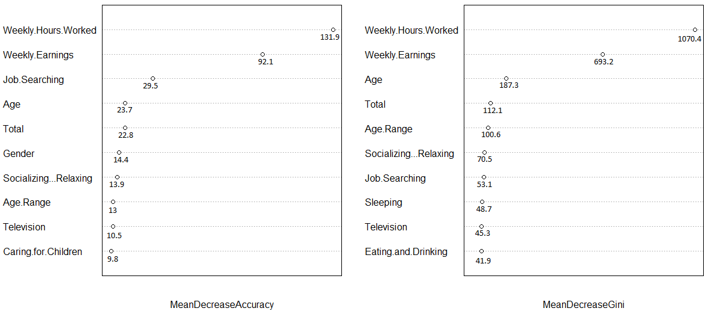
Variable Importance
Below are the top 10 variables used while predicting Employment status in our data. We used two evaluators in the Random Forest model obtain these variables:
Mean Decrease in Accuracy: this graph tests how much will the accuracy of the model decrease by if we remove a variable
Mean Decrease in Gini: This graph measures how pure decrease in purity at the end nodes of trees without each variable
From the graphs, the most important variables are Weekly_hours_worked, Weekly Earnings, Job searching and Age
Please note that the most important variable outside of these test is Education level. It does not show on these graphs as we have used it to split our data to run models customized for each education level

Slide 13
Artificial Neural Network (ANN)
ANN is based on numerous numbers of neurons to calculate the result which is highly flexible to adjust and can be used to deal with multiple data problem easily.
We took the advantage of ANN to build a flexible and scalable model to predict our result.
Model Characteristics
No. of layers | 2
No. of Folds | 5
Total Neurons | 600
Epochs (No. of Cycles) | 1000
Note: Complete details about the model are in the model methodologies word file

Slide 14
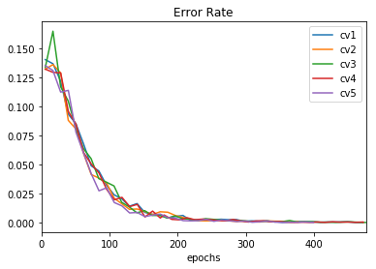
Artificial Neural Network– Evaluation
Confusion Matrix
 | Employed | Not in labor force | Unemployed
Employed | 7941 | 42 | 7
Not in labor force | 80 | 2859 | 330
Unemployed | 14 | 242 | 181
Converted original data into H2O data frame
Created ANN with input 44 variables, 2 hidden layers with 300 neuron each and the soft-max output layer
Used the k-fold cross validation for model robustness
Plotted training error to make sure the model converge
Computed the Confusion Matrix for test data set
Predicted the employment status for target dataset
Model Metrics
Accuracy | 93.53%
Sensitivity | 95.70%
Specificity | 97.74%
Cross- Validation Accuracies
1. 93.89%
2. 93.05%
3. 93.76%
4. 93.44%
5. 93.52%

Slide 15
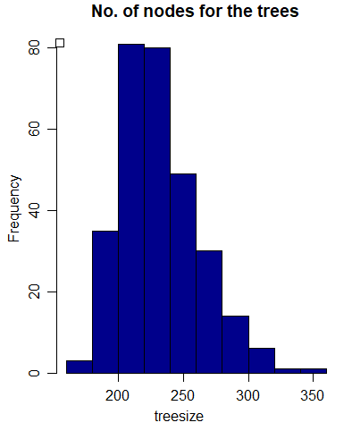
Random Forest
Random forest is an ensemble of decision trees to increase accuracy
The steps followed in this method were
Split the data at an education completed level
Make a forest for each of the education level
Check the importance of predictor variables. Understand the structure and depth of trees
Perform a K-fold cross validation to test model robustness. K was taken as 5 in our case
Predict the values of the test dataset
The mean accuracy provided by K-fold cross validation was 94.42%
Note: Complete details about the model are in the model methodologies word file

Slide 16
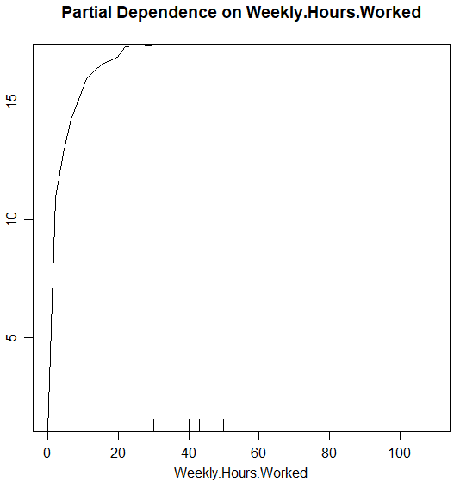
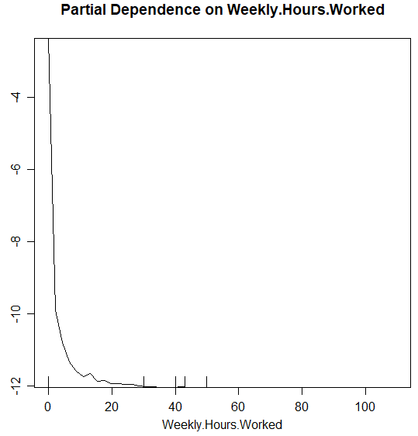
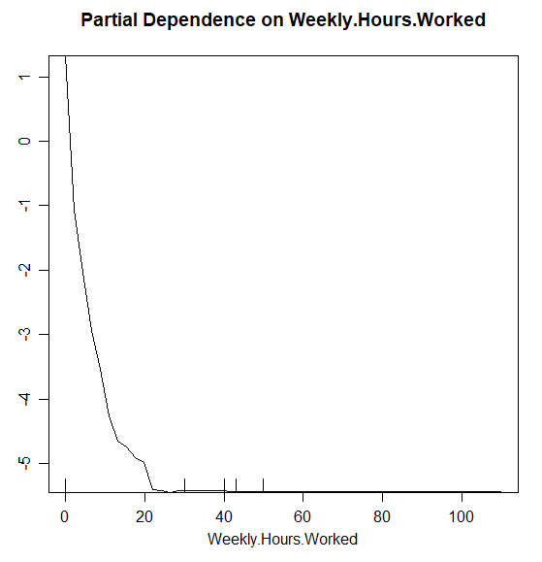
Random Forest – Evaluation
The Partial dependency curves describe for what value of weekly hours worked does the model change it’s value:
For Weekly hours worked greater than 35-40 the model will predict a row as “employed”
For Weekly hours worked less than 10 will tend to be “Unemployed”
The confusion matrix helps predict the accuracy of the model
Partial Dependency Curves – Weekly Hours Worked
Employed
Unemployed
Not in labor force
Model Metrics
Accuracy | 94.42%
Sensitivity | 98.32%
Specificity | 98.07%
Cross- Validation Accuracies
1. 94.15%
2. 95.57%
3. 95.38%
4. 94.23%
5. 92.78%
Confusion Matrix
 | Employed | Not in labor force | Unemployed
Employed | 8033 | 8 | 2
Not in labor force | 112 | 3878 | 538
Unemployed | 11 | 78 | 140

Slide 17
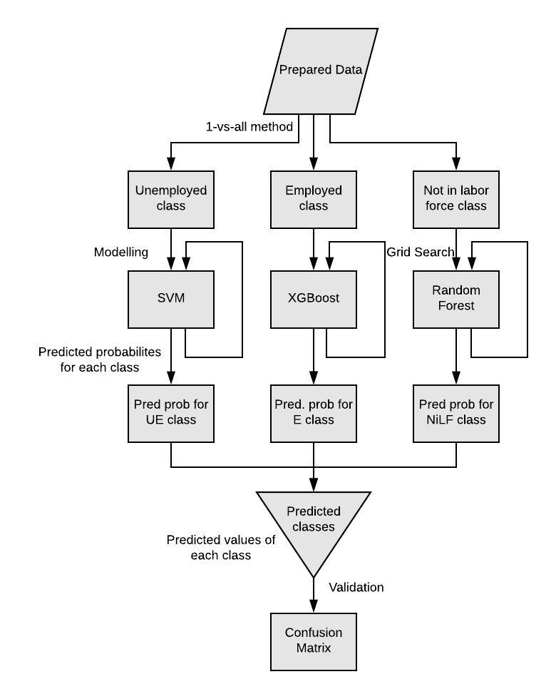
Ensemble model (SVM, XGBoost & Random Forest Classifiers)
Prepared the data (Conversion of fields into nominal form)
Created 3 classes of data using 1-vs-all methodology
Modelled SVM for unemployed class, XGB for Employed class & Random Forest for Not in labor force class
Optimized the models for best parameters using Grid Search
Probability of variable belonging to each class is obtained from the model
Predict the class using highest probability value
Compute the Confusion Matrix for test & validation data set
Using these models, predicted the employment status for test dataset
Cross- Validation Accuracies
1. 91.46%
2. 90.53%
3. 92.75%
4. 92.65%
5. 90.86%
Confusion Matrix
 | Unemployed | Employed | Not in labor force
Unemployed | 240 | 0 | 93
Employed | 25 | 4046 | 36
Not in labor force | 417 | 1 | 1543
Model Metrics
Accuracy | 91.65%
Sensitivity | 82%
Specificity | 96.6%
Note: Complete details about the model are in the model methodologies word file

Slide 18
Model Comparison (ANN Vs RF Vs Ensemble)
Metric | ANN | RF | Ensemble Model
Accuracy | 93.53% | 94.42% | 91.65%
Max. Accuracy | 93.89% | 95.57% | 92.75%
Min. Accuracy | 93.05% | 92.78% | 90.53%
Sensitivity (True +ve rate) | 95.70% | 98.32% | 82%
Specificity (True –ve rate) | 97.74% | 98.07% | 96.6%
Key points to note while selecting model:
The top two models chosen are the Random Forest model and the ANN model:
The RF model has better Accuracy
The ANN Model has better Consistency
2) The Ensemble model is a highly ambitious approach on our part, and still needs more fine tuning to get it’s accuracy higher
3) Please note that we cannot narrow down on one model, and have hence chosen 2 models for prediction submission.
Note: Please find the prediction excels for the predicted values of the test dataset

