Slide 1






Title Page
DRIVE GUARD
Project Presentation
on
“Drive Guard”
By
Pradhyumna G (1JS21IS069)
Sharanagouda G Patil (1JS21IS098)
Sumukha S Hebbar (1JS21IS112)
Shravan S Thane (1JS22IS411)
Under the Guidance of
Mrs. Basamma Umesh Patil, Assistant Professor
Department of Information Science and Engineering

Slide 2


Title Page
Table of Contents
Table of Contents
The Flow
Abstract
3
Introduction
4
Problem Statement
5
Objectives
6
Literature Review
7
Dataset description
8-9
Methodology
10-11
Modules in the project
12-13
Results and Conclusion
14-16
Future Enhancements
17
References
18

Slide 3

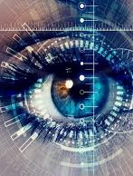
Title Page
Table of Contents
Abstract
Abstract
Abstract
There has always been a safety issue when driving, and this issue is becoming increasingly important as the number of accidents caused by automobile crashes or distracted driving rises. One of the leading causes of accidents worldwide is driver weariness.
To identify fatigue, the device uses a small security camera that points straight at the driver's face and watches the driver's eyes.

Slide 4
Title Page
Abstract
Introduction
Introduction
Introduction
Driver drowsiness detection systems aim to identify when a driver is becoming drowsy and potentially falling asleep at the wheel. Fatigue is a significant cause of road accidents, and these systems can play a crucial role in preventing such incidents.
This system focus on ensuring that the driver remains attentive and engaged with the driving task. Distraction can result from various sources, such as mobile phones, in-car entertainment systems, or external events. This system also tracks focus and gaze direction

Slide 5

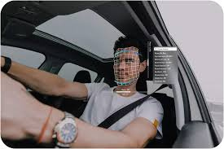
Title Page
Table of Contents
Abstract
Problem Statement
Problem statement
Problem Statement
This project aims to develop an AI-based system to monitor and analyze driver behavior in real-time, with the goal of improving road safety and reducing accidents.
The system will leverage OpenCV and machine learning techniques to detect and classify various driving patterns and behaviors.

Slide 6


Title Page
Table of Contents
Abstract
Introduction
Objectives
Objectives
Objectives
Driver State Identification
Driver fatigue detection
Provide Alerts
Identify the driver’s state (e.g., normal, distracted, drowsy) based on various visual and behavioral cues, such as eye gaze direction and focus
Identify signs of driver fatigue, such as eye closure or reduced eye movement and head nodding leaning
The system will provide real-time alerts to the driver through audio and visual alerts

Slide 7
Title Page
Abstract
Introduction
Literature Review
Literature Review
Authors and Year | Paper Title | Contribution | Findings/Drawbacks
Gauri Adarsh et al[1] Published Year : 2023 | Drowsiness Detection System in Real Time Based on Behavioral Characteristics of Driver using Machine Learning Approach | Dataset : Open eyes, Closed Eyes Algorithm used : Neural networks, SVM | Results : Detected drowsiness based on the opening and closing movement of the driver's eyes
Riad Alharbey et al[2] Published Year : 2022 | Fatigue State Detection for Tired Persons in Presence of Driving Periods | Dataset : EEG signals, Vedio streaming recordings Algorithms used : Machine Learning Classifiers, Deep learning Models | Results : EEG signals processing by predict?ing driver behavior to detect fatigue status. Limitations : Complex techniques used to extract EEG signals
Rajashekar Shastry et al[3] Published Year : 2022 | Driver Drowsiness Detection Using Machine Learning | Dataset : Eyes and Face Algorithms used : Bayesian classifier, FLDA, SVM | Results : Detected drowsiness based on visual behaviour Limitations : Driver attention not included
Sanjeevani Srivastava et al[4] Published Year : 2023 | Driver Drowsiness Monitoring System using Machine Learning | Dataset : Open eyes, Closed eyes Algorithms used : Convolutional Neural Network (CNN), HAAR cascade classifier | Results : calculates the driver's tiredness level from the driver using a combination of webcam, HAAR cascade classifier
Shivam Dhiman[5] Published Year : 2023 | Automated Driver Drowsiness Detection | Dataset used : Face landmarks, Left eyes, Right eyes Algorithms used : Regression tress, SVM | Results : capability to detect sleepy, risky driving behaviors in drivers in a very short amount of time.

Slide 8

Title Page
Abstract
Introduction
Problem Statement
Objectives
Dataset Description
Dataset Description
Dataset Description
Dataset used : shape_predictor_68_face_landmarks.dat
68 Facial Landmarks :
The model can detect 68 specific points on a face, including the eyes, eyebrows, nose, mouth, and jawline. These landmarks help define the shape and structure of the face.
Model Architecture :
This file contains the structure of the trained model, specifying how input images are processed to produce the landmark predictions.
Pre-trained Weights :
The file includes weights from a machine learning model that has been trained on a large dataset of annotated images. These weights are used to predict the location of facial landmarks on new images.

Slide 9
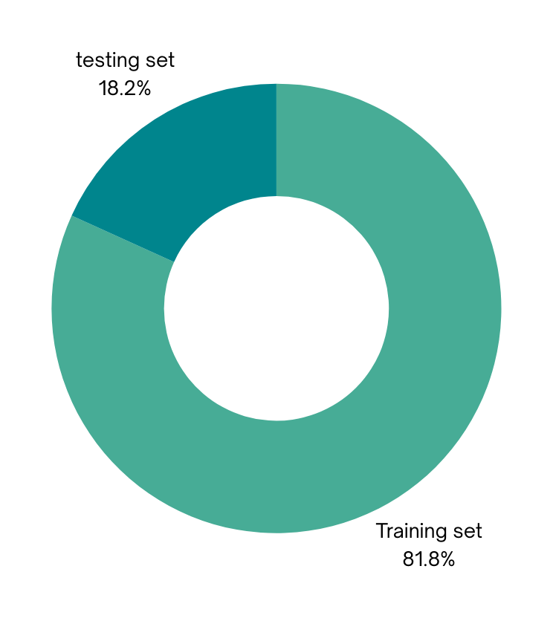
Title Page
Abstract
Introduction
Problem Statement
Objectives
Dataset
Dataset
The shape_predictor_68_face_landmarks.dat is a pre-trained model file used for facial landmark detection. This model is part of the Dlib library, which is an open-source toolkit containing machine learning algorithms and tools for creating complex software.
The shape_predictor_68_face_landmarks.dat model is trained to detect 68 specific points (landmarks) on a human face. These landmarks are typically used in various computer vision tasks such as face recognition, facial attribute analysis, and face alignment.
The model is trained using a dataset that contains annotated facial images. The annotations provide the precise locations of the 68 landmarks on each face.
The dataset includes a diverse set of images to ensure the model's robustness and accuracy across different faces, expressions, and orientations.

Slide 10
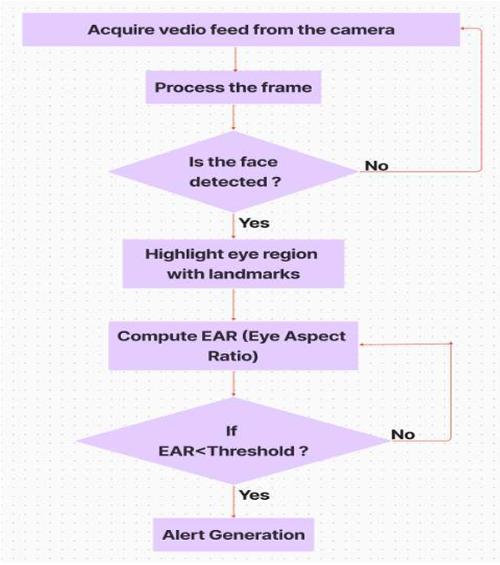
Title Page
Abstract
Introduction
Problem Statement
Dataset
Methodology
Methodology
Methodology
The proposed methodology consists of mainly six stages such as data acquisition(capturing vedio frames), face detection, face landmark detection, classification, drowsiness detection and alert generation. The pictorial representation of the given architecture is given in Figure 1.
Figure 1 Proposed architecture for drowsiness detection system

Slide 11
Title Page
Abstract
Introduction
Problem Statement
Dataset
Methodology
Methodology
Methodology
Data Acquisition(Capturing vedio) :
Data is collected from various cameras, during controlled driving simulations or real-world driving scenarios.
Classification :
Machine learning algorithms, trained on labeled data, classify drowsiness levels based on the eye aspect ratio(EAR).
Face Detection :
Rawdata is i.e vedio is converted to frames and identify the face in the respective frame
Drowsiness Detection :
Based on the eye state classification, if EAR is less than threshold, driver is identified as drowsy.
Facial Landmark Detection :
Model locates landmarks on the detected faces and identifies th eyes in it for further analysis.
Alert Generation :
Both visual and audio alerts will be generated.

Slide 12


Title Page
Abstract
Introduction
Problem Statemnet
Dataset
Methodology
Modules of the project
Modules of the project
Modules of the Project
Face Detection Module :
Detects the presence of a face in the video frame.
Eye Detection Module:
Identifies and locates the eyes within the detected face region
Eye Aspect Ratio (EAR) Calculation Module :
Calculates the Eye Aspect Ratio to measure eye openness.
The EAR is computed using the distances between specific points on the eye.
Drowsiness Detection Module :
Analyzes EAR over time to detect prolonged eye closures, indicating drowsiness.
Threshold values and duration for EAR are set to determine drowsiness.
Alert System Module :
Triggers alerts (such as sounds or vibrations) when drowsiness is detected.
Can also provide visual alerts on the screen.

Slide 13
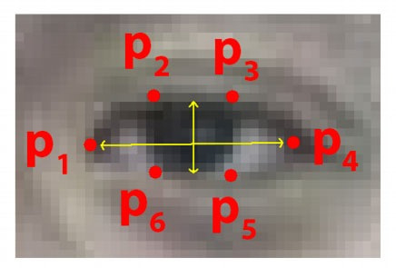
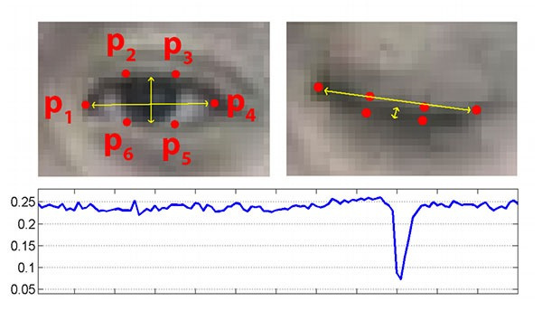
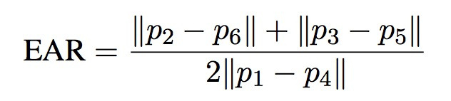
Title Page
Abstract
Introduction
Problem Statemnet
Dataset
Methodology
Modules of the project
Modules of the project
Figure 4 Formula used to calculate the Eye Aspect Ratio (EAR)
Figure 2 Representing 6 points in the eye
Figure 3 Graph indicates the threshold to calculate drowsiness

Slide 14
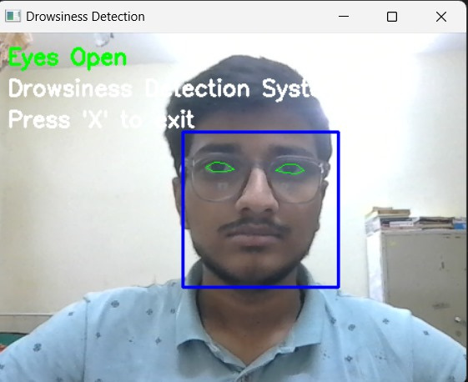
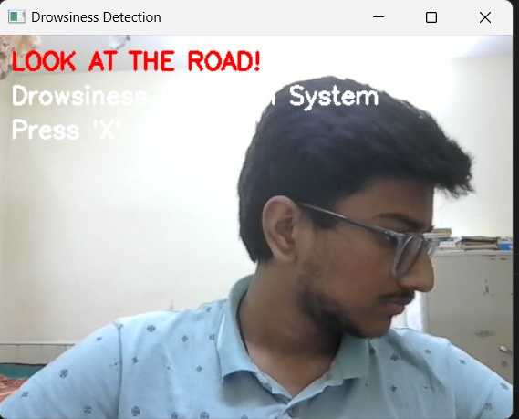
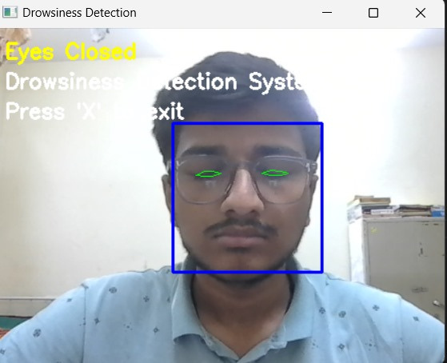
Title Page
Abstract
Introduction
Problem Statemnet
Dataset
Methodology
Results
Results
Figure 5 Landmarks of eyes are highlighted and Status of eyes is open
Figure 7 Landmarks of eyes are highlighted and Status of eyes is closed
Figure 6 Visual alert generated as driver is distracted and looking left

Slide 15
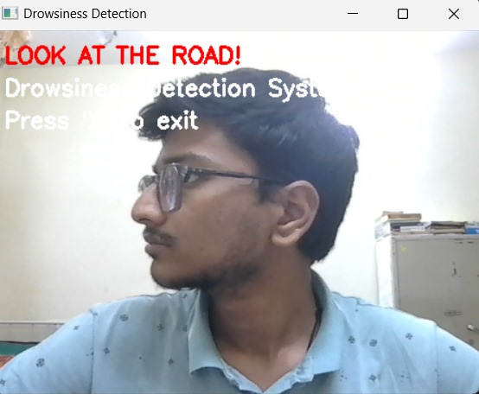
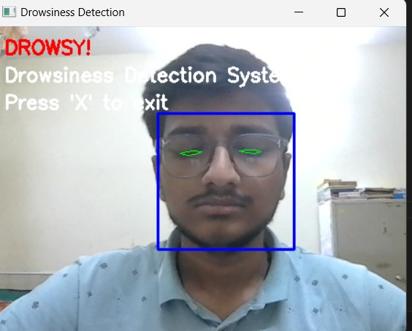
Title Page
Abstract
Introduction
Problem Statemnet
Dataset
Methodology
Results
Results
Results
Figure 8 Visual alert generated as driver is distracted and looking right
Figure 9 Visual alert generated as driver‘s eyes and closed and classified as drowsy

Slide 16
Title Page
Abstract
Introduction
Dataset
Methodology
Results
Conclusion
Conclusion
Conclusion
The proposed drowsiness detection system demonstrates the potential to enhance road safety by detecting and alerting drivers to signs of fatigue.
As the technology evolves, the system can be integrated with advanced driver assistance and autonomous driving features.
The implementation of this AI-based driver behavior detection system has the potential to significantly reduce road accidents and fatalities.

Slide 17

Title Page
Abstract
Introduction
Dataset
Methodology
Results
Conclusion
Future Enhancements
Future Enhancements
Future Enhancements
This project can be furthur developed and can be used to completely analyse the behaviour of driver
Integrating the deep learning algorithm into mobile devices and adding onboard GSM module for SMS alert. Enable remote monitoring and alerts for fleet management in commercial vehicles.
Use anomaly detection algorithms to identify deviations from normal driving behavior that may indicate drowsiness.

Slide 18
Abstract
Introduction
Dataset
Methodology
Results
Conclusion
Future Enhancements
References
References
References
[1] G. Adarsh, V. Singh, S. Singh and B. Hazela, “Drowsiness Detection System in real time based on behavioral characteristics of driver using machine learning approach” Journal of Informatics Electrical and Electronics Engineering (JIEEE), Vol. 04, Iss. 01, S No. 003, pp. 1–10, 2023.
[2] R. Alharbey, M. M. Dessouky, A. Sedik, A. I. Siam and M. A. Elaskily, "Fatigue State Detection for Tired Persons in Presence of Driving Periods," in IEEE Access, vol. 10, pp. 79403-79418, 2022
[3] A Tejaswini, B Sravani, N Sindhu, Rajashekar Shastry, “DRIVER Drowsiness Detection Using Machine Learning”, open access international journal(IJIEMR), Vol. 11, Iss. 06, 2022
[4] S. Srivastava, “Driver Drowsiness Monitoring System using Machine Learning,” International Journal for Research in Applied Science and Engineering Technology, vol. 11, no. 5, pp. 1344–1350, May 2023.
[5] S. Dhiman, “Automated Driver Drowsiness Detection,” International Journal of Innovative Research in Engineering, pp. 181–187, May 2023.
[6] K. Harika, S. Prasad, B. Kumar, S. Mummala, P. Bhavani and R. Swathi, "Drowsiness Detection Using Opencv," 2022 International Conference on Advancements in Smart, Secure and Intelligent Computing (ASSIC), Bhubaneswar, India, 2022, pp. 1-7.

Slide 19
Abstract
Introduction
Dataset
Methodology
Results
Conclusion
Future Enhancements
References
References
References
[7] A. A. Suhaiman, Z. May and N. A. A.Rahman, "Development of an intelligent drowsiness detection system for drivers using image processing technique," 2020 IEEE Student Conference on Research and Development (SCOReD), Batu Pahat, Malaysia, 2020, pp. 233-236.
[8] A. Upadhyay, N. Jain, K. Sharma and S. Kumar, "A Futuristic Approach to Driver Drowsiness Detection and Prevention Using OpenCV And HAAR Software," 2024 International Conference on Smart Systems for applications in Electrical Sciences (ICSSES), Tumakuru, India, 2024, pp. 1-5.
[9] V. Singhal, N. Soni, K. Khatri, B. K. Chokkar and K. Kumar, "Drowsiness Detection and Alert System using DLib," 2023 International Conference on Advances in Computation, Communication and Information Technology (ICAICCIT), Faridabad, India, 2023, pp. 242-246.
[10] M. Bhushan, D. Joshi, T. K. Gujral, S. K. Singh, A. Singh and A. Negi, "Application of Machine Learning in Driver Drowsiness Detection," 2023 International Conference on Artificial Intelligence and Applications (ICAIA) Alliance Technology Conference (ATCON-1), Bangalore, India, 2023, pp. 1-6.

