Slide 1

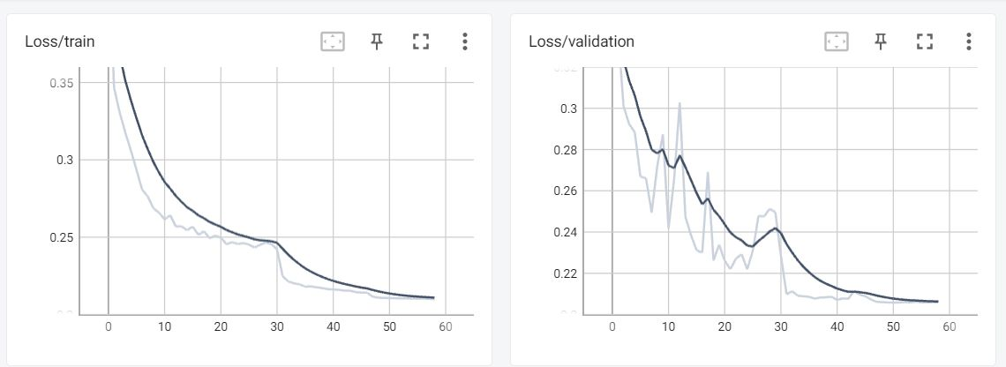
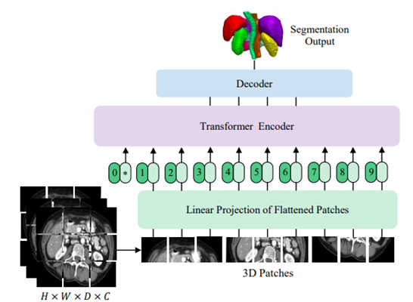
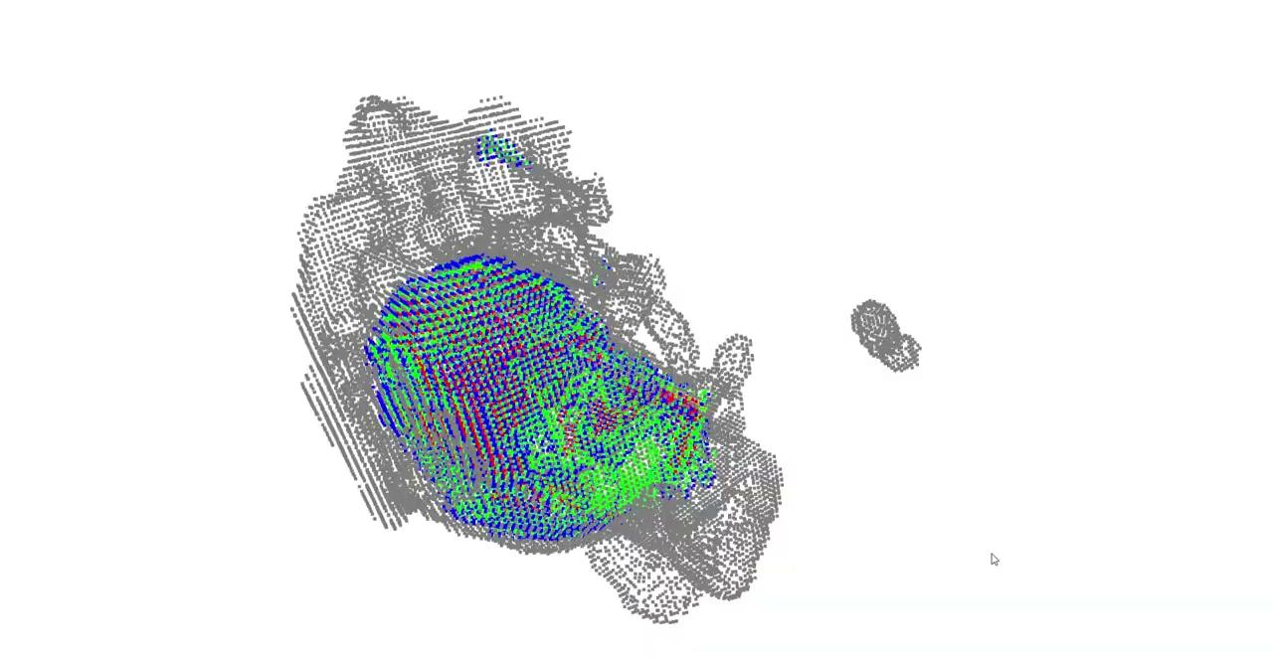
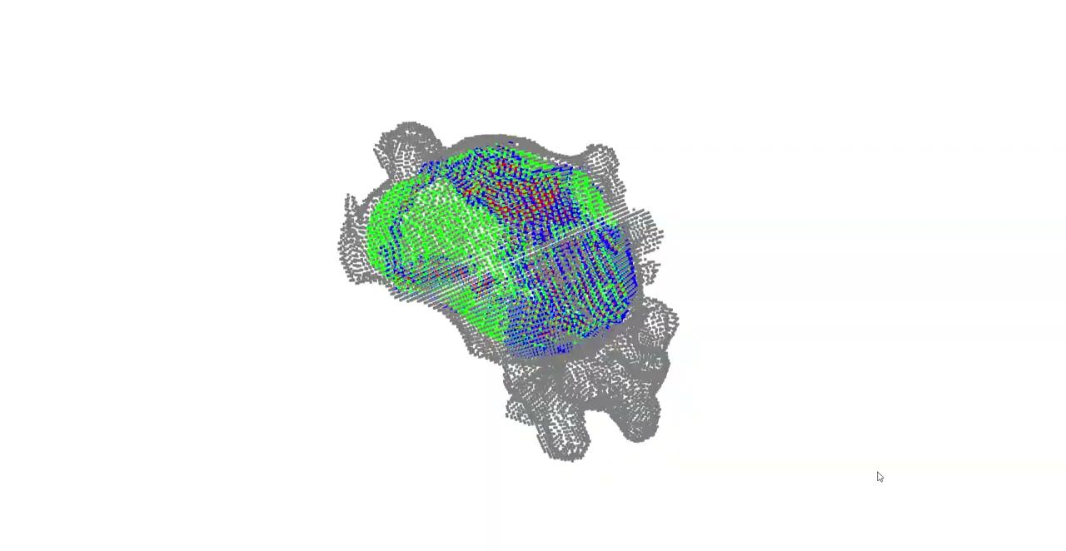
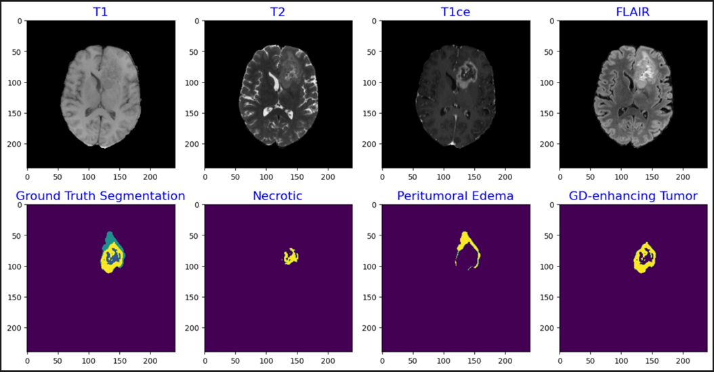
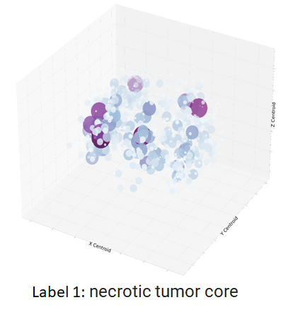
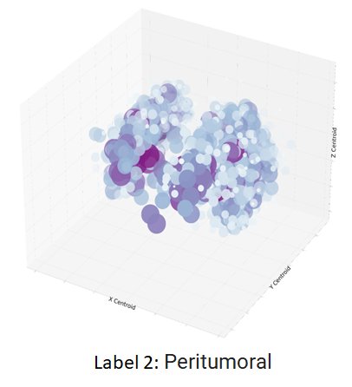
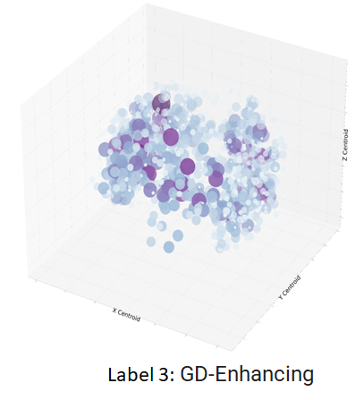
3D Brain Tumor
Segmentation
Department of
Electrical and Computer
Engineering
Introduction
Methodology
Results
Brain tumors are a serious health concern, and accurate and timely diagnosis is critical for effective treatment.
MRI scans are a common diagnostic tool for brain tumors, but analyzing and localizing tumor regions can be time-consuming and difficult.
The goal of our project is to automate the localization and scanning of brain tumor regions in MRI scans using neural networks.
Our method generates segmentation predictions and insightful visualizations, facilitating efficient and accurate diagnosis.
Our project poster showcases the key components and results of our approach.
UNETR:
UnetR is a combination of the VIT model and the Unet architecture.
The effectiveness of UnetR has been showcased on other medical image datasets such as MSD and BTCV.
Based on the characteristics of the data and the correlation between the tumor classes and their localization in the scans, we have used UnetR to localize the tumor classes better in the BRaTS 2021 Dataset.
Predicted and Segmented Label Visualizations:
Datasets and Preprocessing
Predicted Output from Model:
Original Segmented Label:
.
BRaTS 2021 Task1 Dataset:
The dataset contains multi-MRI scans acquired during a single imaging session. It includes the following types of scans:
•Native T1-weighted (T1): This scan is obtained using a standard T1-weighted imaging sequence. This sequence highlights the differences in tissue types based on their contrast with the surrounding tissues.
•Post-contrast T1-weighted (T1Gd): This scan is obtained using a T1-weighted imaging sequence after the administration of a contrast agent such as Gadolinium. This sequence highlights the regions of the brain with a disrupted blood-brain barrier, such as enhancing tumor regions.
•T2-weighted (T2): This scan is obtained using a T2-weighted imaging sequence. This sequence highlights subtle differences in tissue types that are not visible on T1 scans
•T2 Fluid Attenuated Inversion Recovery (T2-FLAIR): This scan is obtained using a T2-weighted imaging sequence. This sequence is useful for distinguishing between edema and other types of brain tissue
Conclusion
In conclusion, our project presents a promising solution for automating the localization and scanning of brain tumor regions in MRI scans.
By leveraging the power of neural networks, we have achieved accurate segmentation predictions and generated insightful 3D visualizations that can aid in timely and effective diagnosis.
Our approach has the potential to significantly improve the efficiency and accuracy of brain tumor diagnosis and treatment, ultimately contributing to better patient outcomes.
We are excited to continue exploring this technology and its applications in the field of medical imaging.
Experiments Performed:
 | Trial 1 | Trial 2 | Trial 3 | Trial 4
MODEL | VNet | UNetR | UNetR | UNetR
DATA | t1ce, t2 and flair | t1ce | t1ce, t2 and flair | t1ce, t2 and flair
TRAINING LOSS | Dice Loss | Dice Loss | Dice Loss | Dice Focal Loss
MEAN IoU | 0.624 | 0.505 | 0.761 | 0.77
Necrotic Core IoU | 0.364 | 0.323 | 0.591 | 0.611
Peritumoral IoU | 0.537 | 0.335 | 0.706 | 0.719
GD-Enhancing IoU | 0.601 | 0.371 | 0.745 | 0.75
Segmentation Label Categories:
•label 0: No tumor
•label 1: necrotic tumor core (Visible in T2): This class represents the core of the tumor, which is composed of necrotic tissue and non-enhancing tumor cells.
•label 2: the peritumoral edematous/invaded tissue (Visible in flair): This class represents the edema, or swelling, that occurs around the tumor due to the accumulation of fluid in the surrounding brain tissue.
•label 4: Gd-enhancing tumor (Needs to be converted to 3) (Visible in T1ce): This class represents the region of the tumor that enhances with the administration of contrast agent
Future Direction
In future directions, we plan to further improve the accuracy of our approach by incorporating data augmentation and boundary conditions.
Data Augmentation Techniques, such as rotation, scaling, and flipping, can help increase the diversity and quantity of the training data, which can improve the robustness and generalization of the neural network.
Additionally, incorporating Boundary Conditions into the neural network can help ensure that the segmentation predictions are consistent with the anatomical structures of the brain, further improving the accuracy of the model.
These enhancements have the potential to significantly improve the performance of our approach and enable even more accurate and efficient diagnosis of brain tumors.
Observations from the Experiments:
From the above experiments, we observed that the segmentation is better when the model is trained with Dice Focal Loss giving a higher mean IoU when compared to the model trained with Dice Loss.
And also, since Dice Focal Loss includes a focal term that assigns higher weights to hard-to-segment samples and gives more importance to the pixels that are misclassified, we observed an increase in the IoU scores for the necrotic tumor.
In the trial 2, we trained the model by enhancing the contrast of the scan but then observed that the results were not that great since all three scans contain important information that is needed for accurate segmentation results.
After few more trials by experimenting with the image size, rotations and other hyper parameter tuning, we observed significant results in the segmentation with Dice Focal loss and the same has been documented above.
References
[1] V-Net: Fully Convolutional Neural Networks for Volumetric Medical Image Segmentation, Fausto Milletari et al., [1606.04797] V-Net: Fully Convolutional Neural Networks for Volumetric Medical Image Segmentation (arxiv.org)
[2] UNETR: Transformers for 3D Medical Image Segmentation, Ali Hatamizadeh et al., [2103.10504] UNETR: Transformers for 3D Medical Image Segmentation (arxiv.org)
[3] The RSNA-ASNR-MICCAI BraTS 2021 Benchmark on Brain Tumor Segmentation and Radiogenomic Classification, Ujjwal Baid et al., [2107.02314] The RSNA-ASNR-MICCAI BraTS 2021 Benchmark on Brain Tumor Segmentation and Radiogenomic Classification (arxiv.org)
Total Data and Train-Val-Test Split:
•Number of data points available: 1251 (patients)
•Number of scans: 155
•Resolution of scans: 240 x 240
Generated splits:
•Training split: 800 patients
•Validation split: 200 patients
•Test split: 251 splits

