Slide 1

Confidence-Aware RAG Pipeline with Hallucination Detection
Answer only when the sources prove it, and say why when they don't.
Shivam Gupta (BTCD24O1060)
Cornerstone Project · Project Expo 2026
Artificial Intelligence & Machine Learning Systems · July–Dec 2026
Notes:
Introduce yourself and the one-line idea: a RAG chatbot that checks its own answers twice and refuses when it cannot show the documents support the answer. Say the talk follows the five milestones and ends with a live demo.

Slide 2



The problem: RAG still answers when it shouldn't
Out of scope
Invented details
Contradiction
The documents don't cover the question, but the model answers anyway from its general training.
The right passages are retrieved, but the model adds facts, numbers or causes they don't contain.
The model states something the passages actually say the opposite of.
The answer sounds equally confident every time. A user cannot tell a correct answer from a fabricated one, and a confident wrong answer does more damage than an honest "I don't know", because people act on it.
Notes:
Plain RAG reduces hallucination but doesn't remove it. Walk through the three failure modes with an example each. The goal of the project is self-assessment: knowing when not to answer.

Slide 3
Objectives
Build
An end-to-end RAG pipeline on one laptop GPU with free, open models
Gate A
Check passage relevance before generating; refuse early if irrelevant
1
2
Gate B
Check every answer sentence against the passages after generating
Decide
Combine both into one confidence and answer, warn, or abstain with a reason
3
4
Monitor
Log every decision and show trends in a dashboard
Measure
Compare honestly against plain RAG on SQuAD 2.0 and HotpotQA
5
6
Notes:
Six objectives. Emphasise the last one: measuring the cost of abstaining honestly against a baseline, not just reporting the good numbers.

Slide 4
Project workflow: five milestones
M1
M2
M3
M4
M5
Build
Benchmark
Calibrate
Stress-test
Audit & improve
Pipeline, both gates, composite score, telemetry, Streamlit app
SQuAD 2.0 harness, 150 questions, guarded vs plain RAG
Data-fitted thresholds, risk–coverage, LLM-judge study
HotpotQA multi-hop; sentence vs chunk indexing
Re-scored every result, fixed scoring, built Gate B v2
31 unit tests; gates add ~134 ms
Hallucinations 75 → 3, but 84% over-abstention
Over-abstention 84% → 72%
Full recall 31% → 66%
Over-abstention 71% → 48% (p < 0.001)
M5 went back over every saved result from M2–M4 before finalising the numbers in this talk.
Notes:
This is the map for the rest of the talk. Each milestone built on the previous one. M5 matters most: it audited everything and corrected earlier numbers, which is why some numbers here differ from the original milestone reports.

Slide 5
System workflow: what happens to one question
1 · Retrieve
MiniLM embedding, top-5 passages from ChromaDB
2 · Gate A
reranker scores relevance (mean of top 2)
Gate A ≥ 0.45?
3 · Generate
llama3.1 8B answers from the passages, cites or refuses
Model refused?
4 · Gate B
NLI checks each sentence vs passages + 3-sentence windows
User question
yes
no
no
yes
Abstain
retrieval not relevant; LLM never runs
Abstain
model replied INSUFFICIENT_CONTEXT
Offline: build the index
PDF / DOCX / Markdown → 800-char chunks → embeddings → ChromaDB
Answer
shown with scores, sources and per-sentence evidence
Combined ≥ 0.33?
5 · Combine
weighted harmonic mean, weights 0.4 (A) and 0.6 (B)
Gate B ≥ 0.25?
yes
yes
no
no
Answer + warning
both gates passed, but only just
Abstain
not grounded; shows the failed sentences
Every outcome is logged to SQLite (scores, verdict, per-sentence labels, latency) and shown on the monitoring dashboard.
Notes:
Follow one question. Gate A can stop it before the LLM runs. The model can refuse by itself. Gate B can withhold an unsupported answer. If both pass, the combined score decides between a clean answer and a warning. Four verdicts in total.

Slide 6



Three design decisions that matter
Two different models
Harmonic mean, not average
Contradiction veto
Before generating there is only a question, so relevance is a ranking problem: a cross-encoder reranker.
After generating there is a statement to verify, so it is an entailment problem: an NLI model.
Raw embedding similarity was rejected as a gate: its values aren't calibrated.
Gate A = 0.95, Gate B = 0.05
If any sentence is judged a contradiction, Gate B is capped at 0.15.
Nine true sentences cannot average away one false one.
The cap is a fixed number, so recalibrating thresholds can never weaken it.
Ordinary average
0.50 looks borderline: would pass
Harmonic mean
0.08 correctly near zero: fails
Good retrieval cannot buy credibility for an unsupported answer.
Notes:
These three choices come up in every viva question. Two models because the two gates ask different questions. Harmonic mean because one weak gate must drag the score down. A fixed contradiction cap so calibration can't quietly switch the safety rule off.

Slide 7
Milestone 1 · Building the pipeline
Layer | Files | Role
Data layer | ingest.py · embeddings.py · retriever.py | parse, chunk, embed, search
Scorers | scorers.py | reranker (Gate A), NLI (Gate B), LLM judge
Confidence layer | confidence.py | gates, contradiction cap, composite, verdicts
Generation | generator.py · llm.py | grounded prompt; Ollama, Groq, Gemini
Orchestration | pipeline.py · store.py | runs the five stages, logs one row per query
Interface | app.py · pages/ | app, how-to-use guide, monitoring dashboard
31 tests
model-free unit tests at M1 (92 today), running in under a second
16 ms
Gate A median latency on an RTX 4060
118 ms
Gate B median latency (v1); generation takes about 3 s
Everything runs locally: no paid API, no data leaves the machine.
Notes:
The confidence layer is isolated in one module with no I/O, which is why it can be unit-tested without loading any model. Both gates together cost far less than one LLM call.

Slide 8
Milestone 2 · A fair benchmark
How each question is tested
75 → 3
SQuAD 2.0: 150 questions, 75 answerable and 75 deliberately unanswerable
Each indexed with its own paragraph plus 4 distractor paragraphs, in a fresh index
Two arms, same model: the guarded pipeline vs a plain RAG baseline that always answers
Hallucination = answering an unanswerable question; over-abstention = refusing an answerable one
unanswerable questions answered: plain RAG vs guarded (of 75)
84%
of answerable questions refused: far too cautious with placeholder thresholds
The gates work, but the thresholds were guesses. Calibration was the next step.
Notes:
SQuAD 2.0 matters because it has ground truth for abstention. Note: the guarded arm also uses a prompt that allows refusing, so the comparison measures prompt plus gates together; the audit in M5 measured how much each contributed.

Slide 9
Milestone 3 · Calibration and the judge study
Threshold | Before | Fitted | How
Gate A | 0.45 | 0.45 | Youden's J; AUC 0.65
Gate B | 0.60 | 0.25 | F1, kept above the 0.15 cap
Composite | 0.55 | 0.33 | just above both gates' corner
84% → 72%
over-abstention after calibration
3 → 8
Gate A's threshold was stable: 0.45 was chosen again in 185 of 200 random half-splits of the data.
hallucinations of 75; paired test p = 0.06, not significant
LLM-judge study (34 questions): the local NLI scorer and a gemma2 judge agreed no better than chance (κ ≈ 0.04), and the judge was ~860× slower. Neither is ground truth for the other.
AUC 0.65
Gate A separates answerable from unanswerable only modestly
Notes:
Calibration traded a little safety for coverage. Be honest that the hallucination increase is not statistically significant, and that over-abstention was still high: the reason only became clear in the M5 audit.

Slide 10
Milestone 4 · Multi-hop questions (HotpotQA)
43% → 59%
plain RAG accuracy, sentence vs chunk indexing
41% → 24%
wrong answers among those given: gates on, but only 22% answered
~2 in 3
correct multi-hop answers rejected by Gate B: single-premise NLI can't chain evidence
Notes:
Chunks retrieve more of the needed facts, partly because each unit covers more text. The gates still lower the error rate, but Gate B rejects most correct multi-hop answers: each passage holds only half of the evidence, and NLI checks one passage at a time.

Slide 11
Milestone 5 · Auditing every result
What the audit found | Why it mattered | Corrected picture
Citation scoring bug | "1894 [1]" scored as wrong, so every guarded answer got exact match 0 | When it answered, it was right 20 of 21 times
Misleading headline | Aggregate exact match rewards abstaining on SQuAD 2.0 | Report the answered/abstained breakdown instead
Prompt vs gates | The guarded prompt also lets the model refuse | Of 67 refusals: 40 by the gates, 27 by the model
Gate B misfiring | Gate B rejected 36 answerable answers | 35 of those 36 were actually correct
The system was more accurate than the earlier numbers showed, and the real bottleneck was Gate B, not the thresholds.
Notes:
Re-scoring every stored answer, with no LLM calls, changed the story. This is the part examiners respect most: finding and openly correcting your own mistakes.

Slide 12
Milestone 5 · Gate B v2: the fix
Why Gate B failed
71% → 48%
The NLI model is trained on one- or two-sentence premises, but was given whole 100–350-word paragraphs
It answered "neutral" even when one sentence stated the claim directly
v2: check each claim against the whole passage and against short 3-sentence windows; keep the best support
Windows alone failed on claims that summarise a list, so both are kept
over-abstention, p < 0.001 (17 gained, 0 lost)
+2
hallucinations of 75; p = 0.5, not significant
Notes:
Same model, prompt and thresholds; only Gate B changed, confirmed in fresh end-to-end runs. 17 more correct answers for 2 more hallucinations. Gate B takes ~0.4 s instead of ~0.1 s, still small next to generation.

Slide 13
Final results on 150 SQuAD 2.0 questions
75 → 11
97%
hallucinated answers (of 75): plain RAG vs guarded
of its answers to answerable questions are correct (38 of 39)
45% → 76%
48%
of all answers given are correct: plain RAG vs guarded
of answerable questions still refused: the cost of caution
Notes:
The headline trade: hallucinations drop from 75 to 11, and three in four answers it gives are correct versus under half for plain RAG. The cost is coverage: it still declines about half of the answerable questions.

Slide 14
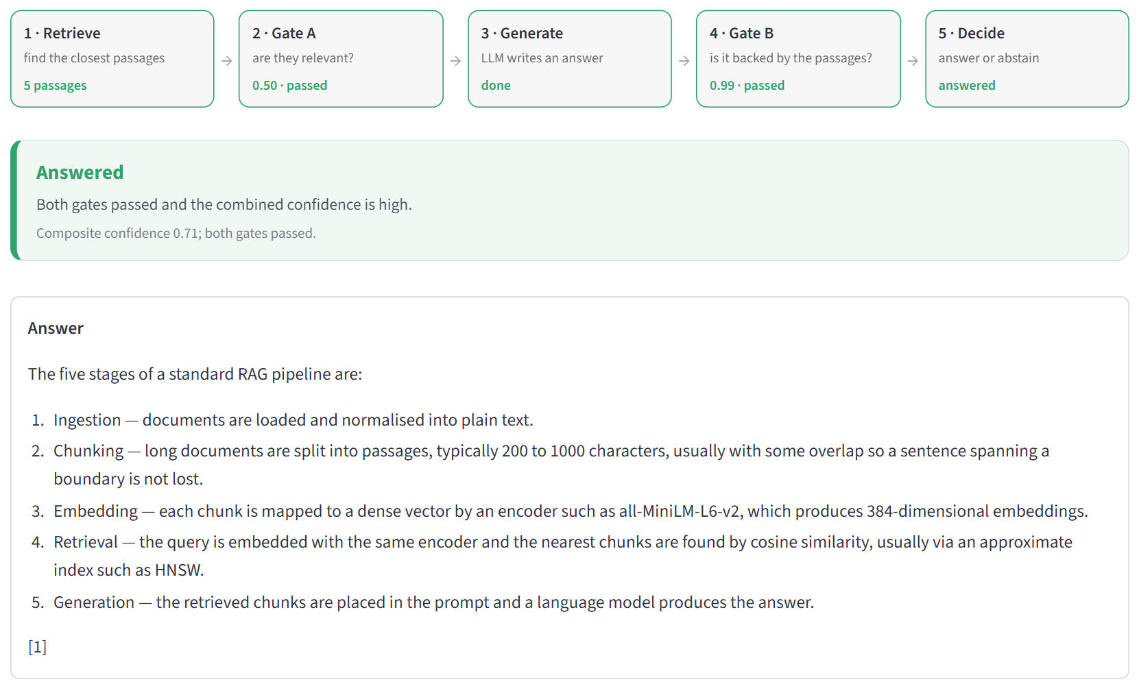
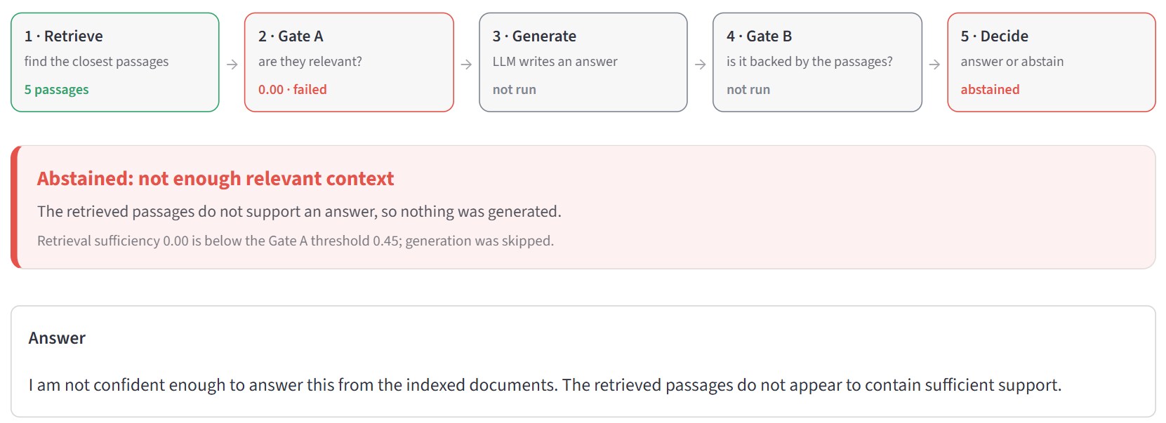
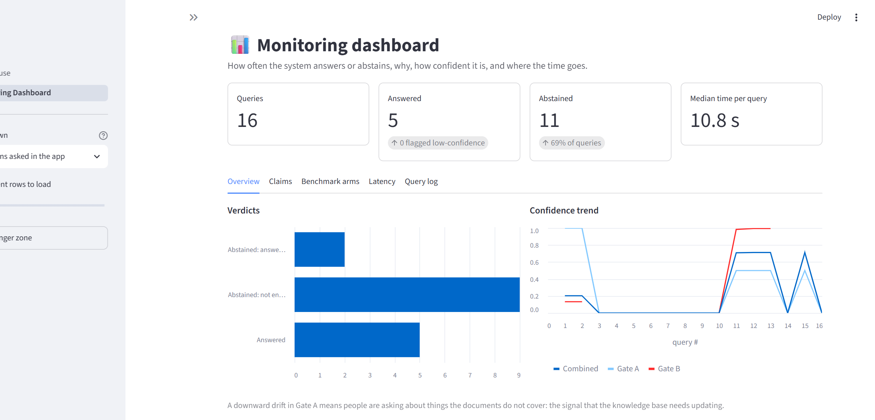
The app: every decision is visible
Out of scope: Gate A refuses, the LLM never runs
Answered: both gates pass, scores shown against their thresholds
Monitoring dashboard: verdicts, trends, latency
Notes:
Live demo order: 1) the Lists question, answered; 2) the Out of scope question, refused at Gate A; 3) the same question in Baseline mode, which answers anyway; 4) the False alarm question, an honest limitation; 5) the dashboard. Warm up Ollama before presenting.

Slide 15


Limitations and future scope
Limitations
Future scope
Gate B still rejects some correct answers (all 18 of its final rejections were correct)
Prompt and gates not fully separated: no prompt-only control run
150-question samples, so intervals are wide (hallucination 8–24%)
Single-premise NLI can't verify multi-hop answers
Larger NLI model: DeBERTa-large tested offline, AUROC 0.65 → 0.70 and false rejections 41% → 10% on SQuAD; needs more GPU memory
Prompt-only control arm to isolate the gates' effect
500+ questions with held-out calibration
Multi-passage entailment or claim decomposition for multi-hop
Notes:
Be upfront about limitations. The DeBERTa-large result shows the next step was tested, not just proposed: better on SQuAD, not on HotpotQA, and it needs more than an 8 GB GPU next to the LLM.

Slide 16
Conclusion
1
Safer answers
Hallucinated answers fell from 75 to 11 of 75, and every refusal comes with its reason.
2
Measured honestly
Benchmarked against plain RAG, audited, and corrected where earlier numbers were wrong.
3
The next limit is clear
Gate B's entailment model, not the thresholds, decides how much coverage is lost.
Thank you · Questions?
Shivam Gupta (BTCD24O1060) · Cornerstone Project
Notes:
Close with the three takeaways, then invite questions. Have the app open in another window for follow-up demos.

