Slide 1



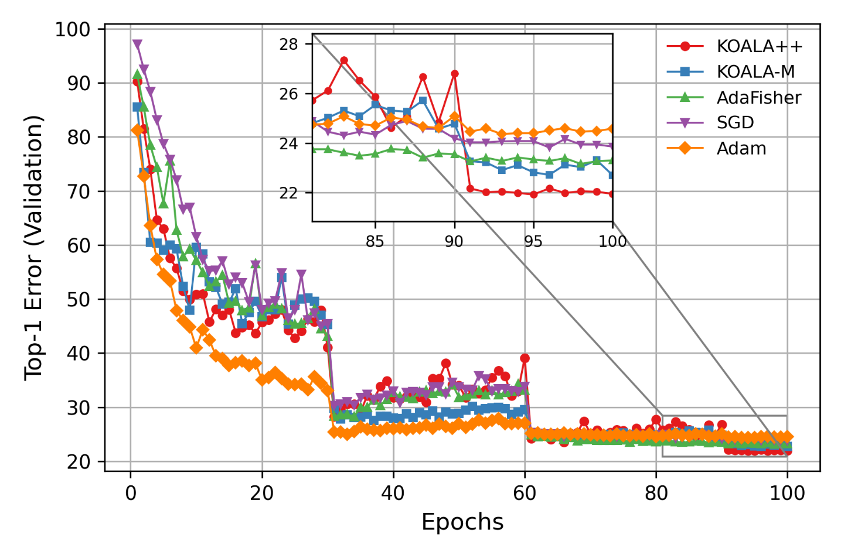
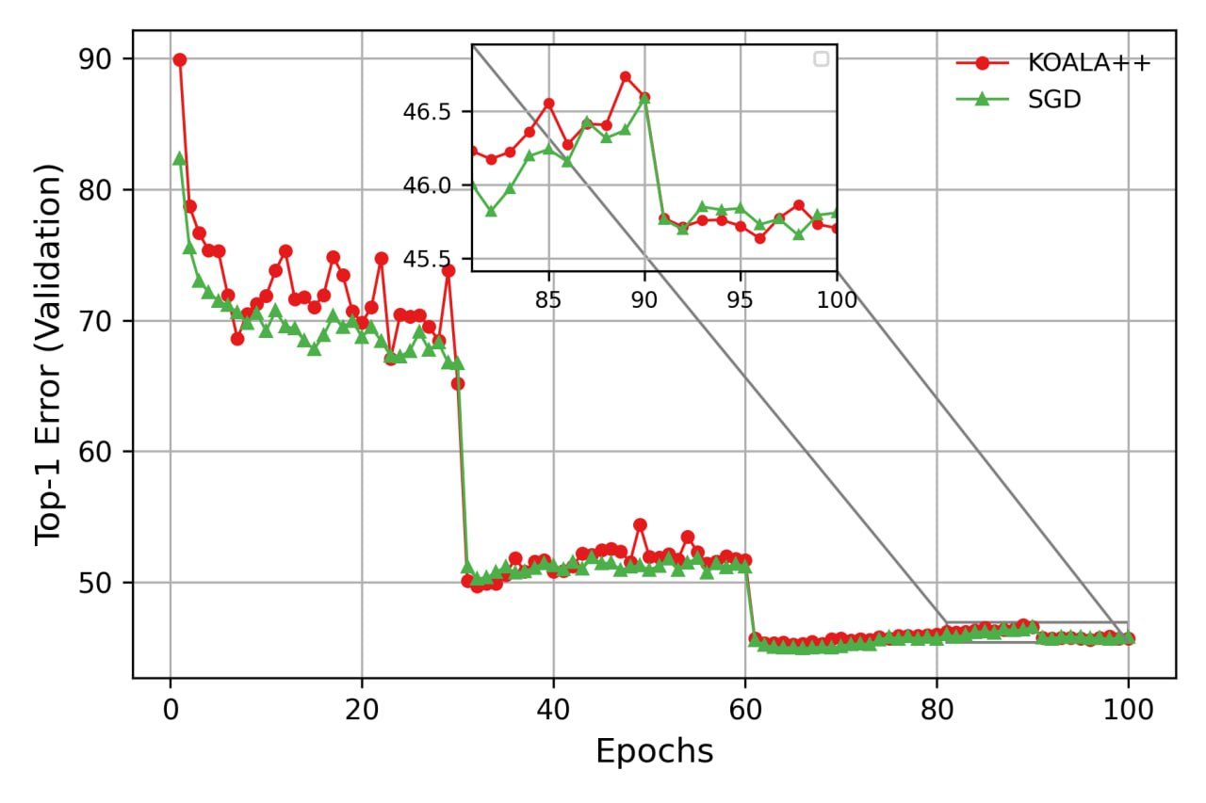
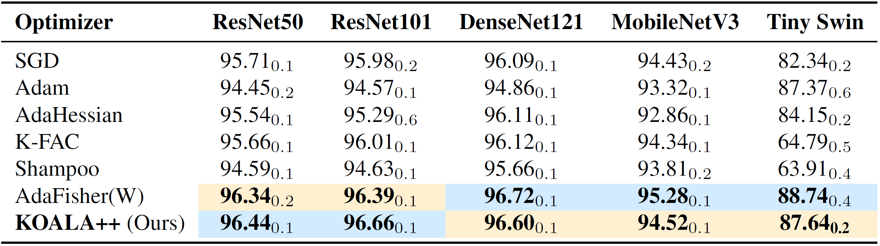
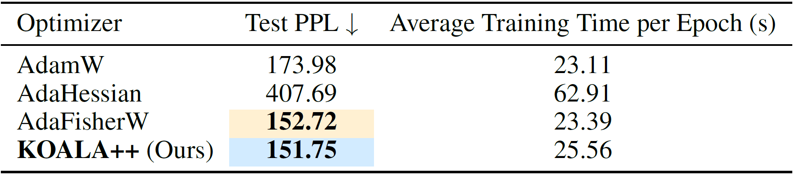
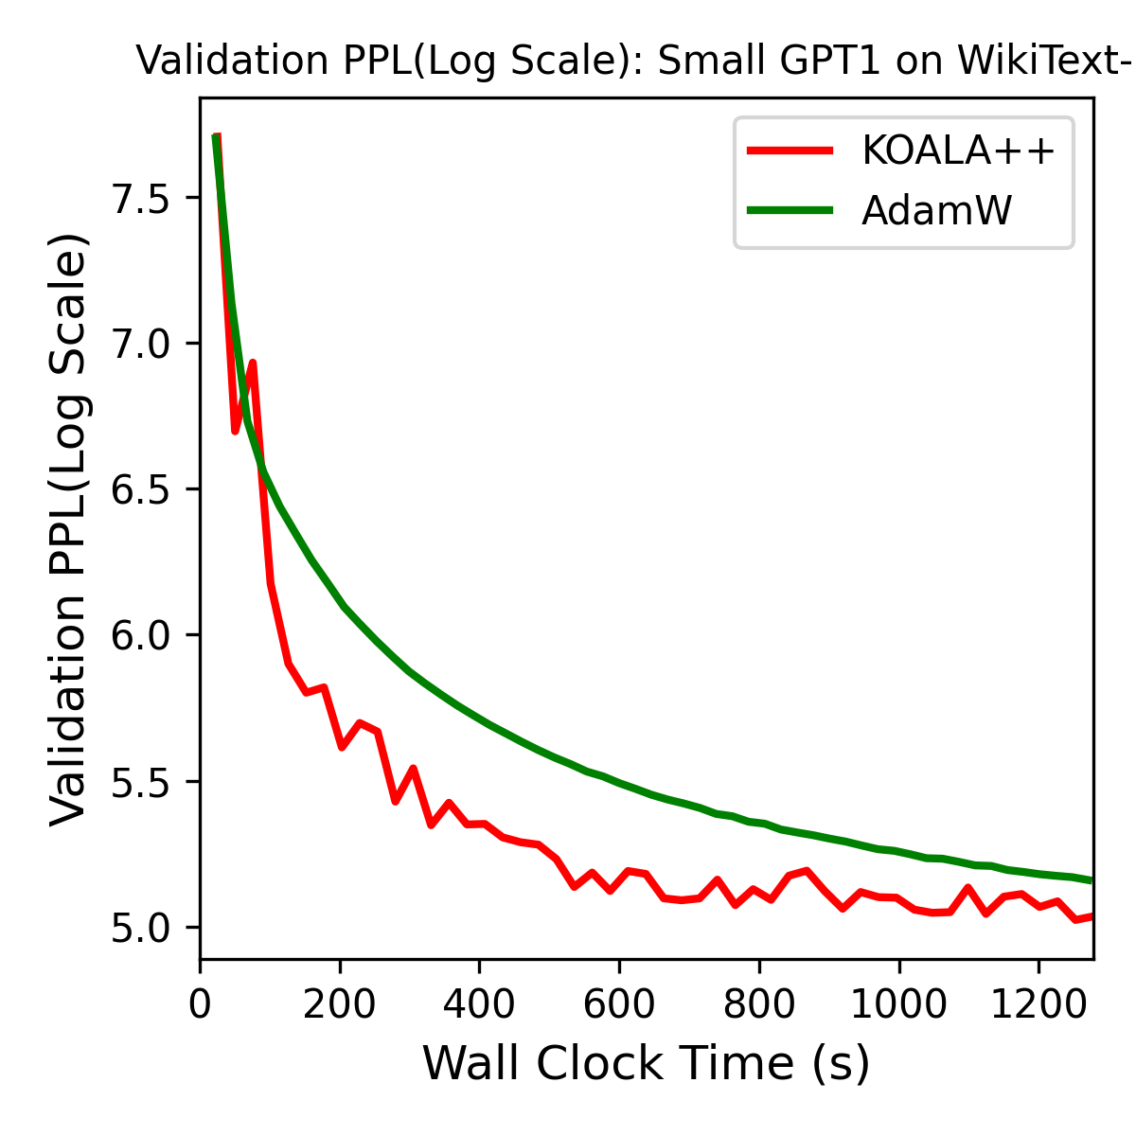
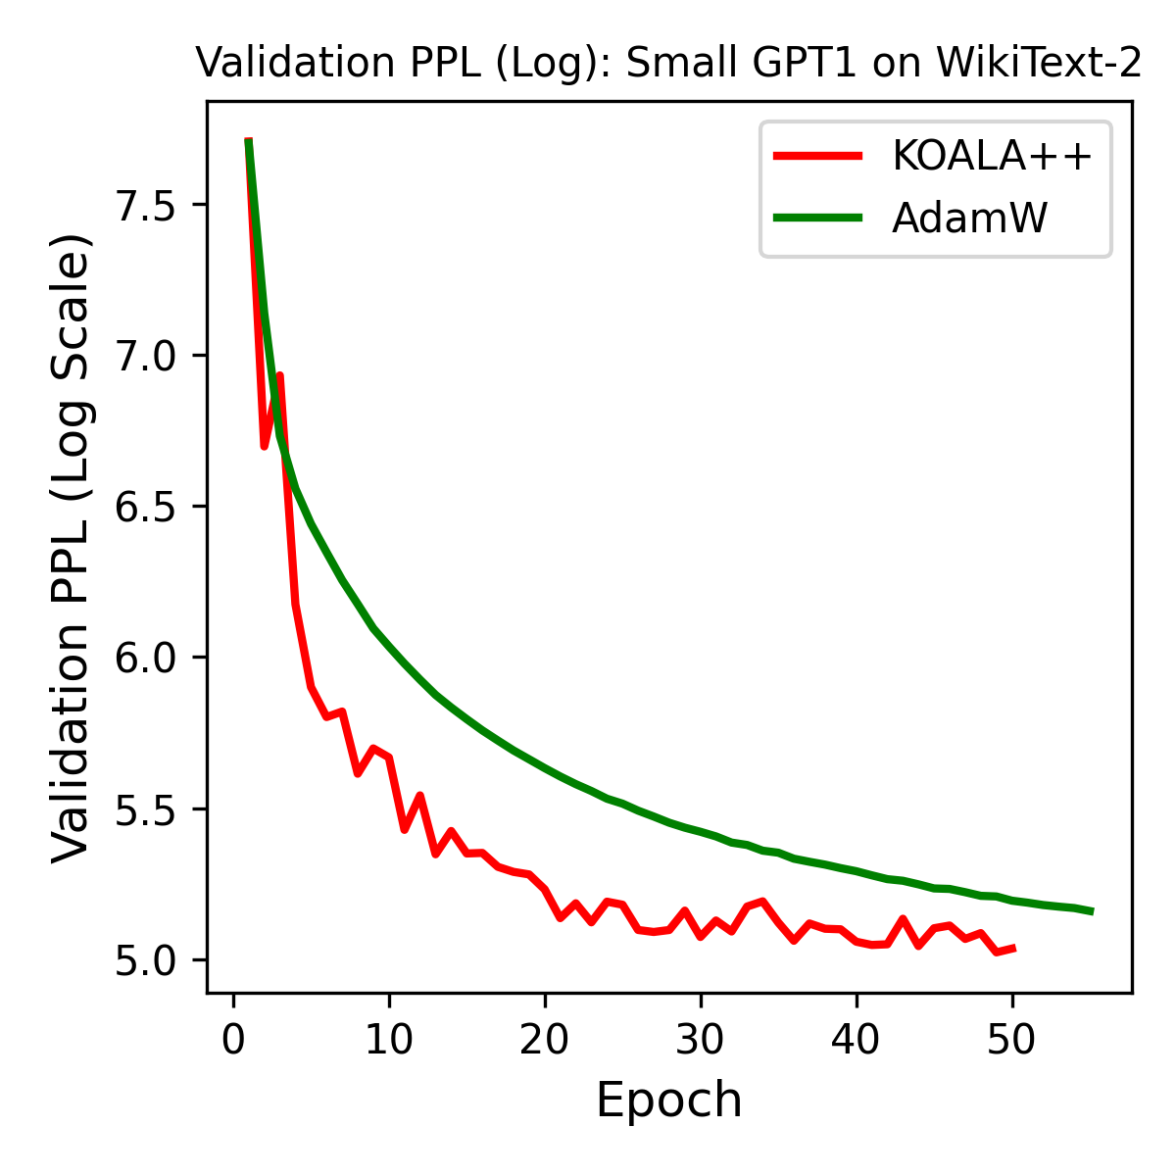

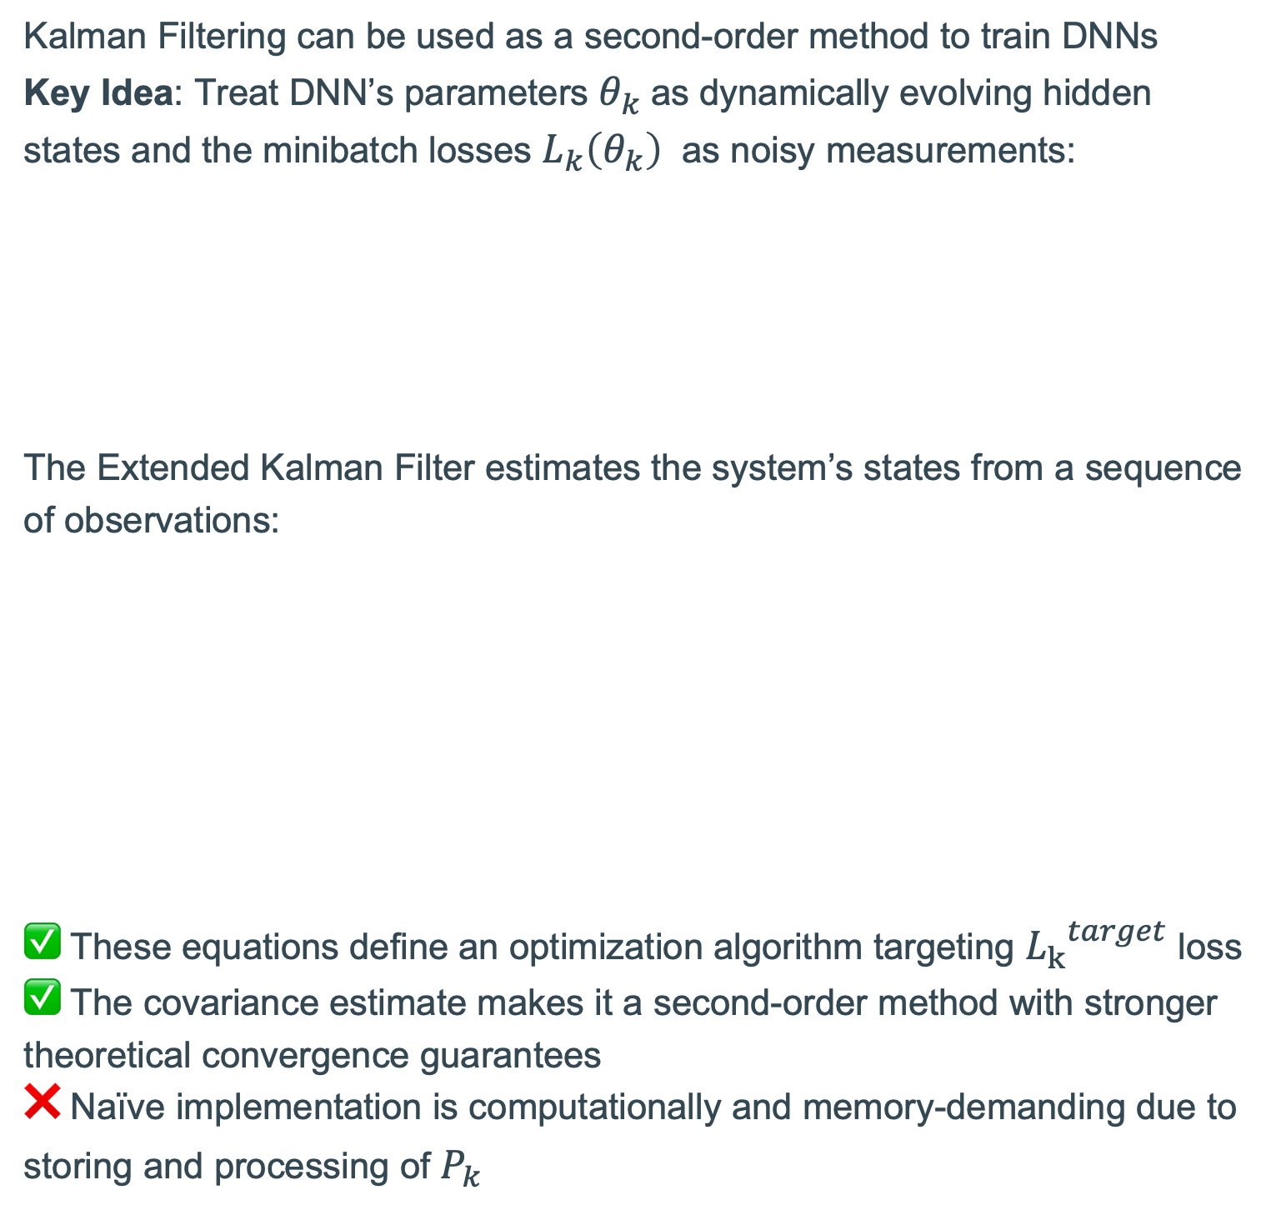
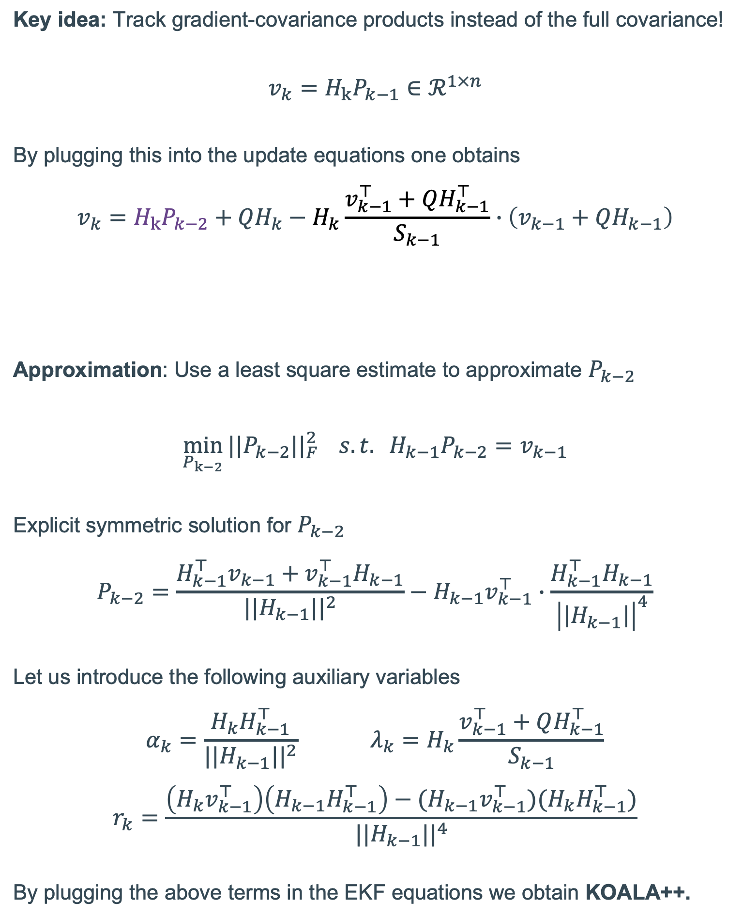
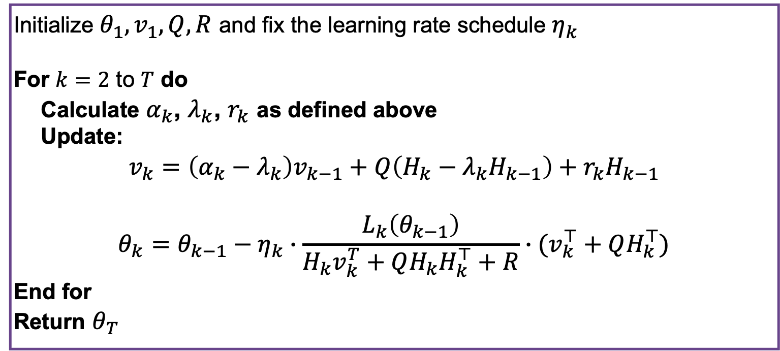
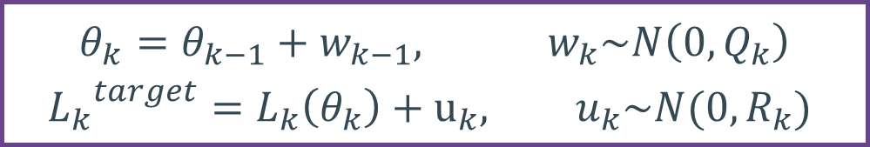
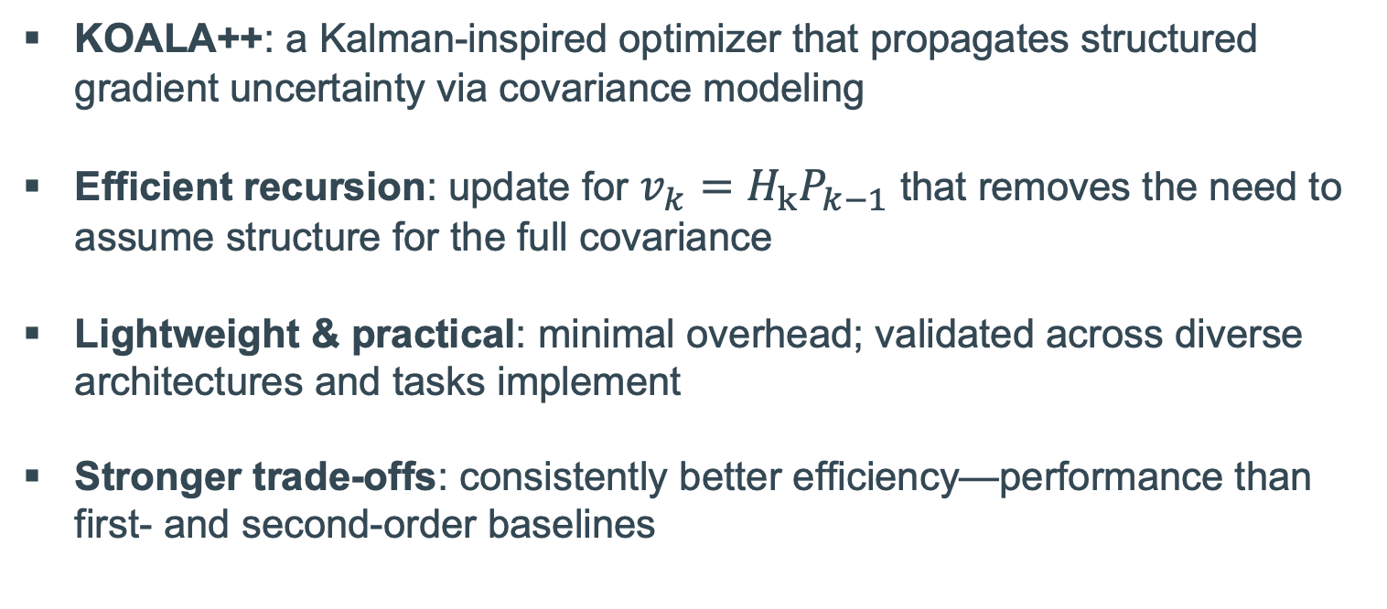
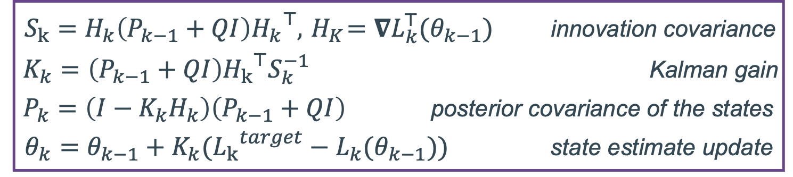
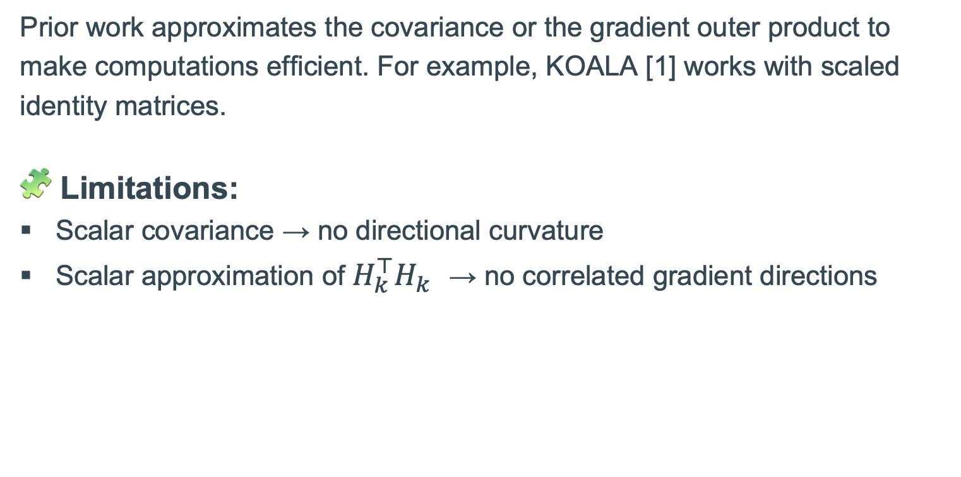
🐨KOALA++: Efficient Kalman-Based Optimization with Gradient-Covariance Products
Zixuan Xia Aram Davtyan Paolo Favaro zixuan.xia@students.unibe.ch, aram.davtyan@unibe.ch, paolo.favaro@unibe.ch
📉 Training DNNs with Kalman Filtering
💡All You Need Is Covariance Projections
🖼️ Image Classification
Kalman Filtering can be used as a second-order method to train DNNs
Key Idea: Treat DNN’s parameters $θ_{k}$as dynamically evolving hidden states and the minibatch losses $L_{k}\left(θ_{k}\right)$ as noisy measurements:
The Extended Kalman Filter estimates the system’s states from a sequence of observations:
✅ These equations define an optimization algorithm targeting ${L_{k}}^{target}$ loss
✅ The covariance estimate makes it a second-order method with stronger theoretical convergence guarantees
❌ Naïve implementation is computationally and memory-demanding due to storing and processing of $P_{k}$
Key idea: Track gradient-covariance products instead of the full covariance!
$$v_{k}=H_{k}P_{k−1}∈ℛ^{1×n}$$
By plugging this into the update equations one obtains
$$v_{k}=H_{k}P_{k−2}+QH_{k}−H_{k}\frac{v_{k−1}^{⊤}+QH_{k−1}^{⊤}}{S_{k−1}}∙\left(v_{k−1}+QH_{k−1}\right)$$
Approximation: Use a least square estimate to approximate $P_{k−2}$
$$\min_{P_{k−2}}{||P_{k−2}{||}_{F}^{2}} s.t. H_{k−1}P_{k−2}=v_{k−1}$$
Explicit symmetric solution for $P_{k−2}$
$$P_{k−2}=\frac{H_{k−1}^{⊤}v_{k−1}+v_{k−1}^{⊤}H_{k−1}}{{||H_{k−1}||}^{2}}−H_{k−1}v_{k−1}^{⊤}∙\frac{H_{k−1}^{⊤}H_{k−1}}{{\left|\left|H_{k−1}\right|\right|}^{4}}$$
Let us introduce the following auxiliary variables
$$α_{k}=\frac{H_{k}H_{k−1}^{⊤}}{{||H_{k−1}||}^{2}} λ_{k}=H_{k}\frac{v_{k−1}^{⊤}+QH_{k−1}^{⊤}}{S_{k−1}}$$
$$r_{k}=\frac{\left(H_{k}v_{k−1}^{⊤}\right)\left(H_{k−1}H_{k−1}^{⊤}\right)−(H_{k−1}v_{k−1}^{⊤})(H_{k}H_{k−1}^{⊤})}{{||H_{k−1}||}^{4}}$$
By plugging the above terms in the EKF equations we obtain KOALA++.
$$θ_{k}=θ_{k−1}+w_{k−1}, w_{k}\sim N\left(0, Q_{k}\right)$$
$${L_{k}}^{target}=L_{k}\left(θ_{k}\right)+u_{k}, u_{k}\sim N(0, R_{k})$$
INTRACTABLE
Figure 1: Comparison of validation error for different optimizers on CIFAR-100 using ResNet-50 with scheduled learning rate decays (epochs 30, 60, and 90
Figure 2: Comparison of Top-1 validation error of ResNet-18 on ImageNet32 with scheduled learning rate decays (epochs 30, 60, and 90)
$S_{k}=H_{k}\left(P_{k−1}+QI\right){H_{k}}^{⊤}, { H}_{K}=∇L_{k}^{⊤}(θ_{k−1})$ innovation covariance
$K_{k}=\left(P_{k−1}+QI\right){H_{k}}^{⊤}S_{k}^{−1}$ Kalman gain
$P_{k}=\left(I−K_{k}H_{k}\right)\left(P_{k−1}+QI\right)$ posterior covariance of the states
$θ_{k}=θ_{k−1}+K_{k}({L_{k}}^{target}−L_{k}(θ_{k−1}))$ state estimate update
Table 1: Top-1 accuracy (%) on CIFAR-10 across various architectures. We report the average and the standard deviation over 5 seeds.
⚖️ Approximations in Prior Work
🔠 Language Modeling
Prior work approximates the covariance or the gradient outer product to make computations efficient. For example, KOALA [1] works with scaled identity matrices.
🧩 Limitations:
Scalar covariance → no directional curvature
Scalar approximation of $H_{k}^{⊤}H_{k}$ → no correlated gradient directions
📊 KOALA++ Optimizer
Table 2: Language modeling performance on Wikitext-2, including the test PPL corresponding to the best validation model, as well as training time per epoch.
🤝 Our Contributions
Initialize $θ_{1}, v_{1}, Q, R$ and fix the learning rate schedule $η_{k}$
For $k=2$ to $T$ do
Calculate $α_{k}$, $λ_{k}$, $r_{k}$ as defined above
Update:
$$v_{k}=\left(α_{k}−λ_{k}\right)v_{k−1}+Q\left(H_{k}−λ_{k}H_{k−1}\right)+r_{k}H_{k−1}$$
$$θ_{k}=θ_{k−1}−η_{k}∙\frac{L_{k}\left(θ_{k−1}\right)}{H_{k}v_{k}^{T}+QH_{k}H_{k}^{⊤}+R}∙(v_{k}^{⊤}+QH_{k}^{⊤})$$
End for
Return $θ_{T}$
KOALA++: a Kalman-inspired optimizer that propagates structured gradient uncertainty via covariance modeling
Efficient recursion: update for $v_{k}=H_{k}P_{k−1}$ that removes the need to assume structure for the full covariance
Lightweight & practical: minimal overhead; validated across diverse architectures and tasks implement
Stronger trade-offs: consistently better efficiency—performance than first- and second-order baselines
Code & Paper
[1] A. Davtyan et al., KOALA: A Kalman Optimization Algorithm with Loss Adaptivity
Figure 3:Language modeling performance on Wikitext-2, including the test PPL throughout the wall clock time (Left) and epochs (Right)

