Slide 1
A Comparative Analysis of Machine Learning Models for Cardiovascular Disease Classification
Riza Asmat Mila- 20101590
Humayra Binte Jamal- 20101591
Sumya Afroj- 19301164
Maimuna Rahman-20101457
ST- Mehnaz Ara Fazal
RA- Md Humaion Kabir Mehedi

Slide 2
Abstract
This paper is about the importance of early detection and prediction of heart disease, also known as cardiovascular disease (CVD), to reduce mortality rates. It emphasizes the significance of anticipating and treating such illnesses in the medical field. The paper provides an overview of machine learning systems, including Logistic Regression, Support Vector Machine, Decision Tree, K-Nearest Neighbors, Random Forest, XGBoost, Multilayer Perceptron, Naive Bayes, applied to medical data for heart disease diagnosis. ECG is highlighted as a primary tool for early assessment. The heart disease prediction system mentioned in the study aims to lower costs and enhance medical treatment through accurate diagnoses.

Slide 3
Introduction
This study discusses the severity of heart disease, a leading cause of global mortality, and the potential increase in fatalities by 2030. It highlights the role of machine learning algorithms, such as Logistic Regression, SVM, Decision Trees, KNN, Random Forest, XGBoost, MLP, and Naive Bayes, in predicting cardiovascular issues. The study uses patient records from various healthcare facilities and emphasizes the use of Python programming, known for its safety and versatility, along with key libraries like Pandas and Matplotlib. The text underscores the efficiency of Python in healthcare applications, specifically in cardiac disorder detection, leading to cost and time savings by avoiding unnecessary tests.

Slide 4
Related Works
Study 1: Cloud-Based Prediction System (Nashif et al., 2018)
Proposed a cloud-based heart disease prediction system using Arduino for real-time monitoring, achieving 97.53% accuracy with SVM. Emphasized early detection and continuous monitoring, notifying through GSM.
Study 2: ML Algorithms in Cardiovascular Diseases (Krittana wong et al., 2020)
Evaluated ML algorithms in cardiovascular diseases, highlighting boosting methods (AUC 0.88) for coronary artery disease and SVM (AUC 0.92) for stroke prediction.
Study 3: Machine Learning for Heart Disease Diagnosis (Nagavelli et al., 2022)
Explored Naïve Bayes, SVM with XGBoost, and enhanced SVM for heart disease diagnosis. XGBoost exhibited accuracy and emphasized the importance of early diagnosis.
Study 4: AI-Based Heart Disease Detection (Chang et al., 2022)
Used random forest in Python for heart disease identification, emphasizing Python's reliability. Addressed data processing, logistic regression, and dataset attribute evaluation.
·

Slide 5
Study 5: K-Modes Clustering for CVD Prediction (Bhatt et al., 2023)
Employed k-modes clustering for cardiovascular disease prediction, focusing on gender-specific datasets. MLP model achieved 87.28% accuracy, addressing biological discrepancies.
Study 6: Deep Learning and ML for Heart Disease (Bharti et al., 2021)
Investigated deep learning and ML techniques for heart disease prediction. Combined strategy of feature selection, dataset normalization, and outlier handling showed superior outcomes.
Study 7: ML Algorithms in Clinical Event Prediction (Beunza et al., 2019)
Compared ML algorithms for clinical event prediction, highlighting SVM in RapidMiner and neural networks in R-Studio. Emphasized ML's potential in healthcare models and interdisciplinary teamwork.

Slide 6
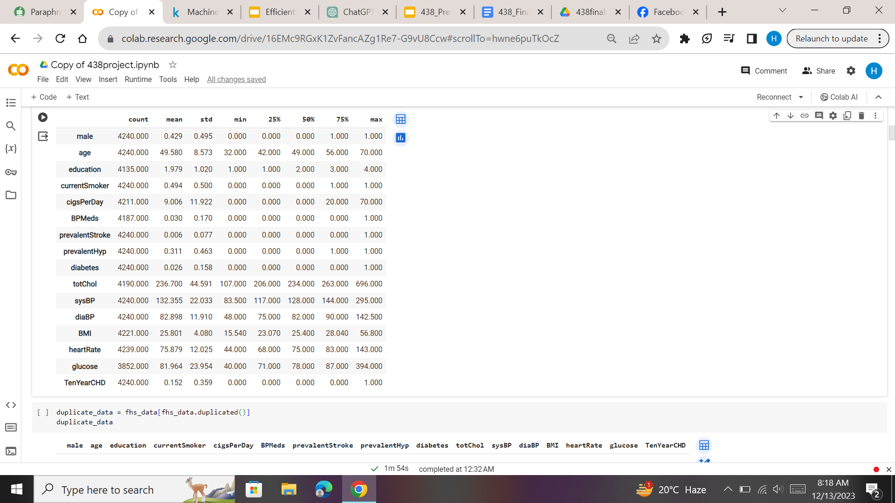
Dataset
The dataset comprises 4,240 entries with 15 features, representing individuals and their health-related attributes. Key features include demographic details, lifestyle factors, and clinical measurements. The target variable, 'TenYearCHD,' binary indicates the likelihood of Coronary Heart Disease (CHD) within the next ten years. Data for model training (80%) and assessment (20%) were separated using an 80-20% train-test split.

Slide 7
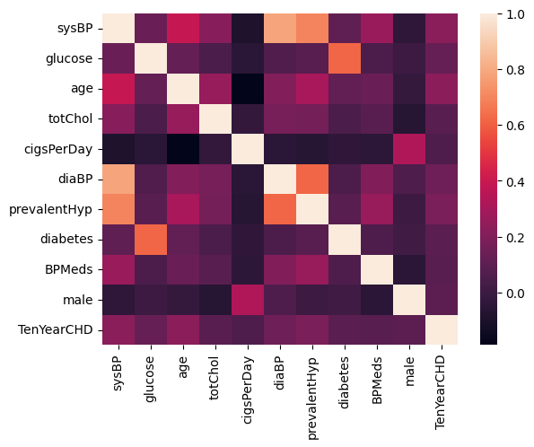
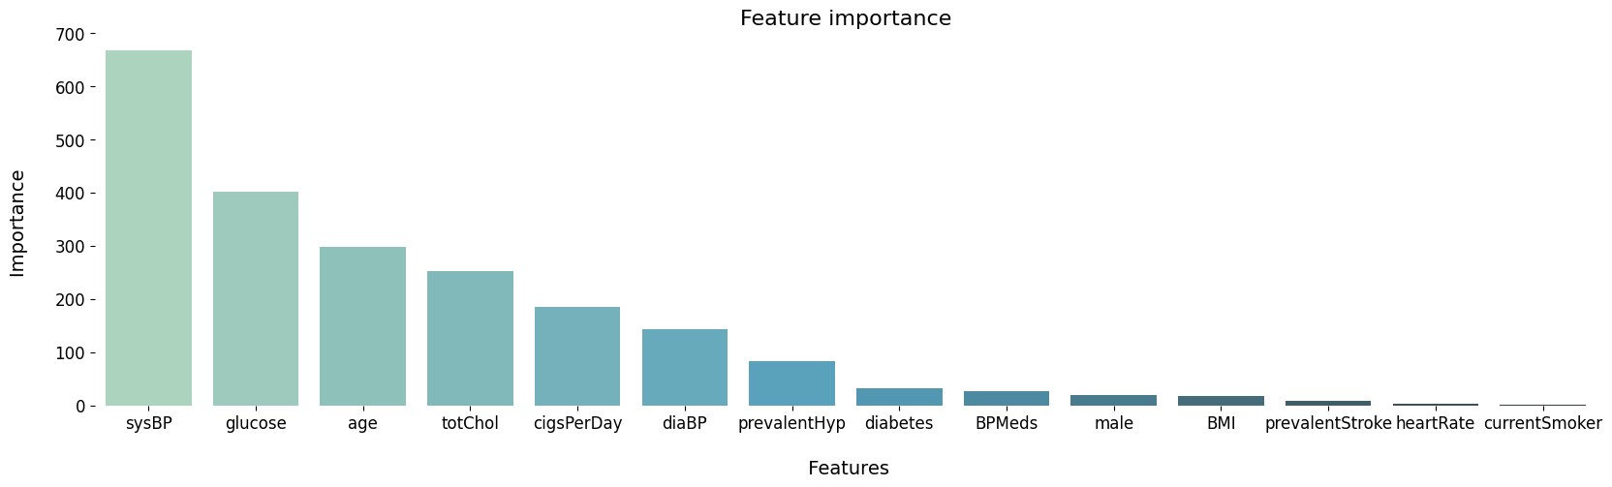
Data Preprocessing
Data Exploration
Removing Null values
Feature Selection

Slide 8
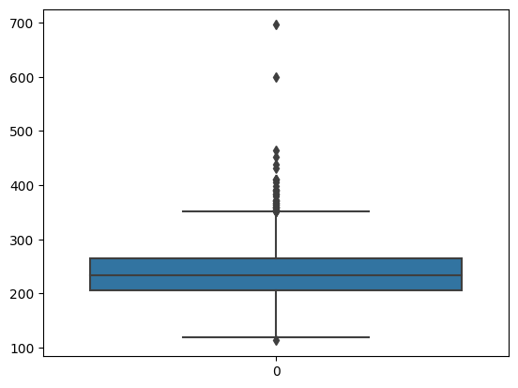
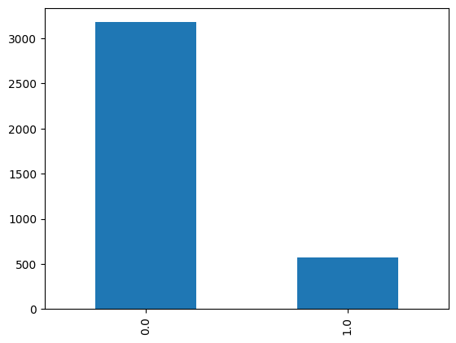
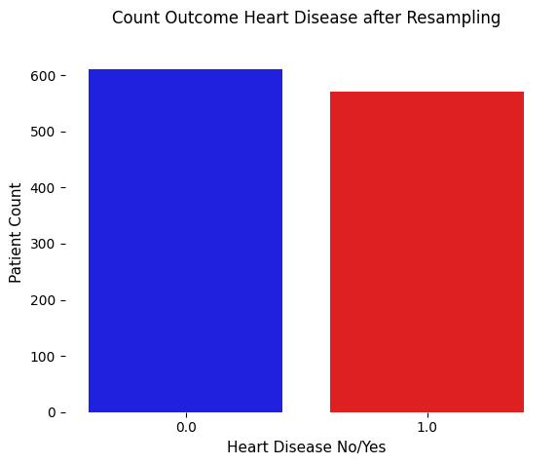
Handling Outliers
=>Pairplot, Boxplot
Scaling
=>Min-Max scaling
Handling Imbalanced Data
=>Undersampling
Outlier in ‘totchol’

Slide 9
Model Selection and Evaluation
Logistic Regression
Support Vector Machine (SVM)
Decision Tree
K-Nearest Neighbors (KNN)
Random Forest
XGBoost
Multilayer Perceptron (MLP)
Naive Bayes

Slide 10
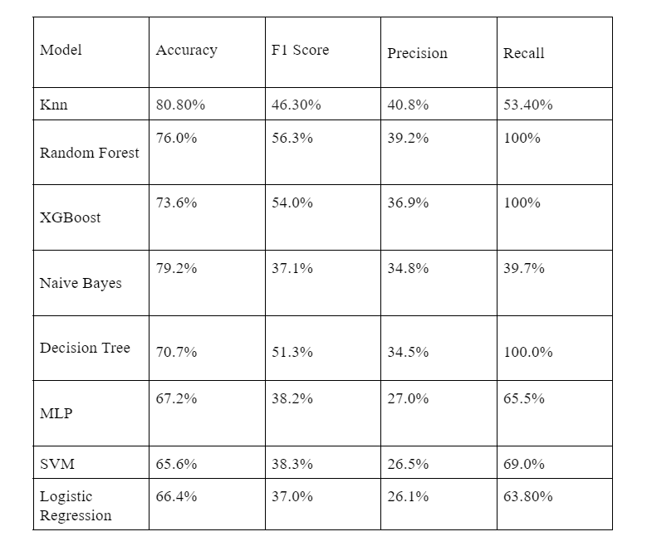
Result Analysis
The optimal choice among various models is K-Nearest Neighbors (KNN), boasting the highest accuracy at 80.0%, a balanced F1 score of 46.8%, and a robust cross-validated accuracy of 83.73%. Despite a slight risk of minimal overfitting, its 69.6% AUC ROC Curve score signifies excellent performance in classification. Notably, Random Forest and Decision Tree Classifier (DTC) yield competitive results with accuracies of 76.3% and 71.2%, respectively. While Multilayer Perceptron (MLP) and Naive Bayes exhibit lower accuracies (78.8% and 66.7%), Support Vector Machine (SVM) and Logistic Regression (LogReg) perform similarly around 65–65.7%.

Slide 11
Limitation and future work
Single Dataset Limitation
Support for Small Datasets
Limited Clinical and Demographic Characteristics
Addressing Shortcomings in Future Studies
Improvements for Future Research
Exclusion of Lifestyle and Genetic Factors

Slide 12
Conclusion
Study Objective
Performance Comparison
Healthy Lifestyle Impact

Slide 13
References
[1]
S. Nashif, Md. R. Raihan, Md. R. Islam, and M. H. Imam, “Heart Disease Detection by Using Machine Learning Algorithms and a Real-Time Cardiovascular Health Monitoring System,” World Journal of Engineering and Technology, vol. 06, no. 04, pp. 854–873, 2018, doi: https://doi.org/10.4236/wjet.2018.64057.
[2]
C. Krittanawong et al., “Machine learning prediction in cardiovascular diseases: a meta-analysis,” Scientific Reports, vol. 10, no. 1, Sep. 2020, doi: https://doi.org/10.1038/s41598-020-72685-1.
[3]
A. M. Al-Ssulami, R. S. Alsorori, A. M. Azmi, and Hatim Aboalsamh, “Improving Coronary Heart Disease Prediction Through Machine Learning and an Innovative Data Augmentation Technique,” Cognitive Computation, vol. 15, no. 5, pp. 1687–1702, May 2023, doi: https://doi.org/10.1007/s12559-023-10151-6.
[4]
D. Shah, S. Patel, and S. K. Bharti, “Heart Disease Prediction using Machine Learning Techniques,” SN Computer Science, vol. 1, no. 6, Oct. 2020, doi: https://doi.org/10.1007/s42979-020-00365-y.
[5]
U. Nagavelli, D. Samanta, and P. Chakraborty, “Machine Learning Technology-Based Heart Disease Detection Models,” Journal of Healthcare Engineering, vol. 2022, pp. 1–9, Feb. 2022, doi: https://doi.org/10.1155/2022/7351061.

Slide 14
[6]
Suhier Odah, Batool Sbenaty, E. Ahmad, Ghada Alhilo, O. Tarawneh, and M. Otair, “Heart disease prediction using machine learning: A comprehensive study,” Nucleation and Atmospheric Aerosols, Jan. 2023, doi: https://doi.org/10.1063/5.0174788.
[7]
V. Chang, V. R. Bhavani, A. Q. Xu, and A. Hossain, “An artificial intelligence model for heart disease detection using machine learning algorithms,” Healthcare Analytics, vol. 2, p. 100016, Jan. 2022, doi: https://doi.org/10.1016/j.health.2022.100016.
[8]
C. M. Bhatt, P. Patel, T. Ghetia, and P. L. Mazzeo, “Effective Heart Disease Prediction Using Machine Learning Techniques,” Algorithms, vol. 16, no. 2, p. 88, Feb. 2023, doi: https://doi.org/10.3390/a16020088.
[9]
R. Bharti, A. Khamparia, M. Shabaz, G. Dhiman, S. Pande, and P. Singh, “Prediction of Heart Disease Using a Combination of Machine Learning and Deep Learning,” Computational Intelligence and Neuroscience, vol. 2021, pp. 1–11, Jul. 2021, doi: https://doi.org/10.1155/2021/8387680.
[10]
J.-J. Beunza et al., “Comparison of machine learning algorithms for clinical event prediction (risk of coronary heart disease),” Journal of Biomedical Informatics, vol. 97, p. 103257, Sep. 2019, doi: https://doi.org/10.1016/j.jbi.2019.103257.

Slide 15
[12]
A. Singh and R. Kumar, “Heart Disease Prediction Using Machine Learning Algorithms,” IEEE Xplore, 2020. https://ieeexplore.ieee.org/abstract/document/9122958
[13]
A. S. Sharma and H. S. Hota, “An early cardiovascular prediction IOT framework using machine learning classification algorithms,” NASA ADS, vol. 2587, p. 080006, Nov. 2023, doi: https://doi.org/10.1063/5.0150543.
[14]
N. Nandal, L. Goel, and R. Tanwar, “Machine learning-based heart attack prediction: A symptomatic heart attack prediction method and exploratory analysis,” f1000research.com, Sep. 29, 2022. https://f1000research.com/articles/11-1126 (accessed Feb. 24, 2023).

