Slide 1
A Comparative Analysis of Machine Learning Models for Cardiovascular Disease Classification
1
Group: 18
Sumya Afroj (19301164)
Humayra Binte Jamal (20101591)
Maimuna Rahman (20101457)
Riza Asmat Mila (20101590)
ST- Mehnaz Ara Fazal
RA- Md Humaion Kabir Mehedi

Slide 2
Table of Contents
2
Introduction
Motivation
Dataset
Workflow
Proposed Methodology
Limitations
Conclusions
References

Slide 3
Introduction
3
By 2030, heart disease—a leading cause of death worldwide—is expected to affect 22 million people. Cardiovascular system illnesses can be predicted using machine learning techniques such as SVM, XGBoost, Decision Trees, K-Nearest Neighbors, Random Forest, Multilayer Perceptron, Logistic Regression, and Naive Bayes. A study that used Python as a safe programming language was conducted utilizing patient records from hospitals and healthcare facilities. Web applications and AI-based software development use Python, and a variety of coding packages and libraries were utilized, including Pandas, Matplotlib, IPython, Numpy, Python, and SciPy. Python programming has the potential to enhance patient outcomes and decrease needless testing in the medical field.

Slide 4
Motivation
4
Global Health Impact:
Address the significant impact of cardiovascular diseases on global mortality.
Aim to improve early detection for effective medical interventions.
Predictive Healthcare:
Recognize the need for predictive healthcare measures.
Develop accurate systems for anticipating and addressing heart diseases.
Machine Learning Advancements:
Explore ML algorithms to leverage advancements in technology.
Enhance accuracy and efficiency in predicting cardiac diseases.

Slide 5
Data-Driven Decision-Making:
Utilize patient records and data mining for informed healthcare decisions.
Empower healthcare providers with reliable information.
Cost and Time Efficiency:
Save costs and time through accurate and early diagnosis.
Streamline healthcare processes by avoiding unnecessary tests.
Python and Technology Adoption:
Leverage Python's acceptance in the medical industry.
Use technology, including Python and relevant libraries, for dynamic healthcare applications.
5

Slide 6
6
Interdisciplinary Collaboration:
Encourage collaboration across disciplines for ML advancements.
Integrate ML algorithms into clinical practice for improved patient care
Continuous Improvement:
Commit to continuous improvement in system features and usability.
Focus on refining technology for practical healthcare applications.

Slide 7
Dataset
7
The dataset comprises 4,240 entries with 15 features, representing individuals and their health-related attributes. Key features include demographic details, lifestyle factors, and clinical measurements. The target variable, 'TenYearCHD,' binary indicates the likelihood of Coronary Heart Disease (CHD) within the next ten years. Data for model training (80%) and assessment (20%) were separated using an 80-20% train-test split.

Slide 8
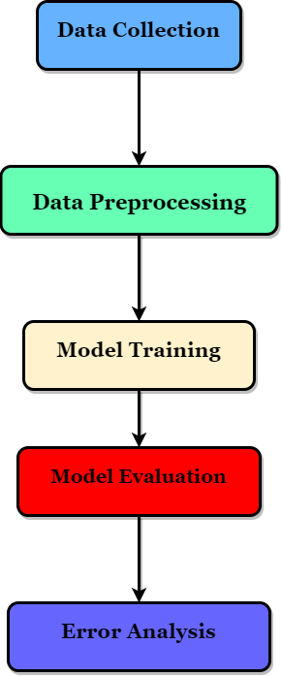
Workflow
8

Slide 9
Proposed Methodology
9
The study utilizes a Kaggle dataset from Framingham, Massachusetts, consisting of medical, behavioral, and demographic data. Data preprocessing involves imputation, feature selection, handling outliers, and balancing datasets. Models like Naive Bayes, KNN, Random Forest, XGBoost, SVM, Decision Trees, and Logistic Regression are trained and evaluated based on performance metrics like accuracy, precision, recall, and F1 score. Receiver Operating Characteristic (ROC) curves and confusion matrices are employed for a comprehensive model evaluation.

Slide 10
Limitations
The study acknowledges limitations, such as reliance on a single dataset and the exclusion of lifestyle and genetic factors. Future work is suggested to address these limitations, including dataset expansion, model optimization, and the development of more user-friendly applications for practical healthcare use.
10

Slide 11
Conclusion
11
Machine learning algorithms, particularly KNN, demonstrate superior performance in predicting heart diseases. Despite some challenges, ML algorithms outperform traditional methods, paving the way for enhanced cardiac care. The study emphasizes the importance of a healthy lifestyle in reducing heart disease risk and suggests future work to improve model features and usability.

Slide 12
References
12
[1]
S. Nashif, Md. R. Raihan, Md. R. Islam, and M. H. Imam, “Heart Disease Detection by Using Machine Learning Algorithms and a Real-Time Cardiovascular Health Monitoring System,” World Journal of Engineering and Technology, vol. 06, no. 04, pp. 854–873, 2018, doi: https://doi.org/10.4236/wjet.2018.64057.
[2]
C. Krittanawong et al., “Machine learning prediction in cardiovascular diseases: a meta-analysis,” Scientific Reports, vol. 10, no. 1, Sep. 2020, doi: https://doi.org/10.1038/s41598-020-72685-1.
[3]
A. M. Al-Ssulami, R. S. Alsorori, A. M. Azmi, and Hatim Aboalsamh, “Improving Coronary Heart Disease Prediction Through Machine Learning and an Innovative Data Augmentation Technique,” Cognitive Computation, vol. 15, no. 5, pp. 1687–1702, May 2023, doi: https://doi.org/10.1007/s12559-023-10151-6.
[4]
D. Shah, S. Patel, and S. K. Bharti, “Heart Disease Prediction using Machine Learning Techniques,” SN Computer Science, vol. 1, no. 6, Oct. 2020, doi: https://doi.org/10.1007/s42979-020-00365-y.

