Slide 1
각종 자기소개
피피티 템플릿
By 지노

Slide 2
목차
001 자기소개
002 나의 장점과 단점
003 팀 소개 및 피피티
004 피피티 컨셉
005 앞으로의 각오

Slide 3
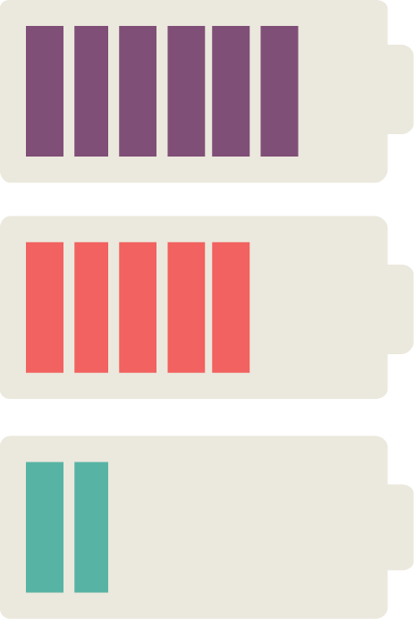

Slide 4
DB
Server
Client
Login
Join
Status
Msg

Slide 5
Login
Join
DB
Server
Client
Server
thread
Status
service

Slide 6
boodyPage
chat
Client
Client
Client
Client
Server
Status
Client
chat
Server
thread
Login
Join
Client
Thread
DB

Slide 7
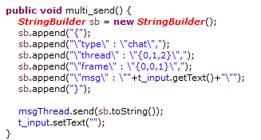
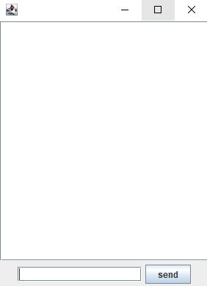
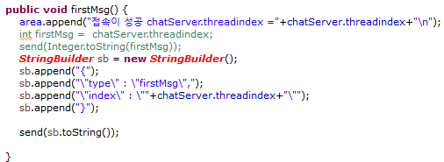
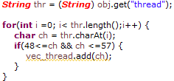
Client
Thread
index
Server
msg

Slide 8
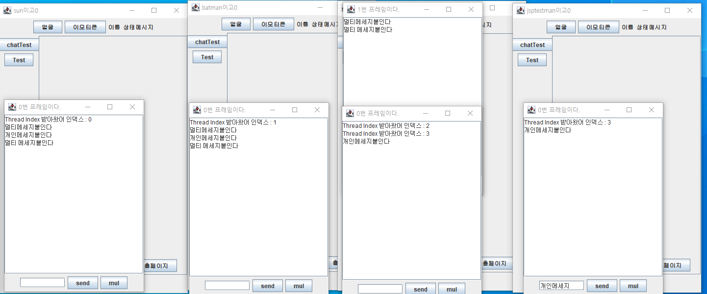
Client
Thread
index
Server
msg

Slide 9
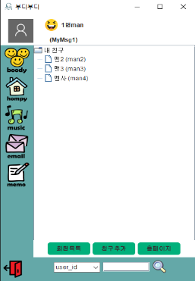


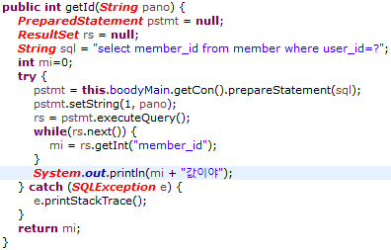
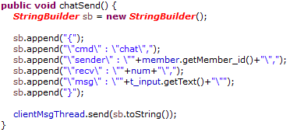
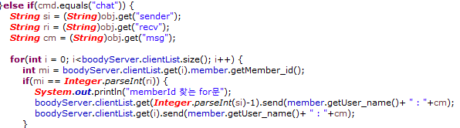
Server
“login”
“login”
client
thread

Slide 10
Client
socket
Client
socket
Thread
Server
socket
Client
socket
Client
socket

Slide 11
전방향출력
Thread
Client
socket
Client
socket
Server
socket
Client
socket
벡터만큼
Client
socket

Slide 12
Status창에서 채팅 누를 시 대화상대를 고르게
벡터
일부 전방향출력
Thread
Client
socket
Client
socket
Server
socket
일부 전방향출력
Client
Thread
socket
Client
socket
벡터

Slide 13
vector
socket
Server
thread

Slide 14
Server
Accept..

Slide 15
Server
Client
socket
socket
Thread

Slide 16
Client
socket
Thread
Server
Client
socket
Thread
socket
Thread
Thread
Thread
Client
socket
Thread

Slide 17
Thread
Server
socket
Client
socket

Slide 18
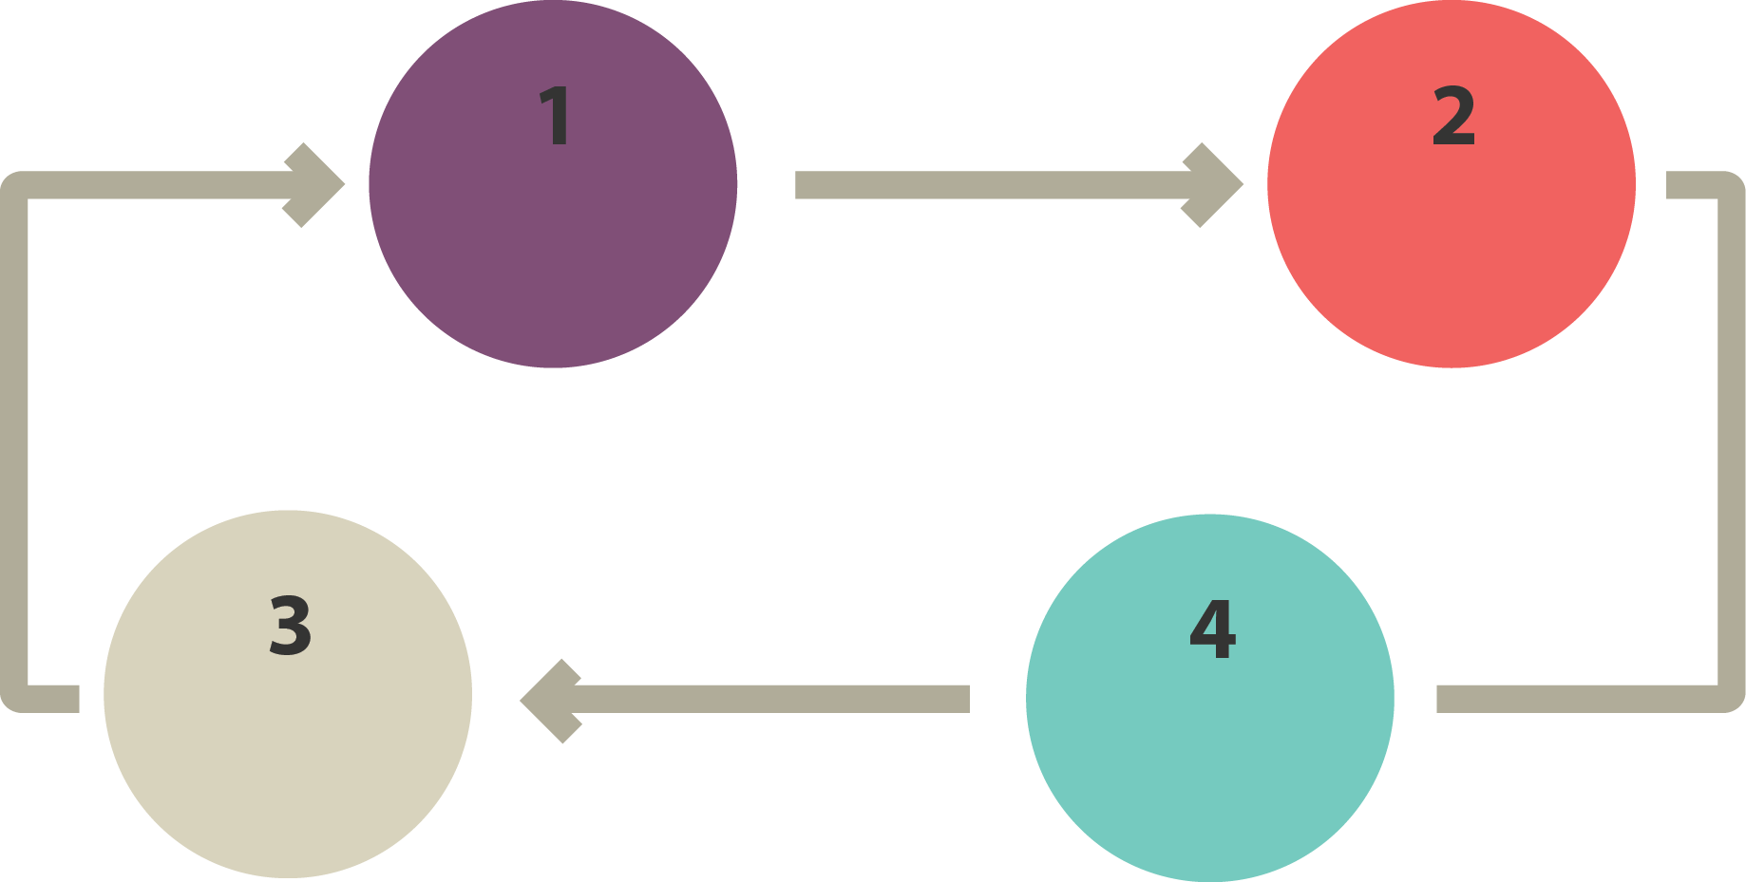

Slide 19


