Slide 1
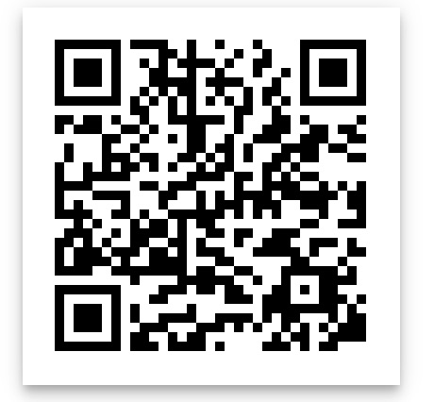

EtherLend
JingChang Sun, Ching-Hui Lin, Zhengyang Song
https://github.com/Sun-Jc/EtherLend
Public Domain for API test: http://taoli.tsinghuax.org:8085/

Slide 2
EtherLend Ledger
 | Alice | Bob | Charlie | Sum
Month 1 | +16 (13) | -8 (12) | -8 (11) | 0
Month 2 | -10 | +19 (12) | -9 (11) | 0
Month 3 | -10 | -10 | +20 | 0
Sum | -4 | +1 | +3 | 0

Slide 3
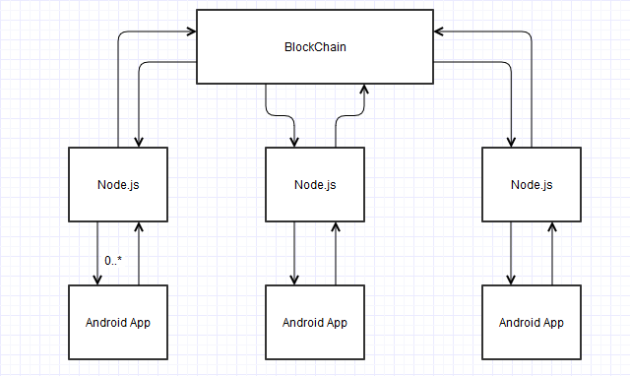
Framework of our ÐAPP

Slide 4


Testrpc
Ethereum client for developer
No need to spend real Ether
No need to wait for blocks to be mined
Store all the transactions and events
Nothing will be changed or lost

Slide 5

Truffle
Write contract
Compile contract
Deploy contract to BlockChain
Generate js files for contracts
Interact with contract using web3

Slide 6


Node.js
Due to the lack of light client
No Android interface for Ethereum
Use a Node.js server to transmit rpc call
Accept GET request from Android Client with parameters
Use web3 interface to interact with contracts on the chain
Return the result as JSON object to Android Client

Slide 7


Android Client
Check user accounts
Manager to apply meetings
Members to Join and Manager to Accept
Manager to Suggest and Members to Vote
Members to Bid and Reveal
Check meetings states

Slide 8
Core Function
Membership Management
The Voting Process
Sealed Second Price Auction

Slide 9
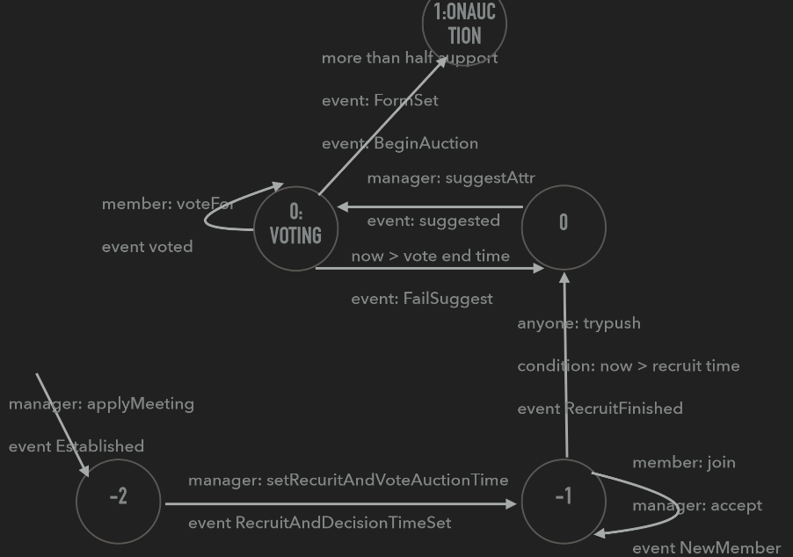
Replicated State Machine

Slide 10
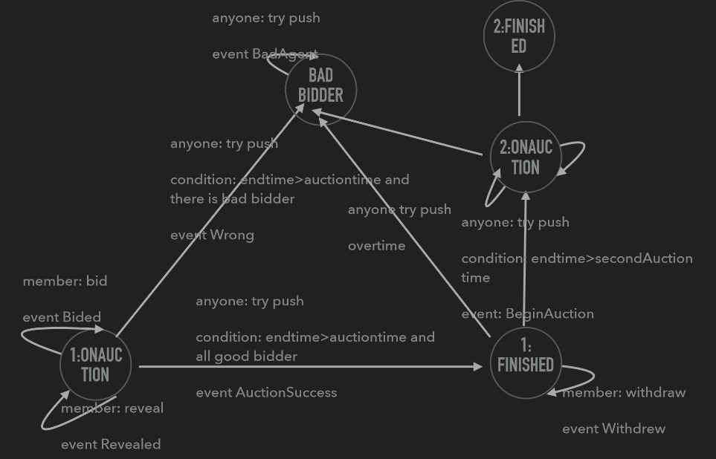
Replicated State Machine

Slide 11
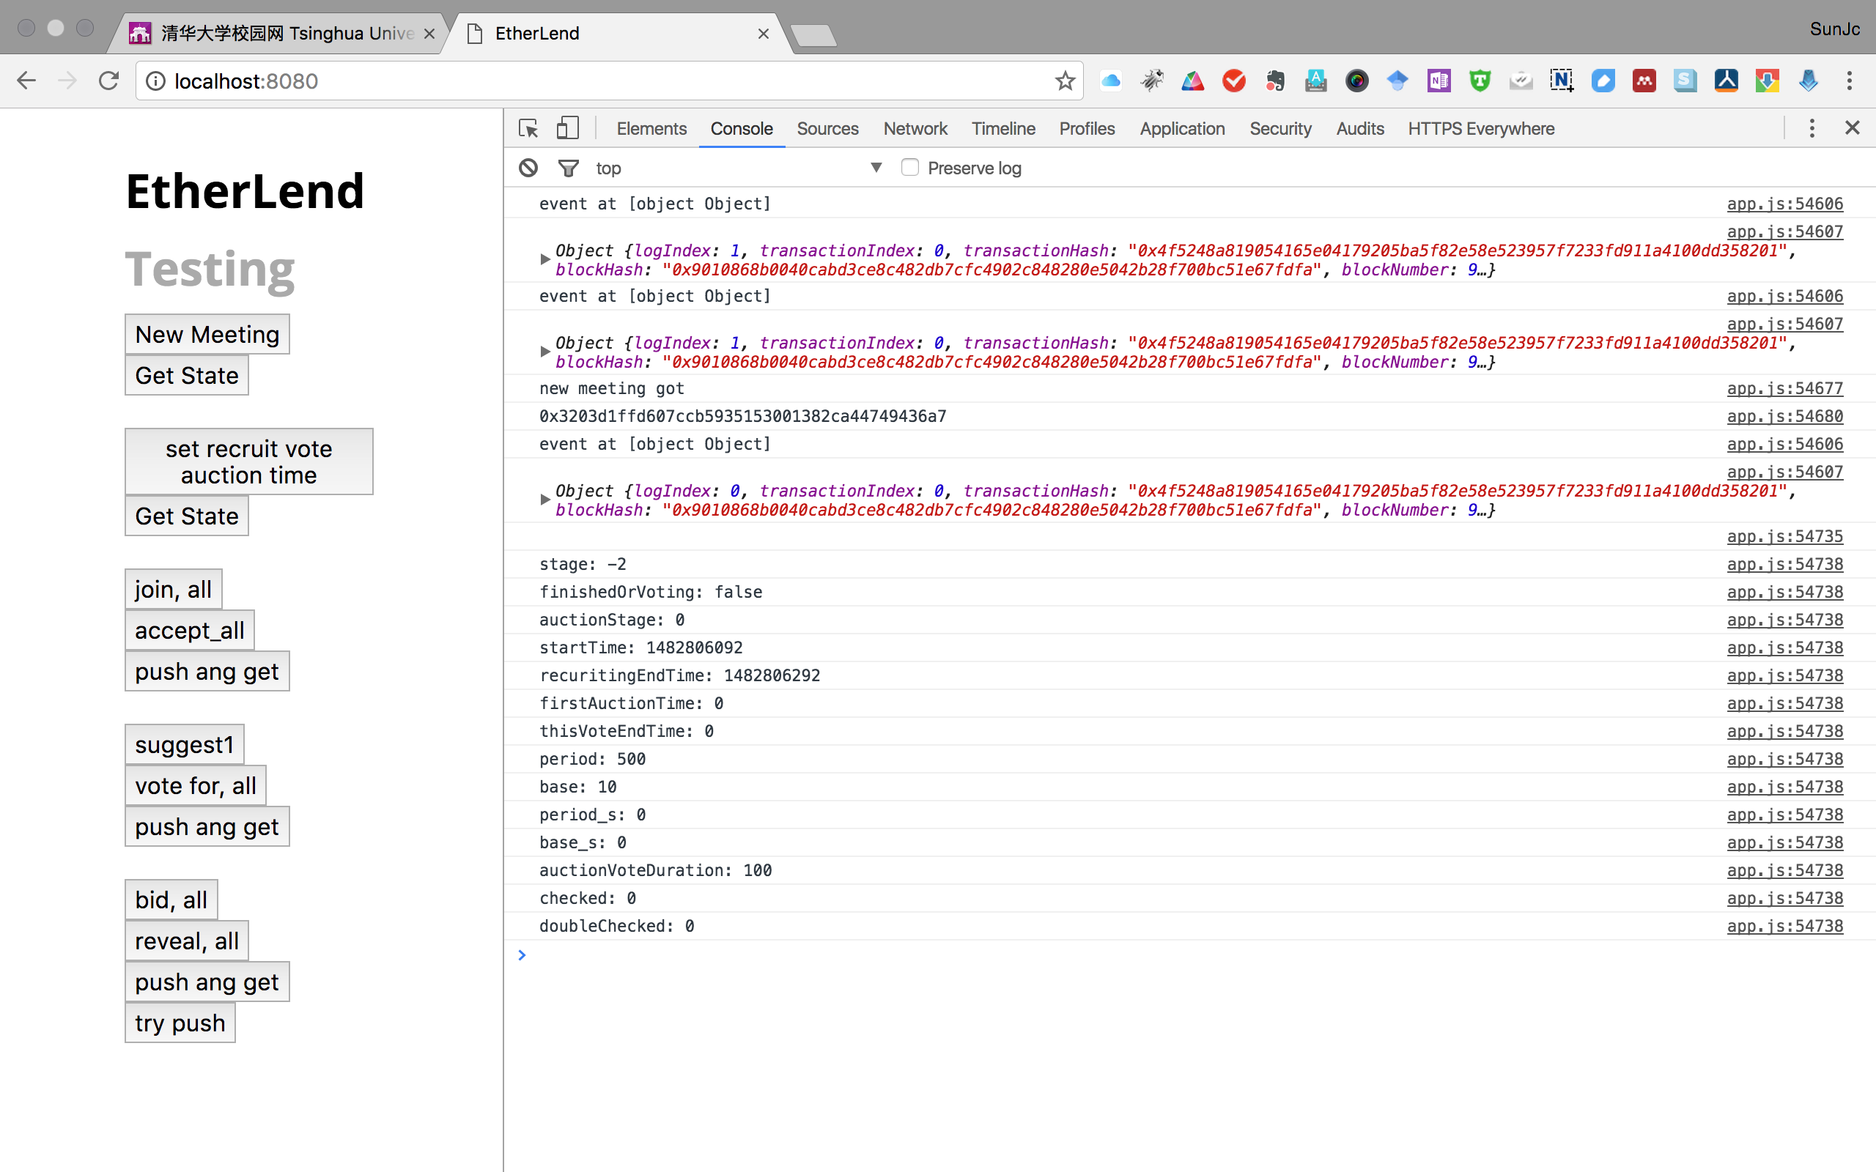
WebApp Demo

Slide 12
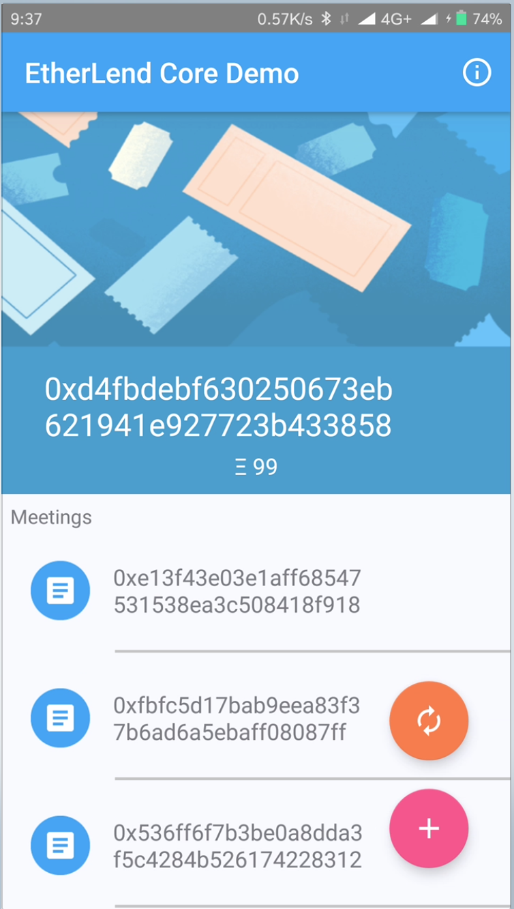
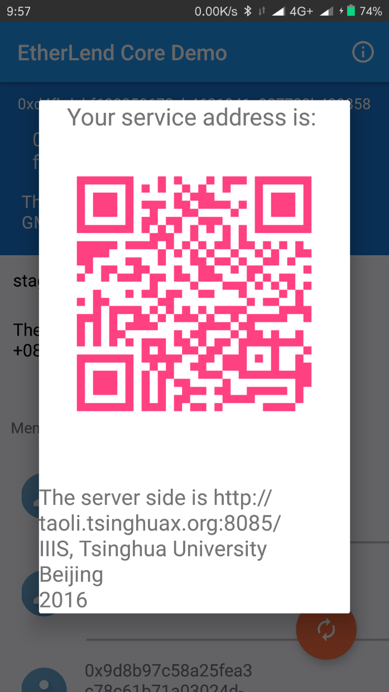
Mobile App

Slide 13
Demo Video

Slide 14
Future work
Group 7
SPV approach: Ethereum mobile
Accounts security
More complicated rules
Credit System
Public Domain for API test: http://taoli.tsinghuax.org:8085/
https://github.com/Sun-Jc/EtherLend

Slide 15
Thanks!

