Slide 1
Deep learning
Sequential modelling / RNNs

Slide 2
Today’s program
14:00-14:15 Recap
14:15-15:00 Machine learning tasks: regression / classification
15:00-15:45 Hands-on: multiclass Fashion MNIST
15:45-16:15 Break
16:15-16:45 Optimizers, regularization techniques
16:45-17:30 Hands-on: Regularization techniques on F-MNIST
17:30-18:00 Analyzing sequential data, RNNs
18:00-19:00 Diner
19:00-19:45 Hands-on: Predicting future temperatures with an RNN
19:45-20:15 Types of RNNs: LSTM, GRU
20:15-21:00 Hands-on: creating sequences, temperature prediction with GRU-based RNN
Time left: Improving RNNs: regularization, stacking, stateful and bi-directional RNNs
Time left: Hands-on: Improved RNNs on temperature prediction

Slide 3
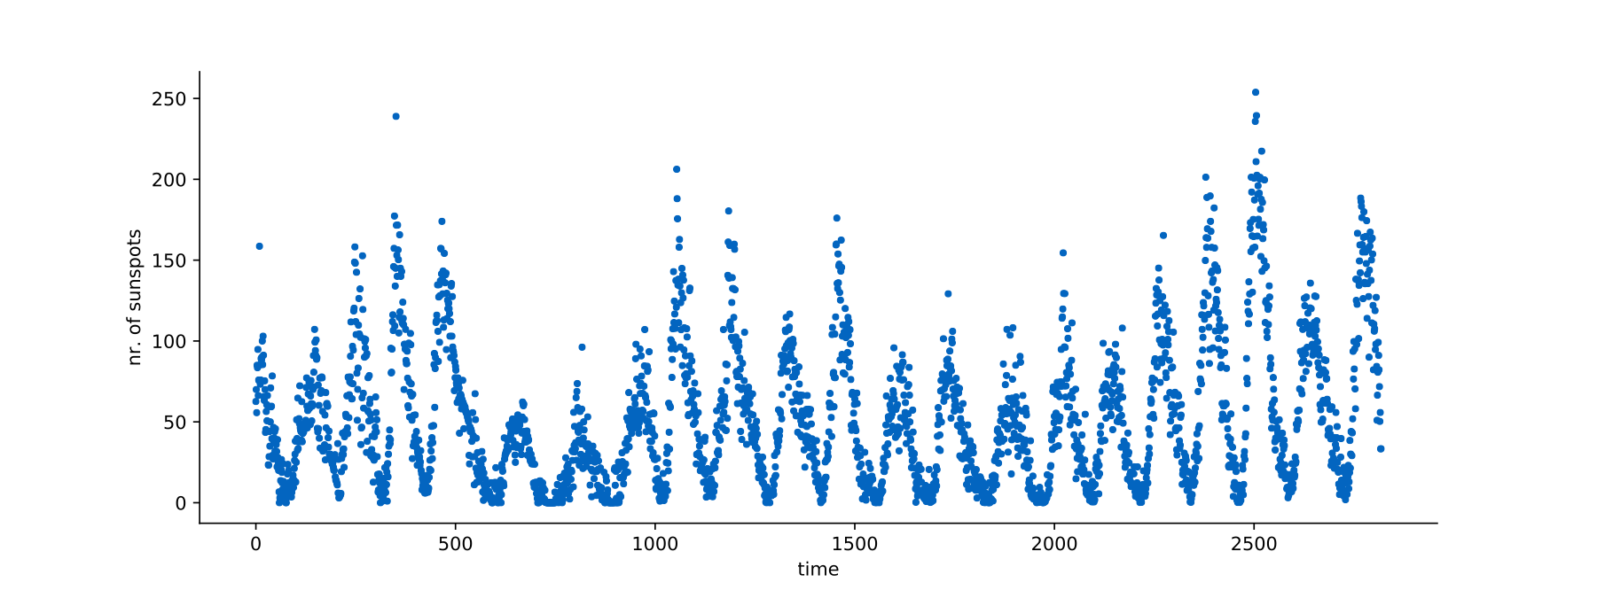
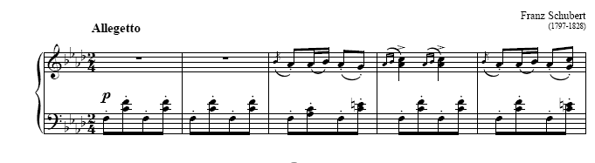
Sequential data
Data is sequential when the data has some order.
The whole dataset can consist of a single order (sunspots) or many individual orders (sentences).
the cat sat on the mat .
the book is open .

Slide 4
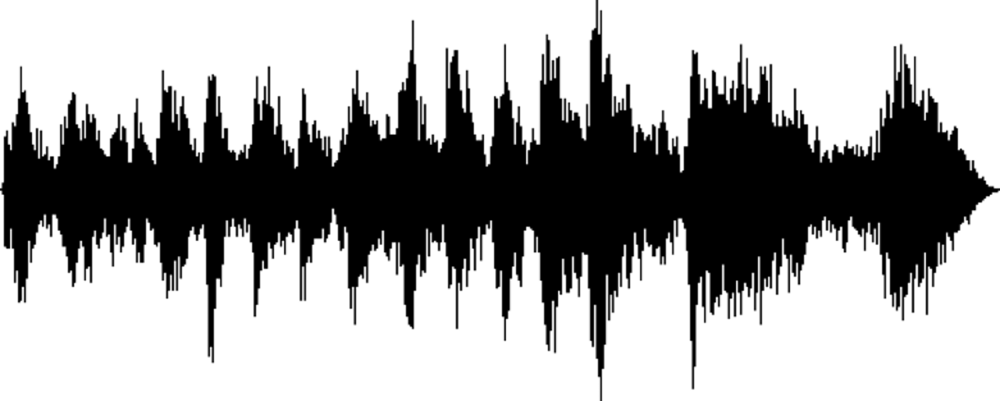
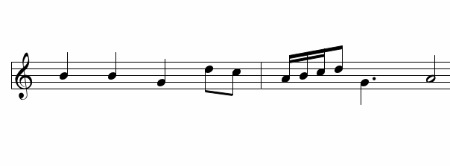


Sequential data
in deep learning
Machine translation
Speech recognition
Music generation
Sentiment classification
Video activity recognition
...
"Hoi, hoe gaat het?"
"Hi, how are you?"
"Hi, how are you?"
Some style / nothing
"Hoi, hoe gaat het?"
Running

Slide 5





Sequential data
In previous lectures our data have been made up from a single example.
A single example can have many features.
Temperature, air pressure, etc.
Now each example is made from a single sequence.
"Hi, hoe gaat het?"
Each sequence has many examples.
"Hi", "hoe", "gaat", "het"
That is, in each iteration we process a single sequence, many examples.
Classic example
Sequence example
$$x_{1}$$
$$x_{1}=$$
$$x_{1}^{<1>}$$
$$x_{1}^{<2>}$$
$$x_{1}^{<3>}$$
Features
Now is

Slide 6












Sequential data
Sequence dataset
$$x_{1}=$$
$$x_{1}^{<1>}$$
$$x_{1}^{<2>}$$
$$x_{1}^{<3>}$$
$$x_{2}=$$
$$x_{2}^{<1>}$$
$$x_{2}^{<2>}$$
$$x_{2}^{<3>}$$
$$x_{n}=$$
$$x_{n}^{<1>}$$
$$x_{n}^{<2>}$$
$$x_{n}^{<3>}$$
...
Number of features = 8
sequence length = 3
#examples = n
Data = (examples, sequence_length, features)

Slide 7
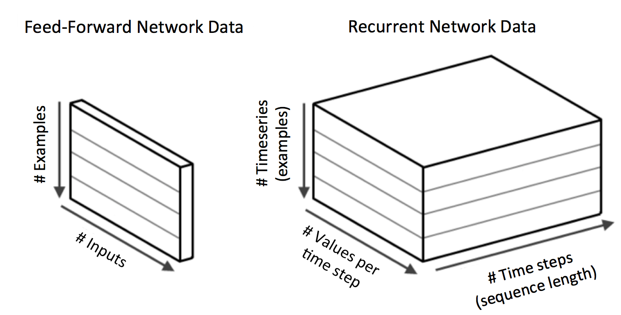
(Features)
(Features)
Data = (examples, features)
Data = (examples, sequence_length, features)
Source: https://www.oreilly.com/library/view/deep-learning/9781491924570/ch04.html

Slide 8
Which task?
Many-to-one
Regression
Tomorrows weather
Next word
Classification
Is this a question?
Assign rating based on review
Output
Het?
Network
Sequence
Hi, hoe gaat …
Output
Network
Sequence
"This product is great!”
Notes:
Explain the notation.

Slide 9
Which task?
Many-to-many
Regression
Daily weather for next week
Classification
Next sentence
Take a piece of music and compose the next section
Machine translation
Output
Met mij gaat het goed!
Network
Sequence
Hi, hoe gaat het?
Output
Network
Sequence
Notes:
Explain the notation.

Slide 10
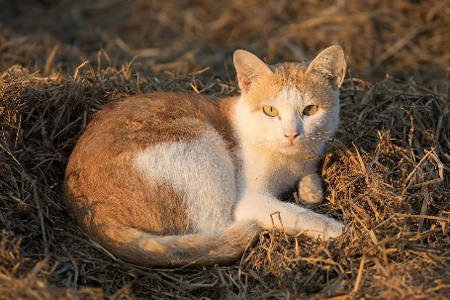
Which task?
One-to-many
Classification
Automatic captioning
Output
Cat laying on straw
Network
Input
Notes:
Explain the notation.

Slide 11




How to model?
Naive model
Why not just a fully connected network?
For this we will need VERY many parameters.
The sequence length might vary between examples.
We can often process each element independently and equally.
"gaat" is the same word regardless of position in a sentence.
Naive sequence model
$${\hat{y}}_{i}$$
Fully connected network
$$x_{i}^{<1>}$$
$$x_{i}^{<2>}$$
...
$$x_{i}^{<t>}$$
"Hi" "hoe" "gaat" "het?"
Notes:
Explain the notation.

Slide 12


How to model?
What about a very simple model that just models the next word?
Dataset:
The president of the United States is Donald Trump.
Wherever Donald Trump goes, security is tight.
A simple network could learn that ‘Donald’ is always followed by ‘Trump’
Pretty easy to learn, not so realistic…
"Trump"
$${\hat{y}}^{<t>}$$
Network
$$x_{i}^{<t>}$$
"Donald"
Notes:
Explain the notation.

Slide 13


How to model?
What about a very simple model that just models the next word?
Dataset:
The president of the United States is Donald Trump.
Wherever Donald Trump goes, security is tight.
The comic Donald Duck is very famous.
Now what?
"?"
$${\hat{y}}^{<t>}$$
Network
$$x_{i}^{<t>}$$
"Donald"
Notes:
Explain the notation.

Slide 14






How to model?
Meaning depends on context!
Recurrent networks have a memory (a ‘state’), $h^{<t−1>}$ in the figure below
The next prediction ${\hat{y}}^{<t>}$ depends not only on the input $x_{i}^{<t>}$, but also on the context ‘remembered’ by the network, $h^{<t−1>}.$
"Donald"
"Duck"
$${\hat{y}}^{<t−1>}$$
$${\hat{y}}^{<t>}$$
Network
$$h^{<t−1>}$$
Network
$$x_{i}^{<t−1>}$$
$$x_{i}^{<t>}$$
"comic"
"Donald"
Notes:
Explain the notation.

Slide 15
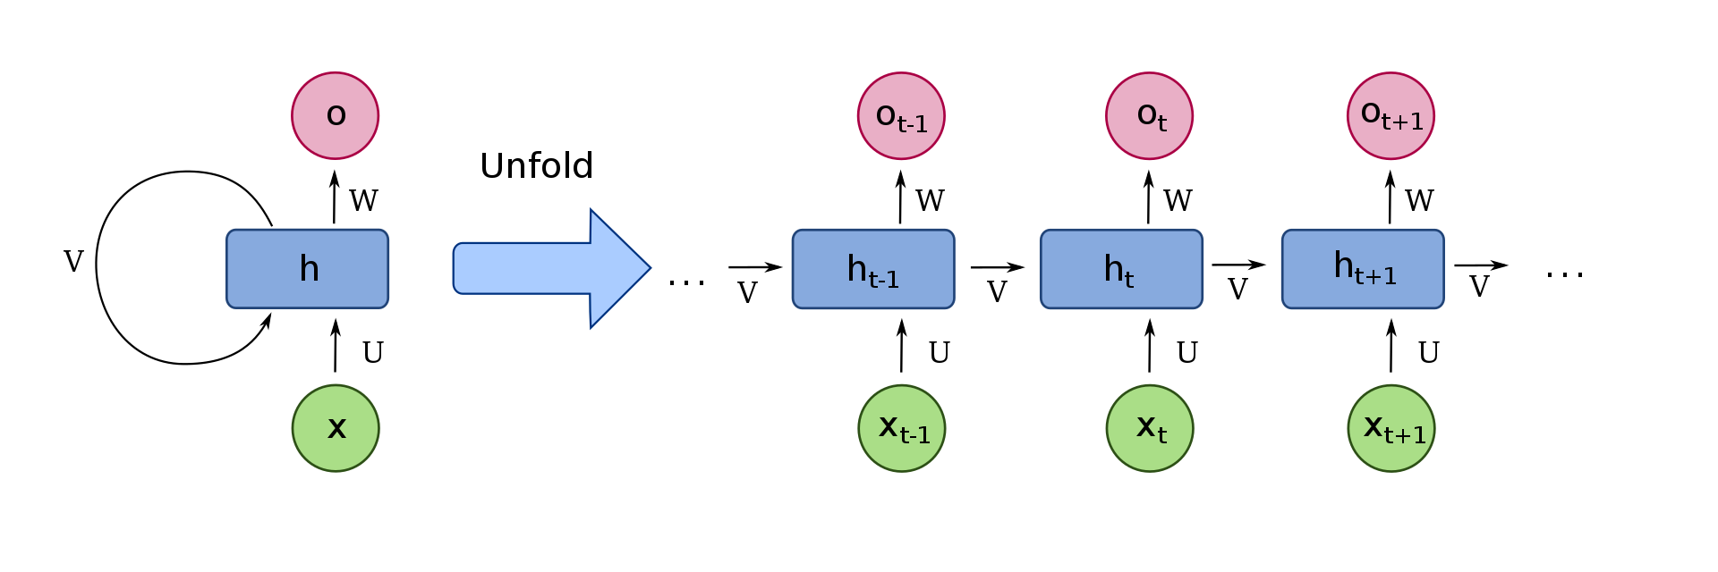
Simple RNN
U, V, W are the weight matrices
Weights are reused!
RNN cell
Notes:
Explain the notation.

Slide 16
Simple RNN
Weights are reused: predictions the same, irrespective of where “comic Donald” occurs in a sequence
…
Duck
The
comic
Donald
Duck is very famous
Notes:
Explain the notation.

Slide 17
Simple RNN
Weights are reused: predictions the same, irrespective of where “comic Donald” occurs in a sequence
…
Duck
Do you know the
comic
Donald
Duck?
Notes:
Explain the notation.

Slide 18
Simple RNN
Of course, this changes if we use longer sequence length (i.e. look at more context/history)
Memory h_{t-1} could alter the prediction
Do you know
the
comic
Donald
Duck?
Notes:
Explain the notation.

Slide 19

Simple RNN
The math inside a simple RNN cell…
$$h_{t}=σ\left(U⋅x_{t}+V⋅h_{t−1}+b_{h}\right)$$
$$o_{t}=σ(W⋅h_{t}+b_{o})$$
Compare to dense layer
$$o_{t}=σ\left({W⋅x}_{t}+b\right)$$
This is often considered the next dense layer
This is often considered the RNN cell
Notes:
Explain the notation.

Slide 20

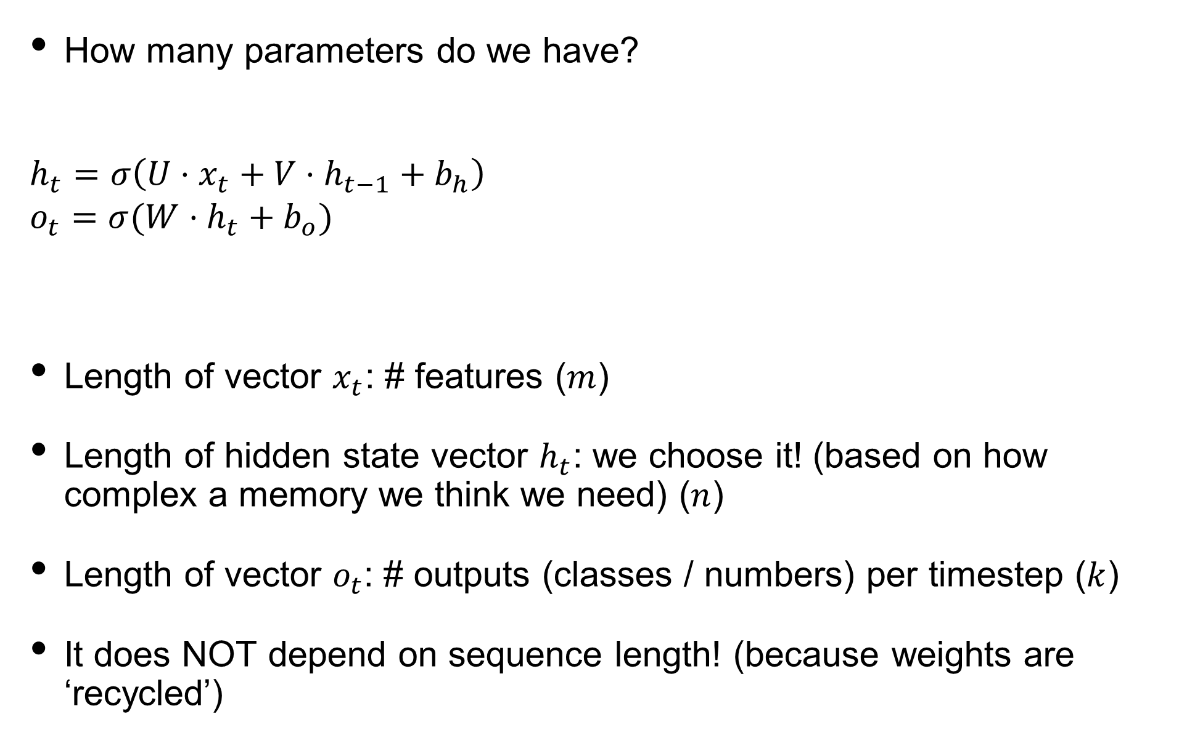







Simple RNN
How many parameters do we have?
$$h_{t}=σ\left(U⋅x_{t}+V⋅h_{t−1}+b_{h}\right)$$
$$o_{t}=σ(W⋅h_{t}+b_{o})$$
Length of vector $x_{t}$: # features ($m$)
Length of hidden state vector $h_{t}$: we choose it! (based on how complex a memory we think we need) ($n$)
Length of vector $o_{t}$: # outputs (classes / numbers) per timestep ($k$)
It does NOT depend on sequence length! (because weights are ‘recycled’)
$$(n,m)$$
$$(m)$$
$$(n,n)$$
$$(n)$$
$$(n)$$
Layer_simple_rnn
Layer_dense
$$(k,n)$$
$$(n)$$
$$(k)$$
Notes:
Explain the notation.

Slide 21

Simple RNN
How many parameters do we have?
$$h_{t}=σ\left(U⋅x_{t}+V⋅h_{t−1}+b_{h}\right)$$
$$o_{t}=σ(W⋅h_{t}+b_{o})$$
Sum up all weights and biases:
$$\#params=(n⋅m+n⋅n+n)+(k⋅n+k)$$
$$(n,m)$$
$$(m)$$
$$(n,n)$$
$$(n)$$
$$(n)$$
Layer_simple_rnn
Layer_dense
$$(k,n)$$
$$(n)$$
$$(k)$$
Notes:
Explain the notation.

Slide 22
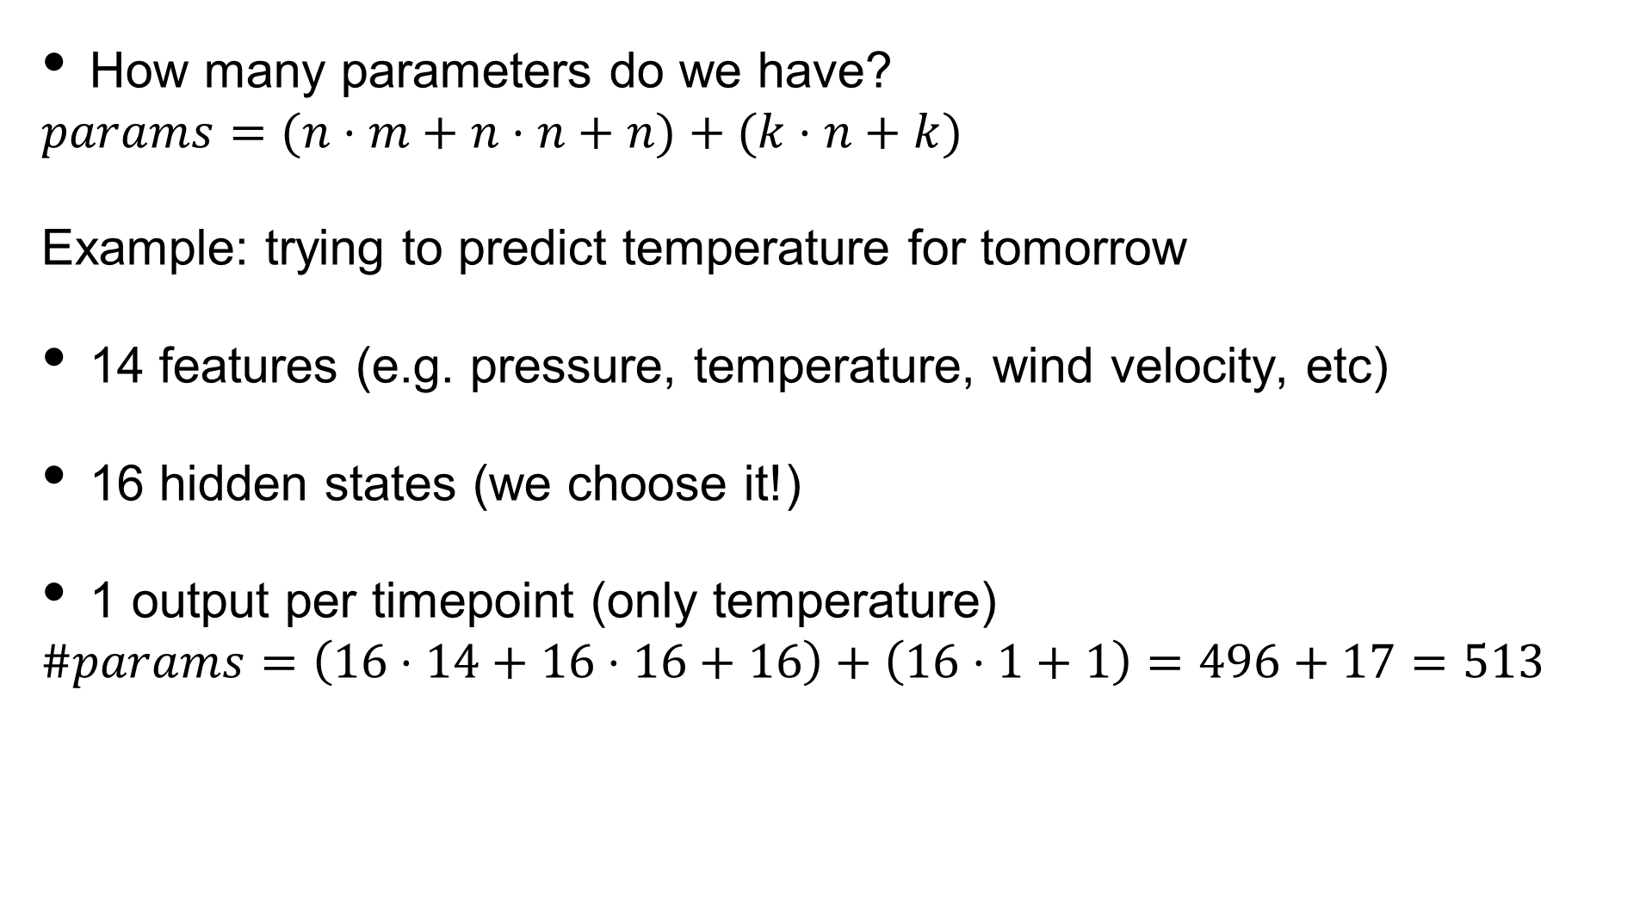
Simple RNN
How many parameters do we have?
$$params=(n⋅m+n⋅n+n)+(k⋅n+k)$$
Example: trying to predict temperature for tomorrow
14 features (e.g. pressure, temperature, wind velocity, etc)
16 hidden states (we choose it!)
1 output per timepoint (only temperature)
$$\#params=\left(16⋅14+16⋅16+16\right)+\left(16⋅1+1\right)=496+17=513$$
Notes:
Explain the notation.

Slide 23
Unfolding an RNN
Sometimes, literature shows RNN as a loop. We have looked at ‘unfolded’ RNNs. Same thing, just different visual representation.

Slide 24
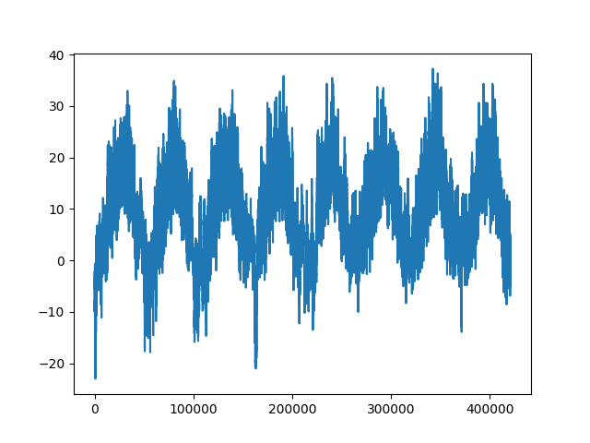
Notebook
The Jena weather dataset.
A long sequence of weather measurements.
Each measurement consists of 15 variables.
We see a time-dependent pattern in the data.
Temperature
Sequence index

Slide 25
Today’s program
14:00-14:15 Recap
14:15-15:00 Machine learning tasks: regression / classification
15:00-15:45 Hands-on: multiclass Fashion MNIST
15:45-16:15 Break
16:15-16:45 Optimizers, regularization techniques
16:45-17:30 Hands-on: Regularization techniques on F-MNIST
17:30-18:00 Analyzing sequential data, RNNs
18:00-19:00 Diner
19:00-19:45 Hands-on: Predicting future temperatures with an RNN
19:45-20:15 Types of RNNs: LSTM, GRU
20:15-21:00 Hands-on: creating sequences, temperature prediction with GRU-based RNN
Time left: Improving RNNs: regularization, stacking, stateful and bi-directional RNNs
Time left: Hands-on: Improved RNNs on temperature prediction

Slide 26

Hands-on
Go to https://jupyter.lisa.surfsara.nl:8000/
Or https://dba.projects.sda.surfsara.nl/
Notebook: 04a-time-series-prediction.ipynb
19:00-19:45

Slide 27
Hands-on recap
sharing parameters
Each time-step we use the same network (same weight matrices), it just gets different "memory" (hidden state) passed to it.
Sharing parameters reduces the number of parameters in the model.
Reduces model complexity and risk of overfitting. This is the value of RNNs over fully connected!
Assumption behind RNN: meaning of an input depends on
Input
Current hidden state
Not on location in the sequence
We process "the" in the same way.
the cat
saw the
layer_simple_rnn(units = 12, input_shape = c(sequence_length, features))

Slide 28
Today’s program
14:00-14:15 Recap
14:15-15:00 Machine learning tasks: regression / classification
15:00-15:45 Hands-on: multiclass Fashion MNIST
15:45-16:15 Break
16:15-16:45 Optimizers, regularization techniques
16:45-17:30 Hands-on: Regularization techniques on F-MNIST
17:30-18:00 Analyzing sequential data, RNNs
18:00-19:00 Diner
19:00-19:45 Hands-on: Predicting future temperatures with an RNN
19:45-20:15 Types of RNNs: LSTM, GRU
20:15-21:00 Hands-on: creating sequences, temperature prediction with GRU-based RNN
Time left: Improving RNNs: regularization, stacking, stateful and bi-directional RNNs
Time left: Hands-on: Improved RNNs on temperature prediction

Slide 29
Sequential data
Long term dependencies
After each time-step we store some information.
When we train RNNs we are training them to do two things.
Store the correct information between time-steps. This is hard.
Map the stored information to solve the task. This is easy.
Source: https://towardsdatascience.com/illustrated-guide-to-recurrent-neural-networks-79e5eb8049c9

Slide 30
Sequential data
Long term dependencies
Why is it hard?
RNNs are trying to learn to represent sequences by remembering what they contain.
In question detection we want to remember if we saw "what", ... .
We learn to represent the sequence in order to solve the task at hand.
At start we are doing poorly (random weights) and we see almost no indication that "what" was used previously.
We want to update our RNN cell so that next time we remember when we see "what".

Slide 31












Sequential data
Long term dependencies
If the sequence is long, little information is passed all the way to the end so a small error signal is sent back for the word "what".
Small error signal = small updates
$$loss(y,\hat{y})$$
Gradient
$${\hat{y}}_{i}^{<1>}$$
$${\hat{y}}_{i}^{<2>}$$
$${\hat{y}}_{i}^{<t>}$$
$$h^{<0>}$$
RNN
$$h^{<1>}$$
RNN
$$h^{<2>}$$
$$h^{<t−1>}$$
RNN
$$h^{<t>}$$
...
$$x_{i}^{<1>}$$
$$x_{i}^{<2>}$$
$$x_{i}^{<t>}$$
What
time
it

Slide 32

Sequential data
Long term dependencies
The is the problem of long term dependencies, which is because the gradient vanishes (the error signal).
This is a general problem in neural networks trained with gradient descent, but very tangible in RNNs due to their depth.
Source: https://towardsdatascience.com/illustrated-guide-to-recurrent-neural-networks-79e5eb8049c9

Slide 33
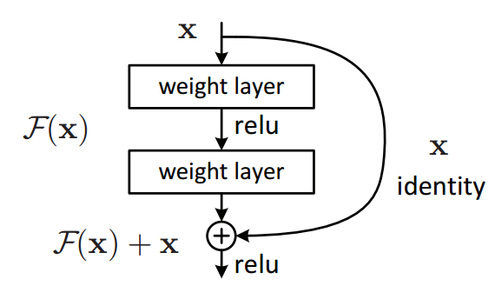
Residual connections
Long term dependencies
The solution to this problem in general are residual connections, (ResNet, 2015).
We add connections which bypass non-linear activations (or go through fewer).
This allows the error signal to flow directly to earlier layers.
Source: https://towardsdatascience.com/illustrated-guide-to-recurrent-neural-networks-79e5eb8049c9

Slide 34
LSTMs and GRUs
Long term dependencies
The solution to the vanishing gradient problem in RNNs was a different implementation of the RNN cell.
LSTM (1997)
GRU (2014)
They are more complex and expensive but are able to deal better with long term dependencies.
LSTM is heavier than GRU.
layer_gru(units = 10)
layer_lstm(units = 10)

Slide 35
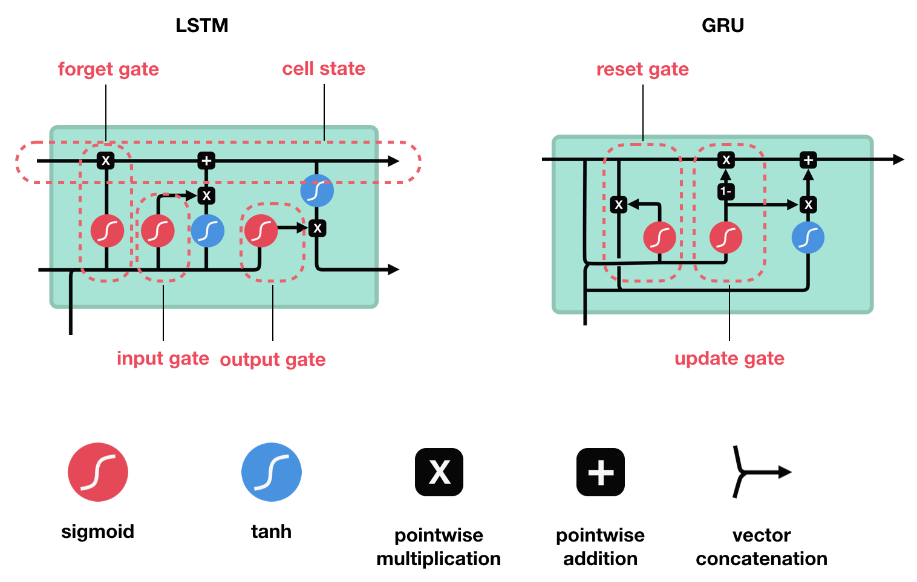
Source: https://towardsdatascience.com/illustrated-guide-to-lstms-and-gru-s-a-step-by-step-explanation-44e9eb85bf21
Notes:
https://en.wikipedia.org/wiki/Long_short-term_memory
https://en.wikipedia.org/wiki/Gated_recurrent_unit
Reset gate: what to keep from hidden state. Input/output gate changed into x and 1-x.

Slide 36
Generating sequences
We want to break this long sequence into many sequences
(1, ... ) (2, ... ) (3, ... ) (4, ... ) (5, ... ) (6, ... ) (7, ... ) (8, ... ) (9, ... ) (10, ... ) (11, ... ) (12, ... ) (13, ... ) (14, ... )
Reshape approach - sequence length = 7
(1, ... ) (2, ... ) (3, ... ) (4, ... ) (5, ... ) (6, ... ) (7, ... ) (8, ... ) (9, ... ) (10, ... ) (11, ... ) (12, ... ) (13, ... ) (14, ... )
1st example
(1, ... ) (2, ... ) (3, ... ) (4, ... ) (5, ... ) (6, ... ) (7, ...)
2nd example
(8, ... ) (9, ... ) (10, ... ) (11, ... ) (12, ... ) (13, ... ) (14, ... )

Slide 37
Generating sequences
We want to break this long sequence into many sequences
(1, ... ) (2, ... ) (3, ... ) (4, ... ) (5, ... ) (6, ... ) (7, ... ) (8, ... ) (9, ... ) (10, ... ) (11, ... ) (12, ... ) (13, ... ) (14, ... )
Shift approach, using shift = 2, sequence length = 7
(1, ... ) (2, ... ) (3, ... ) (4, ... ) (5, ... ) (6, ... ) (7, ... ) (8, ... ) (9, ... ) (10, ... ) (11, ... ) (12, ... ) (13, ... ) (14, ... )
1st example
(1, ... ) (2, ... ) (3, ... ) (4, ... ) (5, ... ) (6, ... ) (7, ...)
2nd example
(3, ... ) (4, ... ) (5, ... ) (6, ... ) (7, ... ) (8, ... ) (9, ... )
3rd example
(5, ... ) (6, ... ) (7, ... ) (8, ... ) (9, ... ) (10, ... ) (11, ... )
4th example
(7, ... ) (8, ... ) (9, ... ) (10, ... ) (11, ... ) (12, ... ) (13, ... )

Slide 38
Generating sequences
Shift approach, using shift = 2, sequence length = 7, target shift = 1
(1, ... ) (2, ... ) (3, ... ) (4, ... ) (5, ... ) (6, ... ) (7, ... ) (8, ... ) (9, ... ) (10, ... ) (11, ... ) (12, ... ) (13, ... ) (14, ...)
x
y
1st example
(1, ... ) (2, ... ) (3, ... ) (4, ... ) (5, ... ) (6, ... ) (7, .. )
(9, ... )
2nd example
(3, ... ) (4, ... ) (5, ... ) (6, ... ) (7, ... ) (8, ... ) (9, ... )
(11, ... )
3rd example
(5, ... ) (6, ... ) (7, ... ) (8, ... ) (9, ... ) (10, ... ) (11, ... )
(13, ... )

Slide 39
Hands-on
Go to https://jupyter.lisa.surfsara.nl:8000/
Or https://dba.projects.sda.surfsara.nl/
Notebook: 05a-rnns.ipynb
20:15-21:00

Slide 40
Today’s program
14:00-14:15 Recap
14:15-15:00 Machine learning tasks: regression / classification
15:00-15:45 Hands-on: multiclass Fashion MNIST
15:45-16:15 Break
16:15-16:45 Optimizers, regularization techniques
16:45-17:30 Hands-on: Regularization techniques on F-MNIST
17:30-18:00 Analyzing sequential data, RNNs
18:00-19:00 Diner
19:00-19:45 Hands-on: Predicting future temperatures with an RNN
19:45-20:15 Types of RNNs: LSTM, GRU
20:15-21:00 Hands-on: creating sequences, temperature prediction with GRU-based RNN
Time left: Improving RNNs: regularization, stacking, stateful and bi-directional RNNs
Time left: Hands-on: Improved RNNs on temperature prediction

Slide 41
Improving RNNs
Regularisation
L1/L2
Dropout, recurrent dropout
Improving RNNs
Stacking
Stateful
Bi-directional

Slide 42
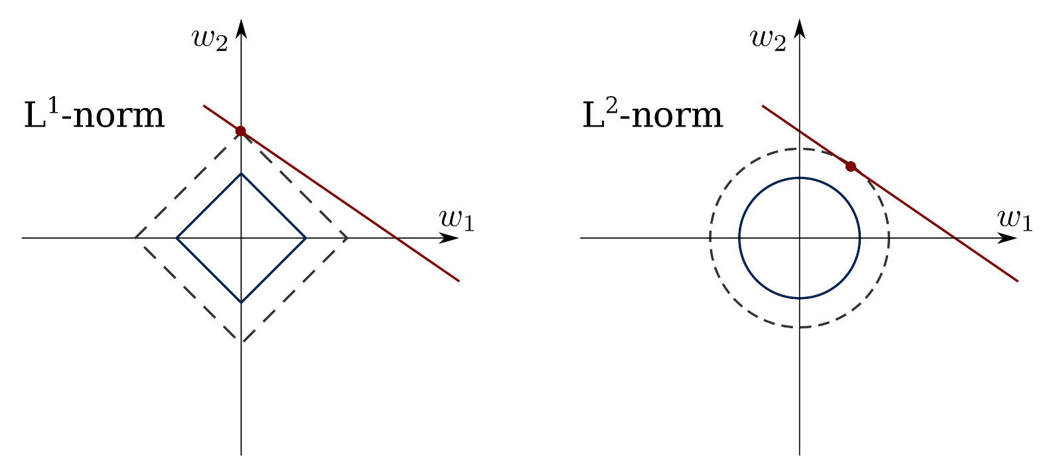
Improving RNNs
L2/L1 regularisation
Just like with normal dense layers.
we add L2/L1 regularisation to the weights learnt in the RNN cell.
layer_gru(units = 10, kernel_regularizer = regularizer_l2(l = 0.001))
layer_gru(units = 10, kernel_regularizer = regularizer_l1(l = 0.001))
Red line: identical predictions of the NN (too many degrees of freedom)
Red point: solution for (w₁, w₂) preferred by each norm.

Slide 43











Improving RNNs
Dropout
In RNNs we consider dropouts in two locations.
Input
Recurrent dropout
layer_gru(units = 10, dropout = 0.2, recurrent_dropout = 0.3)
$${\overset{̂}{y}}_{i}^{<1>}$$
$${\overset{̂}{y}}_{i}^{<2>}$$
$${\overset{̂}{y}}_{i}^{<t>}$$
recurrent dropout
$$a^{<0>}$$
RNN
$$a^{<1>}$$
RNN
$$a^{<2>}$$
$$a^{<t−1>}$$
RNN
$$a^{<t>}$$
...
input dropout
$$x_{i}^{<1>}$$
$$x_{i}^{<2>}$$
$$x_{i}^{<t>}$$

Slide 44



Improving RNNs
Stacking RNNs
Why would we consider input dropout?
Maybe in production we might not always get all inputs.
More likely, we are stacking RNNs.
Stacking RNNs is like adding additional layers in a dense network.
We never go that deep, 1-6 layers. Long training time.
Final output
layer_gru(units = 10, return_sequences = TRUE) %>%
layers_gru(units = 10)
RNN
RNN
...
RNN
RNN
RNN
...
RNN
$$x_{i}^{<1>}$$
$$x_{i}^{<2>}$$
$$x_{i}^{<t>}$$

Slide 45
Improving RNNs
Stateful
A stateful RNN passes the last state of the previous batch to as an initial state to the next batch.
Otherwise the initial state is "all zeroes".
This is useful if there is some connection between batches.
For example, the batches are in sequence.
Batch 1
RNN
...
RNN
Batch 2
RNN
...
RNN

Slide 46
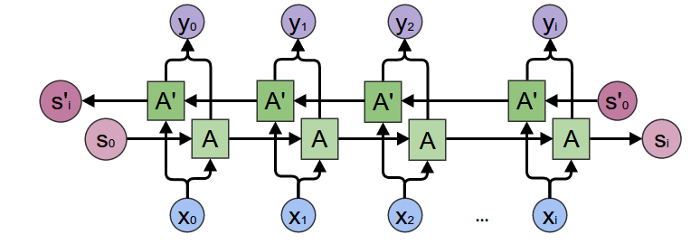
Improving RNNs
Bi-directional
We process the sequence in both directions.
Very helpful for example in named entity recognition, in which we classify every word as a "person", "place", ... .
He said, "Teddy Roosevelt ...
He said, "Teddy bears ...

Slide 47
Summary
Regularisation
L1/L2
Dropout, recurrent dropout
Improving RNNs
Stacking
Stateful
Bi-directional

Slide 48
Hands-on
Go to https://jupyter.lisa.surfsara.nl:8000/
Or https://dba.projects.sda.surfsara.nl/
Notebook: 05b-rnns-improved.ipynb
Duration: +/- 45 mins

Slide 49
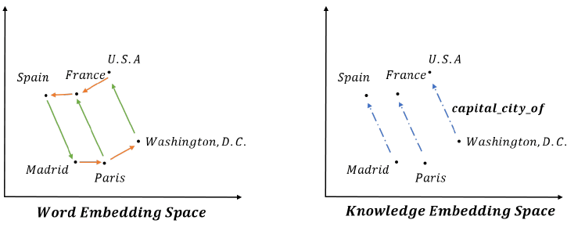
Will not cover
We did not cover any natural language processing (NLP).
Word embeddings, representing words as vectors
RNNs have been very successful in NLP over the years.
NLP requires a lot of data preprocessing and large models.
Same models used.
New Paradigm: Transformers

