Slide 1
Deep learning
CNNs

Slide 2
Today’s program
14:00-14:30 Recap
14:30-14:45 Improving RNNs: regularization, stacking, stateful and bi-directional RNNs
14:45-15:15 Hands-on: Improved RNNs on temperature prediction
15:15-15:45 Image processing, Convolutional Neural Networks (CNN)
15:45-16:15 Break
16:15-17:00 Hands-on: CNN on fashion MNIST
17:00-17:30 Transfer Learning
17:30-18:00 Hands-on: transfer learning with pre-trained ResNet-50 layers for fashion MNIST
18:00-19:00 Diner
19:00-19:30 Unsupervised learning, the (variational) autoencoder (VAE)
19:30-20:15 Hands-on: auto-encoder on MNIST
20:15-20:45 Generative adversarial networks (GAN)
20:45-21:00 Summary, final questions, etc

Slide 3
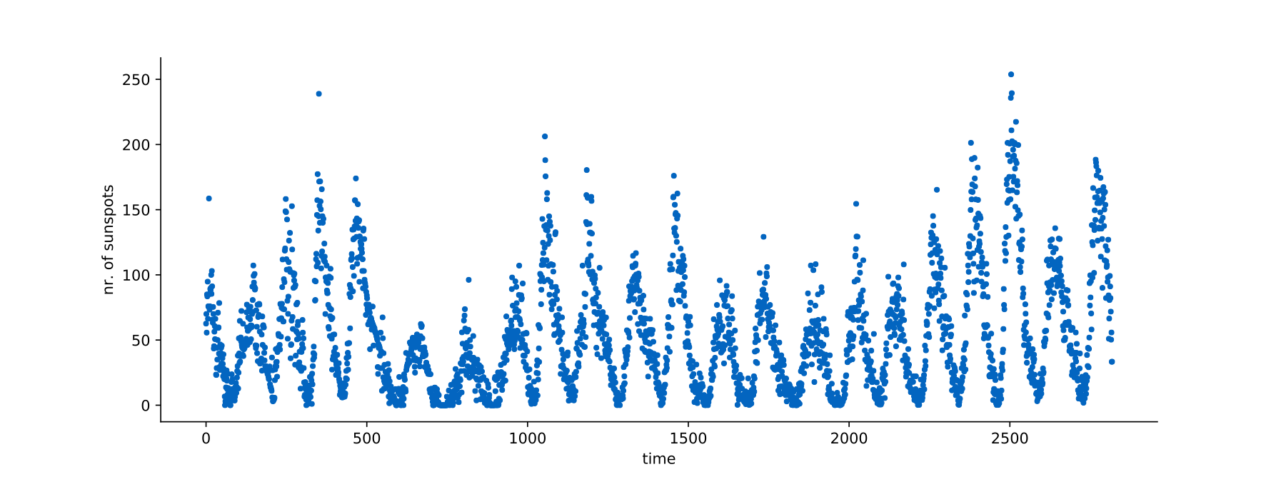
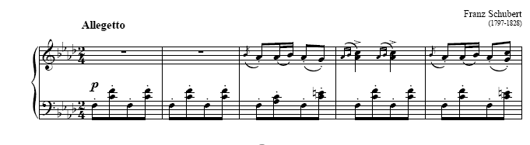
Recap RNNs
Last time, we looked at analyzing sequential data
the cat sat on the mat .
the book is open .

Slide 4
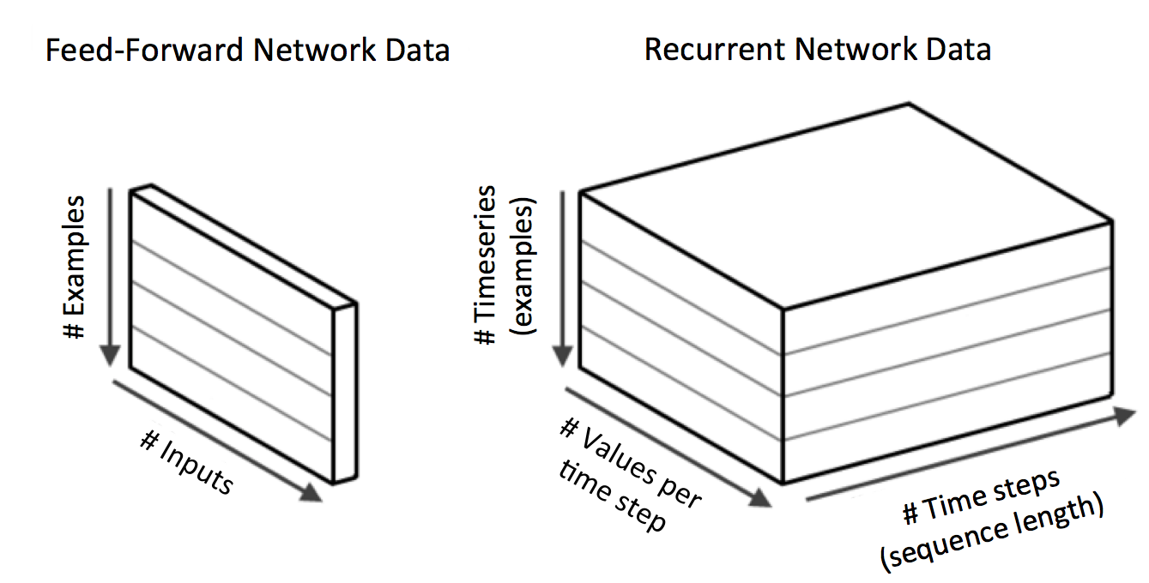
Recap RNNs
Last time, we looked at analyzing sequential data
Data = (examples, sequence_length, features)
Source: https://www.oreilly.com/library/view/deep-learning/9781491924570/ch04.html

Slide 5
Recap RNNs
Applications
Many-to-one, e.g. predict next word
Many-to-many, e.g. machine translation
One-to-many, e.g. automatic image captioning
Note: Many-to-one can also be done iteratively!
The
The cat
The cat is
The cat is sitting …

Slide 6
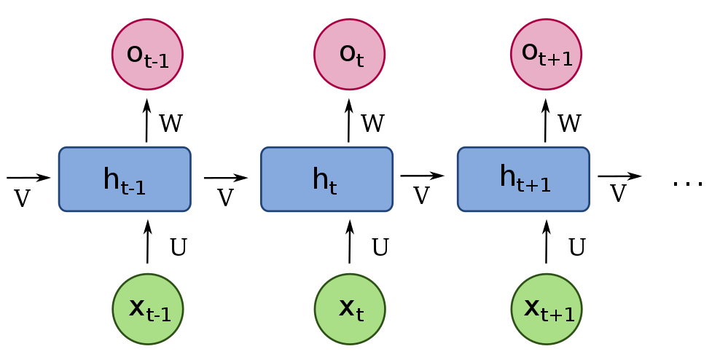
Simple RNN
U, V, W are the weight matrices
Weights are reused!
RNN cell
Notes:
Explain the notation.

Slide 7





Simple RNN
Another way to look at it…
o_{t}
o_{t+1}
$$W$$
$$W$$
h_{t}
h_{t+1}
$$\left[V,U\right]$$
$$\left[V,U\right]$$
Memory / hidden state
h_{t-1}
$$[h_{t−1},x_{t}]$$
$$[h_{t},x_{t+1}]$$
x_{t}
x_{t+1}
Input
Input
Notes:
Explain the notation.

Slide 8
Recap RNNs
Dense networks | RNN
Can’t process sequence of arbitrary length | Can process sequence of arbitrary length
Doesn’t account for ordering of input. E.g. hard to learn that Donald is likely followed by Trump. Would have to learn this for each position in the sequence separately | Does account for ordering of input. It will predict similar outcomes given a similar context. E.g. Donald is generally followed by Trump, irrespective of position in the sequence.
Lots of parameters | Reuse of parameters for each time step in the sequence

Slide 9
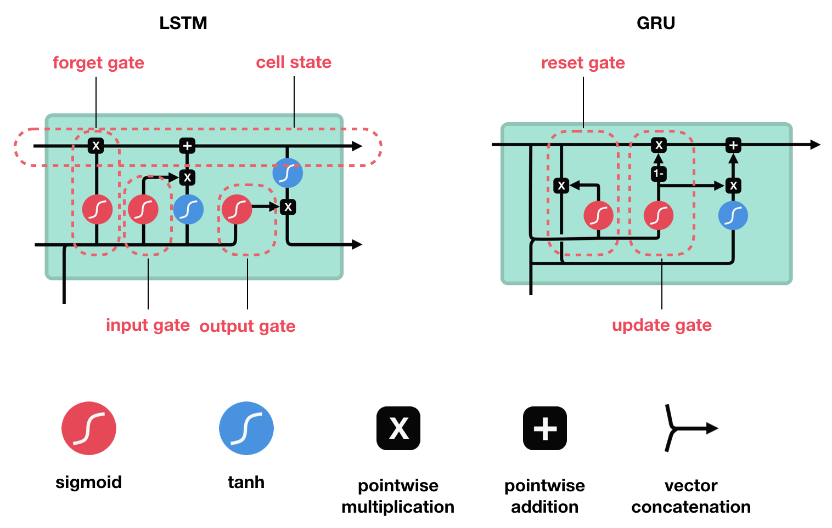
Recap / Questions?
Basic RNN has a very short term memory
GRU and LSTM have a longer memory, but are more complex (heavier to train)

Slide 10
Recap / Questions?
Generating sequences
Choices between consecutive / overlapping sequences (shift), sequence length, target shift…
Shift approach, using shift = 2, sequence length = 7, target shift = 1
(1, ... ) (2, ... ) (3, ... ) (4, ... ) (5, ... ) (6, ... ) (7, ... ) (8, ... ) (9, ... ) (10, ... ) (11, ... ) (12, ... ) (13, ... ) (14, ... )
x
y
1st example
(1, ... ) (2, ... ) (3, ... ) (4, ... ) (5, ... ) (6, ... ) (7, ... )
(9, ... )
2nd example
(3, ... ) (4, ... ) (5, ... ) (6, ... ) (7, ... ) (8, ... ) (9, ... )
(11, ... )
3rd example
(5, ... ) (6, ... ) (7, ... ) (8, ... ) (9, ... ) (10, ... ) (11, ... )
(13, ... )

Slide 11
Today’s program
14:00-14:30 Recap
14:30-14:45 Improving RNNs: regularization, stacking, stateful and bi-directional RNNs
14:45-15:15 Hands-on: Improved RNNs on temperature prediction
15:15-15:45 Image processing, Convolutional Neural Networks (CNN)
15:45-16:15 Break
16:15-17:00 Hands-on: CNN on fashion MNIST
17:00-17:30 Transfer Learning
17:30-18:00 Hands-on: transfer learning with pre-trained ResNet-50 layers for fashion MNIST
18:00-19:00 Diner
19:00-19:30 Unsupervised learning, the (variational) autoencoder (VAE)
19:30-20:15 Hands-on: auto-encoder on MNIST
20:15-20:45 Generative adversarial networks (GAN)
20:45-21:00 Summary, final questions, etc

Slide 12
Improving RNNs
Regularisation
L1/L2
Dropout, recurrent dropout
Improving RNNs
Stacking
Stateful
Bi-directional

Slide 13
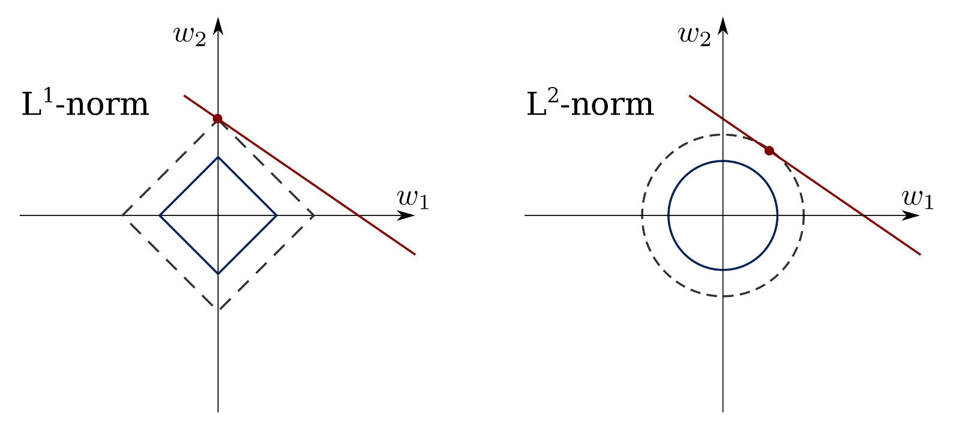
Improving RNNs
L2/L1 regularisation
Just like with normal dense layers.
we add L2/L1 regularisation to the weights learnt in the RNN cell.
layer_gru(units = 10, kernel_regularizer = regularizer_l2(l = 0.001))
layer_gru(units = 10, kernel_regularizer = regularizer_l1(l = 0.001))
Red line: identical predictions of the NN (too many degrees of freedom)
Red point: solution for (w₁, w₂) preferred by each norm.

Slide 14











Improving RNNs
Dropout
In RNNs we consider dropouts in two locations.
Input
Recurrent dropout
layer_gru(units = 10, dropout = 0.2, recurrent_dropout = 0.3)
$${\overset{̂}{y}}_{i}^{<1>}$$
$${\overset{̂}{y}}_{i}^{<2>}$$
$${\overset{̂}{y}}_{i}^{<t>}$$
recurrent dropout
$$a^{<0>}$$
RNN
$$a^{<1>}$$
RNN
$$a^{<2>}$$
$$a^{<t−1>}$$
RNN
$$a^{<t>}$$
...
input dropout
$$x_{i}^{<1>}$$
$$x_{i}^{<2>}$$
$$x_{i}^{<t>}$$

Slide 15



Improving RNNs
Stacking RNNs
Why would we consider input dropout?
Maybe in production we might not always get all inputs.
More likely, we are stacking RNNs.
Stacking RNNs is like adding additional layers in a dense network.
We never go that deep, 1-6 layers. Long training time.
Final output
layer_gru(units = 10, return_sequences = TRUE) %>%
layers_gru(units = 10)
RNN
RNN
...
RNN
RNN
RNN
...
RNN
$$x_{i}^{<1>}$$
$$x_{i}^{<2>}$$
$$x_{i}^{<t>}$$

Slide 16
Improving RNNs
Stateful
A stateful RNN passes the last state of the previous batch to as an initial state to the next batch.
Otherwise the initial state is "all zeroes".
This is useful if there is some connection between batches.
For example, the batches are in sequence.
Batch 1
RNN
...
RNN
Batch 2
RNN
...
RNN

Slide 17
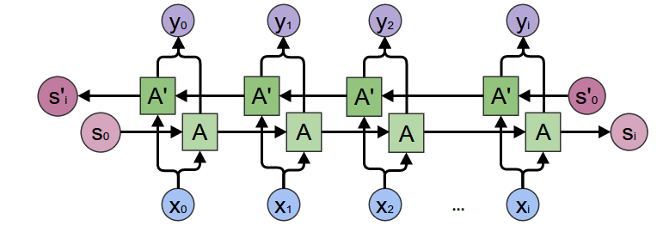
Improving RNNs
Bi-directional
We process the sequence in both directions.
Very helpful for example in named entity recognition, in which we classify every word as a "person", "place", ... .
He said, "Teddy Roosevelt ...
He said, "Teddy bears ...

Slide 18

Hands-on
Go to https://jupyter.lisa.surfsara.nl:8000/
Or https://dba.projects.sda.surfsara.nl/
Notebook: 05b-rnns-improved.ipynb
14:45-15:15

Slide 19
Today’s program
14:00-14:30 Recap
14:30-14:45 Improving RNNs: regularization, stacking, stateful and bi-directional RNNs
14:45-15:15 Hands-on: Improved RNNs on temperature prediction
15:15-15:45 Image processing, Convolutional Neural Networks (CNN)
15:45-16:15 Break
16:15-17:00 Hands-on: CNN on fashion MNIST
17:00-17:30 Transfer Learning
17:30-18:00 Hands-on: transfer learning with pre-trained ResNet-50 layers for fashion MNIST
18:00-19:00 Diner
19:00-19:30 Unsupervised learning, the (variational) autoencoder (VAE)
19:30-20:15 Hands-on: auto-encoder on MNIST
20:15-20:45 Generative adversarial networks (GAN)
20:45-21:00 Summary, final questions, etc

Slide 20
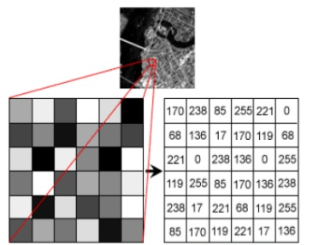
Image data
An image is…
A matrix of intensity values
Range of intensities depend on color depth (#bits / pixel)
Can have 1 (greyscale) or multiple (color) channels
E.g. 8-bit greyscale, intensity 0-255

Slide 21
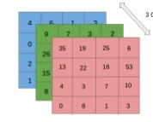
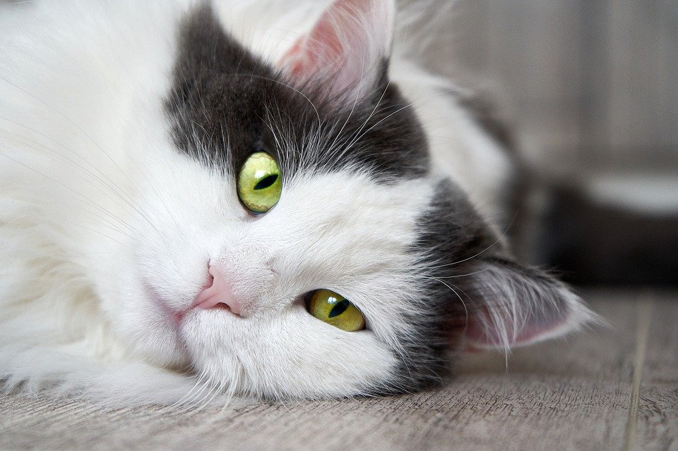
Image data
An image is…
A matrix of intensity values
Range of intensities depend on color depth (#bits / pixel)
Can have 1 (greyscale) or multiple (color) channels
E.g. 8-bit RGB image, intensity 0-255
3 Colour Channels

Slide 22
Image data
Remember notebook 02b, exc 4
model <- keras_model_sequential() %>%
layer_flatten(input_shape = c(28, 28)) %>%
layer_dense(units = 4, activation = "relu") %>%
layer_dense(units = 1, activation = "sigmoid")
Analyzing image data with a dense network
5
Dense layer
2
5 | 2 | 6 | 8 | 2 | 0 | 1 | 2
4 | 3 | 4 | 5 | 1 | 9 | 6 | 3
3 | 9 | 2 | 4 | 7 | 7 | 6 | 9
1 | 3 | 4 | 6 | 8 | 2 | 2 | 1
8 | 4 | 6 | 2 | 3 | 1 | 8 | 8
5 | 8 | 9 | 0 | 1 | 0 | 2 | 3
9 | 2 | 6 | 6 | 3 | 6 | 2 | 1
9 | 8 | 8 | 2 | 6 | 3 | 4 | 5
6
Flatten layer
8
6
3
4
5

Slide 23
Image data
The problem in analyzing images with dense networks:
Our first step is to forget pixel locations!
But pixel locations are important to detect lines, curves, etc!
We need an architecture that preservers this spatial relationship…
5 | 2 | 6 | 8 | 2 | 0 | 1 | 2
4 | 3 | 4 | 5 | 1 | 9 | 6 | 3
3 | 9 | 2 | 4 | 7 | 7 | 6 | 9
1 | 3 | 4 | 6 | 8 | 2 | 2 | 1
8 | 4 | 6 | 2 | 3 | 1 | 8 | 8
5 | 8 | 9 | 0 | 1 | 0 | 2 | 3
9 | 2 | 6 | 6 | 3 | 6 | 2 | 1
9 | 8 | 8 | 2 | 6 | 3 | 4 | 5
5
Dense layer
2
6
Flatten layer
8
6
3
4
5

Slide 24
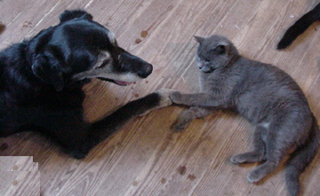
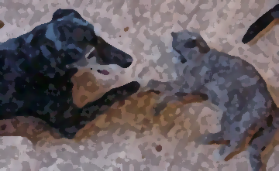
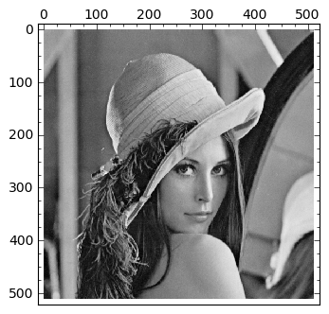
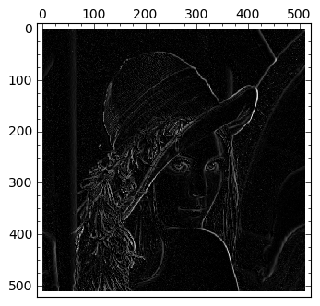
Filtering
In digital image processing, filters are used to achieve certain effects, things like blurring, sharpening, edge detection, etc
Filters apply convolutional operations on an image

Slide 25
Convolutions
Convolutional filters process parts of the image and return a high signal when they detect the filter pattern.
Source layer (image)
2 | 2 | 6 | 8 | 2 | 0 | 1 | 2
4 | 3 | 4 | 5 | 1 | 9 | 6 | 3
3 | 9 | 4 | 4 | 7 | 7 | 6 | 9
1 | 3 | 4 | 6 | 8 | 2 | 2 | 1
8 | 4 | 6 | 2 | 3 | 1 | 8 | 8
5 | 8 | 9 | 0 | 1 | 0 | 2 | 3
9 | 2 | 6 | 6 | 3 | 6 | 2 | 1
9 | 8 | 8 | 2 | 6 | 3 | 4 | 5
Convolutional
Kernel (filter)
Destination layer
-1 | 0 | 1
-2 | 0 | 2
-1 | 0 | 1
 | 5
(-1×2) + (0×2) + (1×6) +
(-2×4) + (0×3) + (2×4) +
(-1×3) + (0×9) + (1×4) = 5

Slide 26
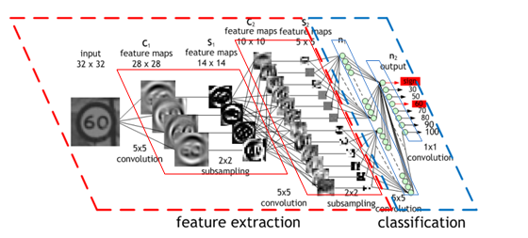
Convolutions
We then applying a convolution upon a convolution.
Allows us to create filters from many other filters.
Then we can detect complex patterns over a larger area.
Source: https://developer.nvidia.com/discover/convolutional-neural-network

Slide 27
Convolutions
Technicalities
The kernel is shifted over the image, and computes output for each position
Source: https://towardsdatascience.com/a-comprehensive-guide-to-convolutional-neural-networks-the-eli5-way-3bd2b1164a53

Slide 28

Convolutions
Output has smaller dimension than input (why?)
$\dim\left(output\right)=\dim\left(source\right)−\left(\dim\left(kernel\right)−1\right)$
I.e. a $3×3$ kernel reduces dimension by 2 along each axis, $5×$5 would reduce by 4, etc
Source layer (image)
2 | 2 | 6 | 8 | 2
4 | 3 | 4 | 5 | 1
3 | 9 | 4 | 4 | 7
1 | 3 | 4 | 6 | 8
8 | 4 | 6 | 2 | 3
Convolutional
Kernel (filter)
Destination layer
-1 | 0 | 1
-2 | 0 | 2
-1 | 0 | 1
 | 5 | 5 | -7
 | 5 | -5 | 7
 | 5 | -1 | 8

Slide 29
Convolutions
Output has smaller dimension than input
Padding can be used, this makes the input image ‘bigger’ by using synthetic data (typically 0-padding)
Padding ‘same’ typically preserves the original input dimension
Source layer (image) - padded
0 | 0 | 0 | 0 | 0 | 0 | 0
0 | 2 | 2 | 6 | 8 | 2 | 0
0 | 4 | 3 | 4 | 5 | 1 | 0
0 | 3 | 9 | 4 | 4 | 7 | 0
0 | 1 | 3 | 4 | 6 | 8 | 0
0 | 8 | 4 | 6 | 2 | 3 | 0
0 | 0 | 0 | 0 | 0 | 0 | 0
Convolutional
Kernel (filter)
Destination layer
-1 | 0 | 1
-2 | 0 | 2
-1 | 0 | 1
8 | 8 | 14 | -11 | -21
13 | 5 | 5 | -7 | -11
11 | 5 | -5 | 7 | -19
13 | 5 | -1 | 8 | -18
17 | -1 | 4 | -2 | -10

Slide 30

Convolutions
Filters can also take bigger ‘steps’. This step size is known as the stride.
Stride also affects the output dimension
E.g. stride of 2, without padding, on $5×5$ input results in $2×2$ output
Source layer (image)
2 | 2 | 6 | 8 | 2
4 | 3 | 4 | 5 | 1
3 | 9 | 4 | 4 | 7
1 | 3 | 4 | 6 | 8
8 | 4 | 6 | 2 | 3
Convolutional
Kernel (filter)
Destination layer
-1 | 0 | 1
-2 | 0 | 2
-1 | 0 | 1
5 | -7
5 | 8

Slide 31
Convolutions
A traditional filter uses a kernel with fixed values, e.g. the vertical edge detection filter shown below
Source layer (image)
2 | 2 | 6 | 8 | 2
4 | 3 | 4 | 5 | 1
3 | 9 | 4 | 4 | 7
1 | 3 | 4 | 6 | 8
8 | 4 | 6 | 2 | 3
Convolutional
Kernel (filter)
Destination layer
-1 | 0 | 1
-2 | 0 | 2
-1 | 0 | 1
 | 5 | 5 | -7
 | 5 | -5 | 7
 | 5 | -1 | 8

Slide 32
Convolutions
A traditional filter uses a kernel with fixed values, e.g. the vertical edge detection filter shown below
In deep learning, the kernel consists of trainable weights
Thus, instead of making an expert decision, the network learns which visual features (such as vertical edges) it should detect
Source layer (image)
2 | 2 | 6 | 8 | 2
4 | 3 | 4 | 5 | 1
3 | 9 | 4 | 4 | 7
1 | 3 | 4 | 6 | 8
8 | 4 | 6 | 2 | 3
Convolutional
Kernel (filter)
Destination layer
w₁ | w₂ | w₃
w₄ | w₅ | w₆
w₇ | w₈ | w₉
 | 5 | 5 | -7
 | 5 | -5 | 7
 | 5 | -1 | 8

Slide 33

Convolutions
For color images, we have multiple input channels
Kernel is now $3×3×3$, i.e. 27 weights
Scans over all channels simultaneously
Source layer (image)
1 | 3 | 5 | 5 | 2
1 | 3 | 4 | 5 | 1
6 | 9 | 4 | 4 | 7
6 | 3 | 4 | 6 | 8
0 | 4 | 6 | 2 | 3
3 Colour Channels
8 | 6 | 3 | 7 | 1
4 | 3 | 4 | 5 | 1
2 | 9 | 4 | 4 | 7
3 | 3 | 4 | 6 | 8
1 | 4 | 6 | 2 | 3
Convolutional
Kernel (filter)
2 | 2 | 6 | 8 | 2
4 | 3 | 4 | 5 | 1
3 | 9 | 4 | 4 | 7
1 | 3 | 4 | 6 | 8
8 | 4 | 6 | 2 | 3
w₁ | w₂ | w₃
w₄ | w₅ | w₆
w₇ | w₈ | w₉
Destination layer
w₁₀ | w₁₁ | w₁₂
w₁₃ | w₅ | w₆
w₁₆ | w₈ | w₉
w₁₉ | w₂₀ | w₂₁
w₂₂ | w₂₃ | w₂₄
w₂₅ | w₂₆ | w₂₇
 | 5 | 5 | -7
 | 5 | -5 | 7
 | 5 | -1 | 8

Slide 34
Convolutions
Typically, we want our network to be able to abstract multiple features in each layer (e.g. learn to detect horizontal lines, vertical lines, diagonal lines, etc)
Each filter produces its own destination layer, known as a feature map or activation map
Convolutional
Kernel (filter)
Destination layer
Source layer (image)
 | 5 | 5 | -7
 | 5 | -5 | 7
 | 5 | -1 | 8
w₁ | w₂ | w₃
w₄ | w₅ | w₆
w₇ | w₈ | w₉
2 | 2 | 6 | 8 | 2
4 | 3 | 4 | 5 | 1
3 | 9 | 4 | 4 | 7
1 | 3 | 4 | 6 | 8
8 | 4 | 6 | 2 | 3
w₁₀ | w₁₁ | w₁₂
w₁₃ | w₁₄ | w₁₅
w₁₆ | w₁₇ | w₁₈
 | 5 | 5 | -7
 | 5 | -5 | 7
 | 5 | -1 | 8

Slide 35
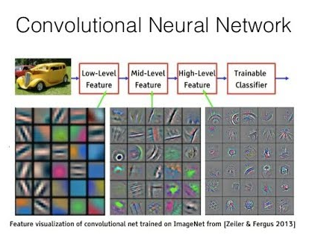
Convolutions
Example showing three convolutional layers, each with 30 filters:

Slide 36
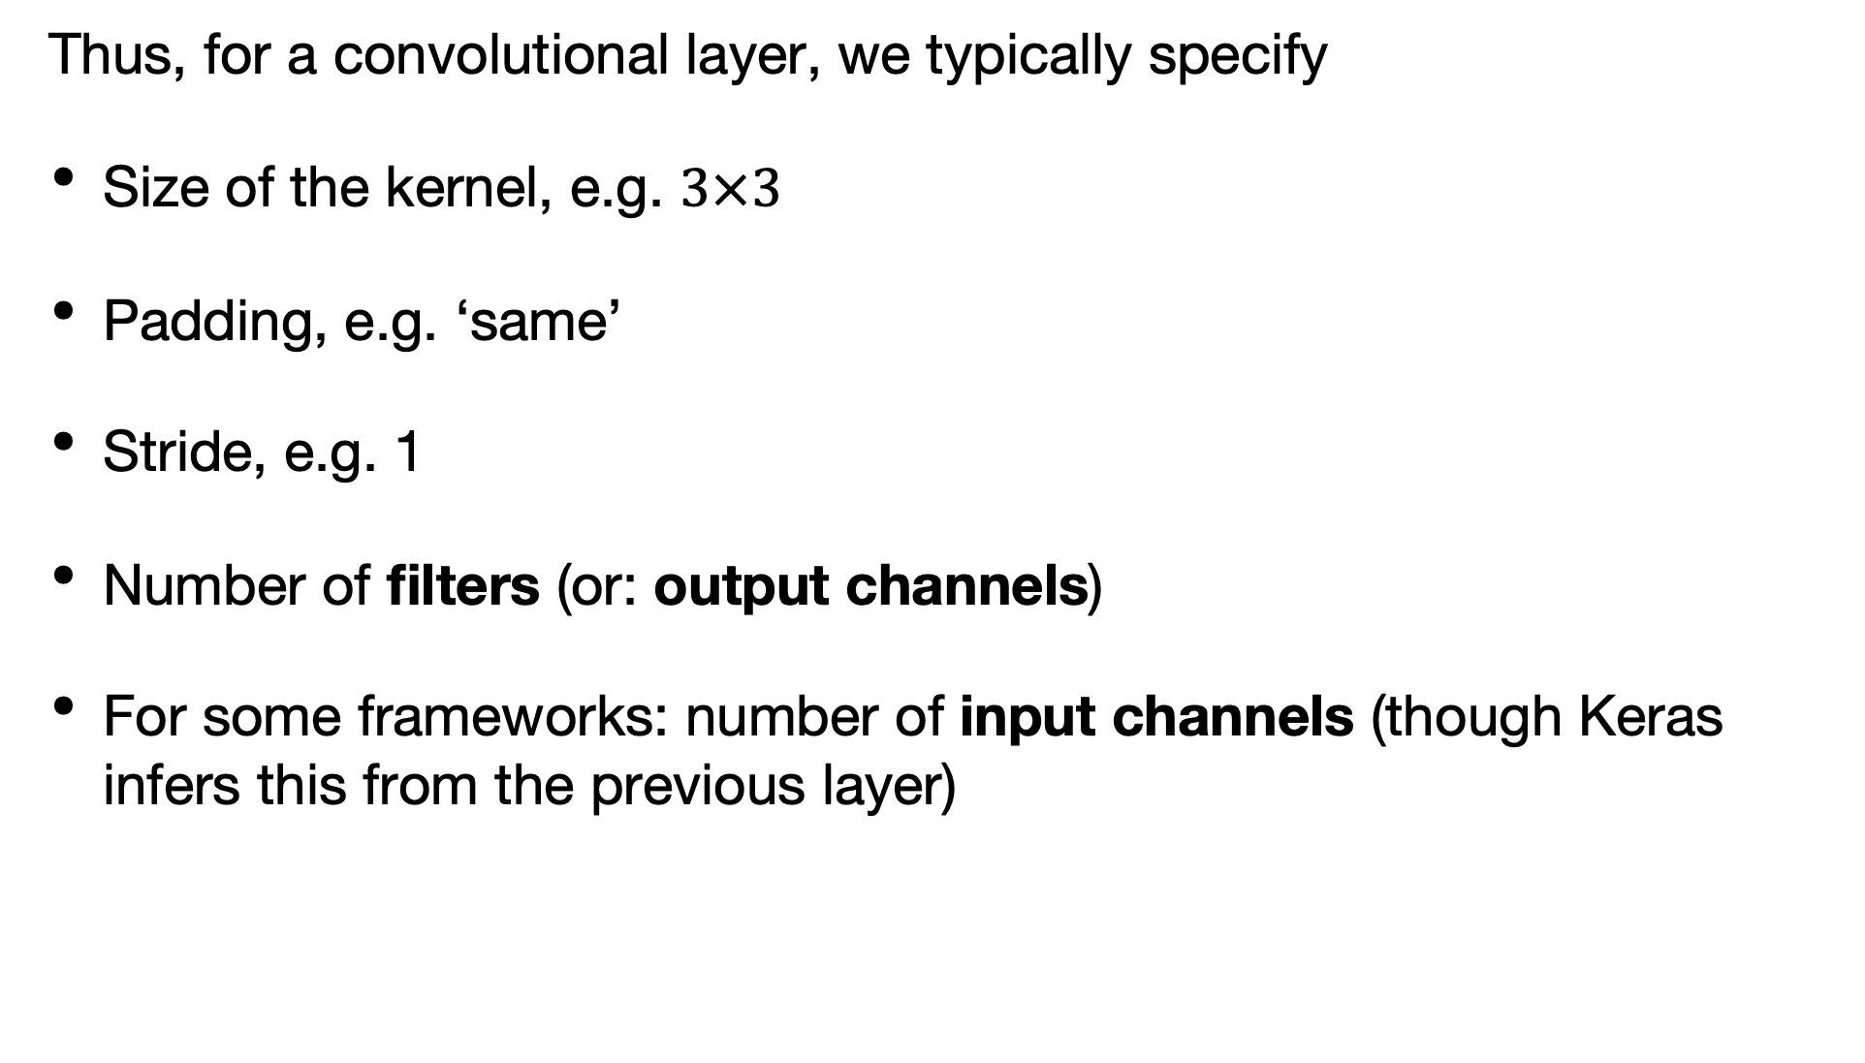
Convolutions
Thus, for a convolutional layer, we typically specify
Size of the kernel, e.g. $3×3$
Padding, e.g. ‘same’
Stride, e.g. 1
Number of filters (or: output channels)
For some frameworks: number of input channels (though Keras infers this from the previous layer)

Slide 37
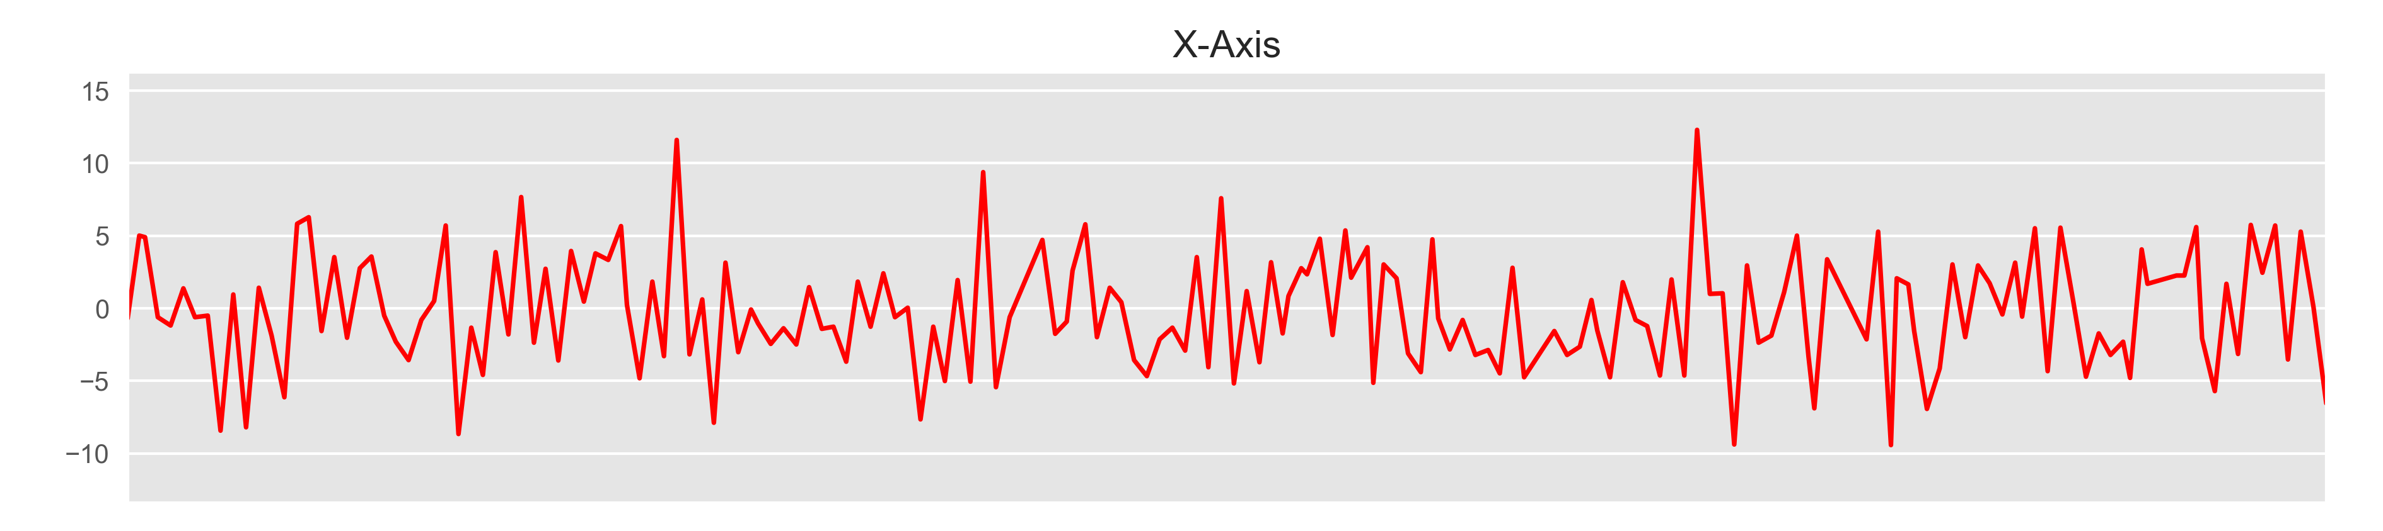
CNNs: not only images
CNNs are most commonly applied on images, but can also work well on other data in which …
closeness / spatial location of data points is meaningful
simple, low level patterns (in nearby data points) combine into more complex, high level patterns (across further data points)
E.g. Timeseries, sound data (1D convolution)
1D convolution example: activity classification based on smartphone accelerometer
Source: https://blog.goodaudience.com/introduction-to-1d-convolutional-neural-networks-in-keras-for-time-sequences-3a7ff801a2cf

Slide 38
Hands-on
Go to https://jupyter.lisa.surfsara.nl:8000
or https://dba.projects.sda.surfsara.nl/
Notebook: 06a-cnns.ipynb
16:15-17:00

Slide 39
Today’s program
14:00-14:30 Recap
14:30-14:45 Improving RNNs: regularization, stacking, stateful and bi-directional RNNs
14:45-15:15 Hands-on: Improved RNNs on temperature prediction
15:15-15:45 Image processing, Convolutional Neural Networks (CNN)
15:45-16:15 Break
16:15-17:00 Hands-on: CNN on fashion MNIST
17:00-17:30 Transfer Learning
17:30-18:00 Hands-on: transfer learning with pre-trained ResNet-50 layers for fashion MNIST
18:00-19:00 Diner
19:00-19:30 Unsupervised learning, the (variational) autoencoder (VAE)
19:30-20:15 Hands-on: auto-encoder on MNIST
20:15-20:45 Generative adversarial networks (GAN)
20:45-21:00 Summary, final questions, etc

Slide 40
CNNs
Reducing dimensions of activation maps
Filter maps are sometimes very large. We typically try to reduce dimensions towards deeper layers. Reducing dimensionality helps
… limit the amount of computation
… increase performance of the network by picking only

Slide 41
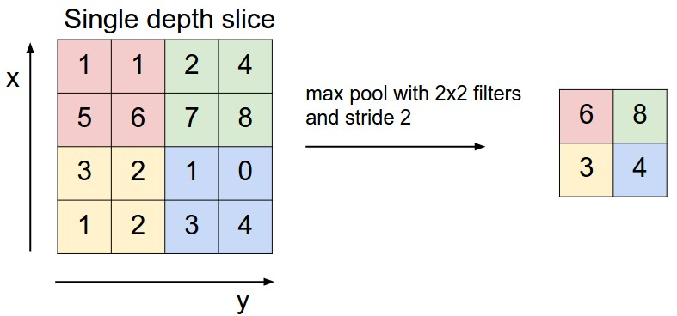
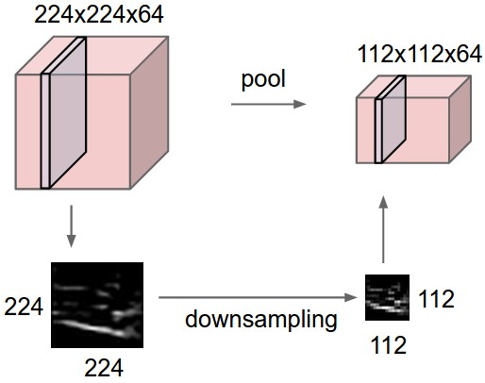
CNNs
Reducing dimensions of activation maps
We’ve seen: stride > 1 reduces dimensions
E.g. stride = 2 approximately halves the size)
Another way is to use pooling.
E.g. Max pooling, take the max.
E.g. Average pooling, take the average.
Pooling is applied after convolutions
Source: http://deeplearning.net/software/theano_versions/dev/tutorial/conv_arithmetic.html

Slide 42
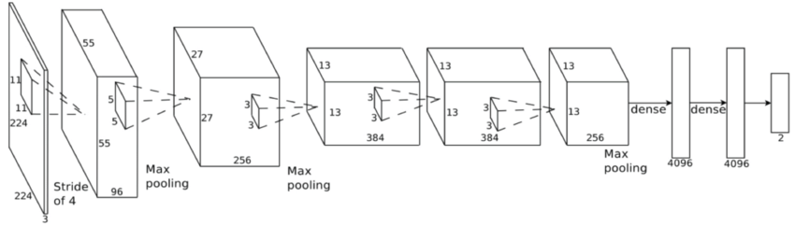
CNNs
CNN architecture
We create a CNN by chaining together convolutional layers
Typically, the dimensionality reduces the deeper we go
Typically, the number of filters increases, the deeper we go
Limited number of low-level features, e.g. horizontal/vertical/diagonal lines (detected in first layers)
Many possible high-level features (all kinds of circular / rectangular shapes, pyramids, cones)
Typically end with one or more dense layers that ‘take the decision’ (e.g. ‘I detect 2 wheels and a person: classify this as a bike’).
AlexNet, a famous CNN
Source: https://www.jeremyjordan.me/convnet-architectures/

Slide 43
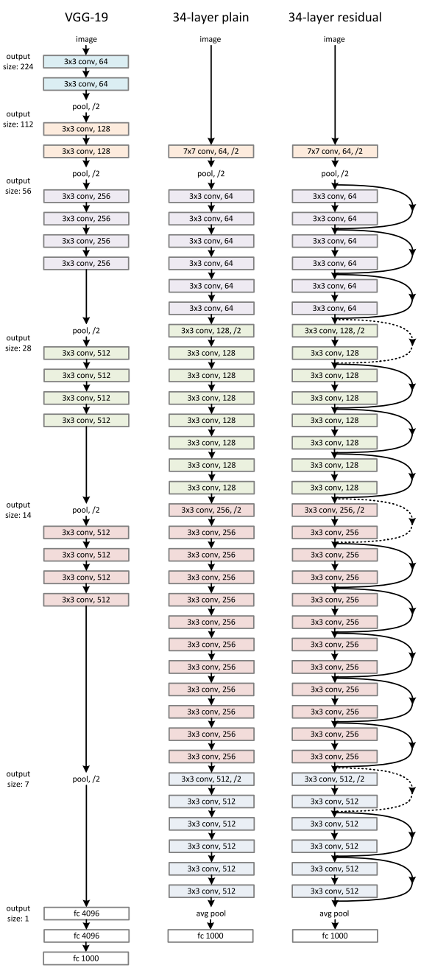
CNNs
Architectures - ResNet (2015)
Source: https://arxiv.org/abs/1512.03385

Slide 44
CNNs
Designing architectures
Should we develop these architectures ourselves?
Typically, we use well-known architectures that we know work well
We might adapt those architectures to tune to our problem
AlexNet, a famous CNN
Source: https://www.jeremyjordan.me/convnet-architectures/

Slide 45
CNNs
Pretrained
Training times can be long, especially for complex architectures
First layers encode low-level features (e.g. lines)
Images of plants probably have similar low level features as images of animals, but different high level features.
We can reuse the first layers of a CNN that was already trained on another dataset
This is called transfer learning.
AlexNet, a famous CNN
Source: https://www.jeremyjordan.me/convnet-architectures/

Slide 46
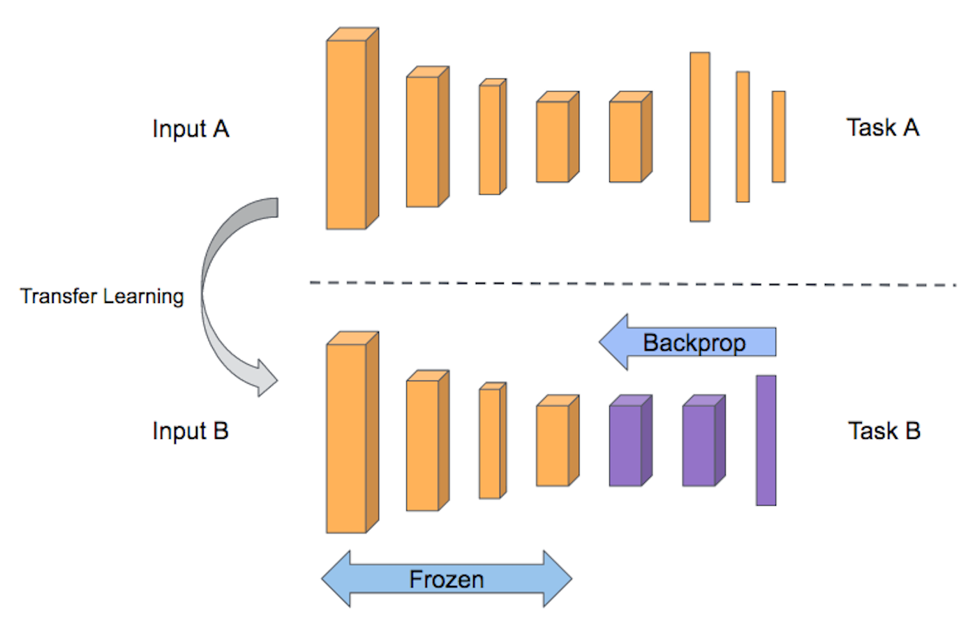
Transfer learning

Slide 47
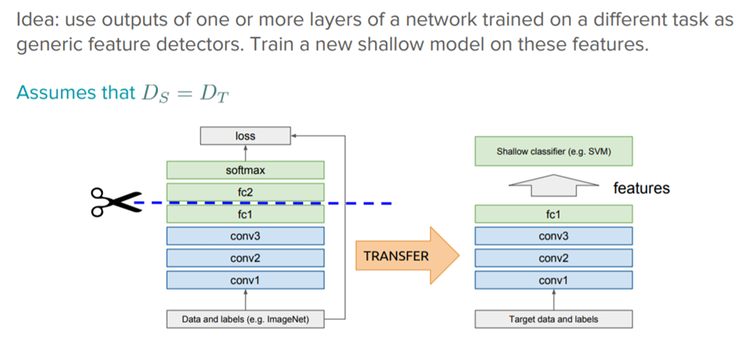
Transfer learning

Slide 48
Transfer learning
Caveats
We need to download the network and weights, which can be large (still 1000 times faster than training ourselves).
We use a smaller learning rate.
To increase speed, many people preprocess the input through the static network and save the representations to disk and then train a new network separately.

Slide 49
Hands-on
Go to https://jupyter.lisa.surfsara.nl:8000
or https://dba.projects.sda.surfsara.nl/
Notebook: 06b-cnns-transfer.ipynb
17:30-18:00

