Slide 1

FRONTEND-ONLY PRODUCT ARCHITECTURE
Static App
React
Static React App Architecture
Local
Session
100
Questions
A frictionless, privacy-first frontend built entirely through LLM prompting
Replit
Hosting

Slide 2
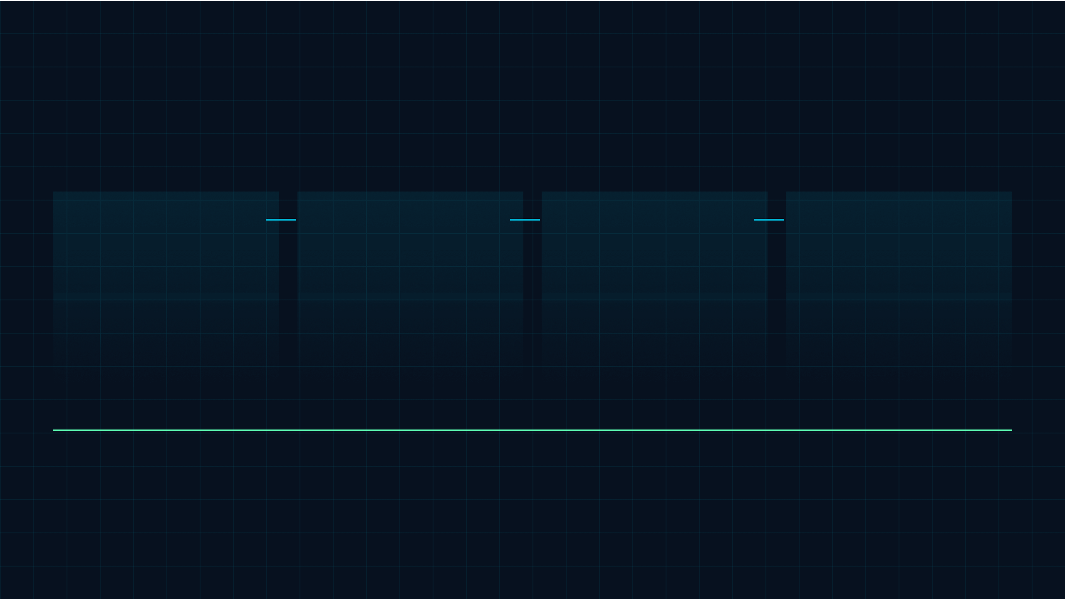
ARCHITECTURE OVERVIEW
Architecture at a Glance
A complete product experience delivered as a static React frontend with no runtime server dependency.
01
02
03
04
Fully static frontend
Built through prompting
Hosted as assets
Low overhead
Replit static hosting serves the bundled application directly to each visitor.
No backend, database, or API infrastructure needs to be operated.
The React app contains the complete interface and application logic.
The development workflow stays lightweight because the app is produced via LLM prompting.
Core idea: static delivery turns infrastructure simplicity into a product advantage.
REACT / STATIC

Slide 3

BACKEND-FREE MODEL
Backend-Free by Design
Complexity intentionally removed from the runtime system
The absence of backend infrastructure becomes an operating advantage.
×
Server capacity planning and request queues.
×
Database contention, migrations, and storage operations.
LOGIC
Interactions are handled directly inside the React frontend.
×
External API reliability and integration monitoring.
RELIABILITY
Fewer moving parts reduce the number of places the experience can fail.
MAINTENANCE
The system avoids server, database, and API administration.
Design stance: less infrastructure means more predictable delivery.

Slide 4

EMBEDDED CONTENT MODEL
Questions Live in the App
The complete question set ships with the frontend, making the experience immediately available without network lookups.
HARDCODED FRONTEND INVENTORY
INSTANT
Users can access the content immediately because no request has to fetch the questions.
100.
STABLE
A fixed content bundle keeps sessions predictable across visits and devices.
Questions bundled directly into the React application code.
INDEPENDENT
The app avoids databases, external APIs, and third-party services for question delivery.
STATIC
BUNDLED
READY
Product effect: the quiz experience starts as soon as the static frontend loads.
NO BACKEND FETCH

Slide 5
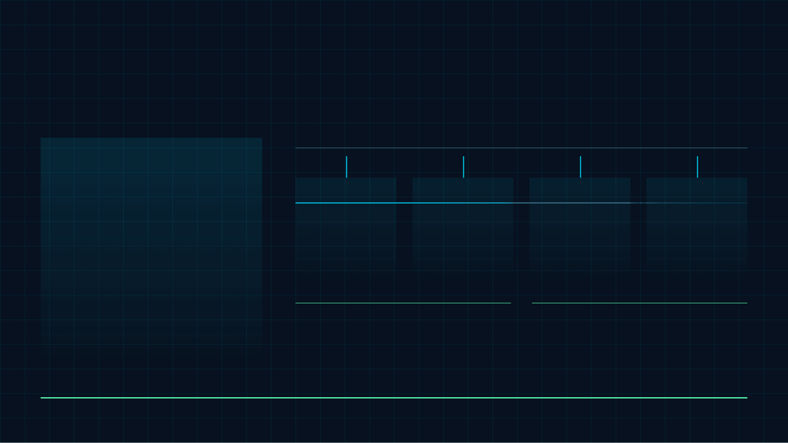
SCALING AND TRAFFIC MODEL
Infinite Sessions, Static Limits
Static delivery lets each visitor run an independent browser session, while practical traffic capacity remains bounded by Replit’s static hosting limits.
STATIC BUNDLE
One hosted app, many local sessions
USER A
USER B
USER C
USER N
Local browser
Local browser
Local browser
Local browser
Progress and state stay inside the current session.
Another independent session uses the same static app.
No shared database or server-side session is required.
Concurrency scales with static hosting capacity.
The React assets are served once per visit; user interaction then runs in the browser rather than on a backend server.
HIGH CONCURRENCY
HOSTING BOUNDARY
Visitors do not compete for backend
The realistic ceiling is the static host’s
No backend compute per interaction
application resources.
delivery limit.
Scaling principle: sessions multiply in the browser; infrastructure remains static and lightweight.
STATIC / LOCAL

Slide 6

USER EXPERIENCE PRINCIPLE
Zero-Friction User Experience
The no-login model removes onboarding gates so users can move directly from arrival to interaction.
Arrive
Start
Continue
Return
No account, password, or setup step blocks the first action.
Fast first interaction because the static app is immediately usable.
Lower abandonment risk through a shorter path into the product.
Accessible by default for casual, one-time, or repeat users.
01
02
03
04
Result: less friction before value is delivered.
ENTRY
MOMENTUM
REACH
Users begin immediately without registration or onboarding gates.
The experience prioritizes direct action over administrative setup.
A simple path supports occasional users as well as repeat visitors.

Slide 7

LOCAL PRIVACY MODEL
Privacy Stays Local
Responses remain inside the browser session instead of being collected by backend infrastructure.
Privacy is built into the architecture, not added afterward.
BROWSER SESSION BOUNDARY
Progress
Answers
State
LOCAL
User progress and responses stay in the browser session.
CONTAINED LOCALLY
SILENT
No answers are sent to a server, database, or external API.
ON CLOSE
Session data is wiped when the browser session ends.
SIMPLE
The system reduces exposure by avoiding unnecessary data handling.
Trust through simplicity: less data movement means fewer privacy risks.

Slide 8

CONTENT CLARITY UPGRADE
Readability Was Restructured
Dense explanation was converted into structured, scannable points with clear emphasis and stronger presentation flow.
BEFORE: DENSE TEXT BLOCK
AFTER: STRUCTURED POINTS
STRUCTURE
Wall-of-text content becomes focused statements that are easier to scan.
Architecture, data storage, scaling, privacy, and user flow were previously compressed into a single continuous explanation, making the main benefits harder to identify quickly.
ANCHORS
Bold lead terms guide attention before the supporting explanation appears.
Each idea stands apart, creating a clearer sequence from architecture to benefits.
FLOW
Key advantages become visible without forcing the reader to parse every sentence.
LOW SCAN VALUE
REPEATED WORDING
WEAK HIERARCHY
EMPHASIS
PRESENTATION-READY CLARITY
SCAN / UNDERSTAND / RETAIN
Improvement made: readability now supports the argument instead of competing with it.
EDITORIAL SYSTEM

Slide 9

MESSAGING REFINEMENT
Language Now Feels Professional
The copy shifts from repetitive constraints to confident, benefit-led positioning that explains why the architecture matters.
BEFORE
AFTER
POSITIONING
Repetition made the idea feel limited
Varied phrasing adds authority
The architecture reads as intentional strategy
“Unlimited users” repeated without nuance
Infinite scalability
BENEFIT
Constraints are reframed as operational and user advantages.
“No backend” framed as absence
Zero friction
“No login” described only as a missing step
Total privacy
CLARITY
Each phrase carries a distinct role in the product story.
Professional language turns a simple technical setup into a stronger product narrative.
The revised flow emphasizes outcomes first, then uses the architecture as proof of those outcomes.

Slide 10
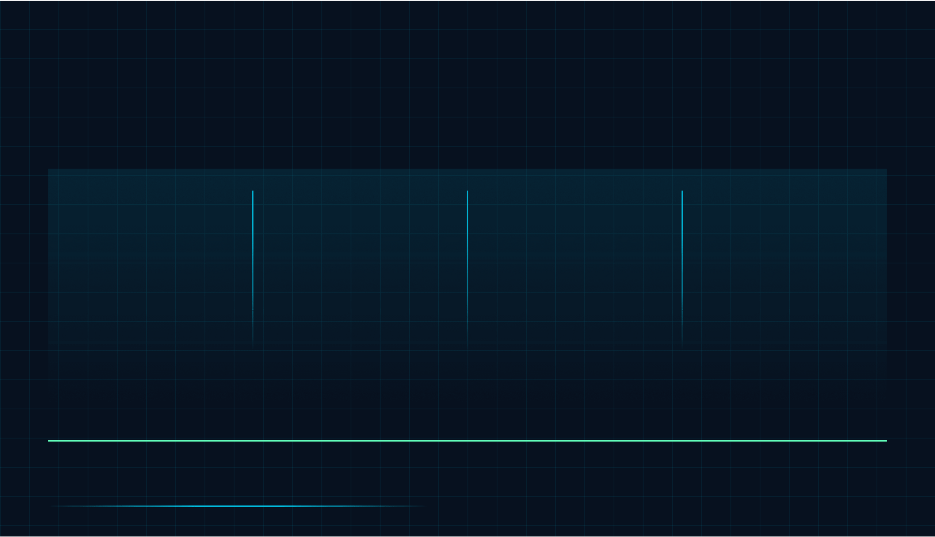
FINAL PRODUCT POSITIONING
Final Positioning
The architecture positions the product as lightweight, scalable, privacy-first, and immediately accessible.
01 / STATIC
02 / PRIVACY
03 / SCALE
04 / ACCESS
Static is strategic
Privacy is automatic
Scale is efficient
User value is immediate
A frontend-only React app keeps the product simple, fast, and resilient.
Independent sessions reduce pressure on infrastructure because interactions run locally.
Local browser sessions avoid unnecessary data collection and backend exposure.
No login, no waiting, and no unnecessary setup mean users reach the experience at once.
A static React product can deliver maximum accessibility with minimal infrastructure.
TAKEAWAY

