Slide 1



POWER BI ANALYSIS
Financial Performance Insights
Strategic Analysis of Global Sales and Profitability
Sunil Vadlakonda

Slide 2





Executive Summary: Data-Driven Growth
Strategic Objective
Data Foundation
Core Metric
Key Outcome
Analysis based on global financial samples, focusing on profitability metrics, seasonal trends, and discount optimization.
Profitability is defined as Gross Sales minus COGS, providing a clear view of operational efficiency.
Identification of high-growth segments and regional expansion opportunities to drive future revenue.
Leverage Power BI to transform raw financial data into actionable business intelligence for informed decision-making.

Slide 3

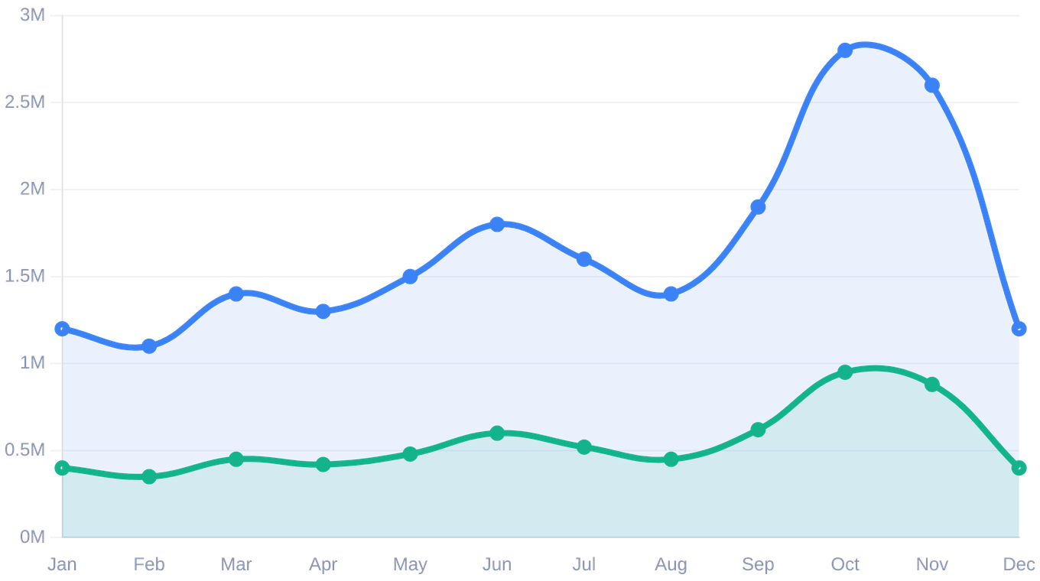
Seasonal Momentum: Q4 Drives Annual Performance
PEAK PERFORMANCE
Significant growth build-up throughout the year, culminating in a major peak during October and November.
YEAR-END CYCLE
A noticeable dip in December suggests a shift in purchasing behavior post-holiday or fiscal year-end adjustments.
COST EFFICIENCY
COGS scales proportionally with sales volume, indicating stable gross profit margins and efficient cost control.
Sales Volume
Net Profit

Slide 4

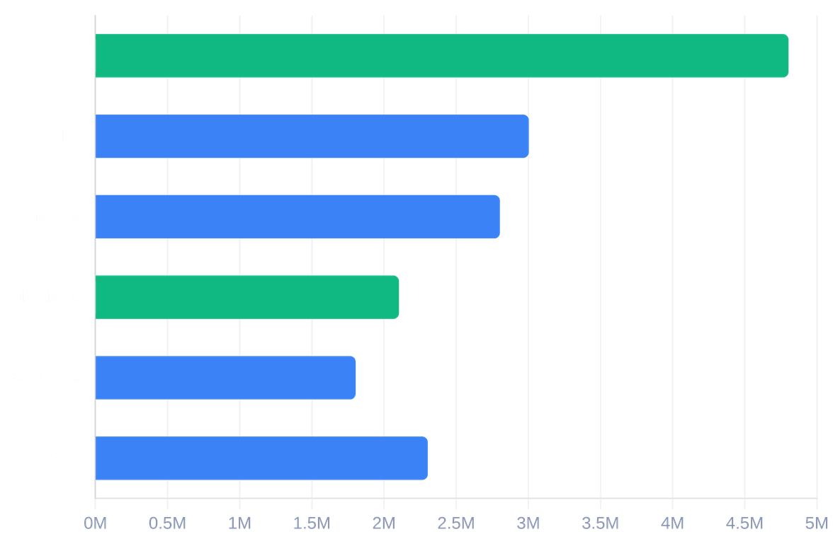
Product Portfolio: Identifying Revenue Engines
Total Profit Contribution by Product
REVENUE ENGINES
Montana & Paseo
Consistently lead the portfolio as the primary revenue and profit generators, maintaining strong market demand across all regions.
VARIABLE PERFORMERS
Amarilla & VTT
Exhibit higher performance variability and lower overall sales contributions, requiring a strategic re-evaluation of market positioning.

Slide 5

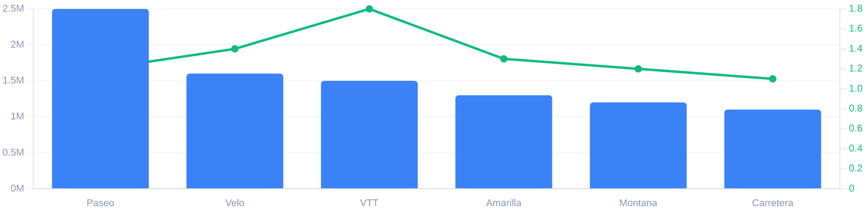
Discount Strategy: Volume vs. Tactical Pricing
Total Discounts (USD)
Avg Discount per Unit
VOLUME-DRIVEN STRATEGY
TACTICAL INTERVENTIONS
Top performers like Paseo and Montana receive the highest total discounts. This is a consequence of high sales volume rather than deep price cuts, maintaining a healthy stable margin across large-scale distributions.
Products like VTT exhibit high average discounts despite lower overall volume. These represent tactical moves to stimulate demand or clear inventory for slower-moving lines without impacting the core portfolio.

Slide 6


Profitability by Segment: Government Leads Growth
BUSINESS SEGMENT
PROFIT
SHARE
$11.39M
65.04%
Government
$4.14M
23.66%
Small Business
$1.32M
7.52%
Channel Partners
$0.66M
3.77%
Midmarket
STRATEGIC FOCUS
The Government sector remains the primary engine of profitability. Strategic efforts should focus on deepening these high-value relationships while scaling Small Business tactics.
Total Profit Contribution
$16.89M

Slide 7

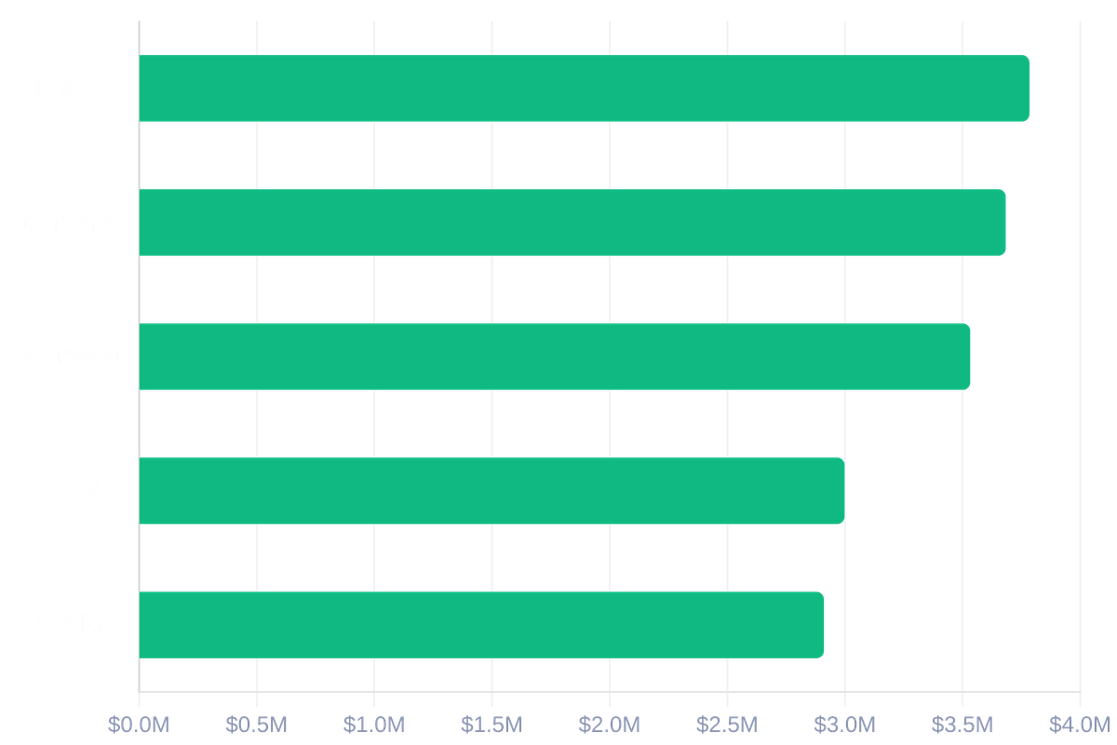
Regional Analysis: Global Profit Distribution
MARKET REGION
NET PROFIT (USD)
France
$3,781,021
Germany
$3,680,389
Canada
$3,529,229
United States
$2,995,541
Mexico
$2,907,523
STRATEGIC INSIGHT
France and Germany lead global profitability, contributing over 7.4M combined. Replicating European sales models in North American markets presents a significant margin optimization opportunity.

Slide 8



Strategic Recommendations: Capitalizing on Success
SEGMENT FOCUS
SEASONAL OPTIMIZATION
PRODUCT STRATEGY
Capitalize on High-Profit Segments
Maximize Q4 Performance
Optimize Product Portfolio
Historical data shows a significant performance peak in Oct-Nov. Capitalizing on this momentum is critical for annual targets.
While Montana and Paseo drive volume, VTT requires a strategic re-evaluation due to high average discounts and lower sales volume.
Government and Small Business sectors contribute over 88% of total profit. These segments offer the highest return on customer acquisition costs.
Strategic Action
Strategic Action
Strategic Action
Deploy targeted promotional
Re-evaluate pricing or consider
Intensify sales and marketing efforts
campaigns for top-selling products
repositioning VTT to ensure resource
in established high-return
during peak demand.
efficiency.
relationships.

Slide 9



Conclusion: Empowering Data-Driven Decisions
Seasonal Intelligence
Strategic Discounting
Actionable Roadmap
Identified clear seasonal sales, profit, and cost trends, highlighting peak performance periods in Q4 for strategic inventory and marketing alignment.
Gained a deep understanding of the strategic application of discounts, distinguishing between volume-driven growth and targeted tactical promotions.
Formulated clear recommendations for revenue growth by focusing on high-profit segments and leveraging strong regional performance in global markets.
Power BI transforms raw data into clear, actionable business intelligence, empowering data-driven decision-making across the organization.

Slide 10



Thank You
Questions & Discussion
Sunil Vadlakonda
Sunil.vadlakonda@yahoo.co.uk
www.linkedin.com/in/sunil-vadlakonda-8246a2aa

