Slide 1
Rasa with webview
Architectural summary
February, 2020

Slide 2
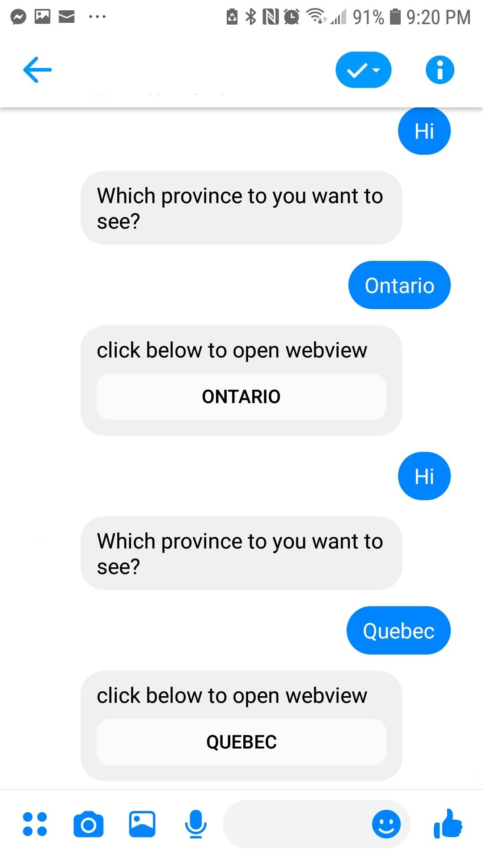
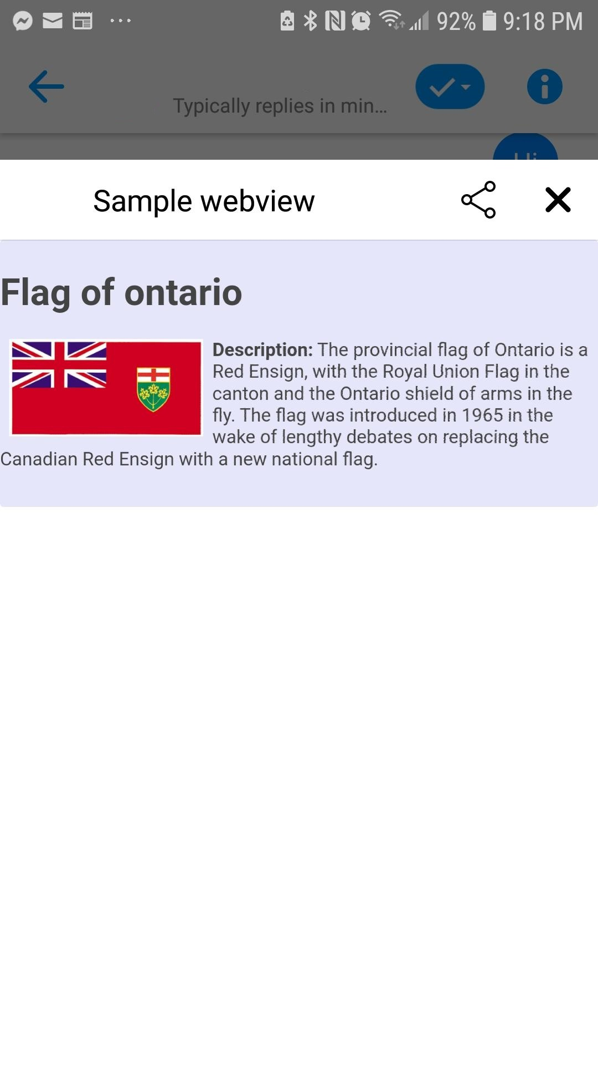





Architecture Feb 2020 blog version full
Flask web server
Webhook callback
Actions & slot values
Python custom actions
Models
Rasa / FM link
Webview / FM link
Rasa server
Rasa models
Facebook Messenger front end
Web page displayed in Webview

Slide 3
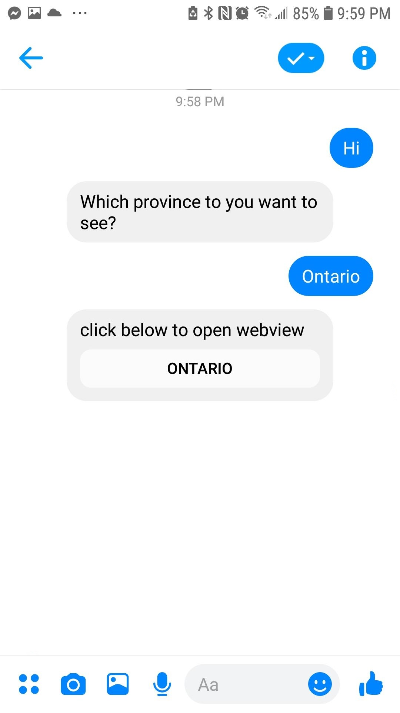
Architecture Feb 2020 blog version simplified
Python custom actions
Flask web server
Webhook callback
Actions & slot values
Rasa / FM link
Webview / FM link
Rasa server
Facebook Messenger front end
Web page displayed in Webview

Slide 4
Architecture Feb 2020 blog version flow
Rasa bot in Facebook Messenger
Dynamically generated web page in webview
Bot prompts for input
User responds with province name
Button appears
When button clicked, webview opens
Displayed in context of Facebook Messenger
Close webview to get back to Facebook Messenger

