Slide 1
Causal AI in world model
chu

Slide 2
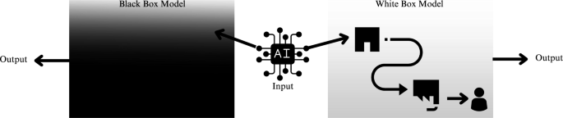
Explainability
In the current world, we design the models and we can get outputs from them. However, we don’t really know what is happening inside the model — we call it a black-box model.

Slide 3
The challenges in AI
We are still facing many issues, for example: Scaling.
Scaling does not transfer well to the real world: say we solve a problem with the current model, but if we change it to a similar problem, we have to do migration or further scaling work. This is not enough for our messy world.
“Just scaling is not enough… We need new ideas for the next jump”– Ilya Sutskever
“Scaling alone will not get us to systems that understand the world” – Yann LeCun
Here comes an idea: Causal understanding in the world

Slide 4
Current challenges in AI
In the real world, these are the challenges in AI that we are still trying to fix:
Lack of explainability capabilities
Unfair and unethical decision-making
Data Inefficiency
Poor generalizability
Lack of controllability
The core of these challenges can be seen as the absence of a robust causal understanding. There are barely any papers trying to optimize or move towards understanding the world in a causal way.
Can we use causal language to model an environment relationship?

Slide 5
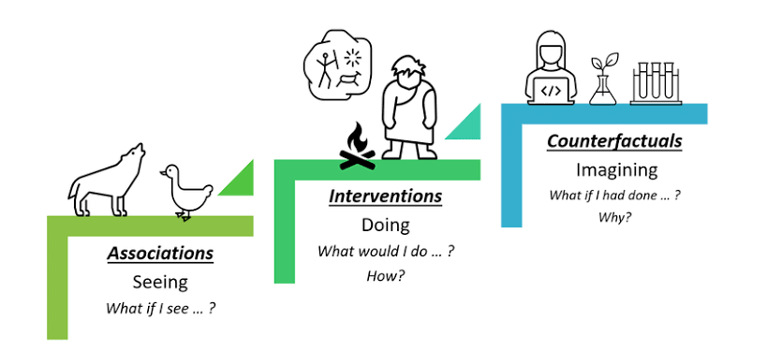
Causal Inference
PCH(Pearl Causal Hierarchy)

Slide 6
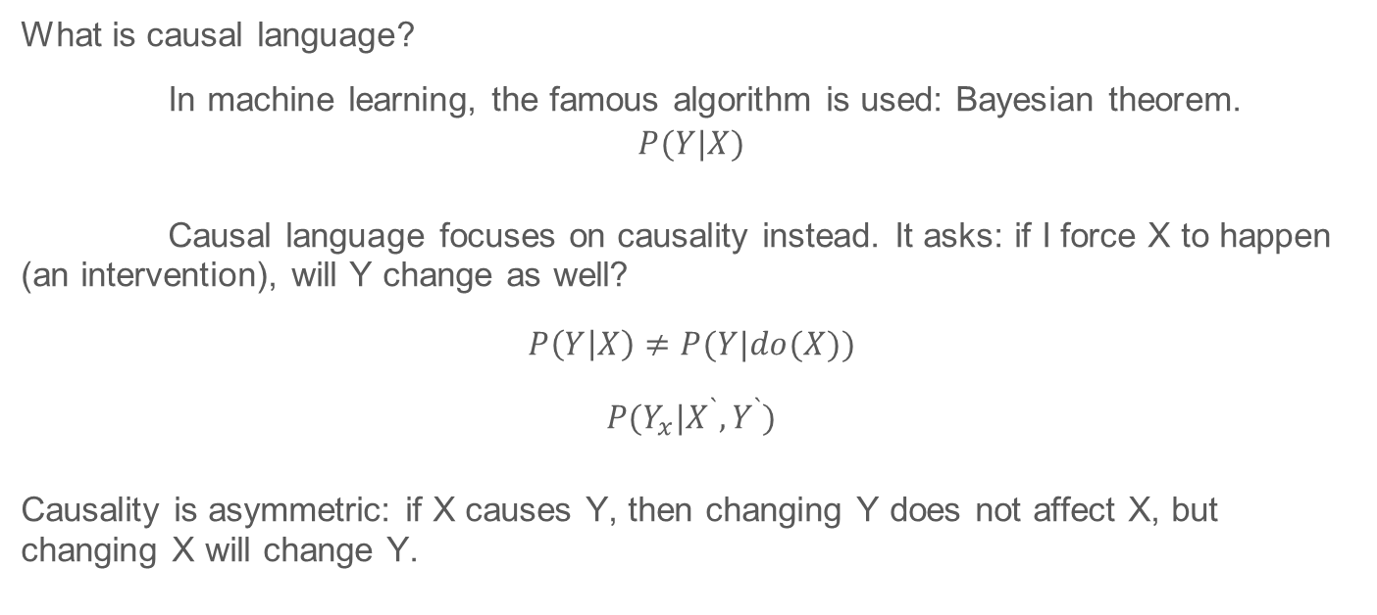
Causal Language
What is causal language?
In machine learning, the famous algorithm is used: Bayesian theorem.
$$P(Y|X)$$
Causal language focuses on causality instead. It asks: if I force X to happen (an intervention), will Y change as well?
$$P\left(Y | X\right)≠P(Y|do(X))$$
$$P(Y_{x}|X^{`},Y^{`})$$
Causality is asymmetric: if X causes Y, then changing Y does not affect X, but changing X will change Y.

Slide 7
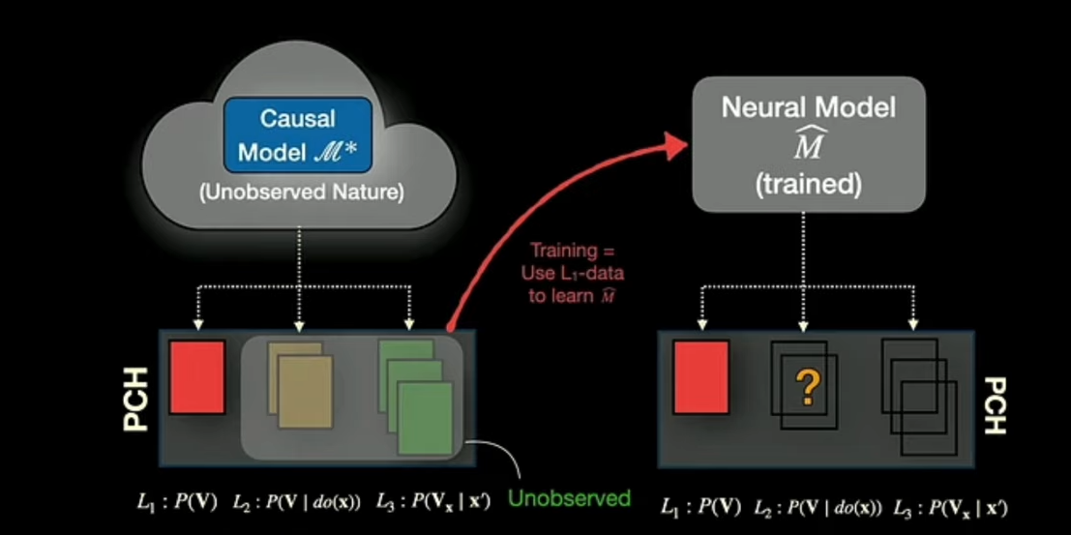
What is the challenge in moving from seeing to doing?
How to use the data collected from observations to answer questions about the interventions (policies, treatments…)?

Slide 8
Causal Artificial Intelligence
The Goal: Develop more general AI systems endowed with the following capabilities:
  Causal and Counterfactual Generation
  Causal Understanding and Explanations
  Efficient and precise decision-making
  Generalizable and Robust Inferences
  Model Learning and Discovery
The key is how to deploy these methods when you only know there is unobserved bias but nothing about its nature and yet still improve convergence and resilience

Slide 9
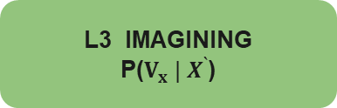
Stuck on the first rung of the ladder
L3 IMAGINING
P($V_{x} | X^{`}$)
observational data — they live on level 1.
“what if I DO x?” by design.
Better prediction ≠ causal understanding.
L2 DOING
P(V | do(x))
?
L1 SEEING
P(V)
LLM · Sora · Diffusion · JEPA

Slide 10
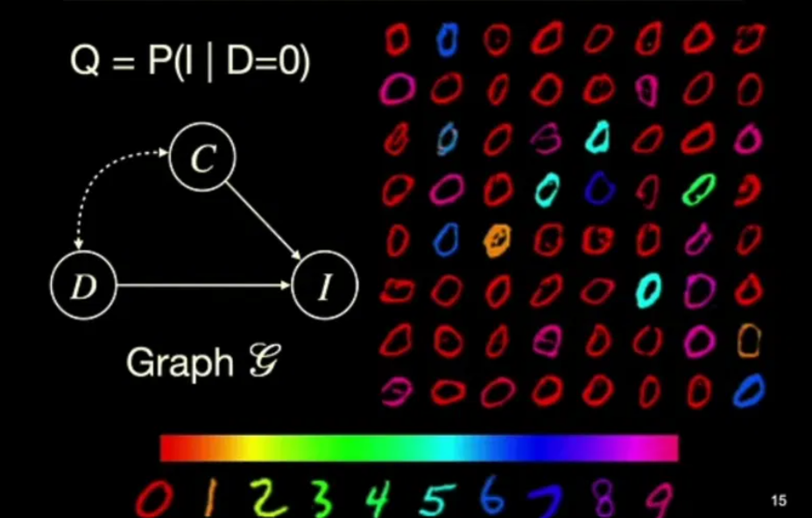
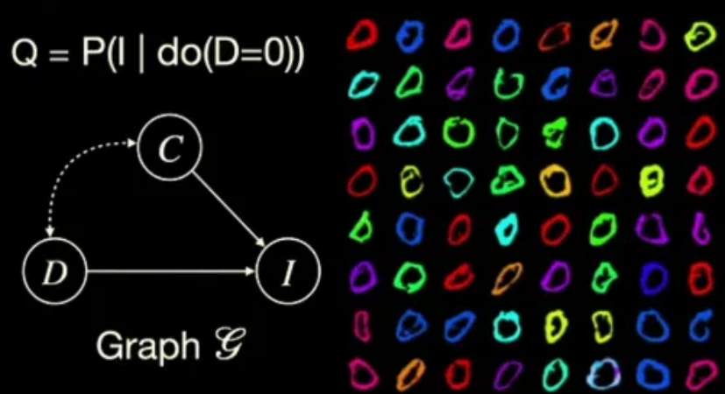
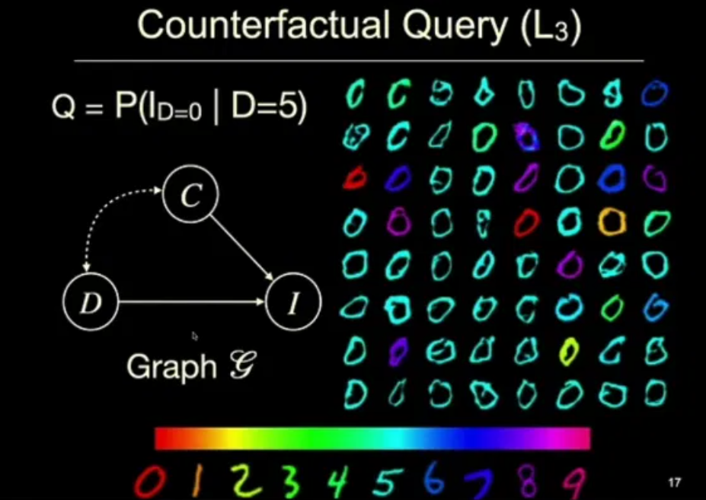
Examples
MNIST Dataset:
L1 L2 L3

Slide 11
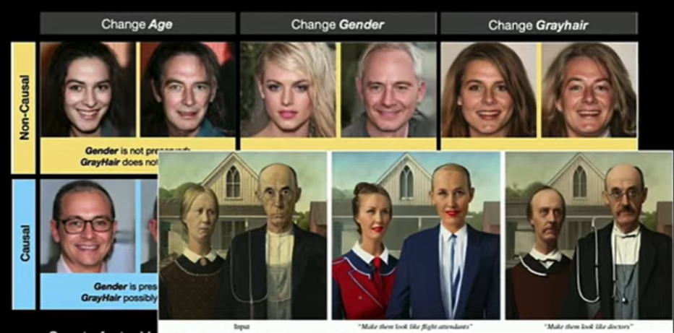
What breaks without causality
This is the problem in one picture: generation that looks right vs generation that IS right under intervention.

Slide 12
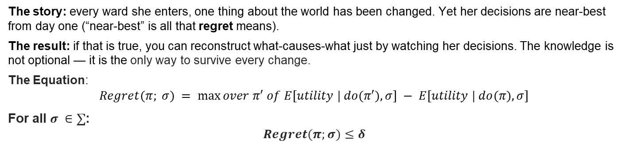
A story: the doctor who never retrains
Ward 1: patients
pre-medicated
The doctor
good calls on day one,
in every ward,
never retrained
then the causal model
of medicine is already
in her head — provably
Ward 2: disease
rates doubled
Ward 3: a new
side-effect appears
The story: every ward she enters, one thing about the world has been changed. Yet her decisions are near-best from day one (“near-best” is all that regret means).
The result: if that is true, you can reconstruct what-causes-what just by watching her decisions. The knowledge is not optional — it is the only way to survive every change.
The Equation:
$$Regret(π; σ) = max⁡over π′ of E[utility | do(π′), σ] − E[utility | do(π), σ]$$
For all $σ ∈∑$:
$$Regret(π;σ)≤δ$$

Slide 13
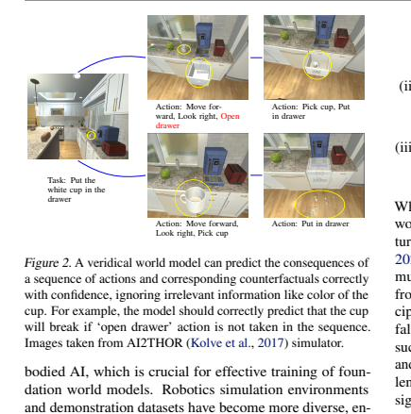
What problem does a causal world model solve?
1. Planning that survives contact: answers P(V | do(action)) — the query every plan actually needs.
2. OOD robustness by modularity: a domain shift changes one or two mechanisms — swap those modules, keep the rest. Correlation models must relearn everything.
3. Sample efficiency & transfer: invariant mechanisms are reused across tasks and environments — the source of 5-10× efficiency claims.
4. Veridicality: predicts the cup breaks if ‘open drawer’ is skipped — while ignoring the cup;s colour. Right for the right reasons.
conclusion: foundation model is not enough for embodied AI
We need AI to predict the status of the world instead of “tokens”
robot simulation (AI2THOR)

Slide 14
Where the research goes next
Causal representation learning: pixels are not causal variables — learn the variables themselves from video + actions. The biggest open problem.
New data paradigm: pretrain on massive offline L1 (internet video) + actively collect the most informative online interventions (L2). Every robot action is a free do( ).
Identifiability at scale: classical guarantees are case-by-case; foundation models need general machinery that degrades gracefully when assumptions fail.
Orthogonal fixes combine: JEPA changes the SPACE of prediction; causality changes the LEVEL. Next generation: causal mechanisms inside a JEPA-style latent space.
From emergent to guaranteed: today causal structure sometimes emerges (Othello-GPT); the goal is architectures where it is guaranteed.

Slide 15
Inside a causal world model
JEPA’s parts
A causal world model’s parts
encoder
variables V
the state, split into meaningful pieces — not one blob
predictor (in latent space)
graph G
who listens to whom — a learnable wiring diagram
EMA teacher (no collapse)
mechanisms f₁ … fₙ
one small module per variable: Xᵢ = fᵢ(parents, noise)
→ changes WHERE you predict
noise U
the individual context — hold it fixed to ask “for THIS case?”
One model, three buttons: run it (see) · clamp a module (do) · infer U, edit, replay (imagine)
JEPA changed where we predict. This changes what we can answer.
Model the mechanisms, not the data.

Slide 16
Reference
Gupta, T., Gong, W., Ma, C., Pawlowski, N., Hilmkil, A., Scetbon, M., Rigter, M., Famoti, A., Llorens, A.J., Gao, J. and Bauer, S., 2024. The essential role of causality in foundation world models for embodied ai. arXiv preprint arXiv:2402.06665.
Richens, J. and Everitt, T., 2024, May. Robust agents learn causal world models. In The Twelfth International Conference on Learning Representations.
Pearl, J., 2009. Causality. Cambridge university press.

