Slide 1

BECAUSE
Chu

Slide 2
Review
Last week, we went thought what is causality and the next process on casual model. And we know: robustness = causal model
Then we have:
THE PARTS
V · G · f · U
V: variables, G: graphic, F: mechanism, U: noise

Slide 3
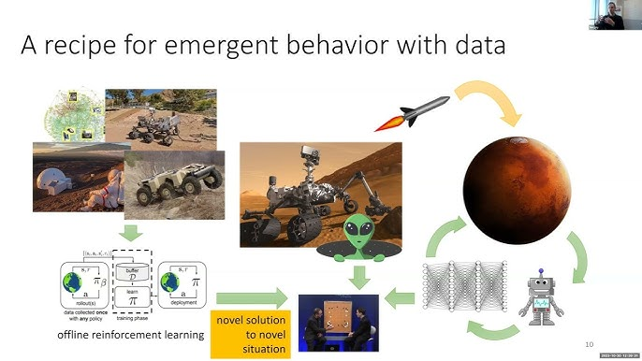
How about the Reinforce Learning
Reinforce Learning, a method that learning to make decisions through trial and error.
And it has two different ways: Online RL and Offline RL

Slide 4

However
Offline RL really rely on correlation on the distribution, but the model will shut down if we change to another distribution, and Online RL is really expensive on testing.
Back to what we knew: variables(V), graph(G), noise(U), mechanisms(f). Lots of researchers found a method to fix this problem, which is using Causality(For example, intervention.) to fix.
If we can find a way to accomplish these components, we can fix the problem what offline RL right now. But how?

Slide 5

Abstract
Since we know the Online RL is expensive, even there is a method which GPT is doing: use offline data to train the model and put it into real-world to do the online RL, but it still really expensive.
So, here comes with two questions:
  1. can we only use offline(historical data)?
  2. how to improve the success rate instead of only decrease the loss rate
There are lots of researcher tried to fix the problem, but BECAUSE want to find the problem at.
It assumed status and actions are considered as causality.

Slide 6
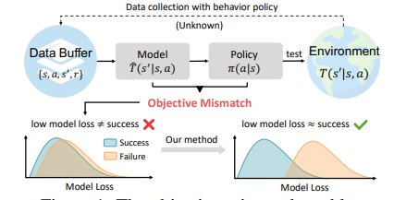
The whole guidline
For now, we have a clearly pipeline which is we are trying to fix the problem what offline RL had right now, which we will base on causal components to make it better.
In a nutshell: formulate the world model as a "matrix sandwiched between two encoders" (bilinear), reinterpret the central matrix as a causal graph and prune it via independence tests, apply a reweighting formula to eliminate the demonstrator's preference-based biases, and finally pair it with a pessimistic planner that avoids trusting unfamiliar scenarios.

Slide 7
Methodology Pipeline
TRADITIONAL
BECAUSE
DATA ↓ LEARN WORLD MODEL ↓ LEARN POLICY ↓ DEPLOY
DATA ↓ DISCOVER CAUSAL VARIABLES ↓ LEARN CAUSAL WORLD MODEL ↓ USE CAUSAL MODEL TO LEARN POLICY ↓ DEPLOY

Slide 8
Baseline
We knew, traditional method, with a world model doesn't discriminate; as long as it can reduce prediction error, it will learn that correlation too. In the report at least it looks really great.
This is the "baseline problem." Traditional methods offer no solution because their loss functions are designed solely to prioritize prediction accuracy, making them unable to distinguish between genuine underlying patterns and coincidental correlations.

Slide 9

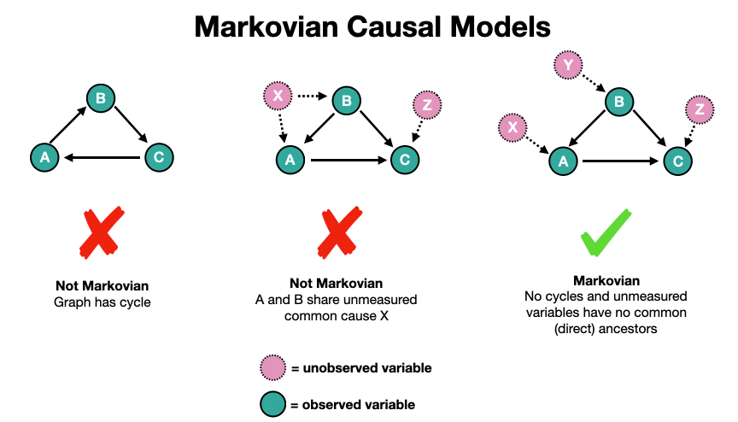
The “Because”
An additional rule is added regarding the "BECAUSE" loss: predictions must be accurate, and—crucially—every piece of information used must pass a test proving it is a genuine cause rather than a mere coincidence.
This is the new path of: ‘Discover Causal Variables + Graph’
Example: action_t -> position_{t+1}, but wall_color -> nothing

Slide 10
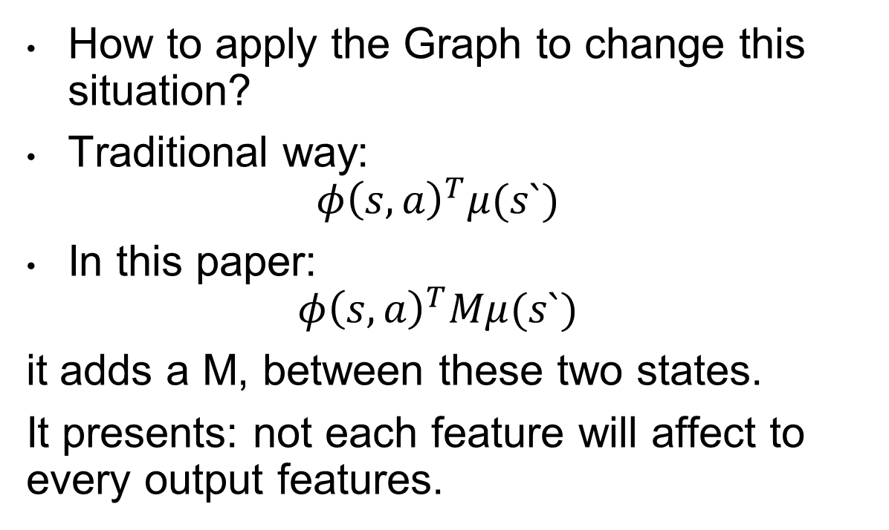
Causal Matrix
How to apply the Graph to change this situation?
Traditional way:
$$φ{\left(s,a\right)}^{T}μ(s`)$$
In this paper:
$$φ{\left(s,a\right)}^{T}Mμ(s`)$$
it adds a M, between these two states.
It presents: not each feature will affect to every output features.
Then the matrix is:
 | position | speed | cup | weather
position | 1 | 1 | 0 | 0
speed | 1 | 1 | 0 | 0
cup | 0 | 0 | 1 | 0
weather | 0 | 0 | 0 | 1
Which means different factors point to different factors, which is the Graph(G)
M(position, position`) = 1, which means position will affect the next position state

Slide 11

Bilinear Representation
If $φ = [f₁,f₂,f₃]$and $μ = [g₁,g₂,g₃]$
  Traditional:
    $$f_{1}g_{1}+f_{2}g_{2}+f_{3}g_{3}$$
    It is only affecting to one dimension
  ‘New Method’:
    if M= $[\begin{matrix}1 & 0 & 2 \\ 0 & 1 & 0 \\ 3 & 0 & 1\end{matrix}]$
    It has:
  $$f_{1}g_{1}+2f_{1}g_{3}+f_{2}g_{2}+3f_{3}g_{1}+f_{3}g_{3}$$
  Which shows the $φ{\left(s,a\right)}^{T}Mμ(s`)$ can let different dimension learn each others

Slide 12
Does it work? — and the honest scorecard
In-Distribution
BECAUSE 73.3 vs best baseline 53.4
OOD (coupling swapped)
BECAUSE 43.0 vs best baseline 28.1
Scorecard on our parts list:
V (latent) · G yes (the matrix) · f yes (not sure, Dynamics Model) · U no.(‘Hidden confounders remain’)
BECAUSE does not recover semantic variables. It learns latent variables instead.
Offline Dataset Behavior Policy -> Data Buffer -> World Model -> New Policy -> Planning

Slide 13
End
Not only causality is important, but also we have to consider Dynamics, Physics and Objects
The future might like:
Correlation -> Representation -> Objects -> Dynamics -> Physics -> Causal Mechanisms -> Planning & Decision Making

Slide 14
Reference
Lin, H., Ding, W., Chen, J., Shi, L., Zhu, J., Li, B. and Zhao, D., 2024. Because: Bilinear causal representation for generalizable offline model-based reinforcement learning. Advances in Neural Information Processing Systems, 37, pp.114510-114552.
Richens, J., Everitt, T. and Abel, D., 2025, June. General agents need world models. In Forty-second International Conference on Machine Learning.

