Slide 1
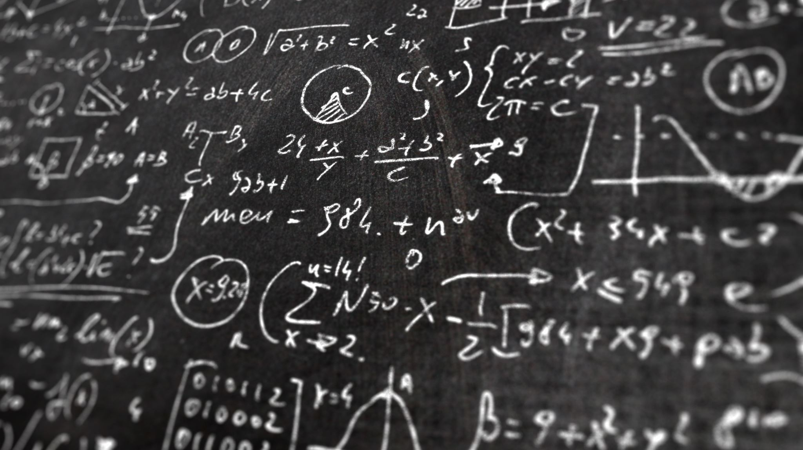
Causal Representation
chu

Slide 2
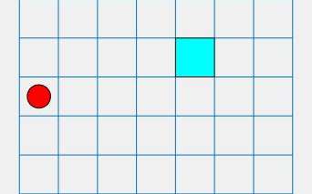

Causal Representation Learning for Out-of-Distribution Reinforcement Learning
In normal RL, we know State → Policy
  Just like the image on the right, the robot
  Will fail since OOD problem.
The main idea on this paper is:
There are actually two types of factors in the environment:
  Causal factors (stable): items position, speed, and contact relationship
  Spurious correlation factors (changes): background color, lighting, camera angle
→
Target training outside of distribution

Slide 3
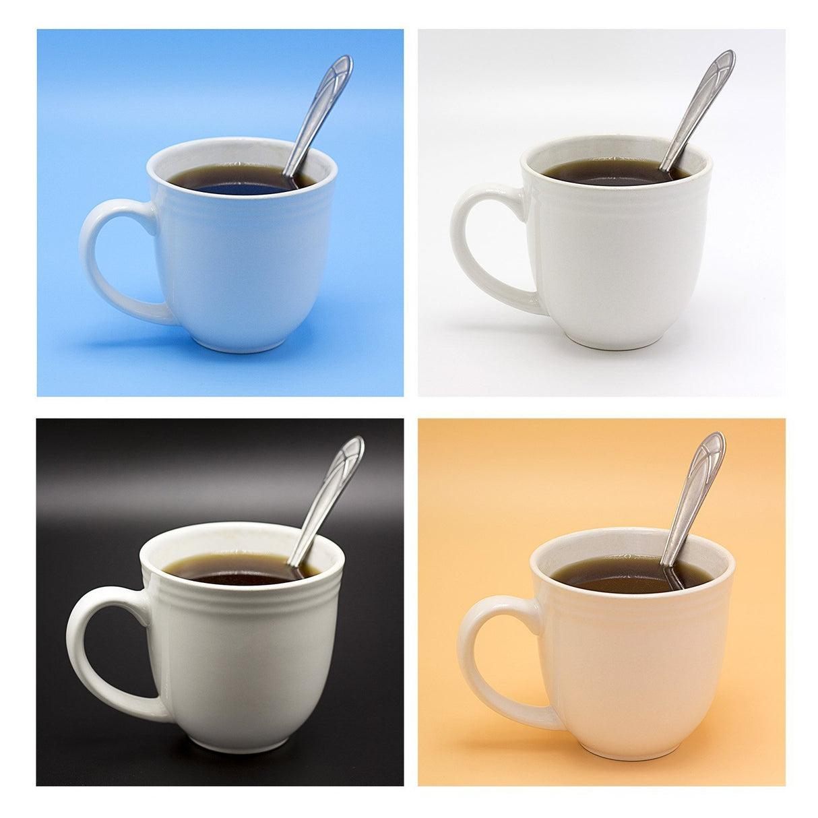
Compare to CLIP
CLIP model:
  You can give the model some prompt words, and let the model to detect the item from the image. Let’s say, if we said the cup on the table, and CLIP will find the images which are close to what the words said.
Example:
  If we look into the image, the main item should be the cup instead of background and lighting.
  The main idea here is trying to learn an embedding vector that only contains the “CUP”

Slide 4
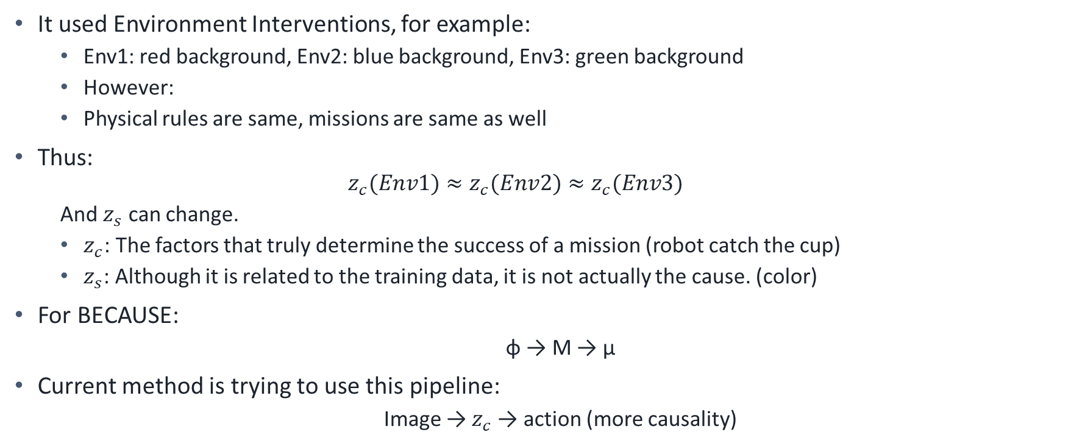
How to make it?
It used Environment Interventions, for example:
  Env1: red background, Env2: blue background, Env3: green background
  However:
  Physical rules are same, missions are same as well
Thus:
  $$z_{c}(Env1)≈z_{c}(Env2)≈z_{c}(Env3)$$
  And $z_{s}$ can change.
  $z_{c}$: The factors that truly determine the success of a mission (robot catch the cup)
  $z_{s}$: Although it is related to the training data, it is not actually the cause. (color)
For BECAUSE:
  φ → M → μ
Current method is trying to use this pipeline:
  Image → $z_{c}$→ action (more causality)

Slide 5
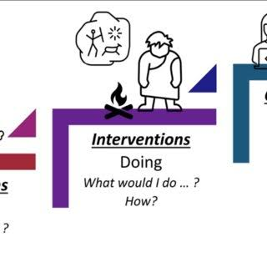
‘Change’ that reveals cause.
Afterward, as know from this method: background change, but the main item will not change, even change will be similar item. Let’s review the previous image first:
Doesn’t it seem like you change the situations and how the variables will be? Learning Causal Representations from Interventional Data.
“BECAUSE” method only use the offline dataset and try to build up the graph to guess the causality. That is why this method is more likely causality than BECAUSE method.

Slide 6
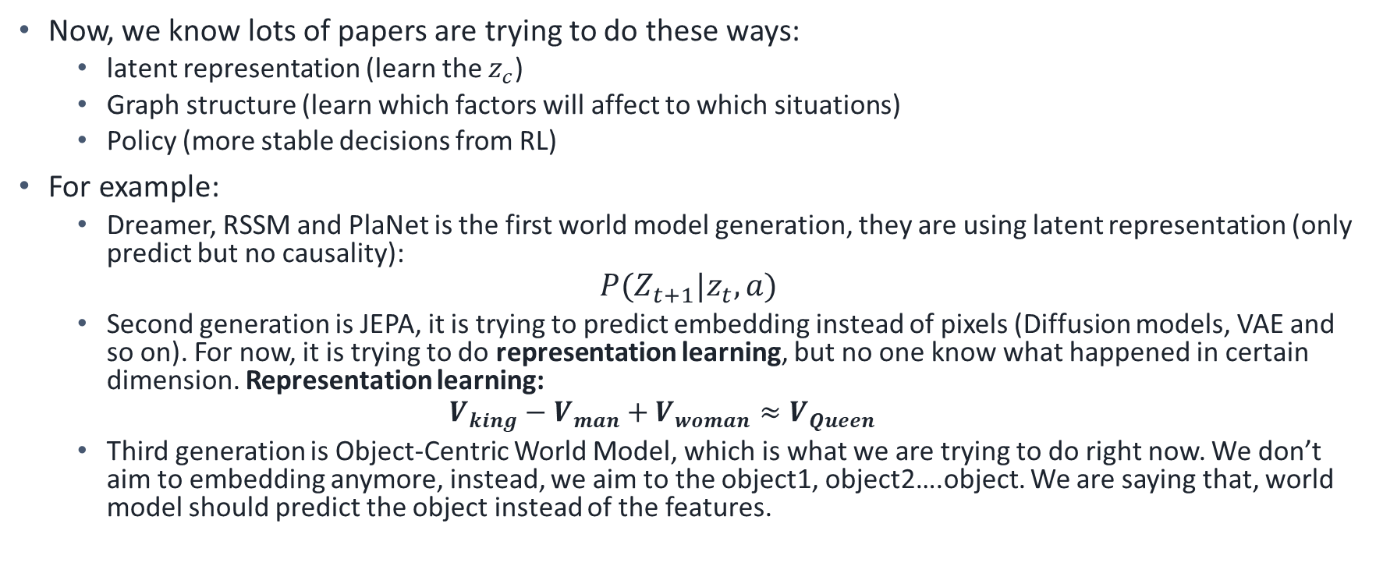
Current papers
Now, we know lots of papers are trying to do these ways:
  latent representation (learn the $z_{c}$)
  Graph structure (learn which factors will affect to which situations)
  Policy (more stable decisions from RL)
For example:
  Dreamer, RSSM and PlaNet is the first world model generation, they are using latent representation (only predict but no causality):
$$P(Z_{t+1}|z_{t},a)$$
  Second generation is JEPA, it is trying to predict embedding instead of pixels (Diffusion models, VAE and so on). For now, it is trying to do representation learning, but no one know what happened in certain dimension. Representation learning:
  $$V_{king}−V_{man}+V_{woman}≈V_{Queen}$$
  Third generation is Object-Centric World Model, which is what we are trying to do right now. We don’t aim to embedding anymore, instead, we aim to the object1, object2….object. We are saying that, world model should predict the object instead of the features.

Slide 7
Causal-JEPA
Now a day, the papers are all learning representation, like z -> z`, but they don’t know why.
So right now, LeCun already had a paper named: ‘Causal-JEPA’
How does it work? We previously discussed V-JEPA. While V-JEPA employs "patch"-based masking, Causal-JEPA aims to use entire objects as masks to drive the model's learning. However, since the model itself has no inherent concept of an "object," a robot is required to push the cup. It is just like the causality!
Furthermore, in paper: ’Interaction-Aware JEPA’, which is talking about why JPEA is not enough, so they aim the interaction, not like the object mask, they mask the action, for example: when the robot touch the cup, we mask.
But they are not enough, since they are all based on the object and transfer it to embedding vectors, they did not do Object -> mechanism

Slide 8
Mechanism Model based on causality
Traditional way:
  Image -> Encoder -> Latent -> Future Latent
JEPA:
  Image -> Embedding -> future Latent
Object World Model:
  Image -> Object -> Graph -> Future Objects
But there is a new method that saying prediction is not equal to Explanation, for example:
  Traditional way is relying on dataset, lets say we have 1M data and model can learn current state to next state. Position -> Position`, but the network doesn’t know what happened, it only know: x -> y
  Mechanism way is trying to explain why x can become y. Lets say we have a robot to push the cup, and physics tells us: robot -> contact -> force -> acceleration -> velocity -> position. It doesn’t have position as input here, only has ‘force, acceleration, and velocity’ which we call it the parameters that affect the final position. Compare to traditional way, if we change the cup to heavier item, the model doesn’t know how to predict the position. But in mechanism, it will understand the item is heavier than before, and based on the new item to predict the new position.

Slide 9
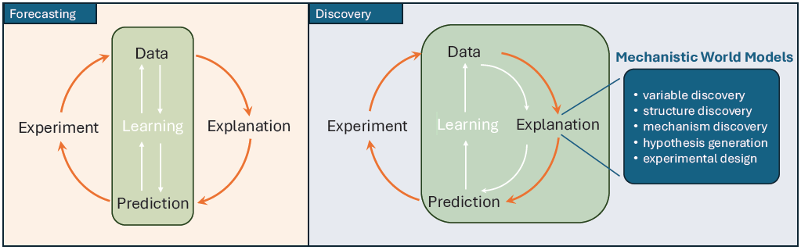
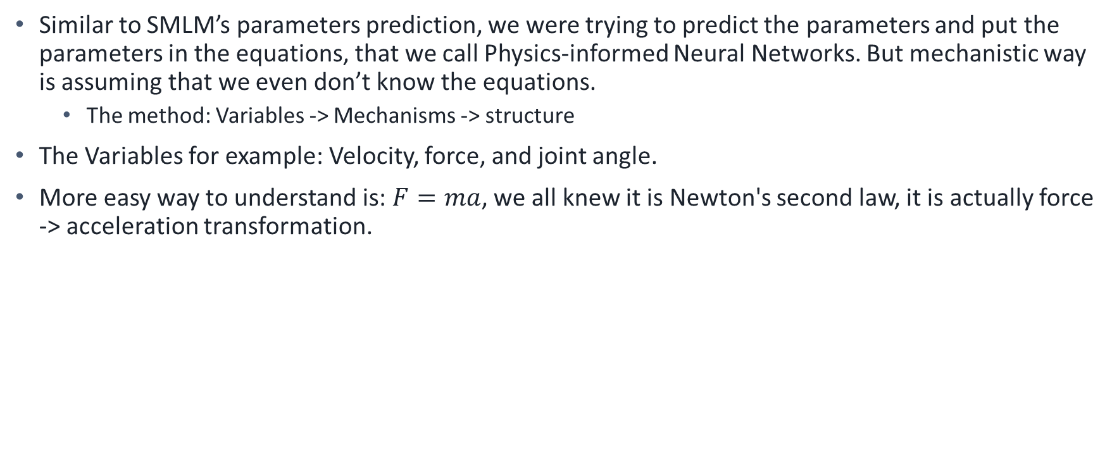
Physics-informed Neural Networks and Mechanistic World Models
Similar to SMLM’s parameters prediction, we were trying to predict the parameters and put the parameters in the equations, that we call Physics-informed Neural Networks. But mechanistic way is assuming that we even don’t know the equations.
  The method: Variables -> Mechanisms -> structure
The Variables for example: Velocity, force, and joint angle.
More easy way to understand is: $F=ma$, we all knew it is Newton's second law, it is actually force -> acceleration transformation.

Slide 10
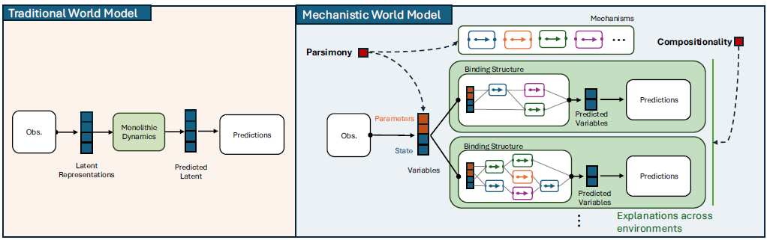
Pipeline
Traditional: black box (lots of different dimension matrix)
Mechanistic World Model (but doesn’t have model so far):
  it is thinking encoder should generate(output): parameters (mass, radius) and state (position, velocity)
  And it has four components: Contact, Friction, Collision, and Gravity (or even add one more Constraint). Each of them is presenting a small module, instead of a huge dynamics network.

Slide 11
Hypothesis
Can we develop a new pipeline that:
  Predicting Mechanisms is better than Predicting States.
Traditional world model:
  (s, a) -> neural network -> s`
  Input: x=3, v=2, action=push_right -> output: x`=5, v=4, we know what is the future from network
My idea:
  (s, a) -> Mechanism Predictor -> Mechanisms -> Physics Solver -> s`
  We only know: What mechanisms are at work in the world? From network

Slide 12
Reference
Ceriscioli, M. and Mohan, K., 2026. Agents robust to distribution shifts learn causal world models even under mediation. Advances in Neural Information Processing Systems, 38, pp.77585-77619.
Nam, H., Lidec, Q.L., Maes, L., LeCun, Y. and Balestriero, R., 2026. Causal-JEPA: Learning World Models through Object-Level Latent Masking. arXiv preprint arXiv:2602.11389.
Paidi, S.K., 2026. Entity-Centric World Models: Interaction-Aware Masking for Causal Video Prediction. arXiv preprint arXiv:2605.15466.
Posner, I., Lei, A. and Schölkopf, B., 2026. From Observation to Insight: Mechanistic World Models and the Quest for Autonomous Discovery. arXiv preprint arXiv:2607.12474.

