Slide 1
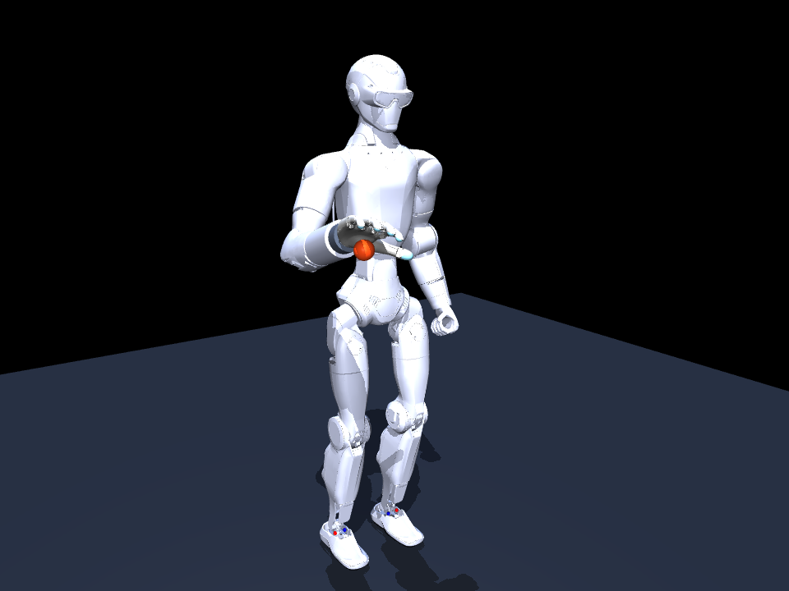
R1 single-arm observation adapter
How robot state becomes the policy’s 51 inputs
Implementation walkthrough
Live data interface with recorded-data testing
01
Notes:
The illustration shows the existing MuJoCo training model, not a real robot photograph. Source image: week 23 research/media/r1_revo2_model_preview.png.
Source: code/scripts/r1_observation_adapter.py and code/ADAPTER.md in the accompanying package.

Slide 2
The adapter’s role
01
A source reader supplies one synchronized R1ObservationFrame.
02
The adapter orders fields and converts them into the training observation format.
03
The saved policy receives a NumPy array with shape (51,) and dtype float64.
04
This implementation ends at the observation. Robot communication and command execution remain separate.
02
Notes:
Source: code/scripts/r1_observation_adapter.py and code/ADAPTER.md in the accompanying package.

Slide 3
One interface for live and recorded data
Stage | Live use | Recorded-data test
Source | Future robot receiver | Future recording reader
Preparation | Align sensor times and estimate missing features | Map fields and preserve recorded timing
Shared conversion | R1ObservationFrame and adapter.observation(frame) | Identical call and input contract
Downstream | Policy inference in a future controller | Inspect observations and log predictions
03
Notes:
The adapter has no source-specific transport and maintains no temporal history. Neither receiver nor recording reader is implemented.
Source: code/scripts/r1_observation_adapter.py and code/ADAPTER.md in the accompanying package.

Slide 4
What the code contains
01
R1ObservationFrame: a dataclass describing all required fields in one frame.
02
R1ObservationAdapter.__init__: validates configuration and reads training joint ranges from XML.
03
observation(frame): validates the frame and assembles the 51 values.
04
OBSERVATION_SLICES: named Python slices for inspecting each output feature group.
04
Notes:
Source: code/scripts/r1_observation_adapter.py and code/ADAPTER.md in the accompanying package.

Slide 5
Required joint and timing fields
Field | Required content | Units or convention
elapsed_seconds | Time since task start | Seconds, finite and nonnegative
joint_positions | 5 arm positions and 6 Revo2 positions | Named joints, simulation signs and offsets
joint_velocities | 5 arm joint velocities | Same arm names
previous_action | 11 previous requested commands | Normalized to [-1, 1], arm then hand
05
Notes:
Default angle units are radians and radians per second. Setting joint_units="degrees" changes both angle and angular-velocity interpretation. Extra named joints are ignored, required joint omissions raise ValueError.
Source: code/scripts/r1_observation_adapter.py and code/ADAPTER.md in the accompanying package.

Slide 6
Required spatial and task fields
Field | Meaning
palm_position / palm_velocity | Position and velocity of acquire_site
ball_position / ball_velocity | Tracked ball position and linear velocity
throw_target | Target position in the same spatial frame
contact_count | Nonnegative integer hand–ball contact count
fixture_active | Boolean matching the task’s ball-support state
06
Notes:
Spatial vectors have three finite values. Positions use metres and linear velocities use metres per second. Contact and fixture semantics originate in the training simulation and need explicitly defined real-world estimators.
Source: code/scripts/r1_observation_adapter.py and code/ADAPTER.md in the accompanying package.

Slide 7
Canonical joint order
Index | Arm joint suffix | Hand joint suffix
0 | shoulder_pitch_joint | thumb_metacarpal_joint
1 | shoulder_roll_joint | thumb_proximal_joint
2 | shoulder_yaw_joint | index_proximal_joint
3 | elbow_joint | middle_proximal_joint
4 | wrist_roll_joint | ring_proximal_joint
5 | No sixth arm joint | pinky_proximal_joint
07
Notes:
All names have the prefix right_. The ARM_JOINTS and HAND_JOINTS constants give the exact full keys. The observation contains separate arm position, arm velocity, and hand ratio blocks. Actions use five arm entries followed by six hand entries.
Source: code/scripts/r1_observation_adapter.py and code/ADAPTER.md in the accompanying package.

Slide 8
Observation layout: time and geometry
Python slice | Feature | Count
0:1 | Normalized task time | 1
1:7 | One-hot phase | 6
7:10 | Ball relative to palm | 3
10:13 | Target relative to ball | 3
13:16 | Palm relative to training reference | 3
16:19 and 19:22 | Palm velocity and ball velocity | 3 + 3
08
Notes:
Python slices are zero-based and exclude the right endpoint. These groups account for the first 22 entries. All slices also appear in OBSERVATION_SLICES.
Source: code/scripts/r1_observation_adapter.py and code/ADAPTER.md in the accompanying package.

Slide 9
Observation layout: joints and history
Python slice | Feature | Count
22:27 | Normalized arm position | 5
27:32 | Scaled arm velocity | 5
32:38 | Hand closure ratios | 6
38:40 | Contact feature and fixture flag | 2
40:51 | Previous requested action | 11
Total | 22 preceding values + 29 values here | 51
09
Notes:
Source: code/scripts/r1_observation_adapter.py and code/ADAPTER.md in the accompanying package.

Slide 10
Validation before conversion
01
Required vectors must have exact shapes and finite numerical values.
02
Missing joint names raise ValueError. Extra joint keys do not alter policy order.
03
Contact count must be a nonnegative integer. Fixture state must be a boolean.
04
Previous actions must contain 11 finite values in [-1, 1]. The adapter rejects invalid frames.
10
Notes:
Construction of the dataclass alone does not enforce these constraints. observation(frame) performs validation. The final finite-value check also catches nonfinite results from conversion.
Source: code/scripts/r1_observation_adapter.py and code/ADAPTER.md in the accompanying package.

Slide 11
Joint units and training ranges
joint_units="radians" # default
joint_units="degrees" # angles and angular velocities
q_radians = q_degrees * pi / 180
dq_radians = dq_degrees * pi / 180
The bundled XML supplies each joint’s low and high training limits.
11
Notes:
The adapter reads explicit ranges from worldbody joints with xml.etree.ElementTree. It requires compiler angle="radian" and finite limits with high > low. XML parsing needs no MuJoCo runtime or mesh loading. These ranges define feature normalization, not hardware command limits.
Source: code/scripts/r1_observation_adapter.py and code/ADAPTER.md in the accompanying package.

Slide 12
Arm and hand normalization
ratio = (q - low) / (high - low)
arm_position = 2 * ratio[:5] - 1
arm_velocity = clip(dq / 8.0, -2, 2)
hand_ratios = clip(ratio[5:], 0, 1)
Arm limits map to -1 and +1. Hand limits map to 0 and 1.
12
Notes:
Arm positions do not have a separate [-1, 1] clip in this observation builder. All assembled values receive the final [-5, 5] clip. Hand ratios clip individually to [0, 1]. Arm velocities first clip to [-2, 2].
Source: code/scripts/r1_observation_adapter.py and code/ADAPTER.md in the accompanying package.

Slide 13
Worked joint example
Quantity | Synthetic input | Adapter value
Elbow limits | low = -0.97564, high = 2.1852 rad | Span = 3.16084 rad
Elbow position | q = 0.60478 rad, the midpoint | 0.0
Elbow velocity | dq = 4 rad/s | 4 / 8 = 0.5
Index position | q = 0.73305 rad, half of 1.4661 | 0.5 closure ratio
Large arm velocity | dq = 24 rad/s | clip(3, -2, 2) = 2
13
Notes:
Values are a teaching example, not a recorded robot frame. The elbow and index limits come from the bundled model XML.
Source: code/scripts/r1_observation_adapter.py and code/ADAPTER.md in the accompanying package.

Slide 14
Coordinate-frame conversion
p_policy = R @ p_source + t
v_policy = R @ v_source
R.T @ R = identity
det(R) = +1
All positions share one source frame. Translation uses metres.
14
Notes:
R is a finite proper 3x3 rotation matrix and t is a finite three-vector. The default is identity rotation and zero translation. Velocities rotate without adding translation. A moving source frame requires additional velocity terms upstream and is outside this constant-transform adapter.
Source: code/scripts/r1_observation_adapter.py and code/ADAPTER.md in the accompanying package.

Slide 15
The palm point and fixed training world
01
The policy’s palm point is acquire_site in the training model.
02
A wrist origin or grasp_site measurement must be converted to the acquire_site location.
03
Upstream kinematics or tracking supplies the point’s position and linear velocity.
04
The policy uses a fixed training world. A moving base requires upstream pose and velocity estimation.
15
Notes:
Source: code/scripts/r1_revo2_env.py, palm_site_id, palm_position and palm_velocity. The simulation obtains acquire_site velocity as a translational site Jacobian multiplied by generalized velocity. A rigid point offset changes both position and, during rotation, linear velocity.
Source: code/scripts/r1_observation_adapter.py and code/ADAPTER.md in the accompanying package.

Slide 16
Spatial feature scaling
ball_from_palm = (ball - palm) / 0.25
target_from_ball = (target - ball) / 0.90
palm_position = (palm - [0.30, -0.25, 0.90]) / 0.50
palm_velocity = palm_velocity / 2.5
ball_velocity = ball_velocity / 3.0
The constants reproduce the existing training observation exactly.
16
Notes:
Position scales are in metres. Velocity scales are in metres per second. Relative vectors use the transformed training frame. The palm reference is a fixed location in that frame. Learned mean/std normalization happens later inside the policy.
Source: code/scripts/r1_observation_adapter.py and code/ADAPTER.md in the accompanying package.

Slide 17
Worked spatial example
Quantity | Synthetic value in training coordinates
Palm / ball / target | [0.30, -0.25, 0.90] / [0.35, -0.25, 0.90] / [0.80, -0.25, 0.90]
Ball relative to palm | [0.05, 0, 0] / 0.25 = [0.20, 0, 0]
Target relative to ball | [0.45, 0, 0] / 0.90 = [0.50, 0, 0]
Palm reference feature | [0, 0, 0]
Palm / ball velocity | [0.25, 0, 0] / 2.5 = [0.10, 0, 0] and [0.30, 0, 0] / 3 = [0.10, 0, 0]
17
Notes:
These values demonstrate the arithmetic only. They do not come from an internet recording or live robot.
Source: code/scripts/r1_observation_adapter.py and code/ADAPTER.md in the accompanying package.

Slide 18
Task time and phase encoding
Elapsed time in seconds | Active phase index
0 to below 1.45 | 0
1.45 to below 3.00 | 1
3.00 to below 3.45 | 2
3.45 to below 3.80 | 3
3.80 to below 4.30 | 4
4.30 and later | 5
18
Notes:
Normalized time = 2 * elapsed / 5.30 - 1. At 2.65 seconds the time feature is 0 and phase is [0, 1, 0, 0, 0, 0]. Equality enters the next phase. These are elapsed-time bins, not visual recognition of successful task progress. Elapsed times beyond the nominal episode remain accepted, with final clipping of the time feature.
Source: code/scripts/r1_observation_adapter.py and code/ADAPTER.md in the accompanying package.

Slide 19
Contacts and fixture state
01
The contact feature is min(contact_count / 4, 1). Counts of 0, 2 and 4 map to 0, 0.5 and 1.
02
The fixture feature is float(fixture_active), which yields 0 or 1.
03
Training counts hand–ball collision contacts and reads the ball fixture equality constraint.
04
Real data needs an explicit meaning for these features. R1 motor telemetry alone does not provide them.
19
Notes:
Source: code/scripts/r1_revo2_env.py, contact_count and _observation. Contact count is not simply a count of touched fingers or a force reading. Such a mapping requires validation. Do not silently fabricate these inputs.
Source: code/scripts/r1_observation_adapter.py and code/ADAPTER.md in the accompanying package.

Slide 20
Previous-action semantics
previous_action = [five arm commands, six hand commands]
reset_arm = clip(2 * (home_q - arm_low)
/ (arm_high - arm_low) - 1, -1, 1)
reset_hand = [-1, -1, -1, -1, -1, -1]
The environment stores the previous requested action, even when actuation is delayed.
20
Notes:
Source: code/scripts/r1_revo2_env.py reset and step. At reset, the environment calls _target_to_action(home_q, np.zeros(6)); the six zeros are hand ratios before action conversion and become -1. The adapter is stateless and the caller must supply this history. Replacing recorded prior commands with fresh predictions changes the replay observations.
Source: code/scripts/r1_observation_adapter.py and code/ADAPTER.md in the accompanying package.

Slide 21
Final observation and policy inference
01
Concatenation preserves the exact block order in OBSERVATION_SLICES.
02
A finite-value check precedes a final elementwise clip to [-5, 5].
03
The policy applies its saved mean/std normalization and runs the neural network.
04
The policy decodes residual predictions around a nominal trajectory into 11 normalized commands.
21
Notes:
Source: code/scripts/neural_policy.py _forward, __call__, nominal_actions and decode_actions. Do not apply the learned normalization before passing the adapter result to the policy. Output commands still need a separate hardware control integration.
Source: code/scripts/r1_observation_adapter.py and code/ADAPTER.md in the accompanying package.

Slide 22
Calling the adapter
from r1_observation_adapter import (
R1ObservationAdapter, R1ObservationFrame
)
adapter = R1ObservationAdapter()
frame = R1ObservationFrame(**payload)
observation = adapter.observation(frame)
payload must contain every required field. The same call works for either data source.
22
Notes:
The code directory includes examples/synthetic_frame.py, which constructs a complete synthetic frame and optionally calls the bundled saved policy. No robot connection is made. The adapter’s default model path resolves relative to its script location.
Source: code/scripts/r1_observation_adapter.py and code/ADAPTER.md in the accompanying package.

