Slide 1
Learning an R1 arm movement
How the policy learns to repeat a real recording
Cesar A. Pascal Vasquez
R1 imitation 1
Notes:
Objective: learn to reproduce the supplied real R1 arm routine. The policy is specialized to one time-indexed sequence. It is not yet a general policy that reacts to a new scene or live state.
Local sources: imitation/code and imitation/results.

Slide 2
Our goal: repeat the recorded arm movement
A policy is the model that chooses the robot’s next target position. Training teaches it which positions to produce.
The adapter prepares the input. The policy learns the movement.
This version learns one recorded routine.
R1 imitation 2
Notes:
The adapter does deterministic preparation of input. Policy training fits model parameters from examples. The previous task used a 51-input ball-task policy without retraining; the current primary model is a time-conditioned five-output routine learned from real positions. This change addresses the user’s stated objective.
Local sources: imitation/code and imitation/results.

Slide 3
Three ways to use the same recording
OLD TEST
NEW POLICY
PLAYBACK
Fed data to a ball-task policy.
Did not train on the recording.
Useful for checking conversion.
Learns the arm sequence.
Uses real positions as targets.
Fits the imitation goal.
Reads saved positions in order.
Needs no policy training.
Already repeats the recording.
LEARNING FITS OUR GOAL, BUT HAS NOT PROVED MORE ACCURATE THAN REPLAY
R1 imitation 3
Notes:
Qualitative comparison by objective, not a controlled accuracy benchmark against the old ball policy. The old fixed policy was designed for ball-task behavior and needed synthetic missing fields in the replay. The new routine trains on real measured five-joint positions and requires no synthetic hand or ball inputs. Direct replay uses saved positions and can reproduce sample values exactly as numerical targets. A trained model is not automatically a superior way to repeat a fixed trajectory. Our test found interpolation better on withheld gaps. Hardware tracking accuracy is untested for every option.
Local sources: imitation/code and imitation/results.

Slide 4
How the policy learns
1
Read the real robot’s five arm positions and their timestamps.
2
Give the model examples of the position at each time.
3
Adjust its learned values to reduce the position error.
4
Check missing portions, then train the final model on the full recording.
Training changes the policy. Data conversion alone does not.
R1 imitation 4
Notes:
Technical details: Gaussian radial-basis network with1077 fixed centers. Validation MSE selected width0.6seconds and regularization0.1. Evaluation uses2160training,269validation,260test samples in complete one-second time gaps. The final policy refits on all2689frames after model selection. The evaluation checkpoint remains separate. Source action duplicates current measured positions, so it does not supply an independent command target.
Local sources: imitation/code and imitation/results.

Slide 5
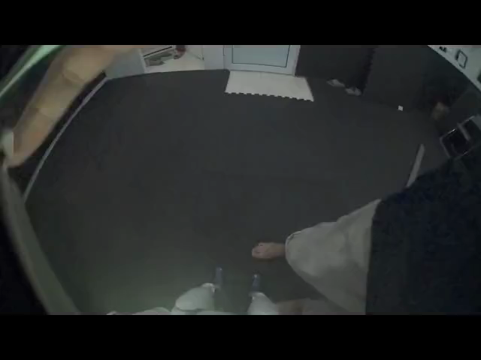
The real recording used for training
2,689
recorded samples
10 Hz
10 samples each second
Original robot camera video
Plays in Slide Show mode
R1 imitation 5
Notes:
Publisher identifies Unitree R1 A5 hand-guided joint validation. Original camera frames show a physical room, operator and robot parts. Pinned revision f36329a96a1e26127772e06350c692b7dfd0556b. Actual timestamp duration268.7999878seconds. Source units and signs are assumed compatible with the model; camera evidence does not certify calibration. The number-pointing dataset was excluded as simulated. Source URL https://huggingface.co/datasets/vasco281204/r1_kinesthetic_joint_check_09.
Local sources: imitation/code and imitation/results.

Slide 6
How the learned movement runs
1
A clock tells us how far we are through the recorded routine.
2
The adapter converts that time into the policy’s input.
3
The trained policy outputs five target arm positions.
4
The model displays those positions beside the recorded movement.
This version follows time. It does not yet react to live robot feedback.
R1 imitation 6
Notes:
RoutineAdapter normalizes elapsed playback seconds by268.8seconds. RoutinePolicy maps phase to five joint position targets using learned coefficients only, without loading recorded frames at inference. Actual hardware commands and closed-loop tracking are not implemented. The body remains static visual context and the hand is omitted.
Local sources: imitation/code and imitation/results.

Slide 7
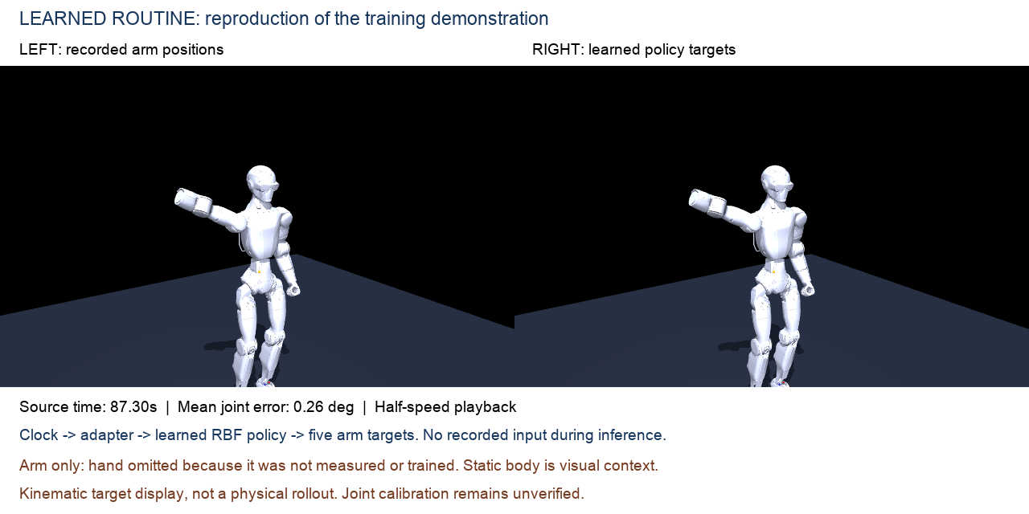
Recorded movement and learned movement
R1 imitation 7
Notes:
Left: real recorded joint values placed in the display model. Right: final routine policy output at matching time. This video uses a movement included in final training. Source interval83.3–91.3seconds,81frames at5fps, half speed. The excerpt selects shoulder movement for visibility without changing the recorded values. The whole-recording average remains0.1789degrees. Both displays are kinematic; no dynamics or robot execution is shown. No hand measurements or hand learning are included. Standalone video: imitation/results/learned_routine.mp4.
Local sources: imitation/code and imitation/results.

Slide 8
What the results show
1
Repeating the training recording: 0.18° average joint error.
2
Predicting portions left out of training: 2.60° average error.
3
Joining known positions with straight lines: 0.64° on the same gaps.
4
The model repeats the known routine. Simple gap filling is more accurate.
Lower error means closer positions. The first result measures training fit.
R1 imitation 8
Notes:
Values rounded from routine_metrics.json. Final full-fit mean absolute joint error0.178946degrees. Separate training-only evaluation model error on260withheld samples2.598103degrees. Linear interpolation from surrounding training samples gives0.637138degrees on exactly the same test samples. These gap results measure interpolation within the same recording, not a new demonstration. The first number is a training reconstruction score and must not be compared as if it used the same held-out test. Smaller is better. No direct hardware accuracy claim.
Local sources: imitation/code and imitation/results.

Slide 9
Why choose learning rather than only playback?
The earlier ball policy learned a different task. Training on this recording gives the new policy the correct movement target.
A learned model produces targets from a clock and saved learned values. It can later support experiments with additional inputs.
For simply repeating this recording, direct playback remains a strong, simpler option.
The benefit is learning the intended behavior. Better accuracy is not established.
R1 imitation 9
Notes:
Why the approach is more appropriate than fixed ball-policy inference: it optimizes the intended measured movement, rather than a different task, and trains parameters from the real arm observations. Why it is not established as better than playback: direct playback already repeats stored targets, while interpolation beat the learned gap model. Learning additional context and feedback is future work, not a current capability. The separate causal policy also failed to establish reliable autonomous imitation and remains documented in imitation/README.md rather than the main narrative.
Local sources: imitation/code and imitation/results.

Slide 10
What we have, and what comes next
We have a policy that repeats this recorded arm routine. The video shows positions in a model, not physical robot execution.
Next: learn from more recordings and test with measured robot feedback. Verify joint calibration before live use.
The hand was not recorded, so this policy does not learn hand motion
R1 imitation 10
Notes:
Current scope: repeat one arm sequence from elapsed time. No learned hand commands, camera conditioning, generalized intent prediction, closed-loop robot control or verified joint calibration. Next experiments should use multiple independent demonstrations and actual feedback. Original ball-task adapter and checkpoint remain unchanged in code/ for reference.
Local sources: imitation/code and imitation/results.

Slide 11
Sources and files
Real R1 recording and original camera footage
https://huggingface.co/datasets/vasco281204/r1_kinesthetic_joint_check_09
R1 imitation 11
Notes:
All claims derive from the local saved metrics and code. The dataset source, pinned revision and hashes are in recorded_test/source/. Full causal and routine metrics are included in imitation/results/. Source URL https://huggingface.co/datasets/vasco281204/r1_kinesthetic_joint_check_09.
Local sources: imitation/code and imitation/results.

