Slide 1

More experimental
chu

Slide 2
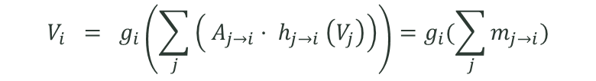
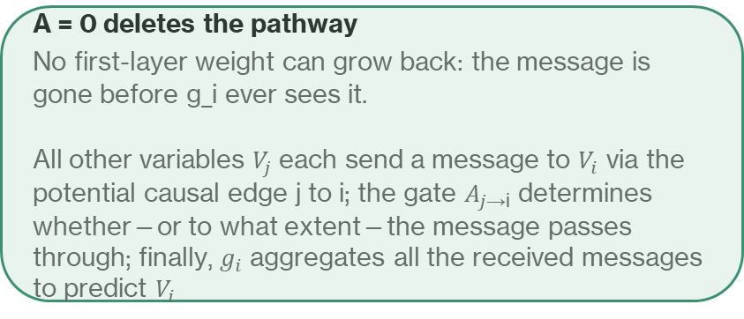
Why edge-wise: the mask had nothing to do
the previous gate learned nothing, and the architecture explains why
Previous form
New form
$$V_{i} = g_{i}\left(\sum_{j}{\left( A_{j→i}· h_{j→i} \left(V_{j}\right)\right)}\right)=g_{i}(\sum_{j}{m_{j→i}})$$
$$Y_{j} = f_{j} ( X ⊙ A[:, j] )$$
The mask only SCALES the input
Halve A_ij, double the matching first-layer weight,
and the function is unchanged. The loss therefore has
almost no preference over A.
Measured: every gate parked inside [0.508, 0.598],
separation 0.0047, decoy AUROC 0.452 — below chance.
A = 0 deletes the pathway
No first-layer weight can grow back: the message is
gone before g_i ever sees it.
All other variables $V_{j}$each send a message to $V_{i}$ via the potential causal edge j to i; the gate $A_{j\text{→i​}}$ determines whether—or to what extent—the message passes through; finally, $g_{i}$ aggregates all the received messages to predict $V_{i}$
The risk that had to be cleared first
Sum aggregation is a DeepSets bottleneck and our mechanism is multiplicative: 1/m cannot be written h_m(m) + h_F(F).
So the first experiment was not "does the gate improve" but "does the ORACLE still reach its ceiling". If the ceiling
collapses, the architecture destroyed what we are competing for and every later comparison is meaningless.

Slide 3
Oracle ceiling survived
Oracle architecture | OOD RMSE ↓ | vs constant ↓ | Spread ≈1 | Corr ↑ | Sign acc ↑
Old per-head oracle | 0.683 | 0.581 | 0.926 | 0.807 | 0.722
Edge-wise oracle | 0.604 | 0.522 | 0.946 | 0.847 | 0.743
OOD vs constant = 0.522 < 1
CEILING INTACT
With G = G*, the edge-wise model predicts better than the old oracle. The architecture did not destroy F*.

Slide 4
Result: the gate recovered structure
Gate quality | per-head | edge-wise
true-cause rank | 5 / 9 | 1 / 9 PASS
separation | 0.0047 | 0.0645
AUROC | 0.535 | 0.675
AUPRC | 0.344 | 0.584
decoy AUROC | 0.452 below chance | 0.711
SHD | 108.9 | 51.7
block margin (truth +1.0) | +0.017 | +0.0886
The blunting is gone too
in-distribution RMSE 0.700 → 0.084
OOD spread ratio 0.120 → 0.892
Removing the stochastic gate sampling was what did
this — the previous arm bought low OOD RMSE by
refusing to predict at all.
Block margin is the strongest of these
gate(B's causes → B) − gate(B's causes → A)
It cannot be earned by closing pure noise. Only a
model that knows WHICH output a parent feeds can
score on it — which is exactly what the two-object
dataset was rebuilt to test.
But downstream did not move at all:
arm | OOD RMSE | vs constant
learned | 1.7419 | 1.441
uniform (gate frozen at 0.5) | 1.7547 | 1.452
full (no gating) | 1.7564 | 1.453
Covers 1.3% of a 65.6% ceiling
Within 1% of committing to nothing, on every metric.
Holm correction leaves nothing standing.

Slide 5
Test: binarise the ranking and see what it is worth
What this separates
The soft gate confuses two failures:
"the ordering is poor"
"the ordering is fine but never committed"
Hardening removes the second by force, so what remains
measures the ordering alone.
Honesty note
Thresholds are swept and the whole curve reported. The
best point is an UPPER BOUND on what this ranking is
worth, not a deployable method — choosing the threshold
by the result would be using the answer.
threshold | edges open | SHD | true edges hit | chance | precision | vs constant
0.40 | 127.0 | 95.8 | 45.1 | 39.0 | 35.5% | 1.452
0.43 | 94.3 | 78.1 | 37.6 | 29.0 | 39.9% | 1.470
0.45 | 72.0 | 65.8 | 32.6 | 22.1 | 45.3% | 1.472
0.47 | 48.4 | 57.0 | 25.2 | 14.9 | 52.1% | 1.461
uniform (no commitment) | — | — | — | — | — | 1.452
oracle (true graph) | 59 | 0 | 59 | — | 100% | 0.505
Every threshold lands on uniform's 1.452. Recovers 0.0% of the ceiling — hardening is slightly WORSE than the soft gate (1.441).
So the earlier reading was wrong
"The ordering is right, it just never commits" does not survive this. The truth has 59 edges out of 192; the best
binarisation opens 48 and hits 25 of them, where chance hits 15. That is 1.69x chance — signal, but nowhere near a usable
graph. AUROC 0.675 sounds acceptable and means 57 cells would have to change to reach a graph with 59 true edges.

Slide 6
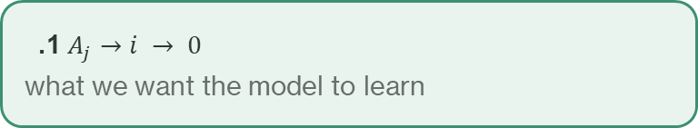
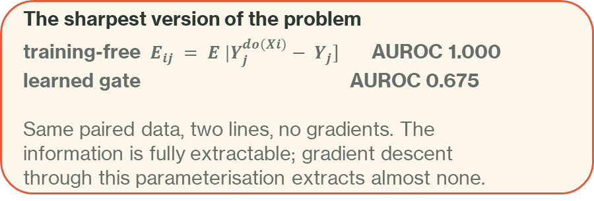
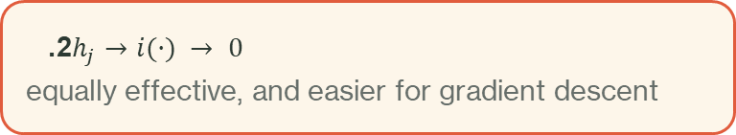
Diagnosis: absorption only moved
$$m_{j→i}= A_{j→i}· h_{j→i}(V_{j})$$
A decoy edge can be silenced two ways:
1. $A_{j}→i → 0$
what we want the model to learn
2. $h_{j}→i(·) → 0$
equally effective, and easier for gradient descent
Route 2 never touches A, so A has no unique job and the loss barely prefers one value of it over another.
Summing stopped g_i from amplifying an edge; it did not stop the edge function from shrinking itself.
This explains every observation
The model predicts perfectly well in-distribution
(ID RMSE 0.084, spread 0.892) while its gate stays
inside [0.33, 0.48].
It learned the right mechanism and declined to express
it through the gate.
The sharpest version of the problem
training-free $E_{ij} = E |Y_{j}^{do\left(Xi\right)}− Y_{j}]$ AUROC 1.000
learned gate AUROC 0.675
Same paired data, two lines, no gradients. The
information is fully extractable; gradient descent
through this parameterisation extracts almost none.
The fix under test
$m_{j→i}= A_{j→i} · h_{j→i}(V_{j}) / ( ‖h_{j→i} (V_{j})‖₂ + ε ) ⇒ {\left\|m_{j→i}\right\|}_{2} = A_{j→i}$identically (verified to 5e-4)

Slide 7
Next: three experiments, in this order
# | Question | Why now | Decides
1 | Was LAYER 1's gain the architecture, or dropping the gate sampling? | both changed at once — still confounded | whether sampling must stay off forever
2 | Does message normalisation lift AUROC above 0.675 and cut SHD below 51.7? | the direct test of the fix | architecture vs loss as the next lever
2b | Binarise the NEW ranking — how much of the ceiling now? | repeats the test that gave 0.0% | whether the ordering became usable
3 | With normalisation on, does sparsity pressure finally help? | L0 measured exactly 0.0% before, but under sampling where nothing about the gate mattered | off by default — skip if 2 fails
Experiment 2 is the fork in the road
AUROC clearly up, SHD clearly down
→ absorption through h was the bottleneck; continue
unchanged
→ the gate never receives enough EDGE-LEVEL signal from
this loss. Change the LOSS, not the architecture again.
Experiment 3 is deliberately last
Sparsity pressure on a weak ordering hardens the wrong edges faster.
Read ordering columns before RMSE
Two runs in a row produced arms whose RMSE looked fine while
they predicted nothing: on a shifted test set, outputting near
the mean lowers RMSE.
vs_const > 1.0 means worse than always predicting the training
mean — that is what caught it both times.
Fixed reference throughout: the training-free estimator reaches
AUROC 1.000 on the same data. The gap to it is what this line of
work has to close.

Slide 8
Three experiments results
Metrics | Unsampling | Sampling
Separation | 0.0599 | 0.0503
AUROC | 0.6635 | 0.5818
AUPRC | 0.5713 | 0.4070
Decoy AUROC | 0.6943 | 0.6518
SHD | 52.7 | 128.7
ID RMSE | 0.0894 | 0.2299
OOD spread | 0.889 | 0.636
Metrics | Unnormalized | Normalized
AUROC | 0.6635 | 0.6722
AUPRC | 0.5713 | 0.5451
Decoy AUROC | 0.6943 | 0.6907
SHD | 52.7 | 52.9
Best F1 | 0.5282 | 0.5321
True-cause rank | 3 | 3
Here shows that after sampling, the results are still better than previous test, but SHD becomes worse which means making the gate's learning signal noisier and more unstable.
The only change is let gate range wider:
From [0.25,0.78]⟶[0.04,0.94]. However, it merely makes the model more prone to producing extreme gates, without making those extreme gates any more accurate. There is virtually no improvement in the structural ranking metrics.

Slide 9
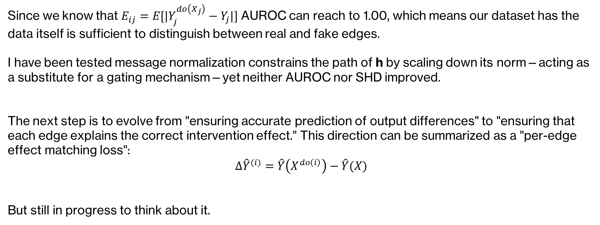
Next: Loss function
Since we know that $E_{ij}=E[|Y_{j}^{do\left(X_{j}\right)}−Y_{j}|]$ AUROC can reach to 1.00, which means our dataset has the data itself is sufficient to distinguish between real and fake edges.
I have been tested message normalization constrains the path of h by scaling down its norm—acting as a substitute for a gating mechanism—yet neither AUROC nor SHD improved.
The next step is to evolve from "ensuring accurate prediction of output differences" to "ensuring that each edge explains the correct intervention effect." This direction can be summarized as a "per-edge effect matching loss":
$$Δ{\hat{Y}}^{(i)}=\hat{Y}\left(X^{do\left(i\right)}\right)−\hat{Y}(X)$$
But still in progress to think about it.

