Slide 1
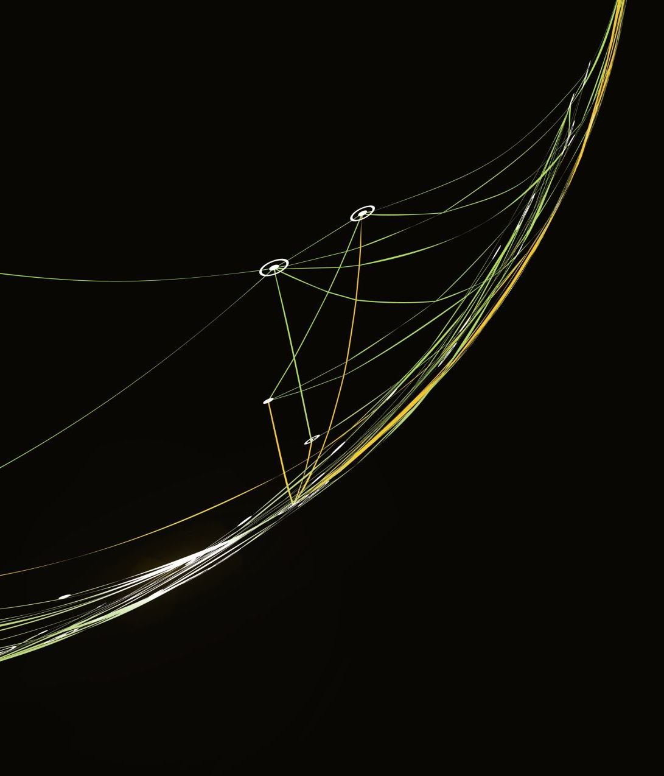
Structured and amenable to intervention
Chu

Slide 2
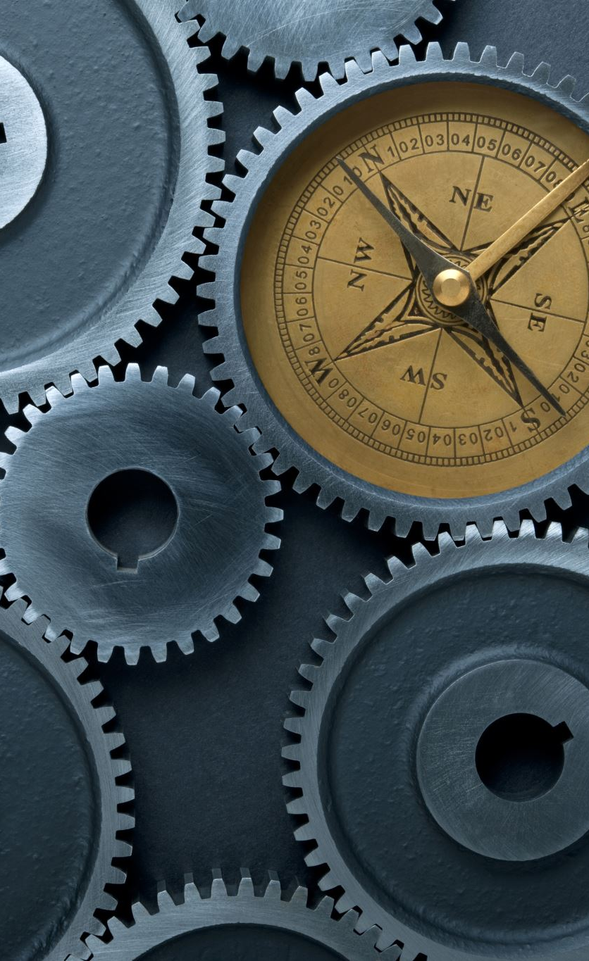

Env setting
The first idea is based on the simple environment. Let’s say there is a two balls, and their states are: (position and velocity), then we have:
$$s_{t}=(x_{1},v_{1},x_{2},v_{2})$$
And the action: Push right or action = +1N, in the future, I want it be the joint velocity or torque. But now we only consider the simplest case: left and right.
Dynamics setting: if we don’t have interaction, how will position updates? Here I used simple case by physics method:
$$v_{t+1}=v_{t}+aΔt$$
And update the position by:
$$x_{x+1}=x_{t}+v_{t+1}Δt$$

Slide 3

The agent
The agent: Push Right, and the push is the ‘force’ concept. Based on Newton's second law:
$$F=ma$$
We got:
$$a=\frac{F}{m}$$
If force = 4N, mass = 2kg, then Acceleration=$2m/s^{2}$. Which means Action will not change the position, instead:
Action -> force -> acceleration -> velocity -> position

Slide 4
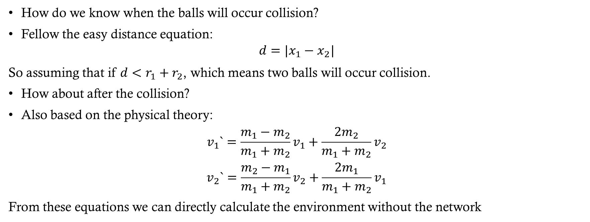
Collision
How do we know when the balls will occur collision?
Fellow the easy distance equation:
$$d=|x_{1}−x_{2}|$$
So assuming that if $d<r_{1}+r_{2}$, which means two balls will occur collision.
How about after the collision?
Also based on the physical theory:
$$v_{1}`=\frac{m_{1}−m_{2}}{m_{1}+m_{2}}v_{1}+\frac{2m_{2}}{m_{1}+m_{2}}v_{2}$$
$$v_{2}`=\frac{m_{2}−m_{1}}{m_{1}+m_{2}}v_{2}+\frac{2m_{1}}{m_{1}+m_{2}}v_{1}$$
From these equations we can directly calculate the environment without the network

Slide 5
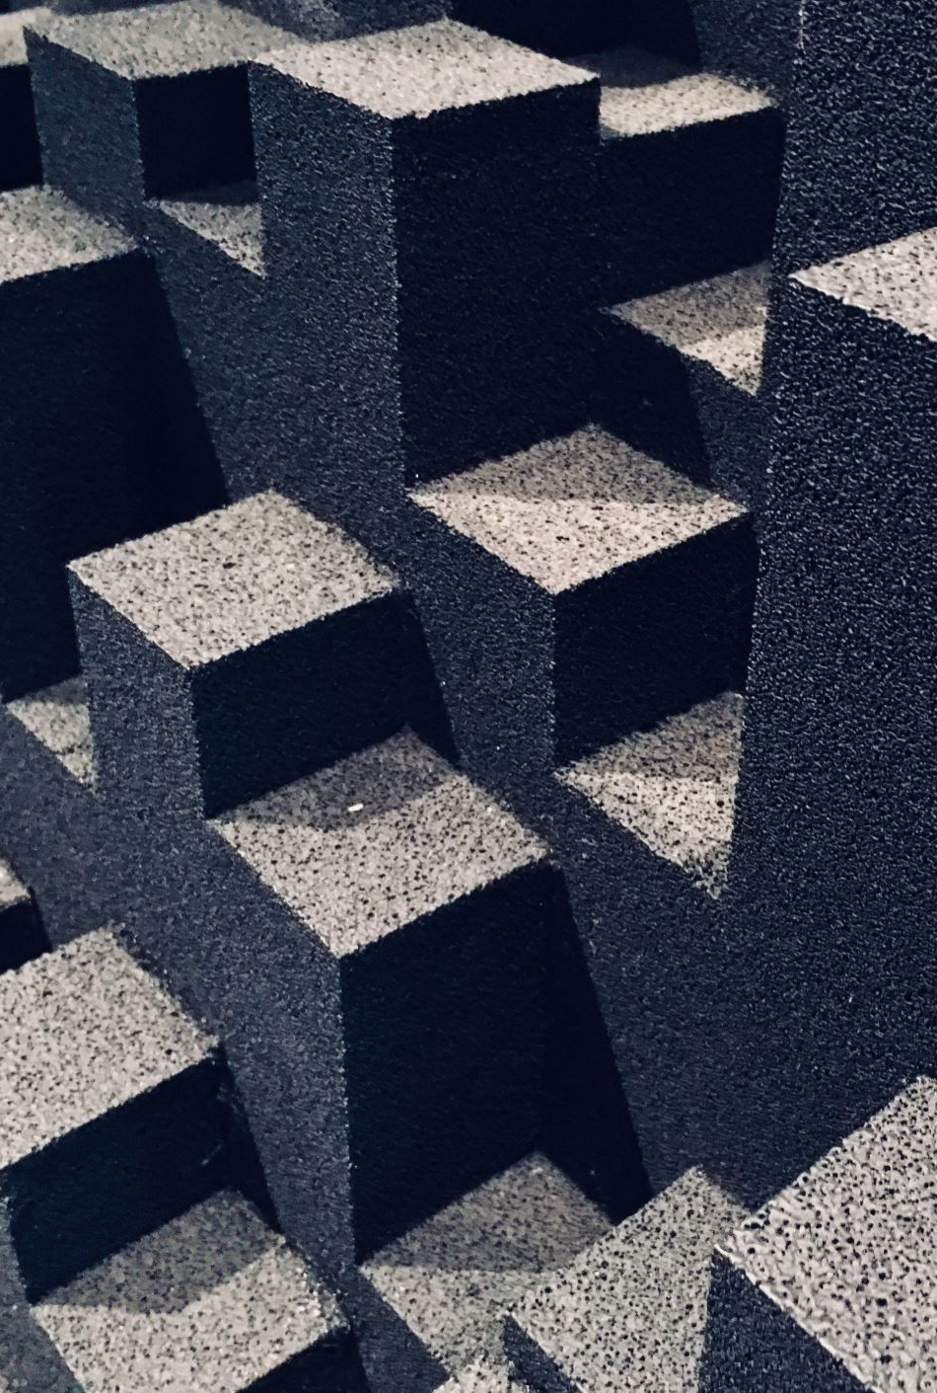

surrounding setting (wall, friction)
If the balls hit the wall what will happend?
We call it Coefficient of Restitution:
$$v`=−ev$$
With the friction:
$$F_{f}=μN$$
Acceleration will be:
$$a=−μg$$
The acceleration will decrease. But we haven’t considered about the noise exist, let’s say the gaussian noise: $x=x+ε$, $ε\sim Ν(0,σ^{2})$, while the future OOD will be affected by Noise.

Slide 6


The design
The code pipeline: env.py, test_env.py, and characterize.py.
Env.py: the physics simulator, which simulate the balls across the tabletop, air resistance (drag), ball-to-ball collision, ball-to-wall collision, and the end, we record exactly what happens at each step (ground truth data). Output will be state, theta (environment parameters), mechanism (what kind of mechanism), and the impulse (after collision). These are the data we can use to train the model later.
Also, designed the functions that can promise some cases will happen (ball-to-ball collision) that can be helpful on the training section. With the impulse equation:
$$v_{t+1}=v_{t}+\frac{ΔtF}{m}+\frac{J}{m}$$

Slide 7
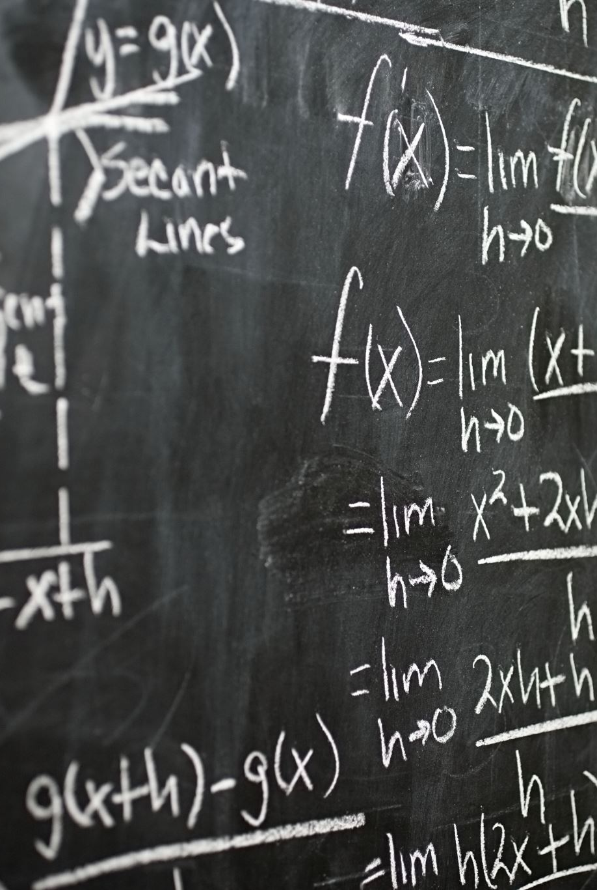

Why Impulse equation
We already know the physical theory directly calculate the speed out. But it is hard to let the network know how hard the force is. Then we change to Impulse equation
$$J=\frac{\text{−(1+}\text{e}\text{)}(v_{1}−v_{2})}{\frac{1}{m_{1}}+\frac{1}{m_{2}}} \left(1\right)$$
$$J=k v_{n}, k=−\frac{1+e}{\frac{1}{m1}+\frac{1}{m2}} (2)$$
$$v_{t+1}=v_{t}+\frac{ΔtF}{m}+\frac{J}{m}, x_{t+1}=x_{t}+Δtv_{t+1} (3)$$
The (3) is the solver, the final equation that we use to calculate the new position. Then let network to guess:
J, which means ‘How heavy is this blow?’
$J_{wall}=m\left(v`−v\right)=−m\left(1+e\right)v (4)$
Use solver to calculate the next frame.

Slide 8
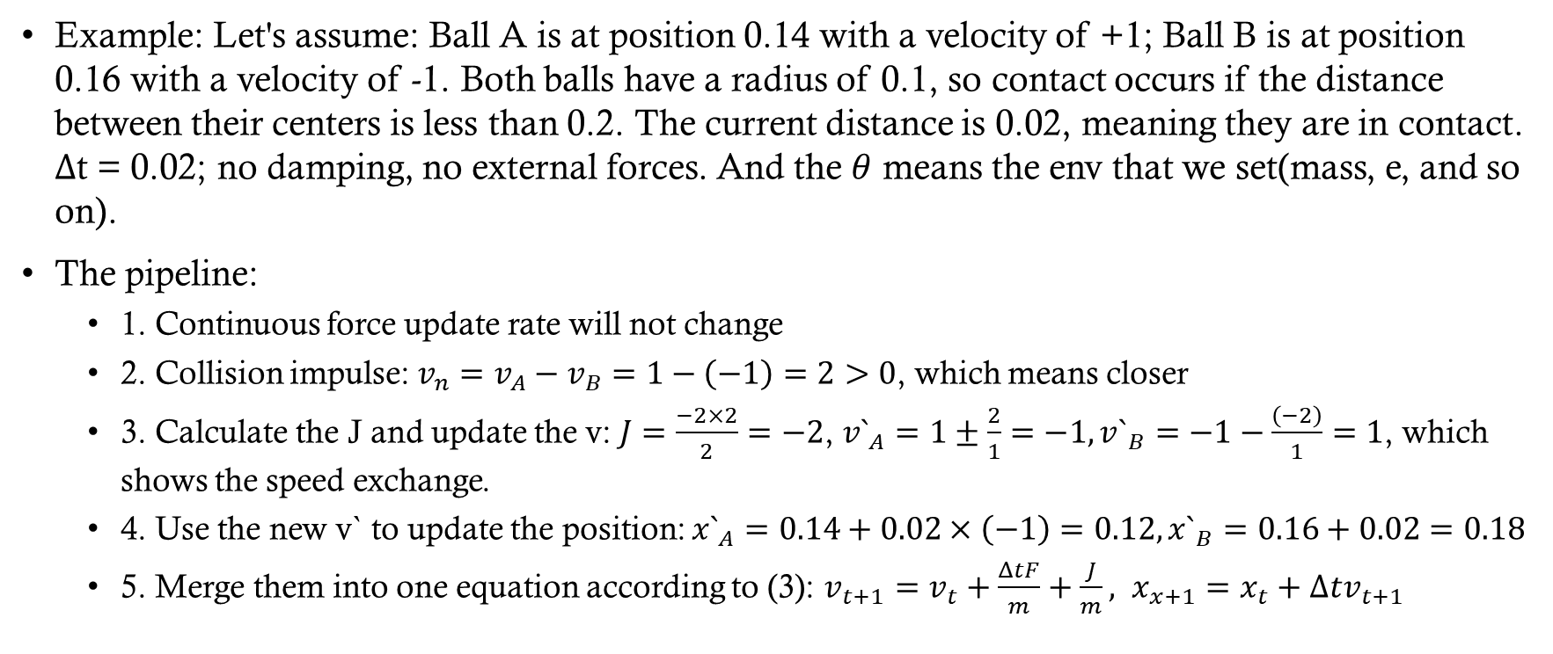
How to calculate next frame?
Example: Let's assume: Ball A is at position 0.14 with a velocity of +1; Ball B is at position 0.16 with a velocity of -1. Both balls have a radius of 0.1, so contact occurs if the distance between their centers is less than 0.2. The current distance is 0.02, meaning they are in contact. Δt = 0.02; no damping, no external forces. And the $θ$ means the env that we set(mass, e, and so on).
The pipeline:
  1. Continuous force update rate will not change
  2. Collision impulse: $v_{n}=v_{A}−v_{B}=1−\left(−1\right)=2>0$, which means closer
  3. Calculate the J and update the v: $J=\frac{−2×2}{2}=−2$, $v`_{A}=1±\frac{2}{1}=−1,v`_{B}=−1−\frac{\left(−2\right)}{1}=1$, which shows the speed exchange.
  4. Use the new v` to update the position: $x`_{A}=0.14+0.02×\left(−1\right)=0.12, x`_{B}=0.16+0.02=0.18$
  5. Merge them into one equation according to (3): $v_{t+1}=v_{t}+\frac{ΔtF}{m}+\frac{J}{m}, x_{x+1}=x_{t}+Δtv_{t+1}$

Slide 9
The first level
L0: the simplest env situation, with two balls, no wall, no fiction, mass fixed, 40 frames, and ensure will occur collision in the front. It will only suddenly change speed at the seventeenth frame. So the mission of this level is trying to predict this frame’s J. L0 only is used for testing if each episode have collision, solver is correct, and the dynamics possesses translational symmetry.
L1 and L2: L1 starts to open the wall, and put the ball randomly. The result is collision rate decrease from 2.5% to 1.2%, since the ball may not occur collision. We want to see if the network can still predict the state with lower collision. L2 just increase the number of frames to 400.

Slide 10
The Intervention level
L3: we already know the observation part, when heavy ball hit each other, the speed will become slower, and we call it correlation. But if we change the mass from 1 to 4(only change one ball), which we say do(m=4), and look what will happen. But the range will be known on training part and testing part.
L4: the env is same as L3, the only diff is the range. In this level, the training part only know [0.8,1.2], but doesn’t know test [2.0, 5.0]. This level is used to test the OOD problem.
L5: the final version, enable damping, set the restitution coefficient to 0.9, and use three balls. This is a robustness test.

Slide 11
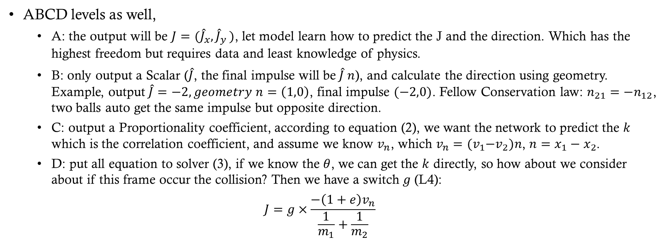
The network planning
ABCD levels as well,
  A: the output will be $J=({\hat{J}}_{x}{,\hat{J}}_{y})$, let model learn how to predict the J and the direction. Which has the highest freedom but requires data and least knowledge of physics.
  B: only output a Scalar ($\hat{J}$, the final impulse will be$\hat{J} n$), and calculate the direction using geometry. Example, output$\hat{J}=−2, geometry n=\left(1,0\right)$, final impulse $(−2,0)$. Fellow Conservation law: $n_{21}=−n_{12}$, two balls auto get the same impulse but opposite direction.
  C: output a Proportionality coefficient, according to equation (2), we want the network to predict the $k$ which is the correlation coefficient, and assume we know $v_{n}$, which $v_{n}={(v}_{1}−v_{2})n$, $n=x_{1}−x_{2}$.
  D: put all equation to solver (3), if we know the $θ$, we can get the $k$ directly, so how about we consider about if this frame occur the collision? Then we have a switch $g$ (L4):
  $$J=g×\frac{−\left(1+e\right)v_{n}}{\frac{1}{m_{1}}+\frac{1}{m_{2}}}$$

