Slide 1

First Step
chu

Slide 2
Idea
I believe that physics formulas can enhance interpretability and reduce the "black box" nature of models. So, I designed the impulse as the output of our black-box model and introduced a gating variable constrained to the [0, 1] range. The goal is for the model to automatically update this gating value to mitigate the influence of irrelevant variables—specifically, to address the OOD (out-of-distribution) problem.
Key design concept: Implementing the V (variables) and G (graph) components within a causal framework, with the aim of enabling the model to learn the graph structure rather than simply predicting the balls' positional data; verification experiments across multiple random seeds are conducted using t-tests.

Slide 3
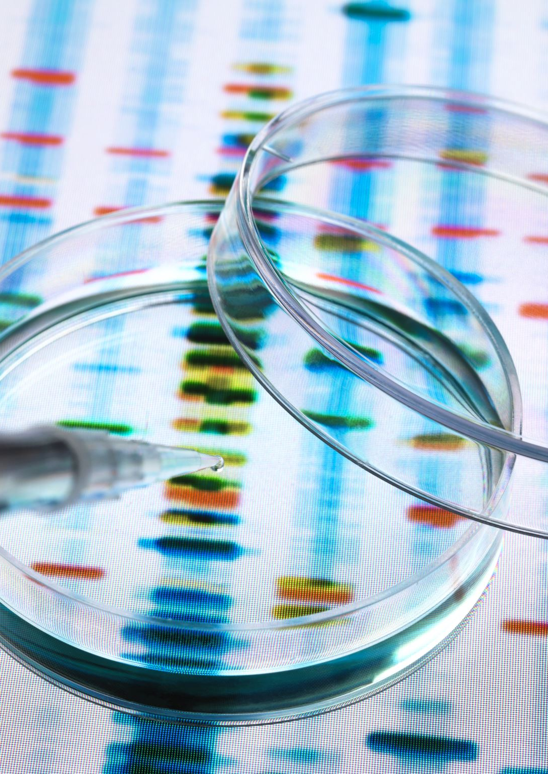
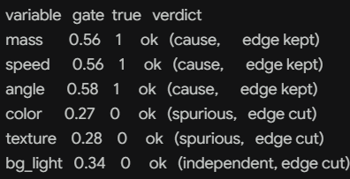

Experimental
Experimental Setup: Red balls (light) and blue balls (heavy) are used as the input dataset; however, the test set employs red and blue balls of different weights to evaluate whether the model can correctly determine the gating value, and the F1 .
$$mass∗gate$$
Every seed, the model kept exactly the three cause edges and cut exactly the three non-cause edges (two spurious, one independent). 30 seeds: graph F1 vs truth = 1.000 +/- 0.000 (100% of seeds perfect). The gate table is directly readable:

Slide 4
Pipeline change
However, given the overly simplistic experimental design—specifically the current relationship mapping of "mass -> target"—and the use of L1-based selection, the setup functions more as a feature-weighting mechanism than a causal graph. Consequently, a pure black-box model (without gating) yields the same output, leading to the conclusion that the dataset contains no genuine "shortcut."
Notice that we can’t put the data directly into the network, instead we should put the image or frames of the videos. Before, we aim the variable -> target, but we should aim to variable -> variable.

Slide 5
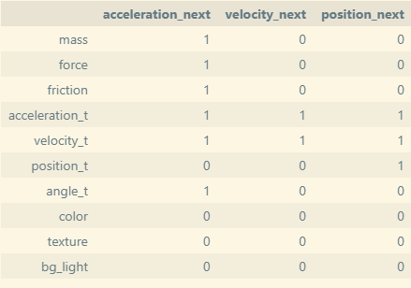

Why it was Feature Selection, not Causality
The method used previously was
$$g_{i}:X_{i}→Y, i=1,…,d$$
Which only has d lines and point to the same target. But the actual causal structure is chain-like. (mass→acceleration→velocity→position), for each factors, they all are both a result and a cause.
So I made a input vector has 10 factors that has 7 real variables that we want the model learn their graph(G). And create a true matrix that has the correct Graph. Also, change the range of the mass, which means mass ∈ [0.8, 2.0] in train/val but mass ∈ [2.1, 3.5] in test for testing the OOD problem.
The matrix A_True

Slide 6
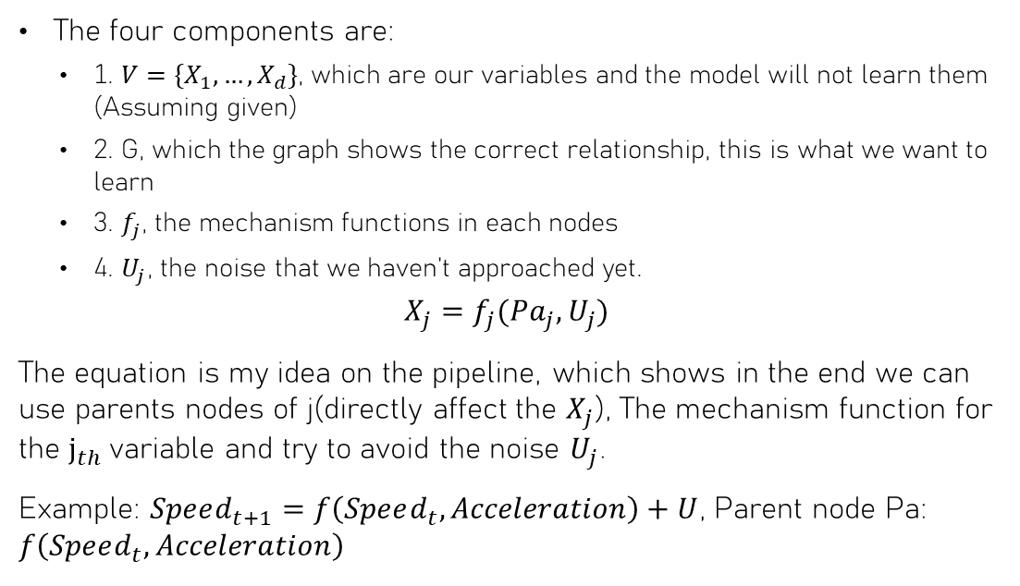
Four components/stages in SCM
The four components are:
  1. $V=\{X_{1},…,X_{d}\}$, which are our variables and the model will not learn them (Assuming given)
  2. G, which the graph shows the correct relationship, this is what we want to learn
  3. $f_{j}$, the mechanism functions in each nodes
  4. $U_{j}$, the noise that we haven’t approached yet.
$$X_{j}=f_{j}(Pa_{j},U_{j})$$
The equation is my idea on the pipeline, which shows in the end we can use parents nodes of j(directly affect the $X_{j}$), The mechanism function for the $j_{th}$variable and try to avoid the noise $U_{j}$.
Example: $Speed_{t+1}=f\left(Speed_{t},Acceleration\right)+U$, Parent node Pa: $f\left(Speed_{t},Acceleration\right)$
Four stages:
Stage 1: Given V → Learn G
Stage 2: Given V, G → Learn mechanism f
Stage 3: Given V, G, f → Model noise U
Stage 4: Jointly learn V, G, f, U from raw observations

Slide 7
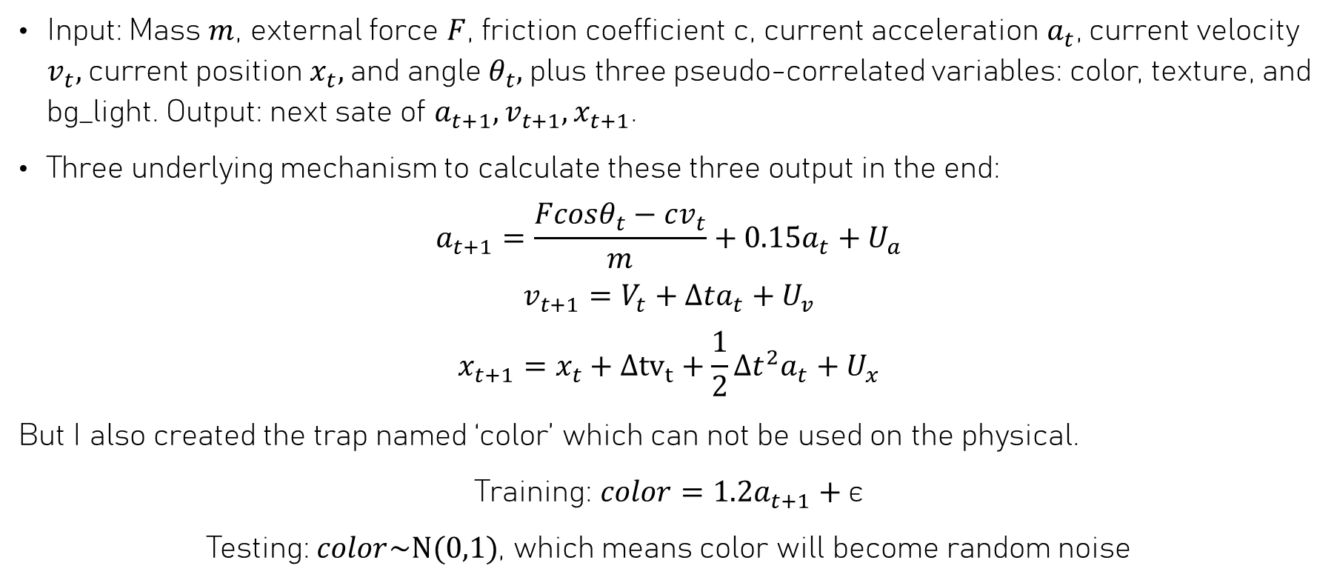
How to make the data
Input: Mass $m$, external force $F$, friction coefficient c, current acceleration $a_{t}$, current velocity $v_{t},$current position $x_{t},$and angle $θ_{t},$plus three pseudo-correlated variables: color, texture, and bg_light. Output: next sate of $a_{t+1},v_{t+1},x_{t+1}$.
Three underlying mechanism to calculate these three output in the end:
$$a_{t+1}=\frac{Fcosθ_{t}−cv_{t}}{m}+0.15a_{t}+U_{a}$$
$$v_{t+1}=V_{t}+Δta_{t}+U_{v}$$
$$x_{t+1}=x_{t}+Δ{tv}_{t}+\frac{1}{2}Δt^{2}a_{t}+U_{x}$$
But I also created the trap named ‘color’ which can not be used on the physical.
Training: $color=1.2a_{t+1}+\text{ϵ}$
Testing: $color\sim \text{N(0,1)}$, which means color will become random noise

Slide 8
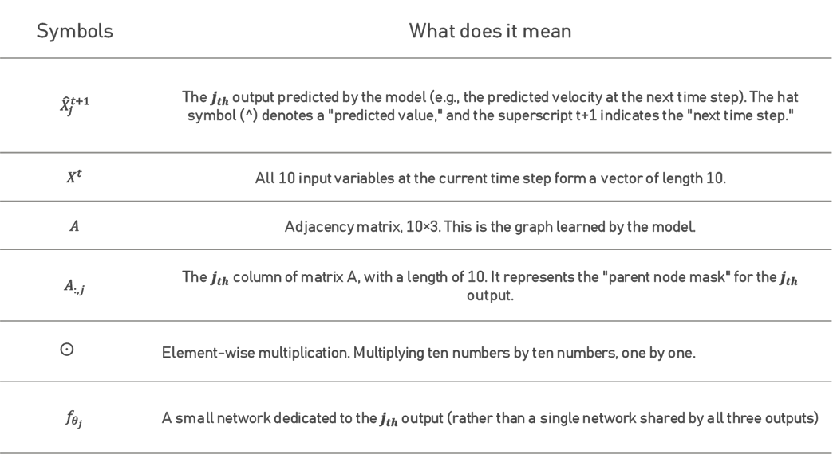
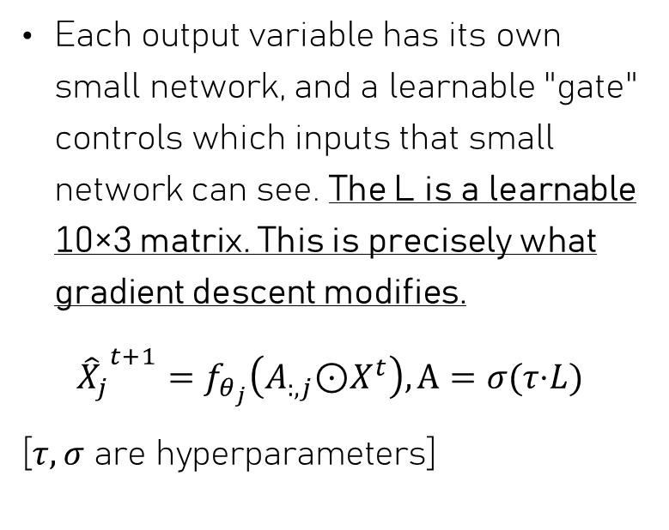
Main model
Symbols | What does it mean
$${\hat{X}}_{j}^{t+1}$$ | The $j_{th}$ output predicted by the model (e.g., the predicted velocity at the next time step). The hat symbol ($^$) denotes a "predicted value," and the superscript t+1 indicates the "next time step."
$$X^{t}$$ | All 10 input variables at the current time step form a vector of length 10.
$$A$$ | Adjacency matrix, 10×3. This is the graph learned by the model.
$$A_{:,j}$$ | The $j_{th}$column of matrix A, with a length of 10. It represents the "parent node mask" for the $j_{th}$ output.
 | Element-wise multiplication. Multiplying ten numbers by ten numbers, one by one.
$$f_{θ_{j}}$$ | A small network dedicated to the $j_{th}$ output (rather than a single network shared by all three outputs)
Each output variable has its own small network, and a learnable "gate" controls which inputs that small network can see. The L is a learnable 10×3 matrix. This is precisely what gradient descent modifies.
${{\hat{X}}_{j}}^{t+1}=f_{θ_{j}}\left(A_{:,j}\text{⊙}X^{t}\right), A=σ(τ\text{⋅}L)$
[$τ,σ$ are hyperparameters]

Slide 9
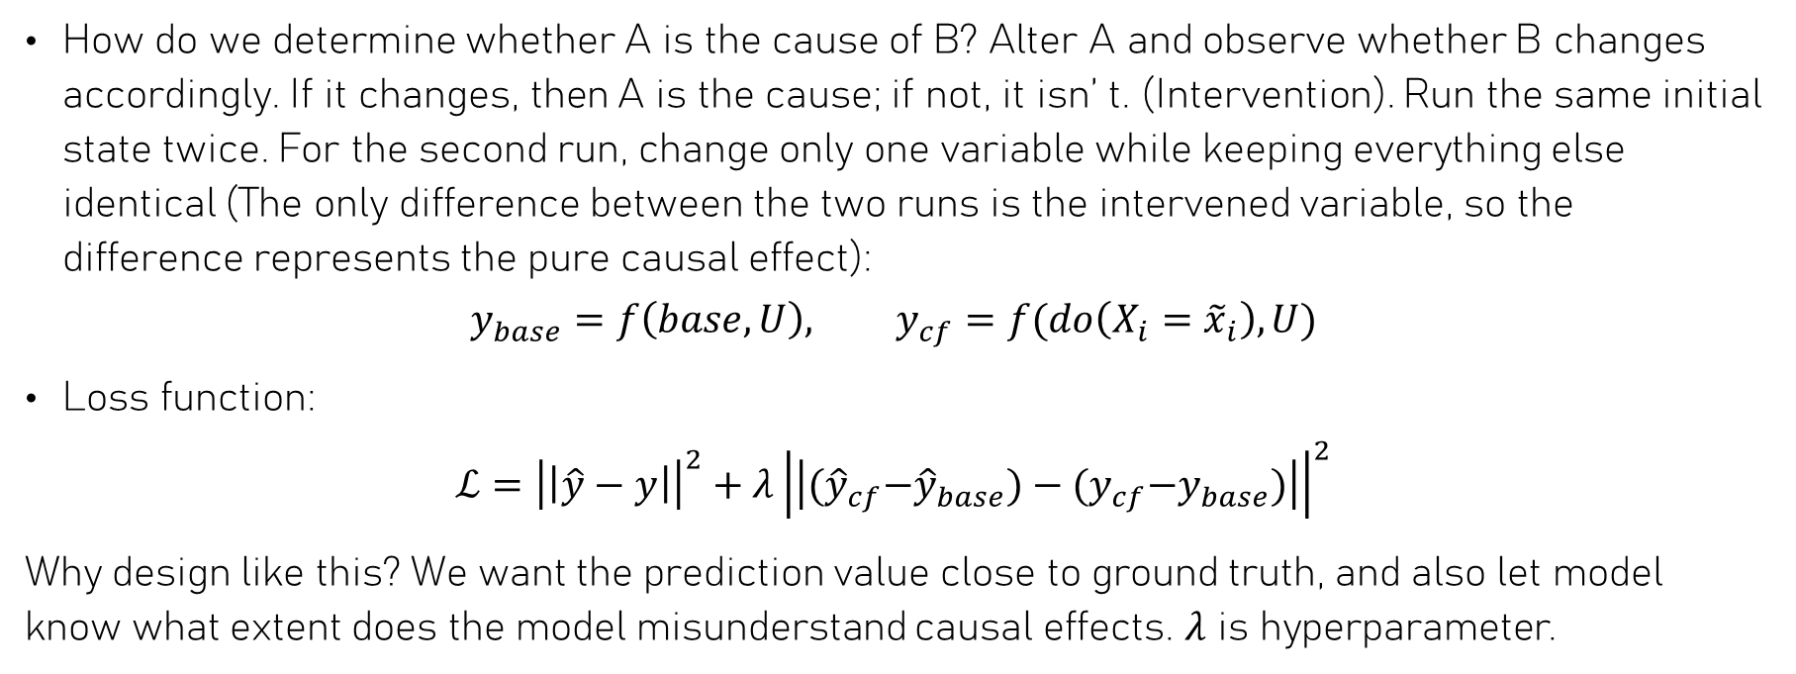
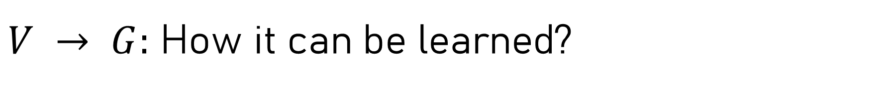
$V → G:$ How it can be learned?
How do we determine whether A is the cause of B? Alter A and observe whether B changes accordingly. If it changes, then A is the cause; if not, it isn’ t. (Intervention). Run the same initial state twice. For the second run, change only one variable while keeping everything else identical (The only difference between the two runs is the intervened variable, so the difference represents the pure causal effect):
$$y_{base}=f\left(base,U\right), y_{cf}=f(do\left(X_{i}={\tilde{x}}_{i}\right),U)$$
Loss function:
$$ℒ={\left|\left|\hat{y}−y\right|\right|}^{2}+λ{\left|\left|{(\hat{y}}_{cf}−{\hat{y}}_{base})−{(y}_{cf}−y_{base})\right|\right|}^{2}$$
Why design like this? We want the prediction value close to ground truth, and also let model know what extent does the model misunderstand causal effects. $λ$ is hyperparameter.

Slide 10
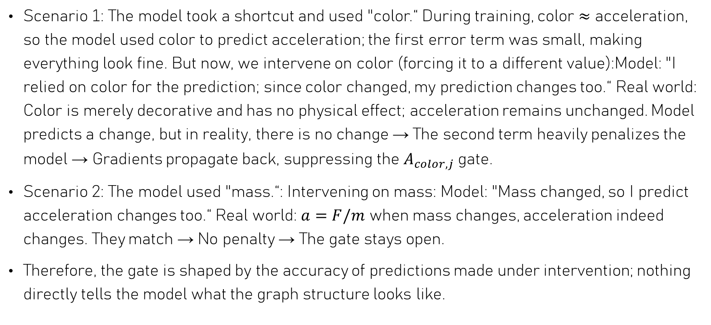
Scenario 1: The model took a shortcut and used "color.“ During training, color ≈ acceleration, so the model used color to predict acceleration; the first error term was small, making everything look fine. But now, we intervene on color (forcing it to a different value):Model: "I relied on color for the prediction; since color changed, my prediction changes too.“ Real world: Color is merely decorative and has no physical effect; acceleration remains unchanged. Model predicts a change, but in reality, there is no change → The second term heavily penalizes the model → Gradients propagate back, suppressing the $A_{color,j}$ gate.
Scenario 2: The model used "mass.“: Intervening on mass: Model: "Mass changed, so I predict acceleration changes too.“ Real world: $a=F/m$ when mass changes, acceleration indeed changes. They match → No penalty → The gate stays open.
Therefore, the gate is shaped by the accuracy of predictions made under intervention; nothing directly tells the model what the graph structure looks like.

Slide 11
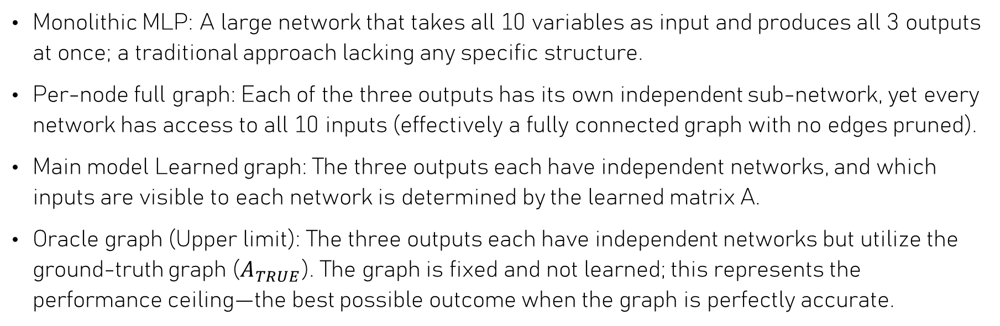
Baseline
Monolithic MLP: A large network that takes all 10 variables as input and produces all 3 outputs at once; a traditional approach lacking any specific structure.
Per-node full graph: Each of the three outputs has its own independent sub-network, yet every network has access to all 10 inputs (effectively a fully connected graph with no edges pruned).
Main model Learned graph: The three outputs each have independent networks, and which inputs are visible to each network is determined by the learned matrix A.
Oracle graph (Upper limit): The three outputs each have independent networks but utilize the ground-truth graph ($A_{TRUE}$). The graph is fixed and not learned; this represents the performance ceiling—the best possible outcome when the graph is perfectly accurate.

Slide 12
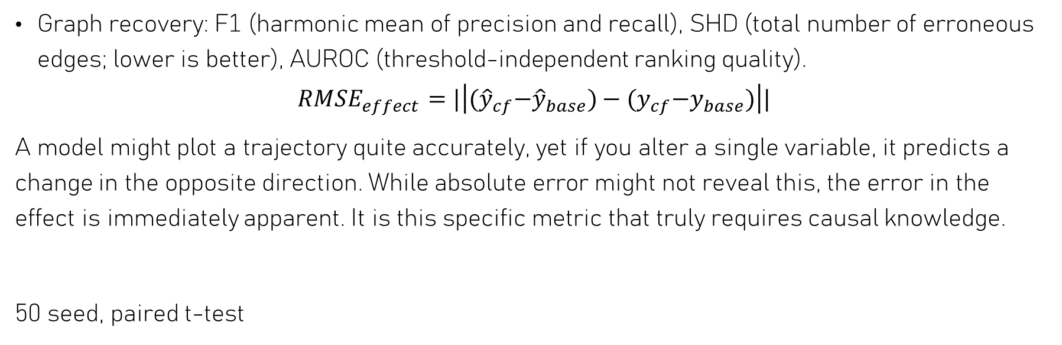
Metrics
Graph recovery: F1 (harmonic mean of precision and recall), SHD (total number of erroneous edges; lower is better), AUROC (threshold-independent ranking quality).
$$RMSE_{effect}=|\left|{(\hat{y}}_{cf}−{\hat{y}}_{base})−{(y}_{cf}−y_{base})\right||$$
A model might plot a trajectory quite accurately, yet if you alter a single variable, it predicts a change in the opposite direction. While absolute error might not reveal this, the error in the effect is immediately apparent. It is this specific metric that truly requires causal knowledge.
50 seed, paired t-test

Slide 13
Bad results
On OOD, all three structured models are numerically worse than the black box (+2.5% / +7.4% / +7.6%).
The oracle is not better than the black box (p = 0.75 effect, p = 0.12 OOD) — so the task does not reward correct causal structure.
Across 50 seeds, no graph-based model beats the black box on either metric. The oracle (true graph) does not either.
Model | OOD RMSE | p | Effect RMSE | p
Monolithic (black box) | 0.0556 ± 0.0122 | — | 0.0331 ± 0.0060 | —
Per-node, full graph | 0.0598 ± 0.0098 | 0.096 n.s. | 0.0355 ± 0.0055 | 0.065 n.s.
Learned graph (gated) | 0.0570 ± 0.0141 | 0.630 n.s. | 0.0315 ± 0.0084 | 0.314 n.s.
Oracle graph (true A) | 0.0598 ± 0.0118 | 0.123 n.s. | 0.0327 ± 0.0063 | 0.752 n.s.

Slide 14
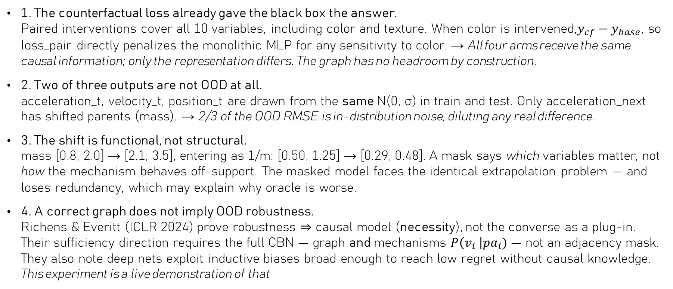
Diagnosis — why there was nothing to win
1. The counterfactual loss already gave the black box the answer.
Paired interventions cover all 10 variables, including color and texture. When color is intervened,$y_{cf}−y_{base}$, so loss_pair directly penalizes the monolithic MLP for any sensitivity to color. → All four arms receive the same causal information; only the representation differs. The graph has no headroom by construction.
2. Two of three outputs are not OOD at all.
acceleration_t, velocity_t, position_t are drawn from the same N(0, σ) in train and test. Only acceleration_next has shifted parents (mass). → 2/3 of the OOD RMSE is in-distribution noise, diluting any real difference.
3. The shift is functional, not structural.
mass [0.8, 2.0] → [2.1, 3.5], entering as 1/m: [0.50, 1.25] → [0.29, 0.48]. A mask says which variables matter, not how the mechanism behaves off-support. The masked model faces the identical extrapolation problem — and loses redundancy, which may explain why oracle is worse.
4. A correct graph does not imply OOD robustness.
Richens & Everitt (ICLR 2024) prove robustness ⇒ causal model (necessity), not the converse as a plug-in. Their sufficiency direction requires the full CBN — graph and mechanisms $P\left(v_{i} \right|pa_{i})$— not an adjacency mask. They also note deep nets exploit inductive biases broad enough to reach low regret without causal knowledge. This experiment is a live demonstration of that

Slide 15
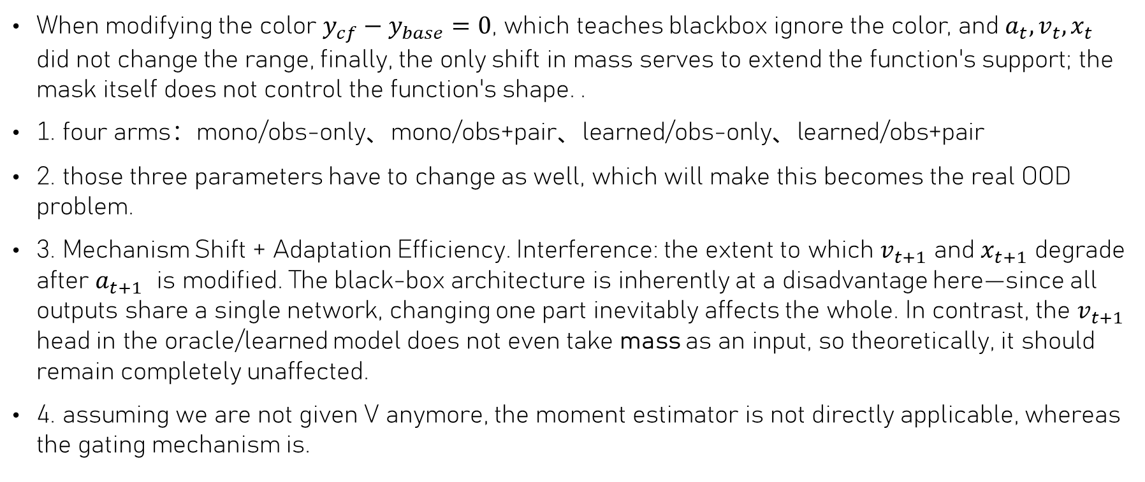
Next steps
When modifying the color $y_{cf}−y_{base}=0$, which teaches blackbox ignore the color, and $a_{t},v_{t},x_{t}$ did not change the range, finally, the only shift in mass serves to extend the function's support; the mask itself does not control the function's shape. .
1. four arms：mono/obs-only、mono/obs+pair、learned/obs-only、learned/obs+pair
2. those three parameters have to change as well, which will make this becomes the real OOD problem.
3. Mechanism Shift + Adaptation Efficiency. Interference: the extent to which $v_{t+1}$ and $x_{t+1}$ degrade after $a_{t+1}$ is modified. The black-box architecture is inherently at a disadvantage here—since all outputs share a single network, changing one part inevitably affects the whole. In contrast, the $v_{t+1}$ head in the oracle/learned model does not even take mass as an input, so theoretically, it should remain completely unaffected.
4. assuming we are not given V anymore, the moment estimator is not directly applicable, whereas the gating mechanism is.

Slide 16
Reference
Zhang, H., Miao, H., Jiang, X., Fang, Y. and Zhang, Y., 2026. Strap: Spatio-temporal pattern retrieval for out-of-distribution generalization. Advances in Neural Information Processing Systems, 38, pp.118006-118041.
Ding, J., Zhang, Y., Shang, Y., Zhang, Y., Zong, Z., Feng, J., Yuan, Y., Su, H., Li, N., Sukiennik, N. and Xu, F., 2025. Understanding world or predicting future? a comprehensive survey of world models. ACM Computing Surveys, 58(3), pp.1-38.
Wang, L., Chen, Z., Du, Y., Yan, D., Ge, W., Shen, G., Xu, X., Wu, L., Chen, M., Xu, T. and Ren, P., 2026. A mechanistic view on video generation as world models: State and dynamics. arXiv preprint arXiv:2601.17067.

