Slide 1
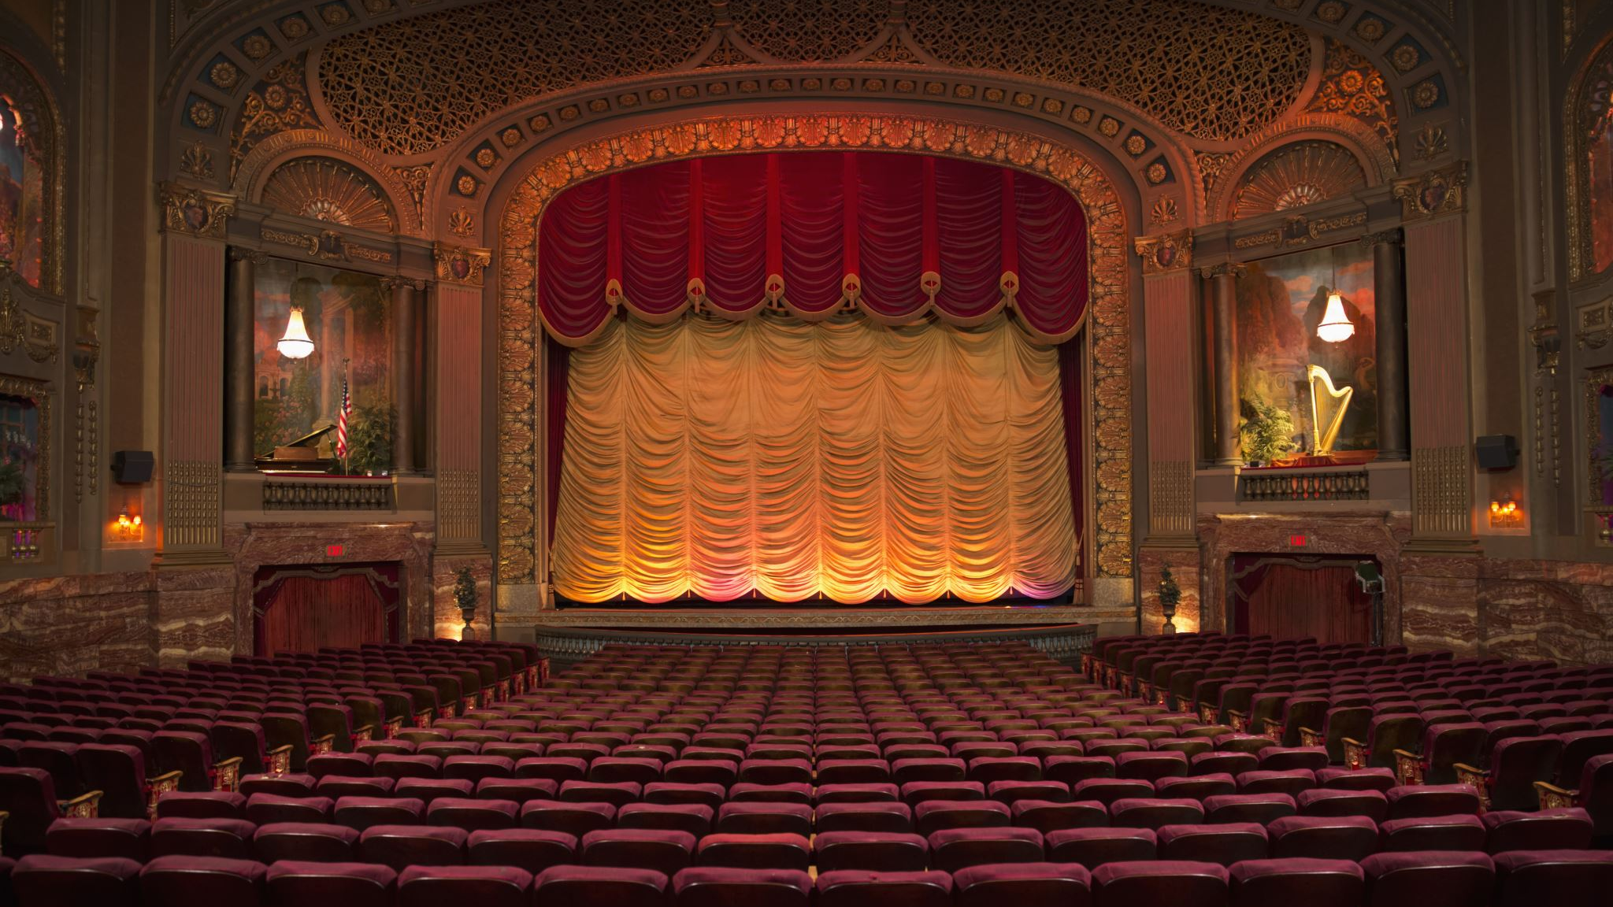
Stage 2
chu

Slide 2
Given V, Learn G
Can a learned causal graph improve OOD prediction and intervention-effect estimation?
The four components of Causality:
V
G
F
U
24 observed inputs
72 candidate edges
collision dynamics
exogenous noise
Main result: correct structure is extremely valuable, but the current learned graph does not recover it.

Slide 3
What this stage tests
Stage 2 assumes named variables V are given; the only target is the causal graph G.
1. Generate SCM
2. Add decoys
3. Train 6 arms
4. Test causality
Known physics F, graph G, noise U
17 non-causes; including strong proxies
Black-box, graph, random, oracle
OOD + paired interventions
Core SCM view: $Vₜ₊₁ = F(Vₜ, Aₜ, Uₜ₊₁ ; G).$
This is not yet a full world model: no pixels, no latent-state discovery, and no learned simulator.

Slide 4

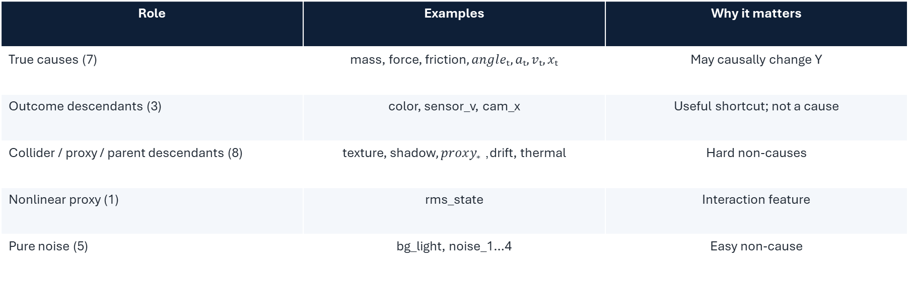
The small world: 24 inputs, 3 outputs
The graph task is mainly “true causes vs. decoys”; collision physics makes all 7 true causes affect all 3 outputs.
Role | Examples | Why it matters
True causes (7) | mass, force, friction$, angleₜ, aₜ, vₜ, xₜ$ | May causally change Y
Outcome descendants (3) | color, sensor_v, cam_x | Useful shortcut; not a cause
Collider / proxy / parent descendants (8) | texture, shadow$, proxy_{∗}$, drift, thermal | Hard non-causes
Nonlinear proxy (1) | rms_state | Interaction feature
Pure noise (5) | bg_light, noise_1…4 | Easy non-cause
$$X^{n}∈R^{24}, X=[m,F,c,θ_{t},a_{t},v_{t},x_{t},…17 decoy]$$
$$Y=\left[\begin{matrix}a_{t+1} \\ v_{t+1} \\ x_{t+1}\end{matrix}\right]∈R^{3}, Y_{t+1}=F^{∗}(X_{t},U_{t+1})$$
Outputs
Known graph
acceleration_next, velocity_next, position_next
21 true edges / 72 candidates; 29% density

Slide 5

OOD setting and real mechanism
The shift punishes shortcut correlations while preserving the true physical mechanism.
Train → test
Mechanism
Mass has zero support overlap; other physical inputs also shift. Decoy relationships flip sign at OOD.
Six substeps with quadratic drag, wall reflection, and restitution.
mechanism (f):
$$D_{t}=c·sign\left(v_{t}\right)·{\left|v_{t}\right|}^{2}$$
$$a_{t+1}= [F cos⁡(θ) −D_{t}] / m + 0.15a_{t}$$
$$v_{t+1}=v_{t}+Δta_{t+1}$$
$$x_{t+1}=x_{t}+Δtv_{t+1}$$
If hit the wall: $\left|x_{t+1}\right|>W$, then $v_{t+1}$ will sign flip
In the end: $Y=[\begin{matrix}a_{t}+U_{a} \\ v_{t}+U_{v} \\ x_{t}+U_{x}\end{matrix}]$

Slide 6
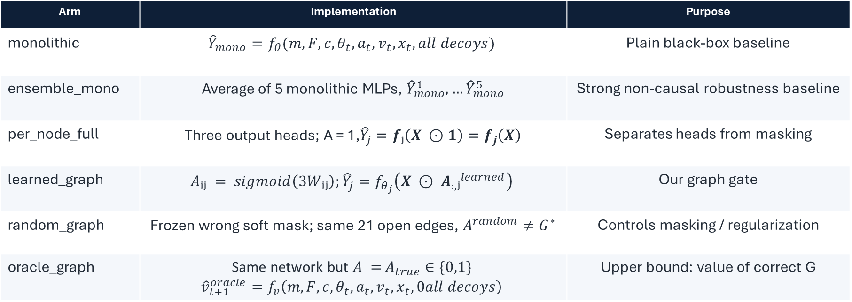
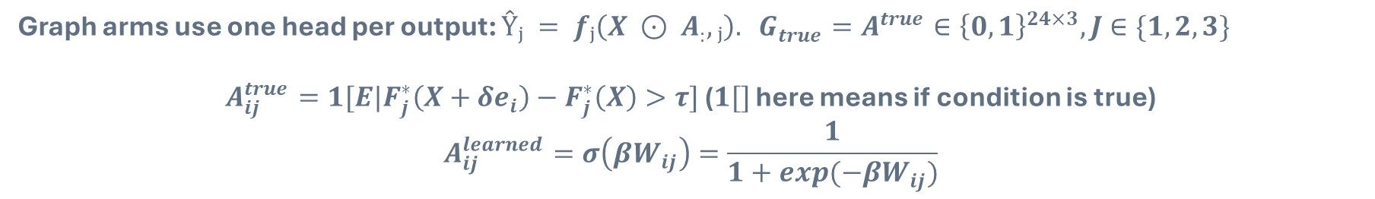
The six methods
Graph arms use one head per output: $Ŷⱼ = fⱼ\left(X ⊙ A_{:},ⱼ\right). G_{true}=A^{true}∈{\left\{0,1\right\}}^{24×3}, J$ $∈\{1,2,3\}$
$A_{ij}^{true}=1[E|F_{j}^{∗}\left(X+δe_{i}\right)−F_{j}^{∗}\left(X\right)>τ]$ ($1[]$ here means if condition is true)
$$A_{ij}^{learned}=σ\left(βW_{ij}\right)=\frac{1}{1+exp(−βW_{ij})}$$
Arm | Implementation | Purpose
monolithic | $${\hat{Y}}_{mono}=f_{θ}(m,F,c,θ_{t},a_{t},v_{t},x_{t},all decoys)$$ | Plain black-box baseline
ensemble_mono | Average of 5 monolithic MLPs, ${\hat{Y}}_{mono}^{1},…{\hat{Y}}_{mono}^{5}$ | Strong non-causal robustness baseline
per_node_full | Three output heads; A = 1,${\hat{Y}}_{j}=fⱼ\left(X ⊙1\right)=f_{j}\left(X\right)$ | Separates heads from masking
learned_graph | $$Aᵢⱼ = sigmoid\left(3Wᵢⱼ\right);{\hat{Y}}_{j}=f_{θ_{j}}\left(X ⊙ A_{:,}ⱼ^{learned}\right)$$ | Our graph gate
random_graph | Frozen wrong soft mask; same 21 open edges, $A^{random}≠G^{∗}$ | Controls masking / regularization
oracle_graph | Same network but $A =$ $A_{true}∈\{0,1\}$ $${\hat{v}}_{t+1}^{oracle}=f_{v}\left(m,F,c,θ_{t},a_{t},v_{t},x_{t},0all decoys\right)$$ | Upper bound: value of correct G

Slide 7
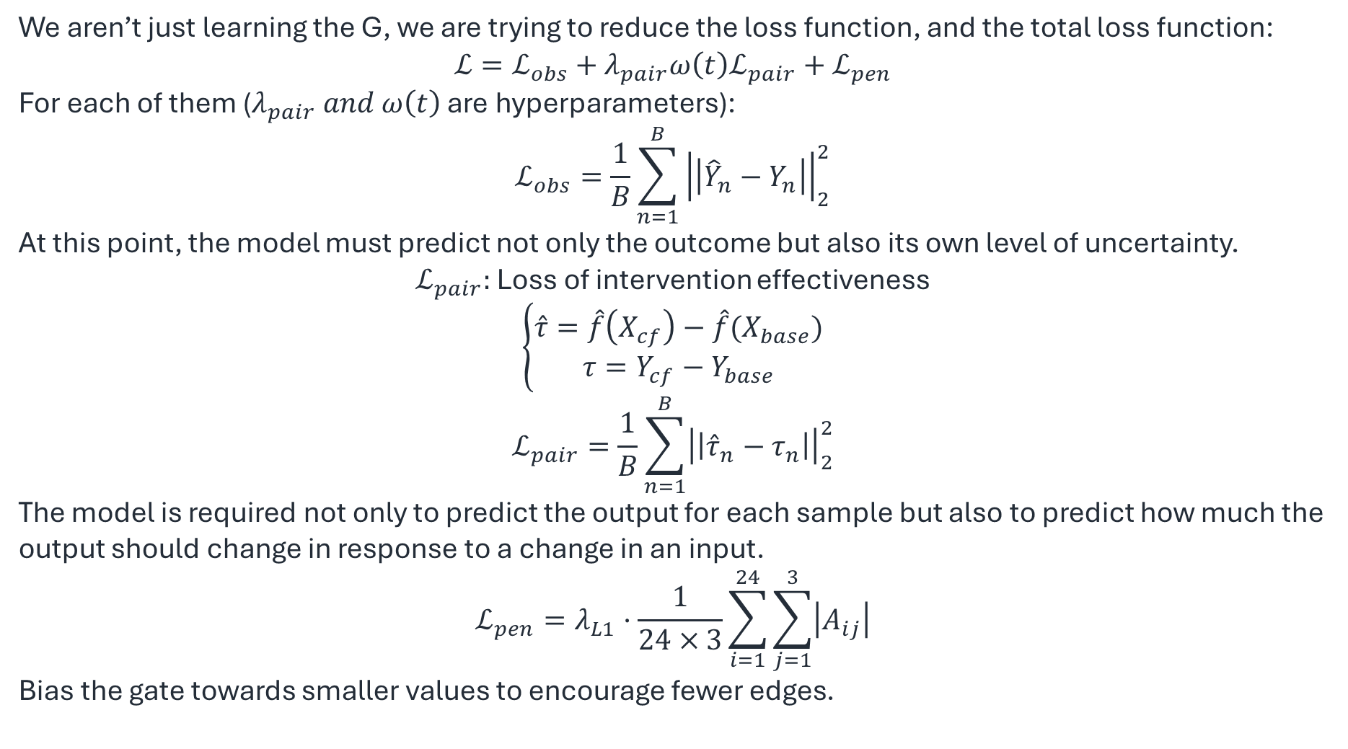
Loss function $ℒ$
We aren’t just learning the G, we are trying to reduce the loss function, and the total loss function:
$$ℒ=ℒ_{obs}+λ_{pair}ω\left(t\right)ℒ_{pair}+ℒ_{pen}$$
For each of them ($λ_{pair} and ω\left(t\right)$ are hyperparameters):
$$ℒ_{obs}=\frac{1}{B}\sum_{n=1}^{B}{{\left|\left|{\hat{Y}}_{n}−Y_{n}\right|\right|}_{2}^{2}}$$
At this point, the model must predict not only the outcome but also its own level of uncertainty.
$ℒ_{pair}:$ Loss of intervention effectiveness
$$\left\{\begin{aligned}\hat{τ}=\hat{f}\left(X_{cf}\right)−\hat{f}(X_{base}) \\ τ=Y_{cf}−Y_{base}\end{aligned}\right.$$
$$ℒ_{pair}=\frac{1}{B}\sum_{n=1}^{B}{{\left|\left|{\hat{τ}}_{n}−τ_{n}\right|\right|}_{2}^{2}}$$
The model is required not only to predict the output for each sample but also to predict how much the output should change in response to a change in an input.
$$ℒ_{pen}=λ_{L1}·\frac{1}{24×3}\sum_{i=1}^{24}{\sum_{j=1}^{3}{\left|A_{ij}\right|}}$$
Bias the gate towards smaller values ​​to encourage fewer edges.

Slide 8

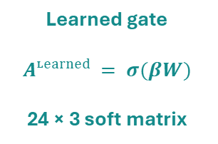


How does learned_graph work?
A learned soft adjacency mask chooses how much each input is shown to each output head.
Important: A is a soft mask, not yet a proven causal mechanism.
mass
Head 1
accelerationₜ₊₁
$$ŷaₜ₊₁$$
force
Learned gate
$Aᶫᵉᵃʳⁿᵉᵈ = σ(βW)$
24 × 3 soft matrix
velocityₜ
Head 2
velocityₜ₊₁
$$ŷvₜ₊₁$$
sensor_v
color
Head 3
positionₜ₊₁
$$ŷxₜ₊₁$$
… 19 more
Blue = true cause
Red = decoy
For output j: $ŷⱼ = fⱼ(X ⊙ A_{:,j})$

Slide 9
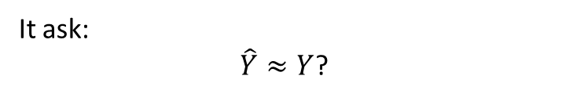

Result 1: OOD prediction
OOD RMSE; lower is better; reference = monolithic.
Method | Mean | vs mono | d_z | Wins
monolithic | 1.2759 | 0.0% | — | 0/50
ensemble_mono | 1.2026 | −5.7% | −0.40 | 37/50
per_node_full | 1.3800 | +8.2% | +0.48 | 10/50
learned_graph | 2.0298 | +59.1% | +3.65 | 2/50
random_graph | 2.0112 | +57.6% | +3.10 | 2/50
oracle_graph | 0.4550 | −64.3% | −3.98 | 50/50
Oracle gives a huge ceiling. Learned graph ≈ wrong random graph and loses to black-box models.
$$RMSE= \sqrt{\frac{1}{N}\sum_{n=1}^{N}{{\left|\left|{\hat{Y}}_{n}−Y_{n}\right|\right|}^{2}}}$$
It ask:
$\hat{Y}≈Y$?

Slide 10
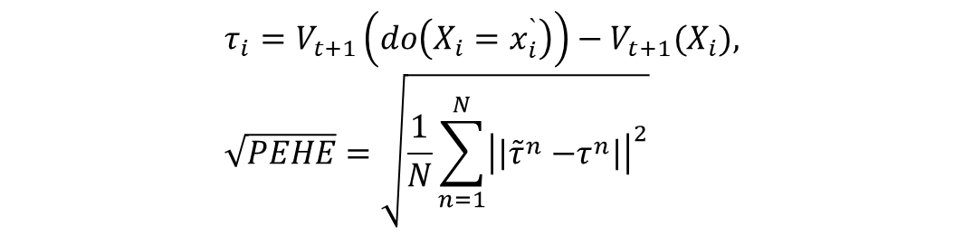
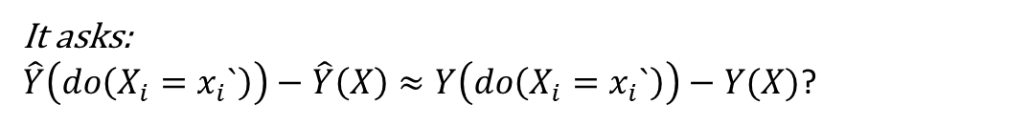
Result 2: OOD intervention effects
OOD √PEHE; lower is better; reference = monolithic.
Method | Mean | vs mono | d_z | Wins
monolithic | 0.5294 | 0.0% | — | 0/50
ensemble_mono | 0.4841 | −8.6% | −0.63 | 40/50
per_node_full | 0.5892 | +11.3% | +0.72 | 5/50
learned_graph | 0.8204 | +55.0% | +3.47 | 2/50
random_graph | 0.8129 | +53.5% | +3.00 | 2/50
oracle_graph | 0.1810 | −65.8% | −4.27 | 50/50
$$τ_{i}=V_{t+1}\left(do\left(X_{i}=x_{i}^{`}\right)\right)−V_{t+1}(X_{i}), \sqrt{PEHE}=\sqrt{\frac{1}{N}\sum_{n=1}^{N}{{\left|\left|{\tilde{τ}}^{n}{−τ}^{n}\right|\right|}^{2}}}$$
The same pattern holds for causal effects: the current gate is not intervention-reliable.
It asks:
$\hat{Y}\left(do\left(X_{i}=x_{i}`\right)\right)−\hat{Y}\left(X\right)≈Y\left(do\left(X_{i}=x_{i}`\right)\right)−Y(X)$?

Slide 11

Good news and bad news
This is not a null result: it separates “structure matters” from “our graph learner works.”
GOOD NEWS
BAD NEWS
• Oracle wins 50/50 seeds on both metrics.
• Correct G gives ~64–66% improvement.
• Random graph is bad: correctness matters, not just masking.
• Ensemble is a strong baseline and improves black-box performance.
• $learned_graph$is 55–59% worse than mono.
• $learned_graph ≈ random_graph$.
• Per-output heads alone do not help.
• We cannot claim the learned gate improves causal robustness.
Defensible conclusion: the task rewards correct causal structure, but the current gate is not learning it.

Slide 12
Why did learned_graph fail?
1. It is mostly feature selection
2. A gate is not a mechanism
3. Proxies work during ID training
All true causes affect all outputs, so the graph is dense.
The MLP can still hide shortcuts inside fⱼ.
Prediction loss rewards shortcuts before the OOD sign flip.
4. One training environment
5. No explicit U
Little evidence tells stable causes from unstable correlations.
Point prediction mixes noise, hidden factors, and uncertainty.
Evidence: learned_graph ≈ random_graph, while oracle_graph is much better.

Slide 13
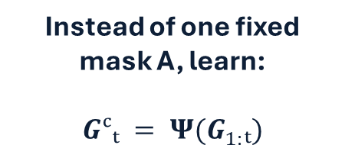
Future improvements: fixed G first, DyCIL next
Do not jump directly to a dynamic graph. First recover a useful fixed G; then add state- and environment-dependent structure.
Step 1 — Fixed temporal SCM
Vₜ, Aₜ → Vₜ₊₁
Learn a sparse fixed G and per-state mechanisms Fᵢ.
Step 2 — Validate graph
Learned G must beat random G
on SHD / AUPRC, OOD RMSE, and √PEHE.
Step 3 — Add U
p(Vₜ₊₁ | Vₜ, Aₜ, G)
Evaluate NLL, coverage, and calibration.
Then borrow DyCIL
Instead of one fixed mask A, learn:
$Gᶜₜ = Ψ(G_{1:}ₜ)$
Causal subgraph
Stable patterns used
for prediction
Variant subgraph
Environment-dependent
patterns
Sample
environments e
and enforce
invariance
DyCIL is a later extension: use it only after the fixed graph is recoverable and helpful.
The real result I aim to is: Correct G gives a large OOD advantage, but the current soft-gate method does not learn
Next step: soft mask -> Modular Dynamic SCM, learn G first, then F, and final, display modeling U.

Slide 14
Reference
• Weinstein & Blei (2026). Hierarchical Causal Models. JMLR 27.
• Liu et al. (2026). Identifying Weight-Variant Latent Causal Models. JMLR 27. [SuaVE]
• Herdeanu et al. (2025). CausalDynamics: A Large-Scale Benchmark for Structural Discovery of Dynamical Causal Models. NeurIPS.
• Bongers et al. (2021). Foundations of Structural Causal Models with Cycles and Latent Variables. Annals of Statistics.
• Ding et al. (2025). Understanding World or Predicting Future? A Comprehensive Survey of World Models. ACM Computing Surveys.
• Richens & Everitt (2024). Robust Agents Learn Causal World Models. ICLR.
•Zhang, X., Jiao, P., Gao, M., Li, T. and Guo, X., 2026, March. Towards OOD generalization in dynamic graphs via causal invariant learning. In Proceedings of the AAAI Conference on Artificial Intelligence (Vol. 40, No. 19, pp. 16379-16387).

