Slide 1

Stage3
chu

Slide 2
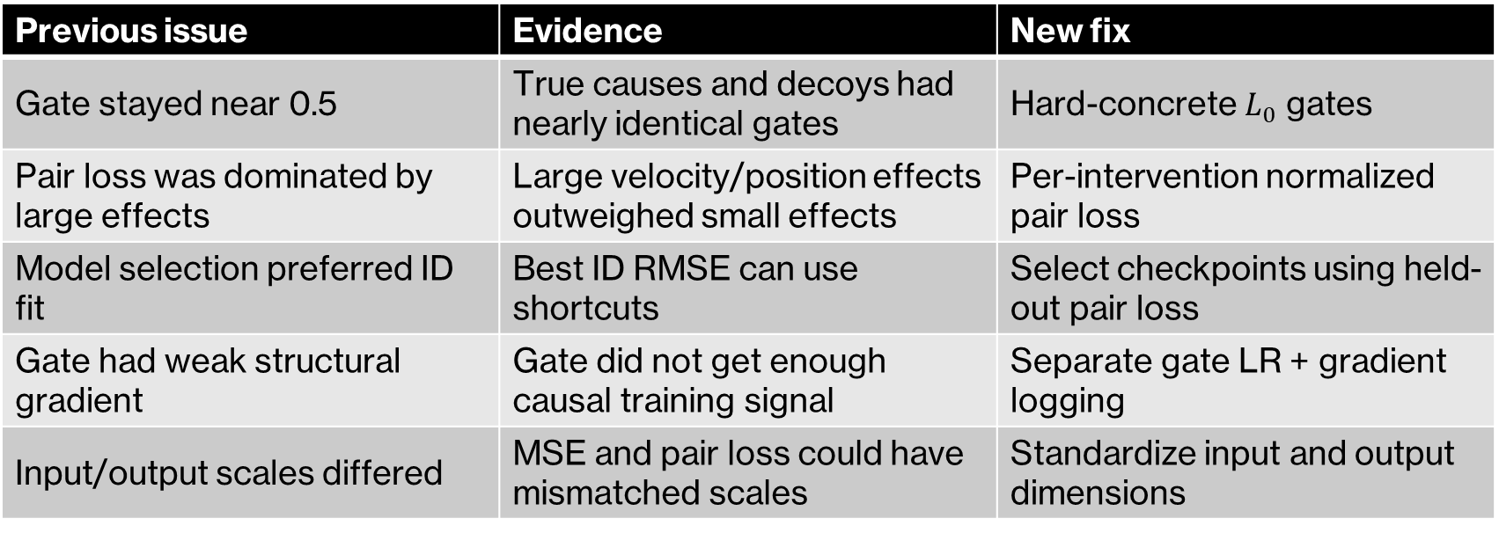

What changed from the previous version?
$$Previous:soft gate+global pair loss$$
The new version improves the graph-learning optimization problem, but still uses a gated predictor rather than a fully modular SCM.
Previous issue | Evidence | New fix
Gate stayed near 0.5 | True causes and decoys had nearly identical gates | Hard-concrete $L_{0}$ gates
Pair loss was dominated by large effects | Large velocity/position effects outweighed small effects | Per-intervention normalized pair loss
Model selection preferred ID fit | Best ID RMSE can use shortcuts | Select checkpoints using held-out pair loss
Gate had weak structural gradient | Gate did not get enough causal training signal | Separate gate LR + gradient logging
Input/output scales differed | MSE and pair loss could have mismatched scales | Standardize input and output dimensions

Slide 3
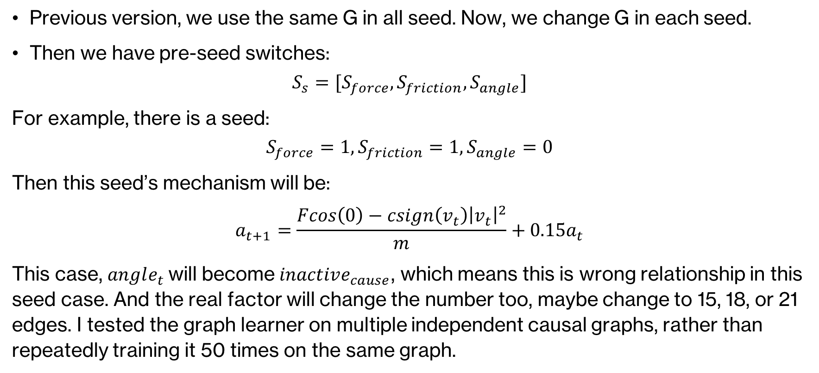
Graph change with different seed
Previous version, we use the same G in all seed. Now, we change G in each seed.
Then we have pre-seed switches:
$$S_{s}=[S_{force},S_{friction},S_{angle}]$$
For example, there is a seed:
$$S_{force}=1,S_{friction}=1,S_{angle}=0$$
Then this seed’s mechanism will be:
$$a_{t+1}=\frac{Fcos\left(0\right)−csign\left(v_{t}\right){\left|v_{t}\right|}^{2}}{m}+0.15a_{t}$$
This case, $angle_{t}$will become $inactive_{cause}$, which means this is wrong relationship in this seed case. And the real factor will change the number too, maybe change to 15, 18, or 21 edges. I tested the graph learner on multiple independent causal graphs, rather than repeatedly training it 50 times on the same graph.

Slide 4
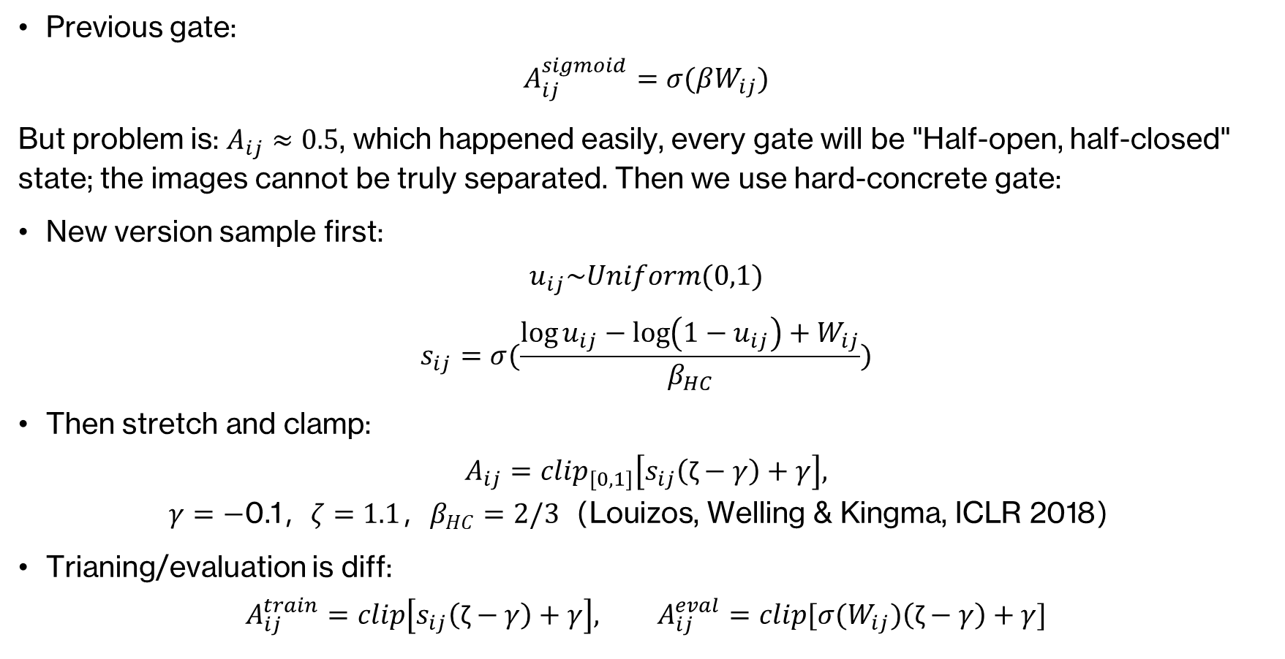
Algorithm change 1: hard-concrete gate
Previous gate:
$$A_{ij}^{sigmoid}=σ(βW_{ij})$$
But problem is: $A_{ij}≈0.5$, which happened easily, every gate will be "Half-open, half-closed" state; the images cannot be truly separated. Then we use hard-concrete gate:
New version sample first:
$$u_{ij}\sim Uniform(0,1)$$
$$s_{ij}=σ(\frac{\log{u_{ij}}−\log\left(1−u_{ij}\right)+W_{ij}}{β_{HC}})$$
Then stretch and clamp:
$$A_{ij}=clip_{\left[0,1\right]}\left[s_{ij}\left(\text{ζ}−γ\right)+γ\right],$$
$$γ=−\text{0.1}\text{，}ζ=1.1\text{，}β_{HC}=2/3\text{（Louizos, Welling \& Kingma, ICLR 2018）}$$
Trianing/evaluation is diff:
$$A_{ij}^{train}=clip\left[s_{ij}\left(\text{ζ}−γ\right)+γ\right], A_{ij}^{eval}=clip[σ(W_{ij})\left(\text{ζ}−γ\right)+γ]$$

Slide 5
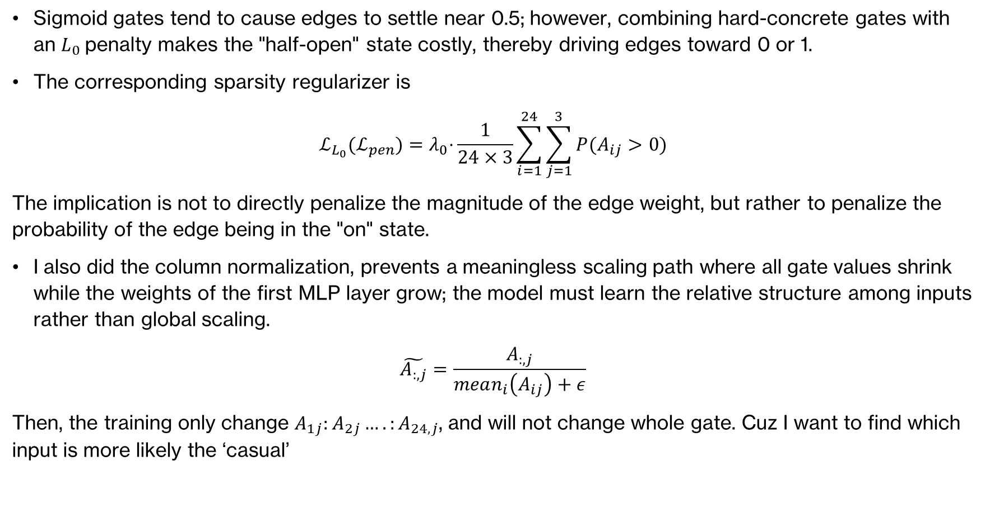
Algorithm change 1: hard-concrete gate
Sigmoid gates tend to cause edges to settle near 0.5; however, combining hard-concrete gates with an $L_{0}$penalty makes the "half-open" state costly, thereby driving edges toward 0 or 1.
The corresponding sparsity regularizer is
$$ℒ_{L_{0}}(ℒ_{pen})=λ_{0}\text{⋅}\frac{1}{24×3}\sum_{i=1}^{24}{\sum_{j=1}^{3}{P(A_{ij}>0)}}$$
The implication is not to directly penalize the magnitude of the edge weight, but rather to penalize the probability of the edge being in the "on" state.
I also did the column normalization, prevents a meaningless scaling path where all gate values ​​shrink while the weights of the first MLP layer grow; the model must learn the relative structure among inputs rather than global scaling.
$$\tilde{A_{:,j}}=\frac{A_{:,j}}{mean_{i}\left(A_{ij}\right)+ε}$$
Then, the training only change $A_{1j}:A_{2j}….:A_{24,j}$, and will not change whole gate. Cuz I want to find which input is more likely the ‘casual’

Slide 6
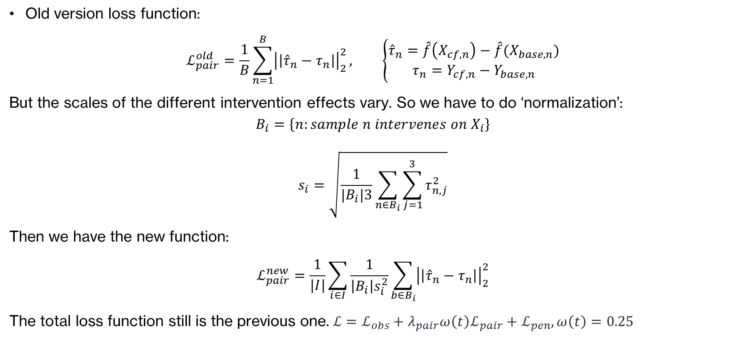
Algorithm change 2: normalized intervention loss
Old version loss function:
$$ℒ_{pair}^{old}=\frac{1}{B}\sum_{n=1}^{B}{{\left|\left|{\hat{τ}}_{n}−τ_{n}\right|\right|}_{2}^{2}}, \left\{\begin{aligned}{\hat{τ}}_{n}=\hat{f}\left(X_{cf,n}\right)−\hat{f}(X_{base,n}) \\ τ_{n}=Y_{cf,n}−Y_{base,n}\end{aligned}\right.$$
But the scales of the different intervention effects vary. So we have to do ‘normalization’:
$$B_{i}=\left\{n:sample n intervenes on X_{i}\right\}$$
$$s_{i}=\sqrt{\frac{1}{|B_{i}|3}\sum_{n∈B_{i}}{\sum_{j=1}^{3}{τ_{n,j}^{2}}}}$$
Then we have the new function:
$$ℒ_{pair}^{new}=\frac{1}{|I|}\sum_{i∈I}{\frac{1}{\left|B_{i}\right|s_{i}^{2}}}\sum_{b∈B_{i}}{{\left|\left|{\hat{τ}}_{n}−τ_{n}\right|\right|}_{2}^{2}}$$
The total loss function still is the previous one.$ℒ=ℒ_{obs}+{λ_{pair}ω\left(t\right)ℒ}_{pair}+ℒ_{pen},ω\left(t\right)=0.25$

Slide 7
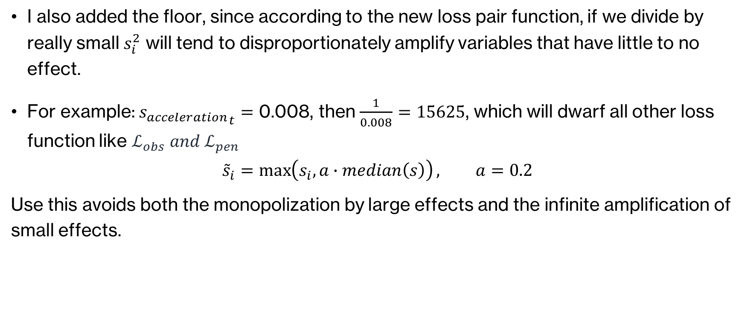
Algorithm change 2: normalized intervention loss
I also added the floor, since according to the new loss pair function, if we divide by really small $s_{i}^{2}$ will tend to disproportionately amplify variables that have little to no effect.
For example: ${s_{acceleration}}_{t}=\text{0.008}$​, then $\frac{1}{0.008}=15625$, which will dwarf all other loss function like $ℒ_{obs} and ℒ_{pen}$
$${\tilde{s}}_{i}=\max\left(s_{i},a∙median\left(s\right)\right), a=0.2$$
Use this avoids both the monopolization by large effects and the infinite amplification of small effects.

Slide 8
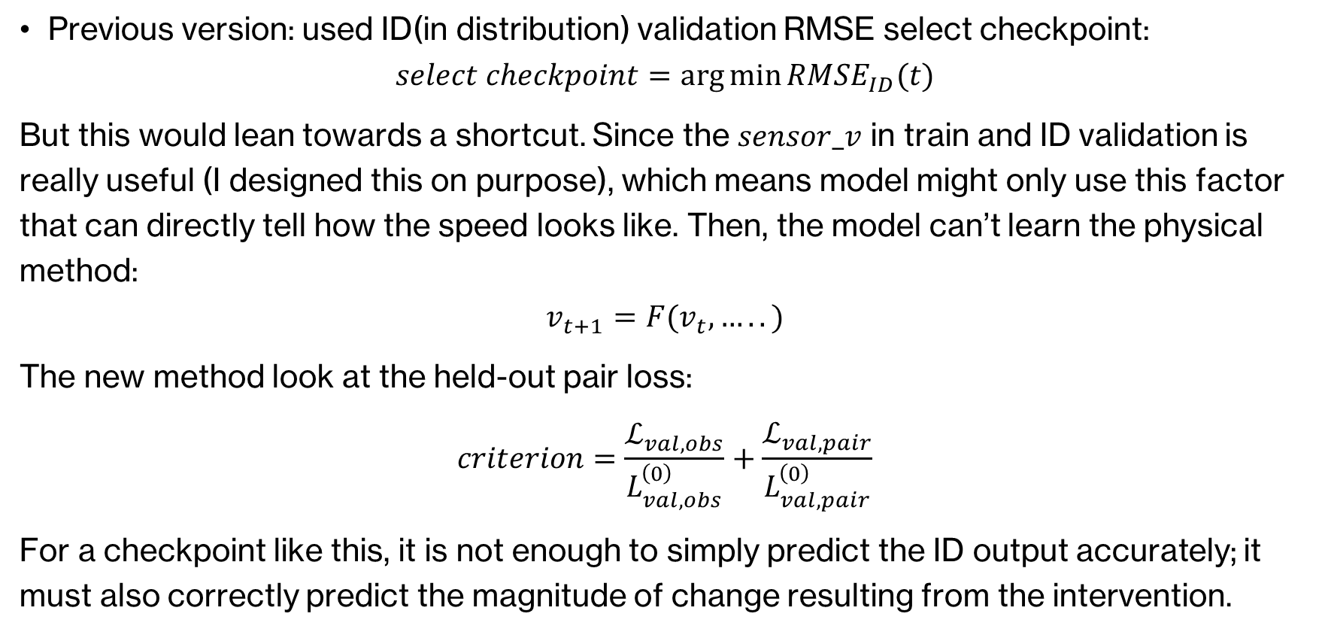
Fixed the anti-causal issue with early stopping.
Previous version: used ID(in distribution) validation RMSE select checkpoint:
$$select checkpoint=\arg{\min{RMSE_{ID}(t)}}$$
But this would lean towards a shortcut. Since the $sensor_v$ in train and ID validation is really useful (I designed this on purpose), which means model might only use this factor that can directly tell how the speed looks like. Then, the model can’t learn the physical method:
$$v_{t+1}=F(v_{t},…..)$$
The new method look at the held-out pair loss:
$$criterion=\frac{ℒ_{val,obs}}{L_{val,obs}^{\left(0\right)}}+\frac{ℒ_{val,pair}}{L_{val,pair}^{\left(0\right)}}$$
For a checkpoint like this, it is not enough to simply predict the ID output accurately; it must also correctly predict the magnitude of change resulting from the intervention.

Slide 9
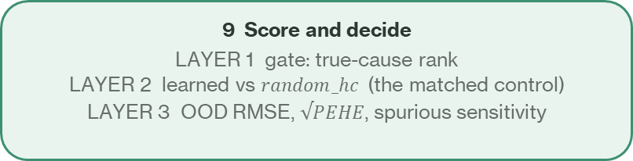
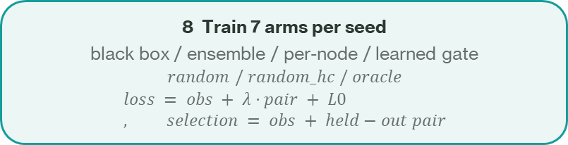
Pipeline: from world to verdict
1 Define SCM
7 physical causes
+ 17 decoys
collision dynamics
2 Per-seed graph
draw switches
S = [force, friction, angle]
5-7 true causes
3 Derive A_true
numerically, not by hand
perturb ±0.4, noise off
see which outputs move
4 Sample data
observational splits
+ twin rollouts
sharing exogenous noise
7 Notebook loads
standardize inputs
compute effect scales
no SCM code needed
6 QA gate
9 checks per seed
do(decoy) effect == 0 ?
shift reaches every output ?
5 Write to disk
dataset/cfg_<hash>/
seed_0000.npz … + manifest.json
4 CSVs: ground truth + QA
8 Train 7 arms per seed
black box / ensemble / per-node / learned gate
$$random / random_hc / oracle$$
$$loss = obs + λ·pair + L0, selection = obs + held−out pair$$
9 Score and decide
LAYER 1 gate: true-cause rank
LAYER 2 learned vs $random_hc$(the matched control)
LAYER 3 OOD RMSE, $√PEHE$, spurious sensitivity
LAYER 1 is the hard gate: a downstream gain with a flat gate is not evidence about causal structure.

Slide 10
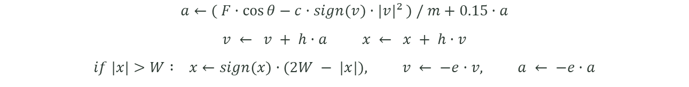
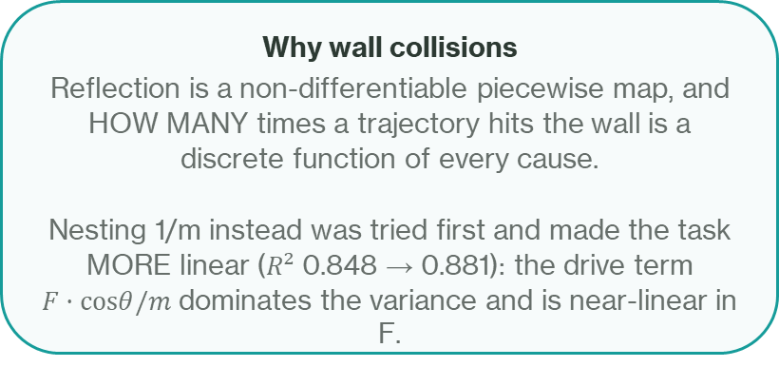
Dataset: the world
one step of a damped, driven particle in a box — the model never sees these equations
Per substep k = 1…K (K = 6, h = Δt/K):
$$a←( F·cos⁡θ−c·sign(v)·|v|² ) / m+0.15·a$$
$$v ← v + h·a x ← x + h·v$$
$$if |x|>W : x←sign(x)·(2W − |x|), v ← −e·v, a ← −e·a$$
Output: $Y = ( a⁽ᴷ⁾+u_{a} , v⁽ᴷ⁾+u_{v} , x⁽ᴷ⁾+u_{x} ), u \sim N(0, σ²)$
Why wall collisions
Reflection is a non-differentiable piecewise map, and
HOW MANY times a trajectory hits the wall is a
discrete function of every cause.
Nesting 1/m instead was tried first and made the task
MORE linear ($R²$ 0.848 → 0.881): the drive term
$F·cosθ/m$dominates the variance and is near-linear in F.
Linear R² of the output | v1 world | v2 world
acceleration_next | 0.906 | 0.78
velocity_next | 0.998 | 0.19
position_next | 1.000 | 0.40
mean | 0.968 | 0.40
R² ≈ 1 means a linear model already solves it: a black box wins for free and there is no ceiling to compete for.

Slide 11
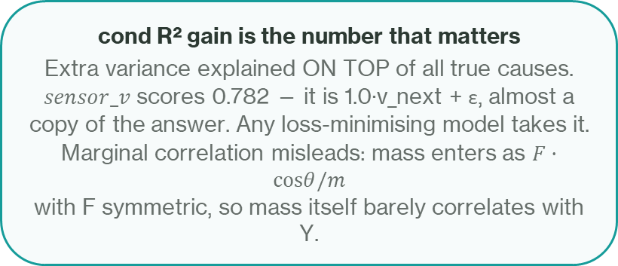
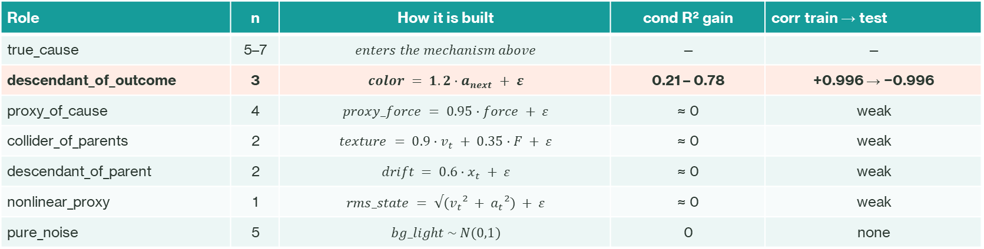
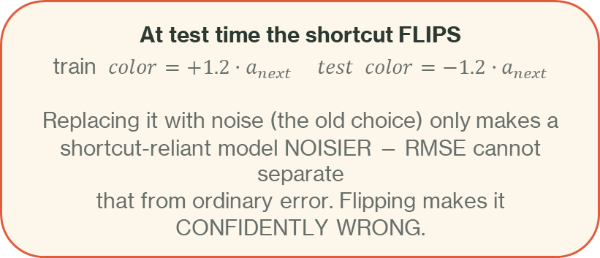
Dataset: 24 inputs, only 5–7 of them are causes
Role | n | How it is built | cond R² gain | corr train → test
true_cause | 5–7 | $$enters the mechanism above$$ | — | —
descendant_of_outcome | 3 | $$color = 1.2·a_{next} + ε$$ | 0.21 – 0.78 | +0.996 → −0.996
proxy_of_cause | 4 | $$proxy_force = 0.95·force + ε$$ | ≈ 0 | weak
collider_of_parents | 2 | $$texture = 0.9·v_{t} + 0.35·F + ε$$ | ≈ 0 | weak
descendant_of_parent | 2 | $$drift = 0.6·x_{t} + ε$$ | ≈ 0 | weak
nonlinear_proxy | 1 | $$rms_state = √(v_{t}² + a_{t}²) + ε$$ | ≈ 0 | weak
pure_noise | 5 | $$bg_light \sim N(0,1)$$ | 0 | none
cond R² gain is the number that matters
Extra variance explained ON TOP of all true causes.
$sensor_v$scores 0.782 — it is 1.0·v_next + ε, almost a
copy of the answer. Any loss-minimising model takes it.
Marginal correlation misleads: mass enters as $F·cosθ/m$
with F symmetric, so mass itself barely correlates with Y.
At test time the shortcut FLIPS
train $color=+1.2·a_{next} test color=−1.2·a_{next}$
Replacing it with noise (the old choice) only makes a
shortcut-reliant model NOISIER — RMSE cannot separate
that from ordinary error. Flipping makes it
CONFIDENTLY WRONG.

Slide 12
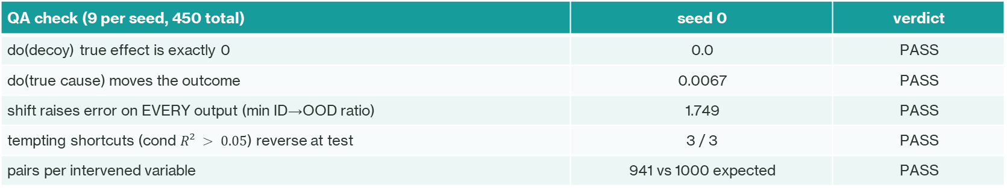
Dataset: paired interventions
why ground-truth √PEHE is computable here and never is on real data
For each sample, two twin rollouts that SHARE the exogenous noise U:
$$τ^{(}ⁿ^{)}=f\left( do\left(Xᵢ = \tilde{x}\right), U^{(}ⁿ^{)}\right)−f( X⁽ⁿ⁾, U⁽ⁿ⁾ )$$
Because U is identical, τ is the EXACT individual treatment effect — no noise term.
The invariant everything rests on
For do(decoy), the true effect must be EXACTLY zero —
no decoy is a cause of anything.
Measured: all 17 decoys give 0.000000.
If this fails, spurious_sensitivity is meaningless.
A bug class this catches
do(mass) moves acceleration_next, so `color` — its child —
must move too. Twins differ in ~17 inputs, not 1.
Freezing the downstream decoys would silently make the
twins non-counterfactual, and nothing would error.
QA check (9 per seed, 450 total) | seed 0 | verdict
do(decoy) true effect is exactly 0 | 0.0 | PASS
do(true cause) moves the outcome | 0.0067 | PASS
shift raises error on EVERY output (min ID→OOD ratio) | 1.749 | PASS
tempting shortcuts (cond $R² > 0.05$) reverse at test | 3 / 3 | PASS
pairs per intervened variable | 941 vs 1000 expected | PASS
449 / 450 passed. The one failure (seed 25, ratio 1.152) is a force-only seed: with friction and angle inactive, fewer shifted variables are causes.

Slide 13
The control that decides the claim: random_hc
once the learned gate became stochastic, the old random control stopped being matched
Arm | Architecture | Mask | HC sampling | L0 | Col. norm
per_node_full | 3 heads | all ones | no | no | no
oracle_graph | 3 heads | TRUE graph, frozen | no | no | no
random_graph | 3 heads | wrong, frozen soft | no | no | no
learned_graph | 3 heads | LEARNED | yes | yes | yes
random_hc | 3 heads | wrong, frozen | yes | yes | yes
Why random_graph is no longer valid
learned_graph gained stochastic gating and an L0 term.
random_graph has neither. Stochastic gating IS a
regulariser, so any gap could be regularisation rather
than structure.
What random_hc holds fixed
Identical machinery, same open-edge count (21),
cell agreement with the truth 0.611 — a genuinely
WRONG graph. The only remaining difference is whether
the graph is correct.
$A_random_hc :$ logits frozen at $±2.5$on a shuffled edge set, $requires_grad = False$
$learned_graph − random_hc$is therefore the only comparison that isolates graph correctness.

Slide 14
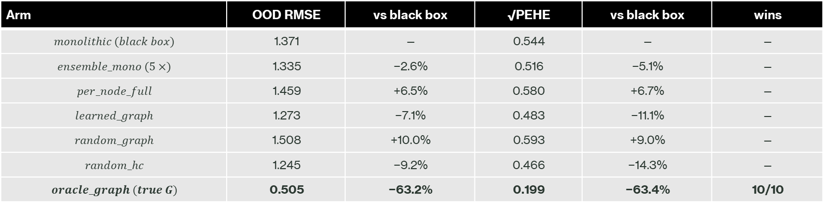
Results: the ceiling is real
10 seeds, 4 distinct graph structures, paired t-test against the black box
Arm | OOD RMSE | vs black box | √PEHE | vs black box | wins
$$monolithic (black box)$$ | 1.371 | — | 0.544 | — | —
$$ensemble_mono (5×)$$ | 1.335 | −2.6% | 0.516 | −5.1% | —
$$per_node_full$$ | 1.459 | +6.5% | 0.580 | +6.7% | —
$$learned_graph$$ | 1.273 | −7.1% | 0.483 | −11.1% | —
$$random_graph$$ | 1.508 | +10.0% | 0.593 | +9.0% | —
$$random_hc$$ | 1.245 | −9.2% | 0.466 | −14.3% | —
$$oracle_graph (true G)$$ | 0.505 | −63.2% | 0.199 | −63.4% | 10/10
Structure is worth 63%
The true graph cuts OOD error by 63.2%,
10/10 seeds.
In the v1 world the same comparison was
p = 0.75 — there was nothing to win.
A general prior is worth 2.6%
A 5-model ensemble is the strongest
robustness prior available without causal
knowledge. It recovers 1/24 of what
structure recovers.
The gain is the mask
per_node_full and oracle_graph are the
SAME architecture and differ only in the
mask. Splitting into heads alone is 6.5%
WORSE than the black box.

Slide 15
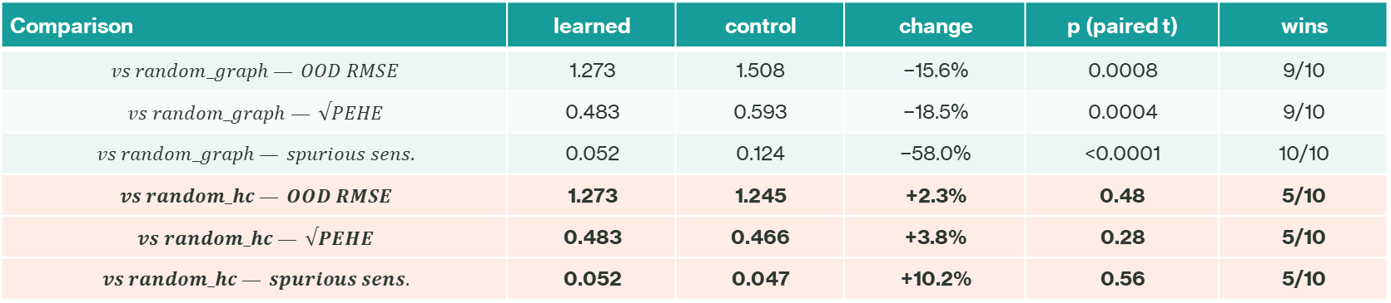
Results: the learned gate does not beat a wrong graph
three independent metrics, same verdict
Comparison | learned | control | change | p (paired t) | wins
$$vs random_graph — OOD RMSE$$ | 1.273 | 1.508 | −15.6% | 0.0008 | 9/10
$$vs random_graph — √PEHE$$ | 0.483 | 0.593 | −18.5% | 0.0004 | 9/10
$$vs random_graph — spurious sens.$$ | 0.052 | 0.124 | −58.0% | <0.0001 | 10/10
$$vs random_hc — OOD RMSE$$ | 1.273 | 1.245 | +2.3% | 0.48 | 5/10
$$vs random_hc — √PEHE$$ | 0.483 | 0.466 | +3.8% | 0.28 | 5/10
$$vs random_hc — spurious sens.$$ | 0.052 | 0.047 | +10.2% | 0.56 | 5/10
A completely wrong graph reproduces the entire gain. The benefit comes from stochastic gating as a regulariser, not from structure.
Signature of heavy regularisation | ID RMSE | OOD gap
monolithic | 0.055 | 25.7×
learned_graph | 0.441 | 3.1×
random_hc | 0.721 | 1.8×
Two more tells
Trading fit for robustness — the hallmark of strong
regularisation (like high-rate dropout), unrelated to causality.
sign_acc: oracle 0.812 black box 0.535 learned 0.343
The learned gate gets intervention DIRECTION wrong more
often than the black box does.

Slide 16
Results: gate direction fixed, magnitude not
per-role gate values, 10 seeds — this is LAYER 1, the hard gate
Role | gate | v1
descendant_of_outcome | 0.5980 | 0.4940
true_cause | 0.5675 | 0.4643
descendant_of_parent | 0.5658 | 0.4560
nonlinear_proxy | 0.5645 | 0.4810
collider_of_parents | 0.5607 | 0.4779
proxy_of_cause | 0.5559 | 0.4771
inactive_cause | 0.5516 | —
pure_noise | 0.5080 | 0.3942
Real progress
true-cause RANK 5/7 → 2/8
decoy mean excluding noise 0.5661
true causes 0.5675 → first time ABOVE
v1's AUROC came entirely from closing pure_noise;
that specific pathology is fixed.
But the magnitude is negligible
all roles inside [0.508, 0.598], span 0.09
separation 0.018 AUROC 0.543
F1 0.363 SHD 43.1
training-free effect matrix: AUROC 1.000
Why the magnitude is still small
The effect-scale floor fixed the 15625× over-amplification of
acceleration_t, but it also weakened the pair signal — and the
pair term is the ONLY one carrying causal information.
So the gate is currently being shaped mostly by in-distribution
fit, which is exactly the criterion that rewards shortcuts.
The diagnosis, and a testable fix
grad_obs 0.0354 grad_pair 0.0145 ratio 0.45
The OBSERVATIONAL term drives the gate 2.2 : 1,
so it opens whatever helps in-distribution fit —
exactly why descendant_of_outcome ranks first.
Prediction: λ_pair = 3 → ratio ≈ 1.35; λ = 10 → ≈ 4.1

Slide 17
What this run does and does not establish
PROVEN
1. The task rewards correct structure.
oracle −63.2%, 10/10 seeds,
across 4 distinct graphs.
2. Structure ≫ generic robustness prior.
63.2% vs 2.6% — a factor of 24.
3. The gain is the mask, not the
architecture. per_node_full is
6.5% WORSE than the black box.
4. The black box does take the bait:
ID 0.055 → OOD 1.371, gap 25.7×.
DISPROVEN
The learned gate did NOT recover
structure.
Against the matched control it is a
tie on all three metrics:
OOD +2.3% p = 0.48
PEHE +3.8% p = 0.28
spur +10.2% p = 0.56
A completely wrong graph reproduces
the whole gain, so the benefit is
regularisation, not structure.
OPEN
Gate direction is now correct but the
magnitude is negligible
(separation 0.018).
Gradient ratio 0.45 says the
observational term dominates — a
specific, testable cause.
Next: sweep λ_pair ∈ {3, 10},
gate_lr ×10, and sigmoid-gate-only.
Criterion: true-cause rank → 1/8.
LIMITATION to state up front: all active causes reach all three outputs, so A_true has rank 1. The 63% ceiling therefore
measures CAUSE-vs-DECOY SEPARATION, not per-output parent-set recovery. Separating those needs a multi-object SCM.
One-sentence summary
We built a task where the true graph is worth 63.2% (10/10 seeds) while the strongest non-causal prior is worth 2.6%.
The learned gate captured 11% of that, and a matched wrong graph captured the same 11% — so the gain is regularisation, not recovered structure.

Slide 18
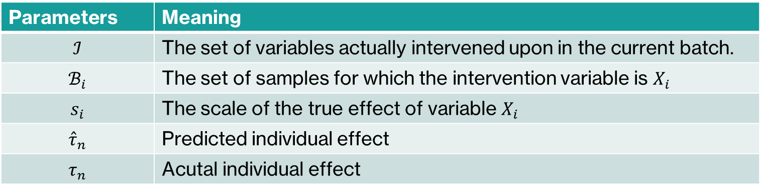
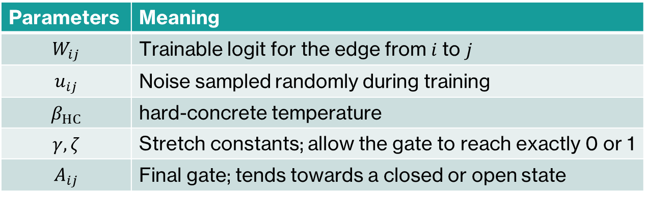
Parameters(1/2) loss function, hard-concrete
Parameters | Meaning
$$W_{ij}$$ | Trainable logit for the edge from 𝑖 to 𝑗
$$u_{ij}$$ | Noise sampled randomly during training
$$β_{HC}$$ | hard-concrete temperature
$$γ,ζ$$ | Stretch constants; allow the gate to reach exactly 0 or 1
$$A_{ij}$$ | Final gate; tends towards a closed or open state
Parameters | Meaning
$$ℐ$$ | The set of variables actually intervened upon in the current batch.
$$ℬ_{i}$$ | The set of samples for which the intervention variable is $X_{i}$
$$s_{i}$$ | The scale of the true effect of variable $X_{i}$
$${\hat{τ}}_{n}$$ | Predicted individual effect
$$τ_{n}$$ | Acutal individual effect

Slide 19
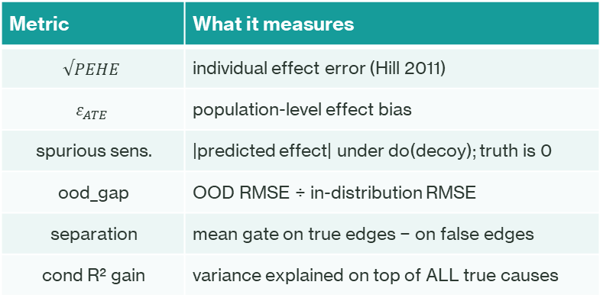
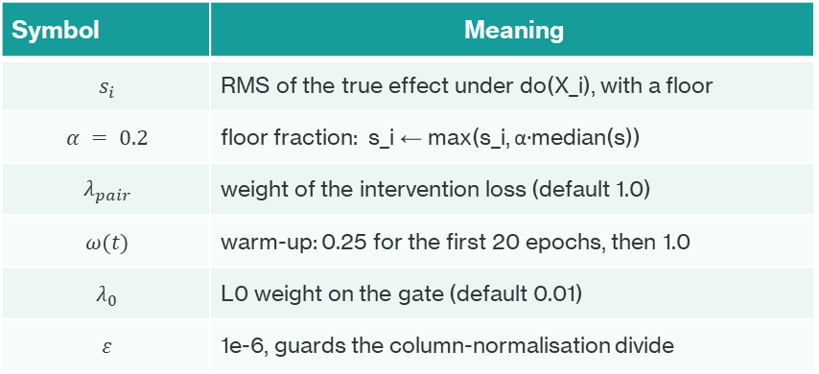
Parameters (2/2): loss, controls, metrics
Symbol | Meaning
$$s_{i}$$ | RMS of the true effect under do(X_i), with a floor
$$α = 0.2$$ | floor fraction: s_i ← max(s_i, α·median(s))
$$λ_{pair}$$ | weight of the intervention loss (default 1.0)
$$ω(t)$$ | warm-up: 0.25 for the first 20 epochs, then 1.0
$$λ_{0}$$ | L0 weight on the gate (default 0.01)
$$ε$$ | 1e-6, guards the column-normalisation divide
Metric | What it measures
$$√PEHE$$ | individual effect error (Hill 2011)
$$ε_{ATE}$$ | population-level effect bias
spurious sens. | |predicted effect| under do(decoy); truth is 0
ood_gap | OOD RMSE ÷ in-distribution RMSE
separation | mean gate on true edges − on false edges
cond R² gain | variance explained on top of ALL true causes
Effect-scale floor — why it exists and what it cost:
Intervened variable | s raw | s floored | raw amp. | floored amp.
force | 1.088 | 1.088 | 0.8× | 0.8×
mass | 0.289 | 0.289 | 12× | 12×
friction | 0.207 | 0.207 | 23× | 23×
acceleration_t | 0.040 | 0.058 | 634× | 299×
The trade-off
Without normalisation, a velocity_t pair contributes
~10⁴× the squared error of an acceleration_t pair —
and acceleration_t is a true parent of ALL three outputs.
But dividing by s = 0.040 amplifies 634×. The floor
keeps the imbalance fixed without letting the smallest
variable dominate — at the cost of a weaker pair
gradient (ratio 0.45).

Slide 20
Reference
Louizos, Welling & Kingma, "Learning Sparse Neural Networks through L₀ Regularization", ICLR 2018.
Maddison et al. 2017；Jang et al. 2017

