Slide 1

Benchmark on existing data
chu

Slide 2
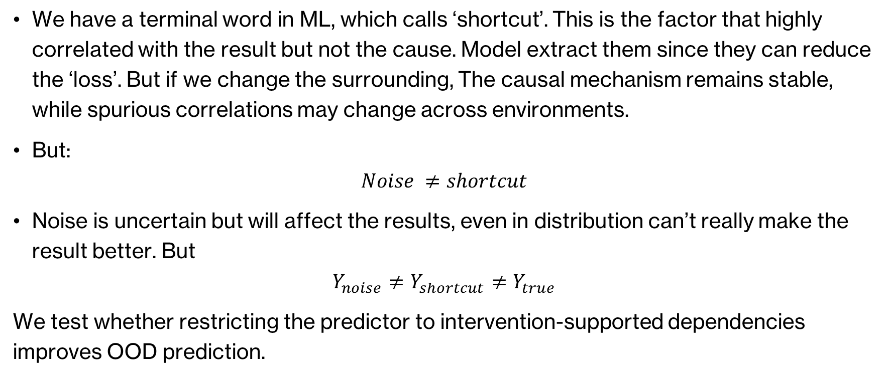
The goal—Enable the model to make accurate predictions even in unseen environments.
We have a terminal word in ML, which calls ‘shortcut’. This is the factor that highly correlated with the result but not the cause. Model extract them since they can reduce the ‘loss’. But if we change the surrounding, The causal mechanism remains stable, while spurious correlations may change across environments.
But:
$$Noise ≠shortcut$$
Noise is uncertain but will affect the results, even in distribution can’t really make the result better. But
$$Y_{noise}≠Y_{shortcut}≠Y_{true}$$
We test whether restricting the predictor to intervention-supported dependencies improves OOD prediction.

Slide 3
Benchmark selection
Dataset:
  We have to find a dataset which matches our goal. It should be:
  I selected CausalWorld because it supports controlled interventions and configurable train–test distributions.
Requirement | Why it matters
Controllable causal and decoy variables | Tests shortcut removal
Defined train–test shift | Measures OOD generalization
Repeatable interventions | Estimates causal influence
Multiple tasks and seeds | Tests robustness

Slide 4
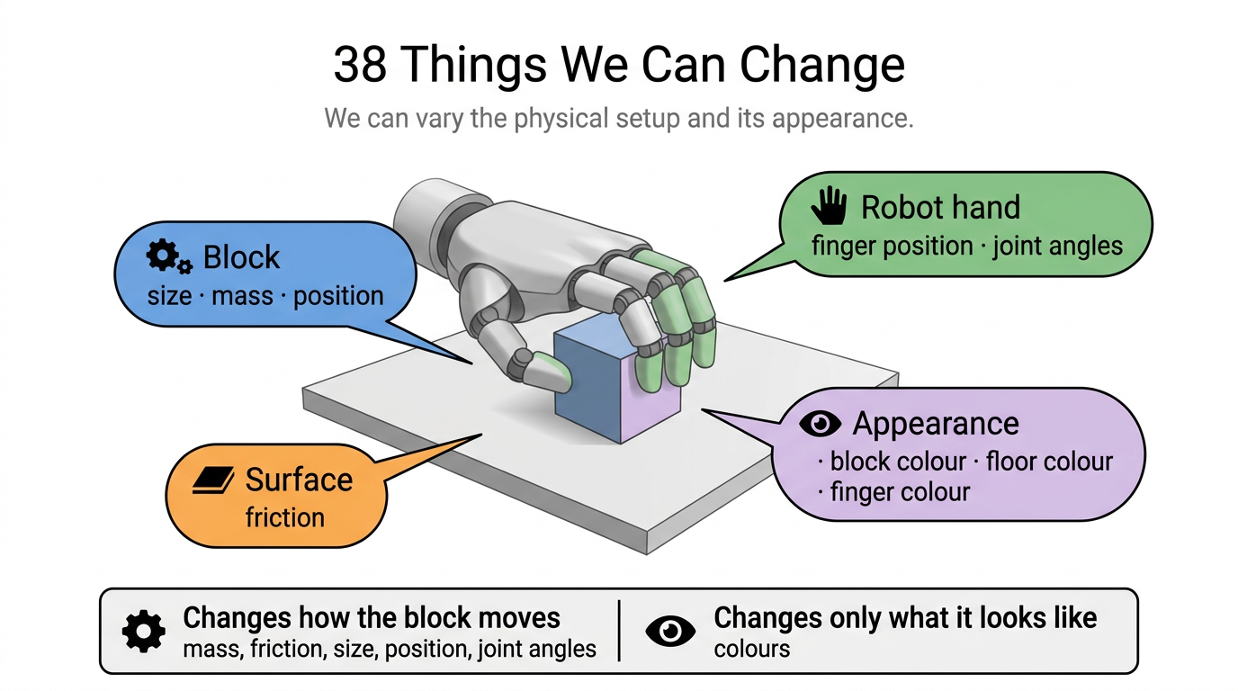
The benchmark: CausalWorld
a robot-hand physics simulator built for causal research
38 properties you can change:
Their train / test split
What we add: paired runs
affect physics
Mass,
Friction,
size, position,
joint angles
affect nothing
block colour,
floor colour,
12 finger, colours,
≈ half of them
space_a — TRAIN
block colour 0.5 → 1.0 (light)
mass, friction: one range
space_b — TEST
block colour 0.0 → 0.5 (dark)
mass, friction: a different range
the same start, twice
run 1
reset → act → record y₀
run 2
reset to the SAME state
change ONE variable → act → y₁
Our task
input 90 numbers,
the current state
output 56 numbers,
the state after the
same action runs 50 steps
y₁ − y₀ = the pure effect
of that one change
the simulator is deterministic — nothing else differs
measured effect on the outcome:
colour
nothing
0.0000
mass
0.0387
friction
0.0529
position
0.2200

Slide 5
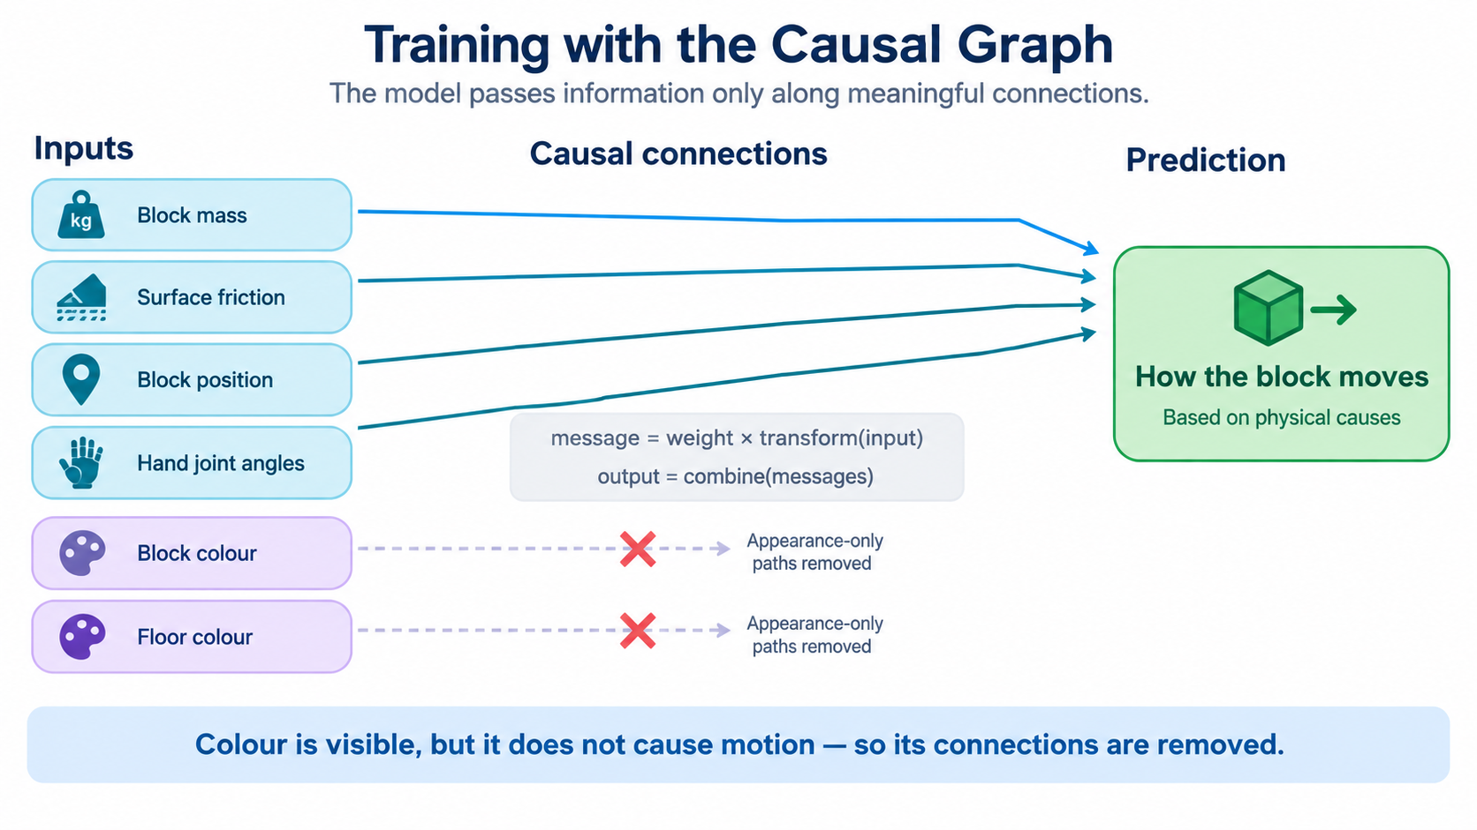

The method
Since we already got the equation from pearl casual paper:
$$E_{ij}=E\left[\left|Y_{j}^{do\left(X_{i}\right)}−Y_{j}\right|\right]$$
This is the equation we don’t have to use any MLP, directly calculate how Y change after we change the X. Then we have another MLP which used to train the graph:
$$m_{j→i}=A_{ji}W_{j→i}φ\left(V_{j}\right), \hat{Y}=g_{i}(\sum_{j}{m_{j→i}})$$
The edge-wise parameterization is inspired by NOTEARS-MLP and DCDI. The contribution here is the controlled evaluation of the mask, not a new causal discovery architecture.
$φ$ is a small MLP to change one number into 8 numbers. $W_{ij}$ means each edge has its own weight(message), totally 5040 edges.
If the fatcor3 is not existed on our graph, the W3 is 0 then it means it will never be updated by MLP

Slide 6
Experiment
arm | Mask | What is being ruled out?
no_graph | All 1 | Baseline
random_graph | Random but same edges | Only need to add mask
corr_graph | Correlation parameters | Correlation parameter is enough
lasso_graph | sparse regression | sparse regression is enough
notears_style | Structure learning using only observations | Observations is enough
PETS | Integrated; no diagrams provided. | Integrated is enough
PETS + our graph | Others model | PETS architecture works
ours | Effect matrix | --
The six graph-comparison arms share the same predictor architecture, training data, loss, and prediction-training schedule. Only their masks differ.
Separately, we evaluate a PETS-style probabilistic ensemble with and without graph-derived input selection.

Slide 7
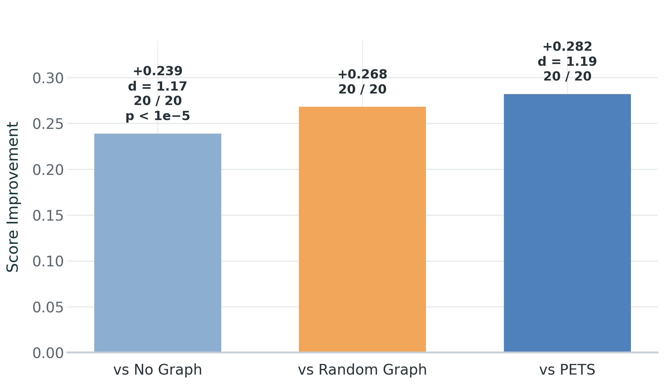
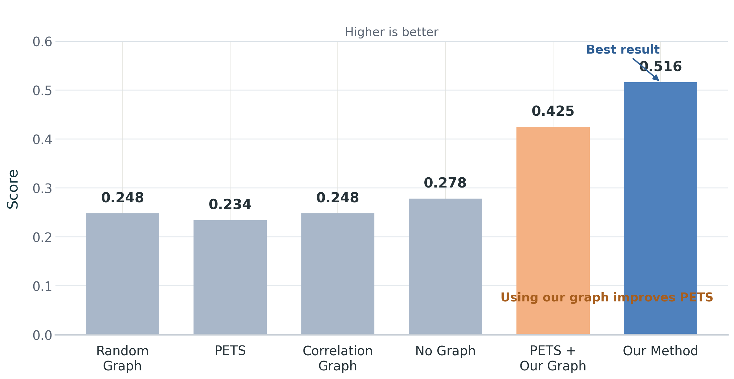

The main result
$$R^{2}$$
Note that `random_graph` scores only 0.248, which is even lower than the 0.278 achieved by `no_graph`—this implies that providing an incorrect graph is worse than providing no graph at all; what matters is the accuracy of the graph, not merely the application of a mask.

Slide 8
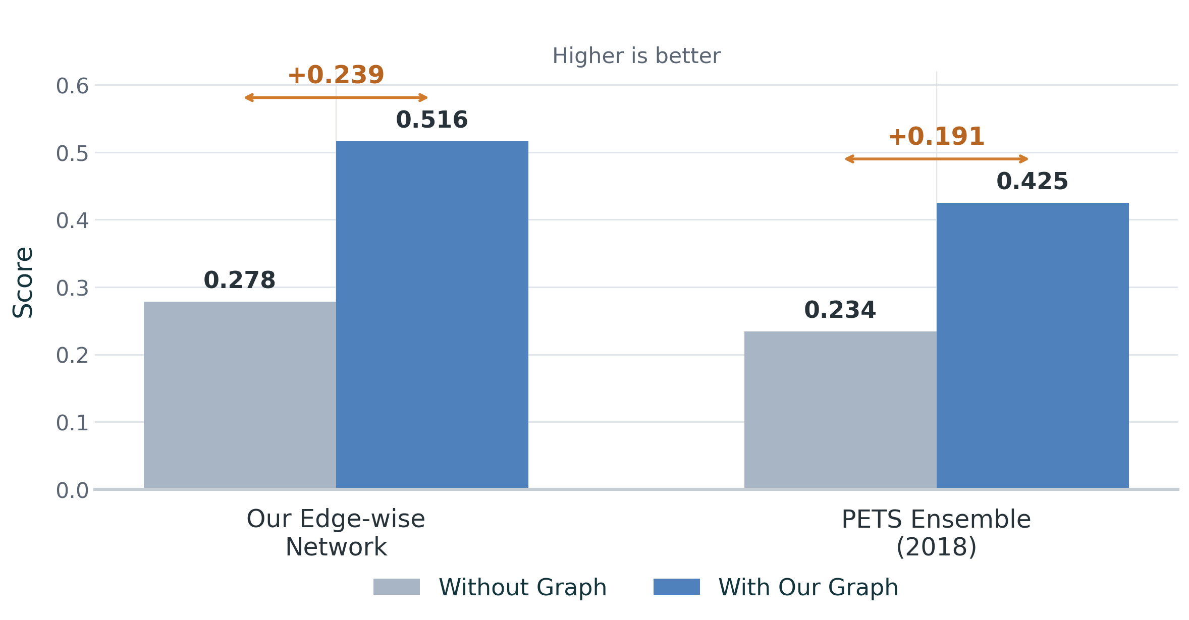
The graph can be transferred to someone else's model.
What is PETS, why we compare it:
  The architecture of PETS is similar to the architecture we are dealing with, namely:
  Input 90 dimensions -> Linear() + SiLU-> Linear + SiLU -> Linear(_, 112), 112 means 56 mean value and 56 std.
  The point is: it also use 90 current state as input and predicts the same 56 dimensional future state as output.
The only different is: I did not put the action in, so PETS might be better on (state, action) area.

Slide 9
The overview
My idea and claim are similar to the paper CDL / CDL-A, for example Wang, Z., Xiao, X., Xu, Z., Zhu, Y. and Stone, P. (2022). Causal Dynamics Learning for Task-Independent State Abstraction. ICML 2022./Learning Causal Dynamics Models in Object-Oriented Environments. 2024 and so on. These are all aim the dynamics learning.
From their pipeline, they also used action as input, but we don’t, we only has state and depends on this state to predict next state, which means we have lots of progress to do on it. But they did not test if the graph can be transferred to another model, we tested and got the better result on PETS, also, CDL is not an innovation in methodology.

Slide 10
Reference
Zheng, X., Dan, C., Aragam, B., Ravikumar, P. and Xing, E.P. (2020) ‘Learning sparse nonparametric DAGs’, in Proceedings of the 23rd International Conference on Artificial Intelligence and Statistics (AISTATS). Palermo, Italy: PMLR, pp. 3634–3644.
Brouillard, P., Lachapelle, S., Lacoste, A., Lacoste-Julien, S. and Drouin, A. (2020) ‘Differentiable causal discovery from interventional data’, in Advances in Neural Information Processing Systems 34 (NeurIPS 2020). Vancouver, Canada: Curran Associates, Inc.
Zaheer, M., Kottur, S., Ravanbakhsh, S., Póczos, B., Salakhutdinov, R. and Smola, A. (2017) ‘Deep Sets’, in Advances in Neural Information Processing Systems 30 (NeurIPS 2017). Long Beach, CA: Curran Associates, Inc., pp. 3391–3401.
Scarselli, F., Gori, M., Tsoi, A.C., Hagenbuchner, M. and Monfardini, G. (2009) ‘The graph neural network model’, IEEE Transactions on Neural Networks, 20(1), pp. 61–80. doi: 10.1109/TNN.2008.2005605.
Chua, K., Calandra, R., McAllister, R. and Levine, S. (2018) ‘Deep reinforcement learning in a handful of trials using probabilistic dynamics models’, in Advances in Neural Information Processing Systems 31 (NeurIPS 2018). Montréal, Canada: Curran Associates, Inc., pp. 4759–4770.
Ahmed, O., Träuble, F., Goyal, A., Neitz, A., Wüthrich, M., Bengio, Y., Schölkopf, B. and Bauer, S. (2021) ‘CausalWorld: A robotic manipulation benchmark for causal structure and transfer learning’, in International Conference on Learning Representations (ICLR 2021).
Wang, Z., Xiao, X., Xu, Z., Zhu, Y. and Stone, P., 2022. Causal dynamics learning for task-independent state abstraction. arXiv preprint arXiv:2206.13452.
Yu, Z., Ruan, J. and Xing, D., 2024. Learning causal dynamics models in object-oriented environments. arXiv preprint arXiv:2405.12615.

