Slide 1

Week 12
chu

Slide 2
Different parameters
K_BASIS = 8 oracle vs_const 0.570
K_BASIS = 16 oracle vs_const 0.573
K_BASIS = 32 oracle vs_const 0.577
The three settings are virtually identical. Furthermore, the capacity sweep for Stage 1 shows more extreme results: HIDDEN goes from 128 to 384, while OOD performance actually drops by 7.4%.
Capacity is not the bottleneck; this has already been tested twice. The suggestion to "compare 8/16/32 first" has actually already been carried out, so there is no need to do it again.

Slide 3
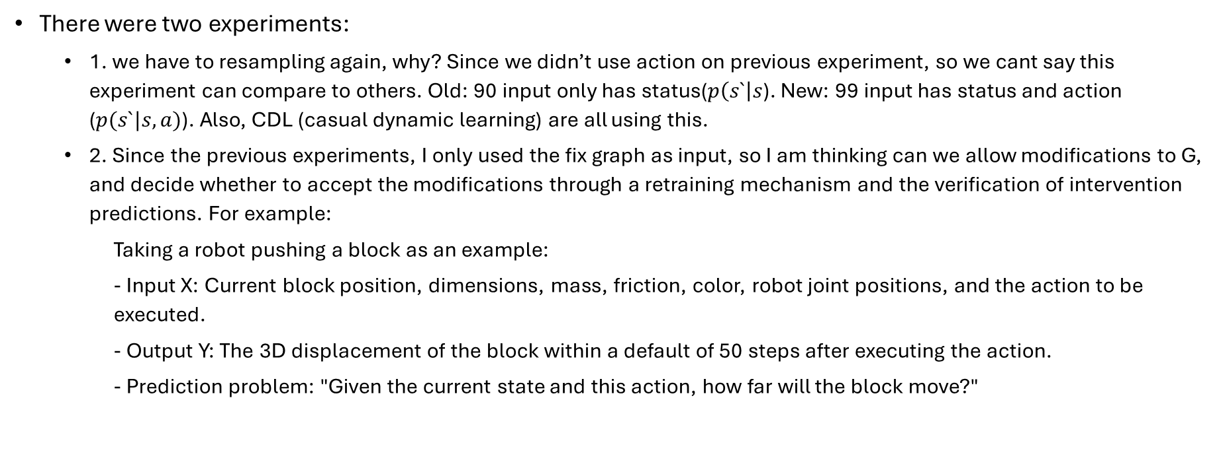
The new experiments
There were two experiments:
  1. we have to resampling again, why? Since we didn’t use action on previous experiment, so we cant say this experiment can compare to others. Old: 90 input only has status($p\left(s`\right|s$). New: 99 input has status and action ($p(s`|s,a)$). Also, CDL (casual dynamic learning) are all using this.
  2. Since the previous experiments, I only used the fix graph as input, so I am thinking can we allow modifications to G, and decide whether to accept the modifications through a retraining mechanism and the verification of intervention predictions. For example:
    Taking a robot pushing a block as an example:
    - Input X: Current block position, dimensions, mass, friction, color, robot joint positions, and the action to be executed.
    - Output Y: The 3D displacement of the block within a default of 50 steps after executing the action.
    - Prediction problem: "Given the current state and this action, how far will the block move?"

Slide 4
The error and the resource limit
In the second experiment, we cant finish the data preprocessing. While it might one of this problem:
  Many random interventions are physically invalid.
    For instance, if the block dimensions are altered, the height relative to the ground should be adjusted accordingly; otherwise, the original sampling would retain the now-incompatible height, resulting in boundary violations. Similarly, independently sampling nine joint angles at random easily leads to collisions involving the robotic manipulator.
  Excessive retries after failure result in a situation where the task is "almost finished but never actually completes."
    The easy-to-collect samples have already been obtained, so the remaining targets are likely difficult to acquire; the total upper limit of attempts for the 4,000 sample pairs reaches as high as 240,000.
  The kernel did indeed crash later on.

Slide 5
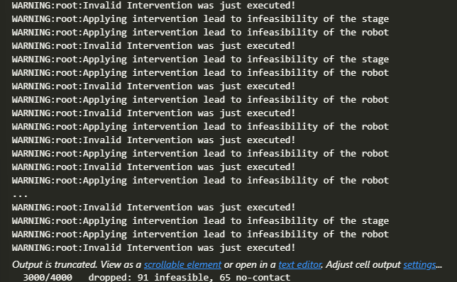
For experiment 1
It can run but I am still running, since in the middle also happened the ‘Many random interventions are physically invalid’ problem. Thus, I have to rerun it and it took 10 hours already……

