Slide 1

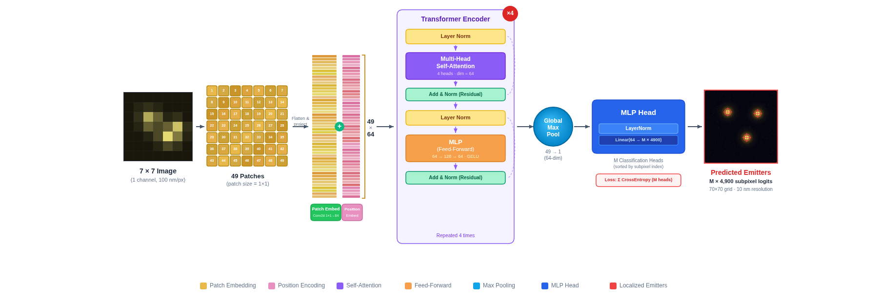
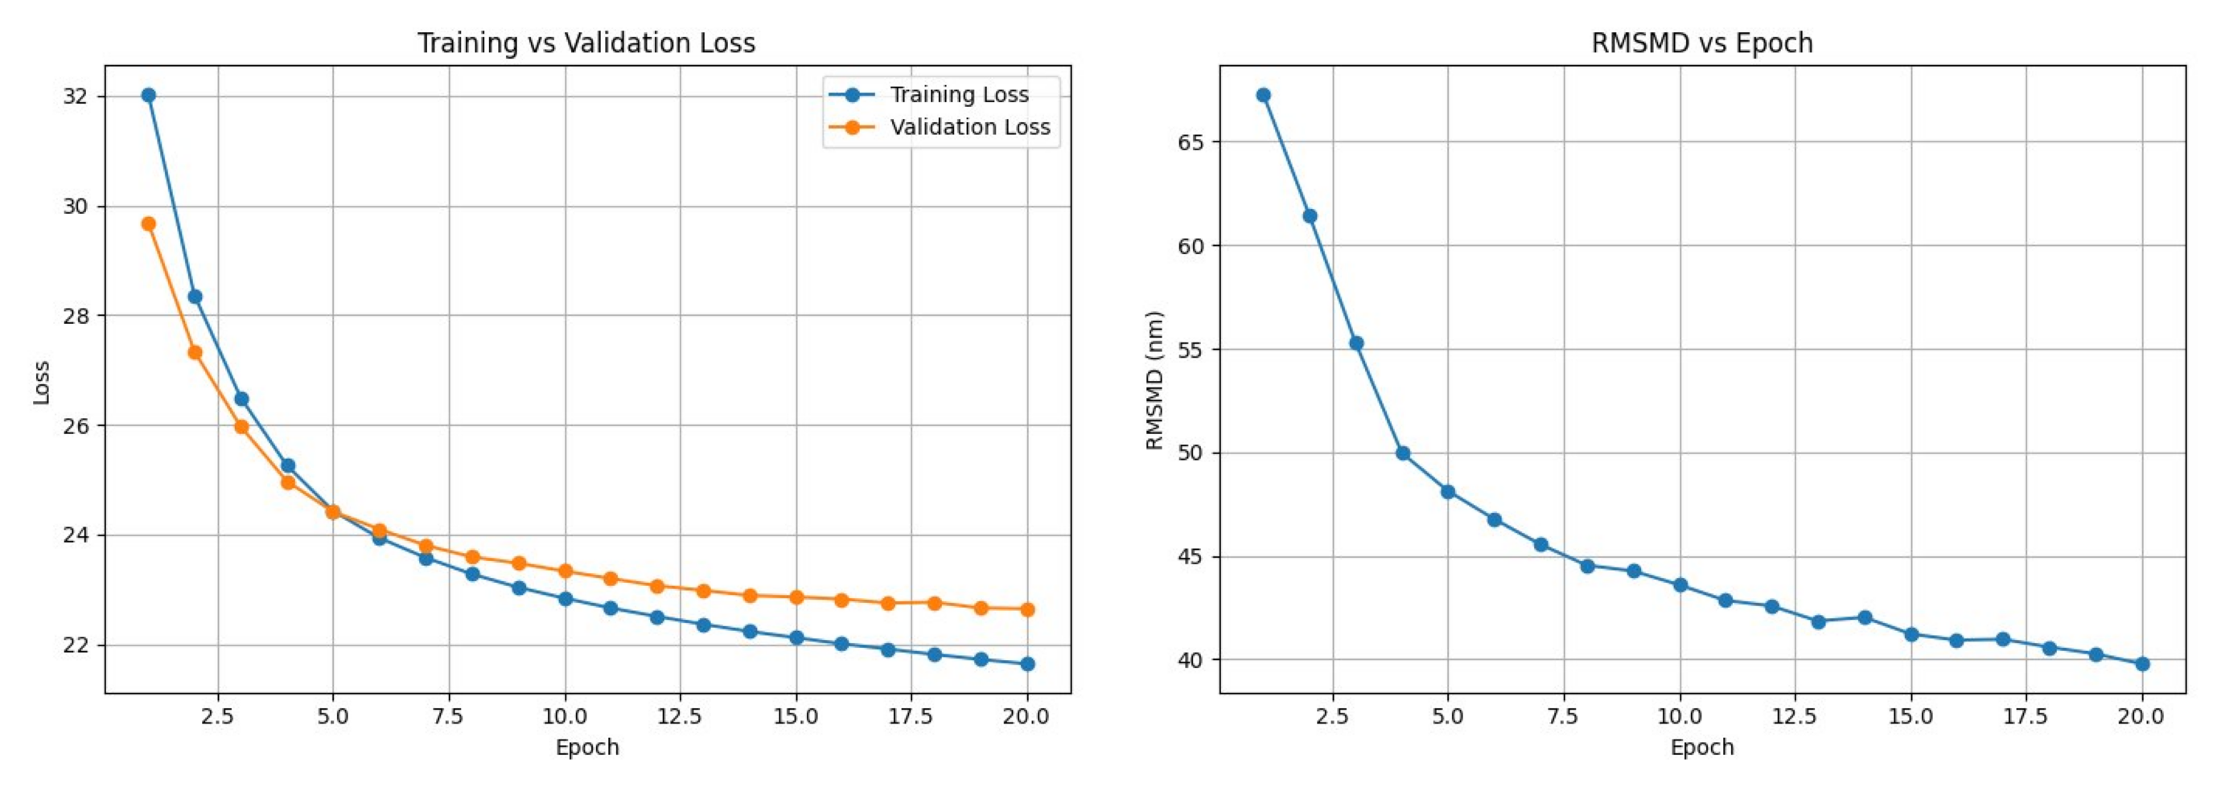
Vision Transformer Approach to Superresolution Single-Molecule Localization Imaging
Muzna Yumman and Yi Sun
Electrical Engineering Department, The City College of New York
Research Background
Single-molecule localization microscopy (SMLM) is a family of super-resolution fluorescence imaging techniques that overcome the Abbe diffraction limit by localizing individual fluorescent emitters across thousands of frames [3,4,5,6].
Deep learning has become central to SMLM, enabling faster and more accurate localization than classical fitting methods. Vision Transformers (ViTs) extend this by modeling global spatial relationships using self-attention [1,2].
NETWORK ARCHITECTURE
Results – 3
Objectives
Develop a ViT for sub-pixel localization of 1–5 emitters in 7×7 pixels SMLM data frames with 10 nm resolution.
Achieve 10 nm precision by treating localization as classification on a 70×70 subpixel grid (4,900 classes), predicting M emitter locations per frame through a multi-head architecture.
Proposed ViT architecture: 7×7 SMLM frames are tokenized at patch size 1 (49 tokens), encoded via four Transformer blocks, and mapped to M×4,900 sub-pixel class logits for 10 nm localization.
.
Average RMSMD vs. Number of emitters: EM < ViT ≪ UGIA-F, confirming ViT achieves near-EM accuracy.
Results – 1
METHODS
Data Generation
Data frames are synthesized using a 2D Gaussian PSF model (NA = 1.4, λ = 723 nm, 100 nm/pixel) with Poisson photon noise and EMCCD readout noise. Each 7×7 frame contains M = 1–5 randomly positioned emitters with ground-truth coordinates at 10 nm sub-pixel resolution.
Network Architecture
The ViT uses patch size = 1, treating each pixel as a token (49 tokens per frame). Tokens are projected to 64 dimensions via 1×1 convolution with learnable positional embeddings.
Four Transformer encoder blocks (4-head self-attention, MLP 64→128→64, GELU, residual connections) process the sequence.
Global max pooling produces a single 64-dim vector, fed to an MLP head outputting M × 4,900 logits over a 70×70 sub-pixel grid (10 nm resolution).
Training Procedure
Separate models are trained for M = 1–5 using Adam (lr = 3×10⁻⁴), batch size 64, for 20 epochs.
Loss: sum of cross-entropy across M heads, with emitters sorted by class index for stable assignment.
Evaluation and Benchmarking
Localization accuracy is measured by RMSMD (root mean square minimum distance), a symmetric nearest-neighbor metric reported in nanometers.
Conclusions
ViT achieves localization accuracy close to EM and significantly outperforms UGIA-F, confirming that a data-driven approach can approach model-based performance without knowledge of the imaging system parameters.
Future work will extend the framework to SMLM data movies, variable emitter counts, larger frames, and experimental datasets.
Learning curves for the ViT (M=5). Left: Training and validation loss converge within 20 epochs. Right: RMSMD (nm) decreases steadily with training.
Acknowledgments
This work is partly supported by National Science Foundation (CCF-2313072) and Army Research Office (W911NF-23-1-0189).
Results – 2
References
[1] Vaswani, A., et al. Advances in Neural Information Processing Systems 30 (NeurIPS), 5998–6008 (2017).
[2] Dosovitskiy, A., et al. International Conference on Learning Representations (ICLR) (2021).
[3] Sun, Y. Optics Express 32(19), 33779–33794 (2024).
[4] Sun, Y. Scientific Reports 8(1), 17211 (2018).
[5] Sun, Y. Journal of Biomedical Optics 18(11), 111418 (2013). [6] Sun, Y., et al. Quantitative BioImaging Conference (QBI) (2014).
Comparison of Ground Truth, UGIA-F, EM, and ViT reconstructions for multi-emitter
data frames (M=1 to 5)

