Slide 1
零知识证明Zero-knowledge proof
Lecturer: Zoe L. JIANG蒋琳

Slide 2
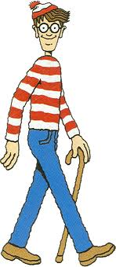
谁是瓦尔多Who is Waldo?
Waldo是一个具有以下特征的人：
红白条纹相间的长袖衫red-and-white striped shirt
顶部有绒球的羊毛帽bobble hat
戴眼镜glasses
总是拿着一根手杖also with a walking stick

Slide 3
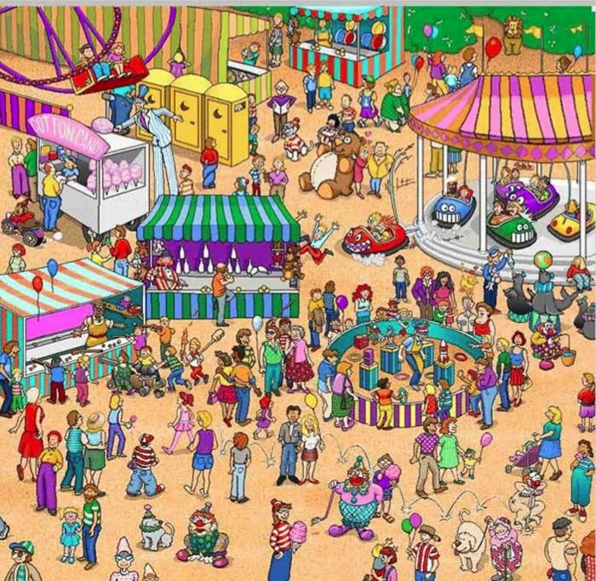
瓦尔多在哪里Where is Waldo?
Notes:
A series of children's books created by a British illustrator. The books consist of a series of pictures depicting dozens or more people doing a variety of amusing things at a given location. Readers are challenged to find the person named Waldo hidden in the group
There are some deceptive use of red-and-white striped objects in these pictures
As the following true story will reveal, in these pictures also lies an interesting cryptographic problem

Slide 4
和密码学中零知识证明的关系
Alice and Bob were playing “Where’s Waldo”
Alice suddenly claimed: “I know where Waldo is!”
Bob responded: “Alice, where is he?”
Alice wondered: “How can I prove to Bob that I know where Waldo is without revealing his location?”

Slide 5
解决方案1
剪出Waldo的图像
不足
伪造
应对：检查
Notes:
Alice and Bob have access to a photocopy machine
They photocopy the specific “Where is Waldo” puzzle in question
Alice now cuts out Waldo’s image from the copy while Bob is not looking and then shows Bob the image (after hiding or destroying the leftovers)
Her ability to do so is certainly a proof that she knows where Waldo is. On the other hand Bob learns nothing from the piece he sees
Disadvantage
Alice can cheat by hiding an additional image of Waldo (taken from a different picture) and showing this image (instead of the one in the original picture) to Bob
One way to combat this danger is to require Alice to enter an empty room with nothing on her part from the picture and scissors

Slide 6
解决方案2
Notes:
Alice and Bob need a large piece of cardboard (at least twice as large as the picture in each dimension) with a small rectangle cut in the middle
To show that she knows where Waldo is, Alice puts the rectangle on top of Waldo while Bob is not looking
Bob sees Waldo and at worse learns something about Waldo’s immediate surroundings
However, since the cardboard is large enough to cover the picture, he learns nothing else about the location of Waldo

Slide 7
解决方案2
Notes:
Alice and Bob need a large piece of cardboard (at least twice as large as the picture in each dimension) with a small rectangle cut in the middle
To show that she knows where Waldo is, Alice puts the rectangle on top of Waldo while Bob is not looking
Bob sees Waldo and at worse learns something about Waldo’s immediate surroundings
However, since the cardboard is large enough to cover the picture, he learns nothing else about the location of Waldo

Slide 8
讨论
Alice向Bob证明了自己对知识的拥有，但没有揭露知识本身
Notes:
Alice can demonstrate possession of knowledge without revealing it in a simple “everyday” scenario and without resorting to high technology

Slide 9
Zero knowledge proof
证明
Alice：26781不是质数
Bob：证明给我看
Alice：113 × 237 = 26781
上述证明的副产品：Bob除了知道26781不是质数，还知道26781的两个因数
零知识证明Zero knowledge proof
Bob除了能够被说服26781不是质数，不能获得其他信息
Notes:
Proof
If I know that X is true, and I want to convince you of that, I try to present all the facts I know and the inferences from that fact that imply that X is true
Example: I know that 26781 is not a prime since it is 113 times 237, to prove to you that fact, I will present these factors and demonstrate that indeed 113 × 237 = 26781
A typical byproduct of a proof is that you gain some knowledge, other than that you are now convinced that the statement is true
In the example before, not only are you convinced that 26781 is not a prime, but you also learned its factorization
Zero knowledge proof
Alice will prove to Bob that a statement X is true, Bob will completely be convinced that X is true, but will not learn anything else as a result of this process. That is, Bob will gain zero knowledge

Slide 10
Zero knowledge proof
1985年由麻省理工学院的研究人员Shafi Goldwasser、Silvio Micali和Charles Rackoff在他们的论文《交互证明系统的知识复杂性》中首次提出:
“零知识协议是一种方法，其中一方（验证方）可以向另一方（验证方）证明某件事是真的，除了该特定声明是真的以外，不透露任何信息。”
零知识证明的应用必须满足三个要求：
正确性：只要statement是正确的，prover就可以让verifier确信
完备性：只要statement是正确的，prover就可以让verifier确信
隐私性：只要statement是正确的，prover就可以让verifier确信

Slide 11
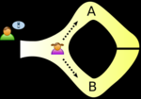
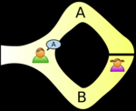
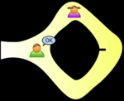
阿里巴巴山洞Ali Baba's Cave
Alice要向Bob证明她知道阿里巴巴山洞中通道的大门钥匙
Alice和Bob走到山洞门口
Alice在Bob看不到的情况下，随机从A或B进入山洞
Bob也随机让Alice从A或B出来
如果Alice知道大门钥匙，那么她每次都可以从指定的口出来
Bob多次重复，就可以被说服Alice是知道钥匙的
Gate
http://en.wikipedia.org/wiki/Zero-knowledge_proof
Notes:
Alice wants to prove to Bob that she knows how to open the gate between two passages A and B (secret).
Alice and Bob go to the cave
Alice goes to A or B while Bob is not looking
Bob tells Alice to come from A or B randomly
If Alice knows the secret, she can appear from the correct side of the cave every time
Bob repeats as many times as he wants until he believes Alice knows to open the gate

Slide 12
References
[1] M. Naor, Y. Naor and O. Reingold. Applied kid cryptography or how to convince your children you are not cheating, http://www.wisdom.weizmann.ac.il/~reingold/publications/waldo.pdf, 1999.

