Slide 1
Frames Theme
Functionality/Design
Implementation

Slide 2
Theme preview image
Allows user to see a preview image of each theme before making a selection.
Shows an image of the current theme without user having to load the main page to see theme.
(insert image from Software principles: Prototype presentation, if necessary)

Slide 3
Sidebar Editing
Motivation: A CMS shouldn’t require users to edit code
Solution: Visually Editable sidebar

Slide 4
File Upload/Relevant Page Links
Benefits: Improved Navigability, attached files can now be accessed, site can be traversed in a logical manner

Slide 5
Page history
Tracks changes and allows users to revert to them
Users now have the ability to rollback accidental changes

Slide 6
Bugs/Usability Fixes
List of bugs? E.g., groups editing

Slide 7
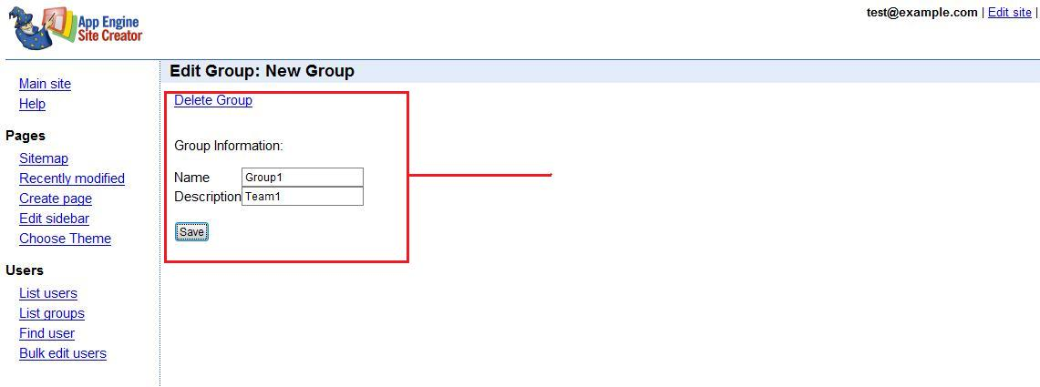
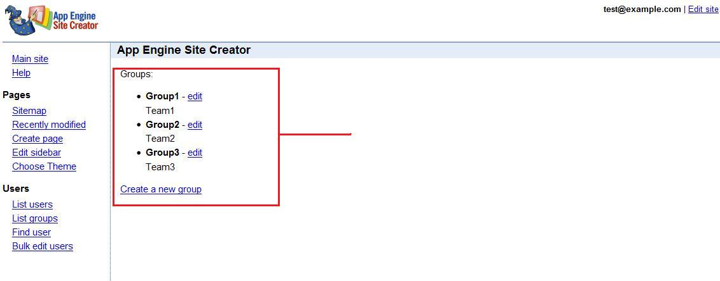
Bug #53:Adding/Editing Groups
Creating a new group
List of groups

Slide 8
Child access links
In the previous AESC system no access to child pages was automatically given
The class Page has a property called page_children
Cycled through the pages in the list and displayed there paths to the user

Slide 9
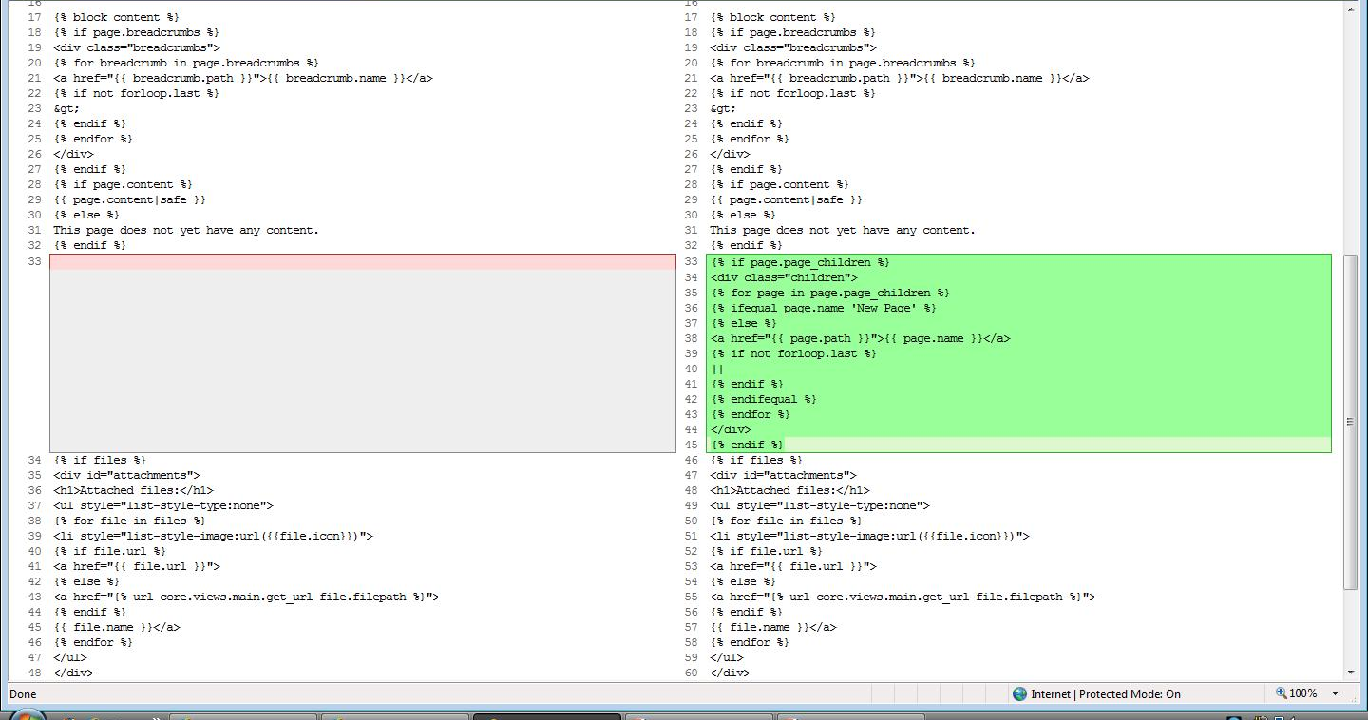
Child access links code
First: looks through all children of the current page
Second: Checks to see if page is an empty page (‘New Page’)
Third: Creates link for all non-empty pages at the bottom of the current page
Code added

Slide 10
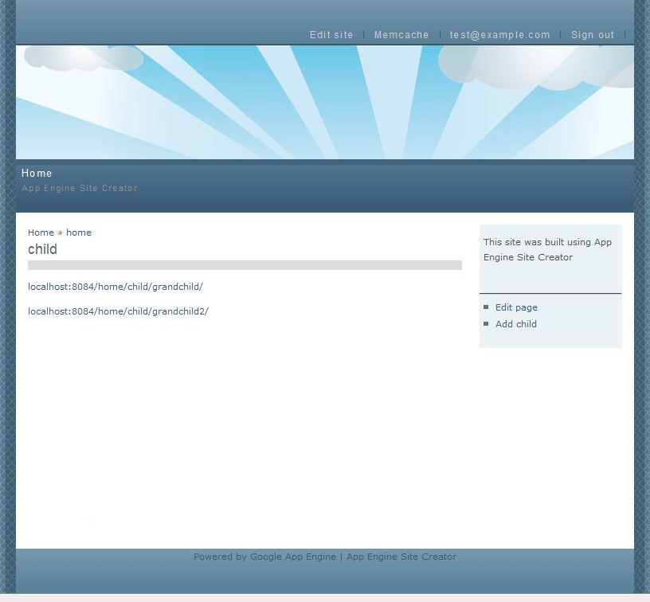

Child access links screenshots
Before: A page could only access its parents
After: A page can access can access its parent and its children pages
Before
After
Parent links
Parent links
Child links

