Slide 1
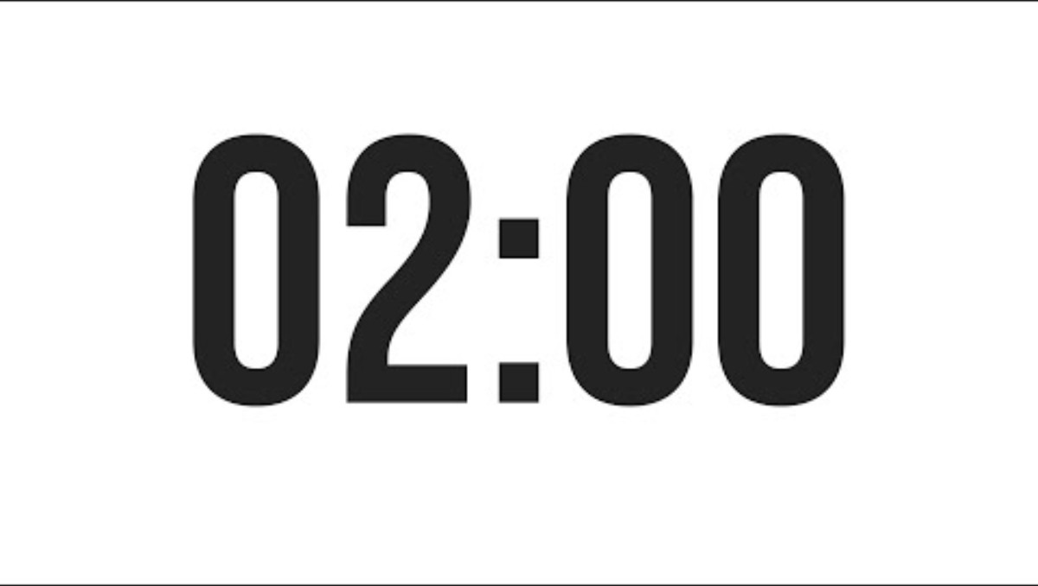
Out of the Game

Slide 2

Francesco Penasa
Leonardo Mosca
FrancescoPenasa.github.io > Teaching

Slide 3
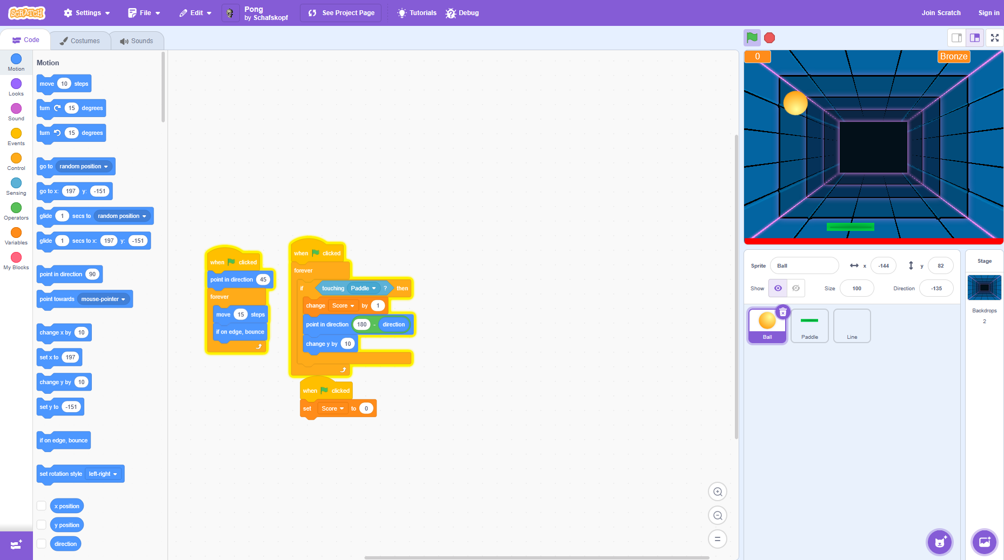
End of the day
Scratch
Eventi
Azioni
Condizioni

Slide 4
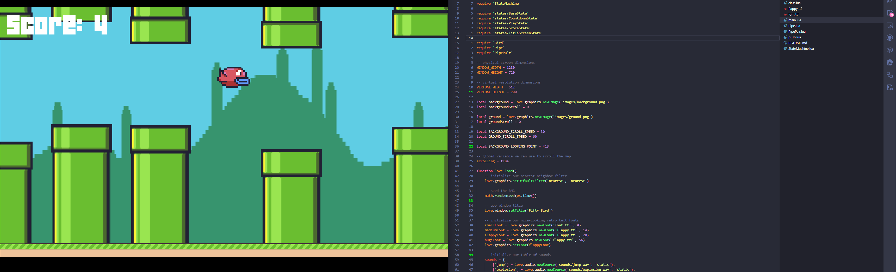
End of the course
Lua
Sviluppo completo
Autonomia
Programmazione
Inglese
Notes:
promise

Slide 5
Scratch > start creating
Create -> Code, Art, Sound
Program
Preview
Assets

Slide 6
Game 1: a short story

Slide 7
Game 2: a short game

Slide 8
Game 3: a not short game

Slide 9
Game 4: Hello World!

